Slide 1
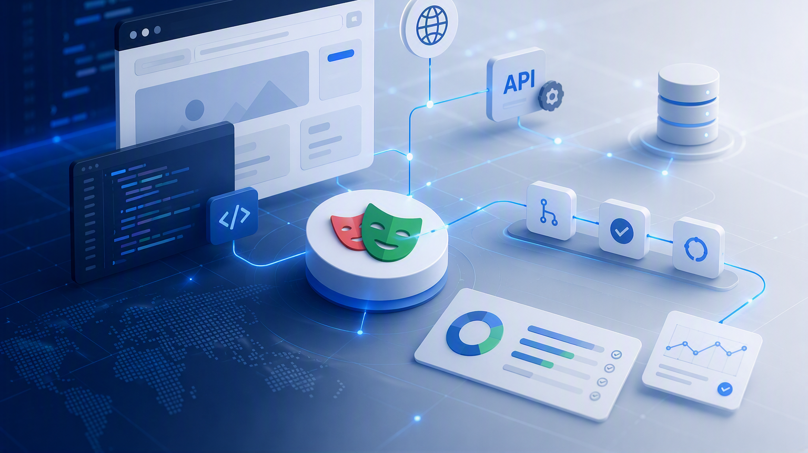

Web automation with playwright
Introduction
Web automation with playwright
Project Scope & Automation Foundations
Instructor: Eliana Navia Claros
Instructor: Eliana Navia Claros

Slide 2
Web automation with Playwright
Module 2 | Introduction
Purpose, strategy, frameworks, tools, measurable benefits, and responsible AI use
WHY
HOW
WHAT
AI
Why automate?
How to choose?
What to test?
Use responsibly
Main outcome: Learn how to identify, analyze, and justify automation opportunities while defining the baseline for your automation framework.

Slide 3
What you will learn
Module objectives
By the end of this module, you will be able to:
1
Explain the purpose, scope, and limitations of test automation.
2
Choose manual or automated testing based on the scenario.
3
Connect automation with CI/CD and fast feedback.
4
Classify tests as unit, integration/API, or end-to-end.
5
Identify the components of a maintainable automation framework.
6
Compare Selenium and Playwright using project criteria.
7
Use AI responsibly while verifying generated suggestions.
8
Select and justify automation candidates for the course project.
Guiding question: What should we automate, at which level, and what evidence will prove its value?

Slide 4
Purpose and scope of test automation
Why? - Automation creates repeatable feedback
A basic automated test cycle
AUTOMATION IS
Software that executes checks, compares actual and expected behavior, and reports the result.
1
Arrange
2
Act
3
Assert
Data, user, browser state
Interact with application
Compare expected behavior with acceptance criteria
4
Report
5
Clean up
Record evidence and outcome
Isolate the next test
Not just a sequence of clicks.
A test needs a purpose, an expectation, and an objective result.
Good candidates are repeated, valuable, stable enough, and objectively verifiable.

Slide 5
Manual vs. automated testing
Why? - Complementary approaches, different strengths
MANUAL TESTING
AUTOMATED TESTING
Exploration of new behavior
Usability and visual judgment
Investigation of unexpected results
Ambiguous or rapidly changing features
Regression and smoke checks
Repeated critical workflows
Data and browser combinations
Fast feedback in CI/CD
Strength: human observation and adaptability
Strength: repeatability and speed at scale
The goal is useful feedback—not the maximum number of automated tests.

Slide 6
The role of automation in modern testing
Why? - Fast feedback from code change to delivery
Code change
>
Local checks
>
Pull request
>
CI pipeline
>
Reports & feedback
Automation supports:
Prioritize using risk
Early defect detection
Repeatable regression coverage
Evidence: traces, screenshots, logs
Safer and faster releases
Business impact × probability × frequency × cost of manual repetition

Slide 7
The testing pyramid
Why? - Use the lowest level that provides reliable evidence
End-to-end
Few, realistic, expensive
Integration / API
Focused collaboration checks
Unit
Many, fast, isolated
Example: checkout
Quantity vs Quality
Price formula → Unit
Order persistence → Integration / API
Customer completes purchase → End-to-end

Slide 8
What Makes a Good Automation Candidate?
What? - Automation Candidate Selection
Good Candidates
Repetitive activities
Business-critical workflows
Stable features
Data-driven scenarios
Consider Carefully
• Exploratory testing
• Rapidly changing features
• One-time validations
• Subjective visual checks
Key Takeaway
Focus on automating scenarios that provide repeatable business value.

Slide 9
Acceptance dashboard: from concept to evidence
Measure benefits with baselines, trends, and responsible interpretation
ILLUSTRATIVE SAMPLE DATA — replace with project evidence
TIME SAVED
EXECUTION SPEEDUP
FLAKINESS REDUCTION
NET HOURS RECLAIMED
55%
12×
−85%
Track
Manual baseline vs. automated effort
Manual time / automated time
Intermittent failures over reruns
Savings minus maintenance effort
EFFICIENCY GAINS
RELIABILITY & MAINTENANCE
Creation time | Execution time | Maintenance time
Build success rate
89%
False-positive reduction
Track
Weekly maintenance hours
Trend
AI adoption / confidence
Review
Manual
Automation
Automation + AI
Metric rule: baseline → comparable runs → classified failures → decision

Slide 10
Automation Standards & Baselines
Pillars : Automation Success Fundamentals
Test Selection
What to automate
Prioritization criteria
Business value
Engineering Standards
• Conventions
• Project structure
• Code review criteria
Coverage Strategy
Scope definition
Risk coverage
Progress tracking
Execution & Reporting
• Execution model
• Reporting standards
• CI/CD integration
Key Takeaway
Establishing clear baselines early reduces technical debt and creates a sustainable automation framework..

Slide 11
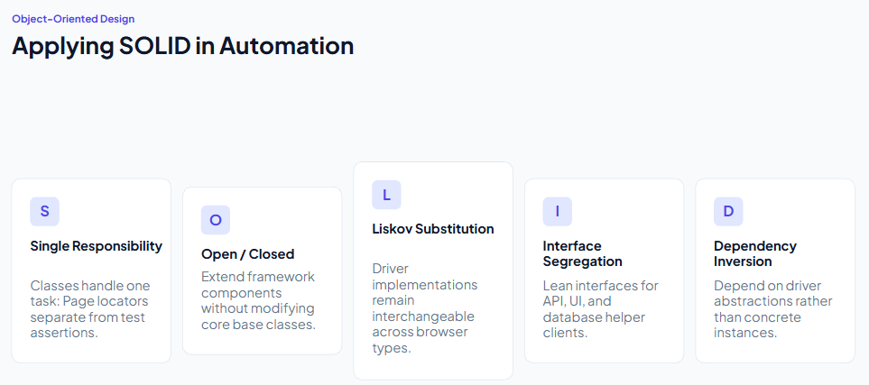
Architectural Design Principles
Governance: Building maintainable, scalable, and deterministic test automation frameworks.

Slide 12
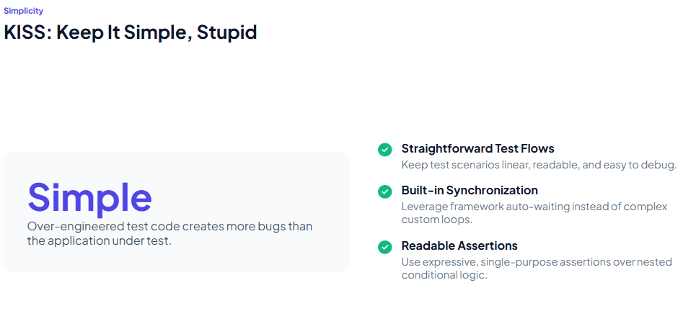
Architectural Design Principles
Governance: Building maintainable, scalable, and deterministic test automation frameworks.

Slide 13
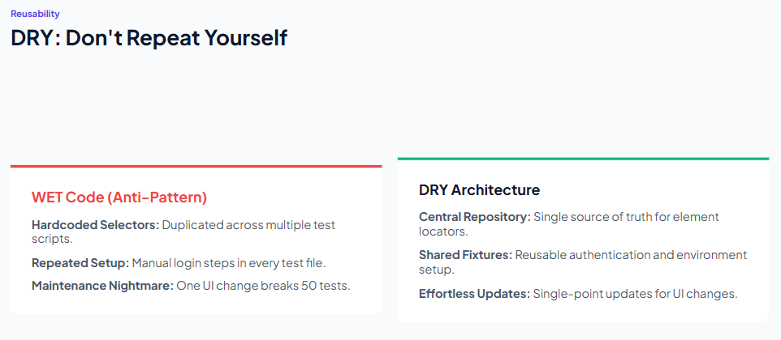
Architectural Design Principles
Governance: Building maintainable, scalable, and deterministic test automation frameworks.

Slide 14
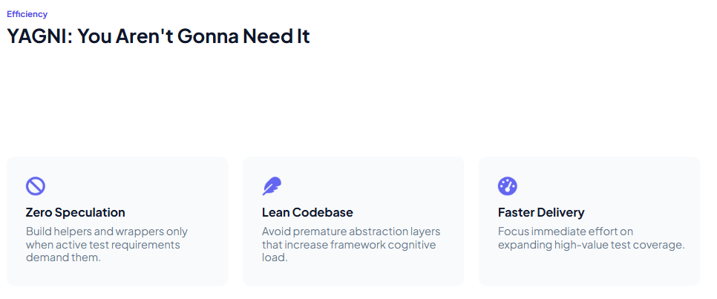
Architectural Design Principles
Governance: Building maintainable, scalable, and deterministic test automation frameworks.

Slide 15
Architectural Design Principles
Governance: Building maintainable, scalable, and deterministic test automation frameworks.

Slide 16
Architectural Design Principles
Governance: Building maintainable, scalable, and deterministic test automation frameworks.

Slide 17
Foundations of a Scalable Automation Framework
Framework Layers - Scalable Framework Foundations​
Framework Layers​
Test Layer​
Business Layer​
Page Layer​
Infrastructure Layer​
Framework Goals​
• Scalability​
• Reusability​
• Maintainability​
• Readability​
• Collaboration​
Key Takeaway
A framework should reduce complexity and accelerate development.

Slide 18
Core Components of an Automation Framework
Framework Components - A framework is more than a browser tool
Test runner
Assertions
Locators
Test data
Fixtures
Configuration
Pages / actions
Reports & CI
Quality criteria
Can a new teammate run it quickly? | Are failures understandable? | Can tests run independently in CI?
Project direction: Playwright + TypeScript + Chromium + GitHub Actions

Slide 19
Selenium vs. Playwright
Choose based on context, not popularity
Criterion
Selenium
Playwright
Browser control
WebDriver ecosystem
Integrated browser automation
Waiting
Synchronization is often designed by the team
Auto-waiting for many actions and assertions
Isolation
Runner, Grid, or framework dependent
Browser contexts built in
Execution
Usually combined with an external runner
Integrated runner, projects, workers, and retries
Evidence
Reporting and artifacts commonly assembled from tools
Readable assertions, HTML reports, traces, screenshots, and videos
Best fit
Existing enterprise investment and infrastructure
Modern web projects seeking an integrated TypeScript workflow
Course decision: Playwright is selected for its integrated runner, assertions, auto-waiting, browser contexts, reports, traces, and TypeScript workflow.
Important limit: Playwright reduces common synchronization and isolation work, but test design, data control, environment stability, and locator quality remain engineering responsibilities.

Slide 20
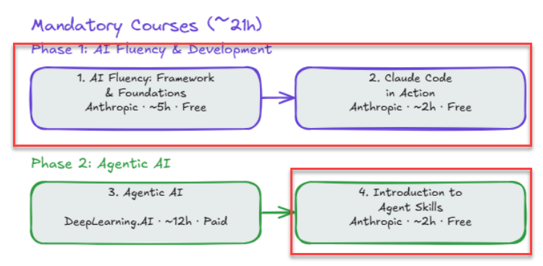
Module 2 | Required Actions– Part 1
Activities
Activity 1 – AI Course Exploration
Goal: Connect AI concepts with our automation course.
Task: Review recommended AI courses [JCE - Jalasoft Core Engineer V2.1.pdf] at your own pace.
Focus: Identify tools and concepts relevant to software testing.
Activity 2 – AI Agent Skills Comparison
Goal: Compare Kiro's Skill architecture with other AI agents.
Task: Check tools you use (Claude, ChatGPT, Copilot, Cursor, etc.).
Analyze:
Feature name (Custom Instructions, Rules, Prompts, MCP/Tools).
Structure of instructions and context files.
Note: Self-study, Self-directed research • No submission required
1
2
3
4
5

Slide 21
AI capabilities and limitations in testing
Use AI as an accelerator—not as the authority
AI CAN HELP WITH
HUMANS MUST VERIFY
Drafting scenarios and test code
Suggesting boundary and negative cases
Explaining errors and summarizing reports
Generating safe synthetic data
Reviewing naming, assertions, and duplication
Business rules and expected behavior
Selectors, waits, and test data
Security, privacy, accessibility, usability
Whether a failure is real or a test defect
Maintainability and team standards
Define intent → Provide context → Generate → Inspect → Run → Review → Refine

Slide 22
The SDET role in an AI-enabled SDLC
Software quality engineering is expanding across the full development lifecycle
FROM TEST EXECUTION TO QUALITY ENGINEERING
AI THROUGH THE SDLC
Designs testable systems and acceptance criteria.
Builds automation, tooling, data, and quality gates.
Partners with developers, product, security, and operations.
Uses evidence to improve risk decisions and delivery feedback.
Discover → Design → Build → Test → Release → Operate
Summarize context and identify risks.
Draft code, tests, data, and documentation.
Review changes, failures, security, and maintainability.
Learn from production feedback and guide the next change.
SDET: Software Development Engineer in Test
AI changes how work is performed; humans remain accountable for decisions and outcomes.

Slide 23
AI Skills across the automation lifecycle
Planned capabilities in stages: Requirements & Story Analysis - Test Design & Architecture - DOM & Locator Validation
Token Impact
Main Skill (Under demand steering)
Sub-skill / Task Skill
Main Objective
Medium
steering-requirements-analyst
pbi-problem-understanding
Analyze a PBI or feature request to identify edge cases, system behavior, and domain constraints.
Low
steering-requirements-analyst
pbi-creator
Draft structured PBIs (user stories, description, acceptance criteria) from unstructured problem statements.
Medium
steering-requirements-analyst
tc-generator
Generate plain-English Test Cases aligned with PBI acceptance criteria and Playwright annotation standards.
Low
steering-playwright-arch
architecture-guardrails
[Governance] Enforce architecture rules (POM, Screenplay, no tight coupling) and project folder conventions.
Medium
steering-playwright-arch
locator-strategy
Formulate resilient locator hierarchy (prioritizing user-facing locators like getByRole over CSS/XPath).
Medium
steering-locator-checker
dom-selector-validator
[Validation] Analyze HTML snippets/DOM snapshots to verify locator uniqueness, resilience, and shadow DOM visibility.
Medium
steering-locator-checker
dynamic-element-inspector
Inspect dynamic IDs, auto-generated classes, or iframe boundaries and propose stable dynamic locator strategies.
The skill is not the prompt. It is the repeatable engineering practice plus reviewable evidence.

Slide 24
AI Skills across the automation lifecycle
Planned capabilities in stages: Test Development - CI/CD & Execution - Maintenance & Triage
Token Impact
Main Skill (Under demand steering)
Sub-skill / Task Skill
Main Objective
High
steering-playwright-dev
test-code-builder
Write TypeScript Playwright tests using natural language specs, fixtures, and auto-mocking.
[Validation] Analze HTML snippets/DOM snapshots to verify locator uniqueness, resilience, and shadow DOM visibility.
Medium
steering-playwright-dev
test-quality-auditor
[Governance] Audit test logic against hard rules (no arbitrary sleeps/timeouts, mandatory web-first assertions, atomic tests).
Low
steering-qa-governance
static-code-compliance
[Governance] Validate TypeScript linting rules, naming conventions, type safety, and clean code principles.
High
Medium
steering-qa-governance
pr-reviewer
Perform automated PR reviews checking test completeness, maintainability, and regression risk.
Low
steering-devops-ci
pipeline-yaml-builder
Create multi-stage Azure/GitHub pipelines and configure readable HTML/Allure test reports.
High
steering-failure-analysis
trace-debugger
Analyze Playwright Trace Viewer logs/screenshots to auto-fix flakiness and report bugs.
The skill is not the prompt. It is the repeatable engineering practice plus reviewable evidence.

Slide 25
How an AI agent works: structure and tools
An agent combines a model, context, instructions, skills, and tool access
AGENT CORE
SKILLS
MCP TOOL ACCESS
Model: reasons over the request.
Context: files, rules, state, and evidence.
Instructions: define goals, constraints, and quality.
Reusable instructions for a repeatable task.
Encode workflow, standards, inputs, and evidence.
Examples: test-case-design and code review.
MCP connects an agent to external tools and data.
Configure a server with a command, arguments, and environment.
The agent discovers available tools and calls them with permission.
Observe → Plan → Act → Inspect → Refine
A Skill guides behavior; it is not a replacement for judgment.
{ "mcpServers": { "name": { "command": "...", "args": [] } } }
Only expose approved, necessary, and non-sensitive capabilities.
WEB AUTOMATION FUNDAMENTALS | MODULE 2 | 14

Slide 26
From intent to an executable check
A test has a risk, an action, an assertion, and evidence
What to inspect
test('valid user reaches the Dashboard', async ({ page }) => {
await page.goto('/login');
await page.getByLabel('Email').fill('student@example.com');
await page.getByRole('button', { name: 'Sign in' }).click();
await expect(page).toHaveURL(/dashboard/);
await expect(page.getByRole('heading', { name: 'Dashboard' })).toBeVisible();
});
Business intent is visible.
Locators match the real UI.
Assertions verify the outcome.
No arbitrary fixed wait is hidden.
Execution produces readable evidence.
M2 introduces the shape of a good test; M3 builds the project that executes it.

Slide 27
Module 2 | Session Summary
Wrap-Up, Key Takeaways, Assignments & Next Steps
What We Learned
✅ Automate valuable, repeatable checks—not every possible action.
✅ Manual and automated testing work together.
✅ Use the test level that provides reliable evidence.
✅ A framework includes code, data, configuration, reporting, CI, and practices.
✅ Select Selenium or Playwright based on team and product context.
✅ Measure benefits with baselines, classified failures, trends, and maintenance cost.
✅ AI Skills will support the lifecycle progressively, not only prompting.
✅ Every AI suggestion requires human verification and execution evidence.
Required Actions
📋 Install VSCode
📋 Install Git
📋 Install Node.js (includes npm)
1
2
3
4
5
Next Module:
Framework Setup & First Test
Build a repeatable Playwright project and first working test.

