Slide 1
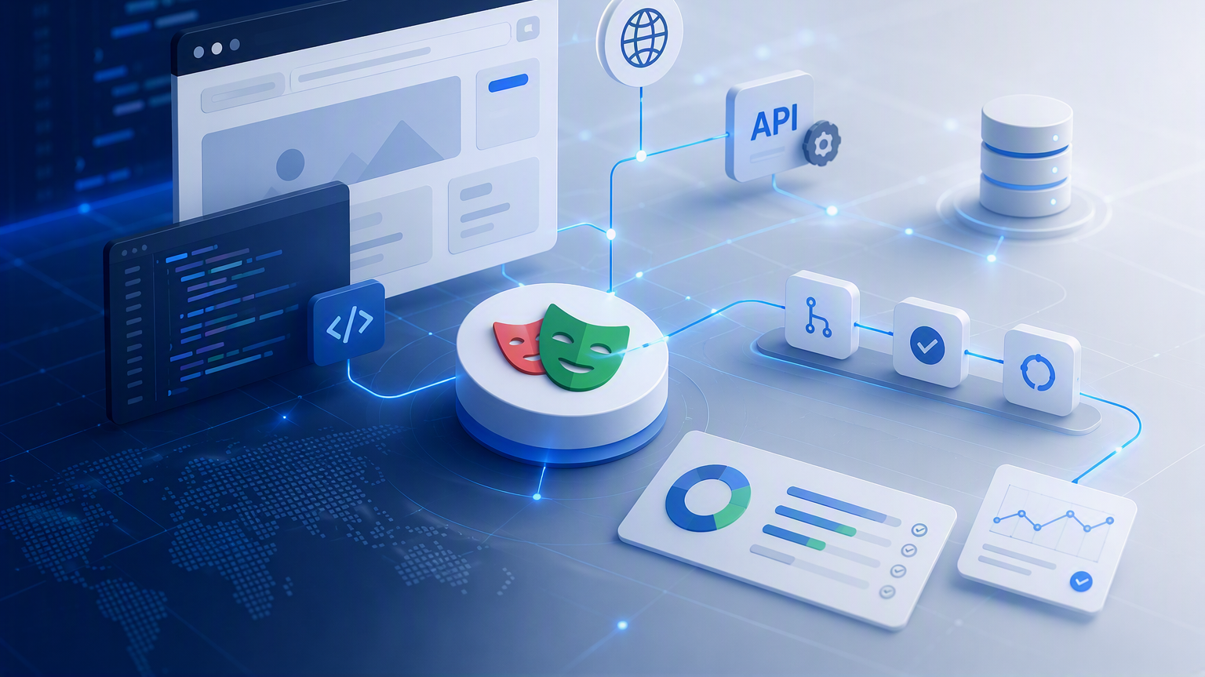

Web automation with playwright
Course Overview
Instructor: Eliana Navia Claros

Slide 2
Web Automation
Fundamentals
How we will learn
Start with a real user flow and a clear scope.
Build through guided laboratories.
Use AI as an assistant, never as an authority.
Produce evidence that another person can understand.
Instructor: Eliana Navia Claros
A practical journey from project scope to reliable automation and delivery evidence.
Welcome — let’s build useful automation together.
Playwright | TypeScript | Chromium | Responsible AI

Slide 3
Ways of working
Create a safe, respectful, evidence-driven learning environment
WORKING AGREEMENTS
PROJECT SAFETY RULES
Do not commit secrets or real personal data.
Use placeholders and controlled test data.
Review AI-generated code before acceptance.
Be on time and participate.
Ask questions and share learning.
Respect different levels and perspectives.
Deliver agreed work and evidence.
Complete assignments before deadlines.

Slide 4
Prerequisites and support
No prior automation experience is required
ESSENTIAL KNOWLEDGE
RECOMMENDED BACKGROUND
Basic programming concepts.
Basic command-line usage.
Introductory Git.
Basic AI literacy and responsible use.
JavaScript or TypeScript basics.
Web and HTTP concepts.
Team development practices.
AI-assisted development tools.
Required before the first session
Helpful, but introduced during the course
Support path: ask questions, use the practice applications, and keep assumptions visible.

Slide 5
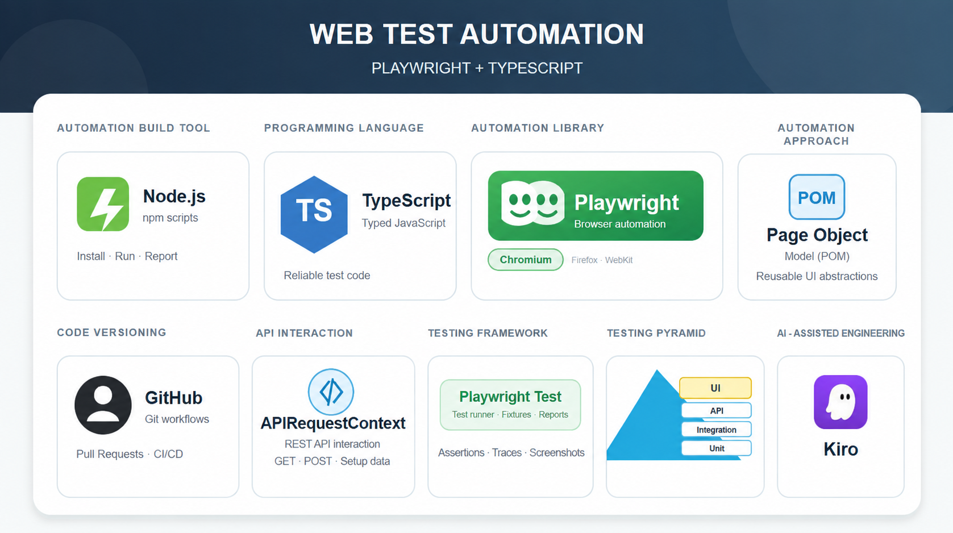
Technology Stack
Scope: technologies, tools, and platforms to be cover in the course

Slide 6
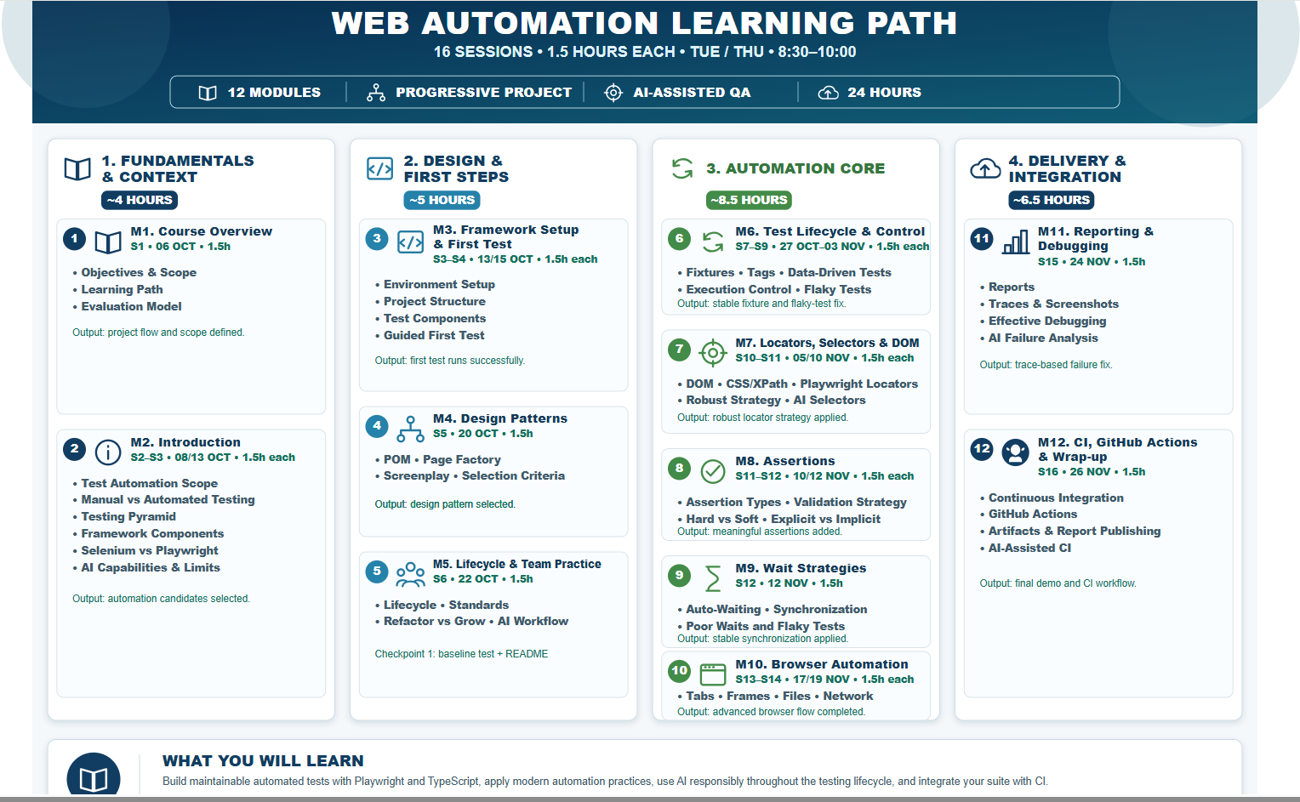
Course learning path
The project grows from a decision into a delivery pipeline

Slide 7
Evaluation model
Four evidence-based components across the course
1
Participation and laboratories
Active contribution, guided practice, and reusable evidence from sessions.
2
Checkpoint 1
Baseline test, README, project structure, conventions, and initial review.
3
Checkpoint 2
Suite with robust locators, assertions, waits, and controlled execution.
4
Final project
Maintainable suite, reports, debugging evidence, CI workflow, demo, and reflection.
Assessment is based on demonstrated work and evidence, not only attendance or copied syntax.

Slide 8
Course & Learning Resources
Platforms, tools, and materials to be use throughout the course
🌐
⚙️
🎓
📂
Practice Applications
Development Environment
Learning Platform
Source Repository
Web Automation Classroom
web-automation Repo
Demoqa
QA Playground
The Internet (Herokuapp)
SauceDemo
Automation Exercise
UI Testing Playground
• VS Code
• Node.js
• Playwright
• TypeScript
• Source Tree
• Kiro IDE
All course materials, exercises, source code, and assignments will be available through Google Classroom and GitHub.

Slide 9
Module 1 | Session Summary
Wrap-Up, Key Takeaways, Assignments & Next Steps
What We Learned
✅ Course scope, structure and learning journey.
✅ Evaluation and grading model.
✅ Progressive project approach.
✅ Collaboration and communication workflow.
Required Actions
📋 Join Google Classroom.
📋 Complete Baseline & Expectations Form.
📋 Share GitHub profile.
📋 Select a project user flow.
1
2
3
4
5
Next Module:
Project Scope & Automation Foundations
Learn how to identify, analyze, and justify automation opportunities while defining the baseline for your automation framework.

Slide 10
References & Resources
Category | Description & Link
Playwright | playwright.dev — Installation guides, API reference, locators, fixtures, and tools like Trace Viewer & Codegen.
TypeScript | typescriptlang.org/docs — Language handbook, type system reference, and tsconfig.json compiler configuration.
AI in Automation Lifecycle | docs.github.com/copilot — Official guides on integrating AI into dev workflows, test generation, and prompt engineering.
Web Automation Fundamentals | w3.org/TR/webdriver2 — W3C standard for browser automation concepts, DOM interaction, and browser control protocols.
GitHub | docs.github.com — Official documentation for Git version control, repository management, and CI/CD pipelines via GitHub Actions.
Page Object Model (POM) | playwright.dev/docs/pom — Official architectural guide for implementing the Page Object Model pattern using TypeScript.
UI Testing | developer.mozilla.org — The definitive reference for web standards, DOM event models, HTML semantics, and browser rendering.

