Slide 1
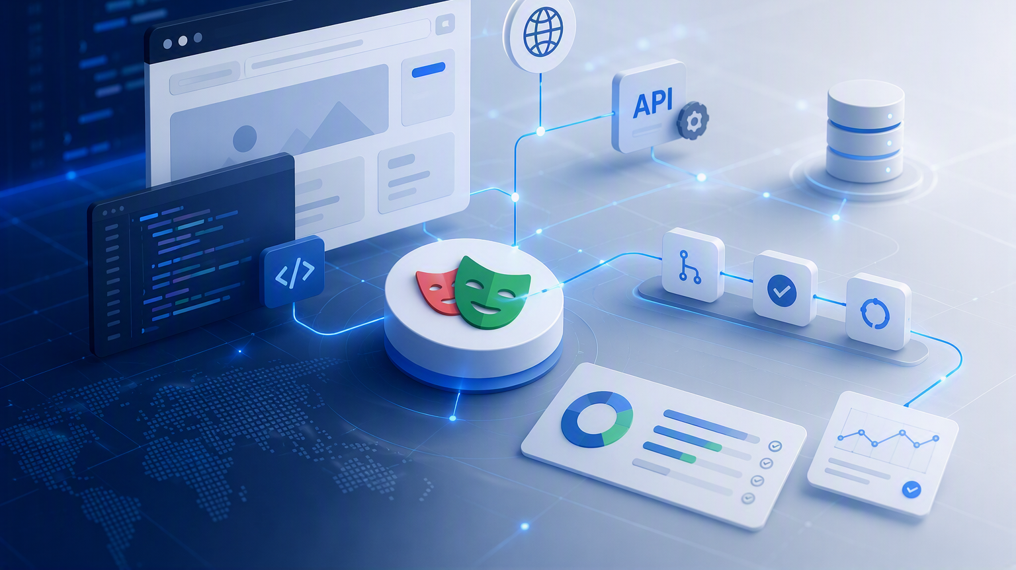

Web automation with playwright
Test Lifecycle & Control
Instructor: Eliana Navia Claros

Slide 2
Web automation with Playwright
Module 6 | Test Lifecycle & Control
Build, execute, control, diagnose, and maintain an automated test
LIFECYCLE
SETUP/TEARDOWN
DATA CONTROL
DIAGNOSE
Anatomy of a test
Prepare by API
State and environment
Learn from failure
Main outcome: controlled, reusable, and diagnosable tests

Slide 3
Test case anatomy
The lifecycle starts before the first click
1
Suite initialization
2
Setup / preconditions
Config, environment, reporters, shared immutable resources
Data, auth, context, mocks, and files
3
Test actions
4
Assertions
User behavior under test
Expected result; detailed design comes in M8
5
Evidence / reporting
6
Teardown / postconditions
Events, logs, screenshots, and traces
Cleanup data, restore state, release resources
Browser process → setup → test body (actions & assertions) → teardown -> reporting

Slide 4
Flaky Tests — The Lifecycle as Your Defense
Diagnose instability instead of hiding it — each lifecycle phase prevents a specific class of flakiness
1
Suite initialization
2
Setup / preconditions
3
Test actions
prevents: shared browser / page state
prevents: dirty state from a previous run
prevents: race conditions & brittle selectors
→ BrowserContext is isolated per test
→ Always start from a known clean state
→ Playwright auto-wait — never sleep()
→ Fixtures own setup — no global state
→ API sets up data deterministically
→ Wait for elements, not for time
→ Never share a page across test cases
→ Pre-existing data → delete, then create
→ Locators: role / text / data-testid
→ Parallelism is safe with isolated contexts
→ No dependency on test execution order
→ Avoid positional XPath or nth-child
No shared state = no order dependency
Clean precondition = reproducible start
Semantic locators survive UI refactors
4
Assertions
5
Evidence / reporting
6
Teardown / postconditions
prevents: timing-dependent & non-deterministic checks
prevents: undiagnosable — hiding failures with retry
prevents: state bleeding to the next test
→ Runs even when the test fails
→ expect() retries automatically until timeout
→ test.step() scopes failure to one action
→ Cleans all data created during the test
→ Assert behavior, not timing
→ Trace shows exact timing + network calls
→ Regenerate token after a UI login step
→ Polling matchers for async state changes
→ Screenshot captures UI at the failure point
→ Leave environment exactly as found
→ One assertion per observable outcome
Classify as: product / test / data / env
No leak = next test starts clean too
Retryable assertions absorb latency spikes
⚠ A retry provides evidence — it is not a fix
Common causes: Race conditions · Weak locators · Fixed waits · Shared state · Unstable dependencies · Non-deterministic data

Slide 5
Setup - Teardown
Prepare the state before, restore it after testing the behavior
1
Site
2
Test Cases
3
Skills
https://demoqa.com/books
https://demoqa.com/swagger
TC02
lifecycle-architect
Key principle:
Control the lifecycle and you get a framework that is maintainable, parallel-safe, and portable across environments.
Common preconditions
Common postconditions
Why API?
Faster than UI setup.
Less fragile.
More deterministic.
Separates setup and teardown from behavior.
Supports parallel isolation.
Create data.
Authenticate user.
Prepare context.
Register mocks.
Prepare deterministic files.
Verify environment readiness.
💡 Robust selectors reduce flakiness — treat them as a setup concern.
💡 A TC without verifiable acceptance criteria has no clear definition of done — also a setup concern.
Common teardowns
Delete created data.
Log out user.
Dispose context.
Remove mocks.
Clean up temporary files.
Reset environment state.
Do not perform destructive cleanup in production without explicit safeguards.
API-based setup and cleanup
Use the UI to test the UI; use the API to prepare and cleanup data whenever possible.

Slide 6
REST API — Quick Refresh
Quick refresh before we automate the first API test
API URL Structure
HTTP Methods
Status Codes
https://api.site.com/books/42?page=1
GET
Read a resource
2xx
Success
▪ base protocol + host
POST
Create a resource
3xx
Redirect
▪ path resource + id
PUT
Replace a resource
4xx
Client error
▪ query ?key=value
PATCH
Partial update
5xx
Server error
DELETE
Remove a resource
Common:
200 201 400 401 404 500
How It Works
Response / JSON
AuthN vs AuthZ
→ Client sends an HTTP Request
{
Authentication
Authorization
→ Server processes the request
"isbn": "9781491904244"
Who are you?
What can you do?
→ Server returns an HTTP Response
"title": "You Don't Know JS"
Verifies identity
Verifies permissions
→ Stateless — no shared session
"pages": 278
e.g. login, JWT
e.g. roles, scopes
→ Resources are identified by URL
}
Key-value · Strings · Numbers · Arrays

Slide 7
API Layer Architecture
Decouple HTTP calls from test logic with a layered, typed API client
Why an API Layer?
Layer Structure
ApiClient
→ Separates HTTP calls from test logic
client/ApiClient
The ONLY class that calls request.*
→ Central token and auth management
└ sole HTTP entry point
Wraps APIRequestContext from Playwright
→ Typed requests and responses (TypeScript)
endpoints/resource.endpoints
Methods:
→ Reusable operations across test files
└ URL constants only
get<T>(url)
Returns parsed JSON as T
models/resource.model
post<T>(url, data)
POST with JSON body
→ Predictable setup and teardown state
└ TS interfaces only
delete(url, opts?)
Supports body + query params
→ No hardcoded URLs in tests
controllers/ResourceController
└ business operations
setAuthToken(token)
Injects Bearer on every request
Throws on non-2xx — no silent failures
Endpoints & Models
Controllers
Fixture Integration
ENDPOINTS
▪ Receive ApiClient — not APIRequestContext
SETUP
URL string constants — one file per resource
▪ One controller per resource / domain
generateToken()
No HTTP calls · No imports from client/
▪ Methods = named business operations
cleanState() if needed
Prevents hardcoded strings across the codebase
▪ Return typed model objects
── test body executes ──
MODELS
TEARDOWN
TypeScript interfaces only — no classes
Typical operations:
regenerateToken() ← mandatory
Request payloads · Response shapes
generateToken(user, pass)
POST → returns token string
cleanState()
No business logic · No side effects
getAll()
GET → returns typed array
UI login invalidates the setup token
create(payload)
POST → returns created object
delete(id, userId)
DEL → void, throws on error

Slide 8
Module 6 | Activities –Part 1
Prepare the state before, restore it after testing the behavior
Student tasks
Evidence to submit
Write 2 test cases whose preconditions and postconditions can be executed via API.
Run lifecycle-architect-skill-prompt against your model.
Invoke the lifecycle-architect skill.
SKILL EXECUTION – BEFORE & AFTER
Prompt execution: Adapt lifecycle-architect-skill-prompt to your AI agent, run it, then generate a notes.md file with the changes.
Skill verification: Trigger the skill against your existing code. Document what it found and whether the output matched the expected format in a .md file. Prompt iteration: Document in a .md file what you had to change to get the expected result and why.
Note: every phase includes a .md file that you can generate with your AI assistant.
TEST CODE EVIDENCE
The generated code, .md files, spec files, and skills must be committed and visible on the main branch of your GitHub repository. (Paste the GitHub URL here.)
TEST EXECUTION EVIDENCE
Playwright HTML report — all tests passing on Chromium

