Slide 1


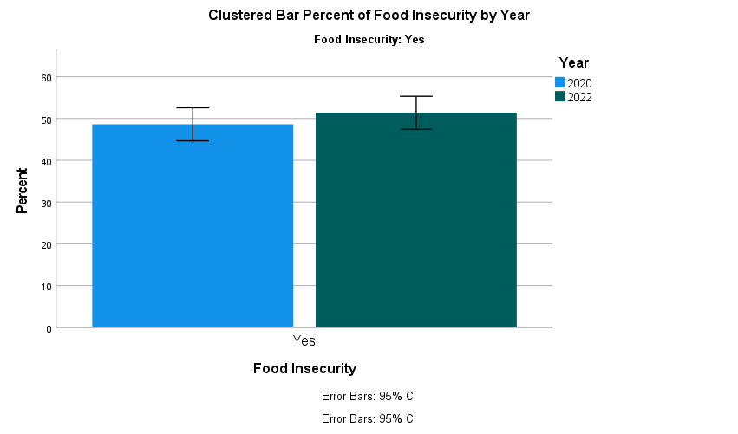
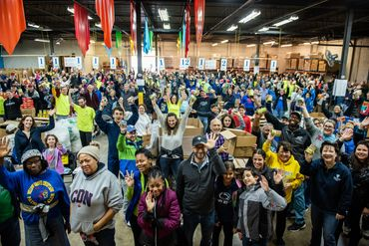
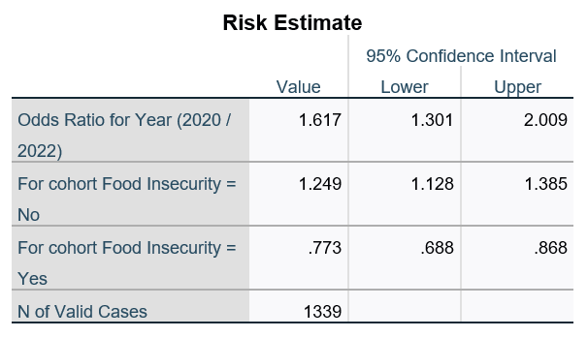
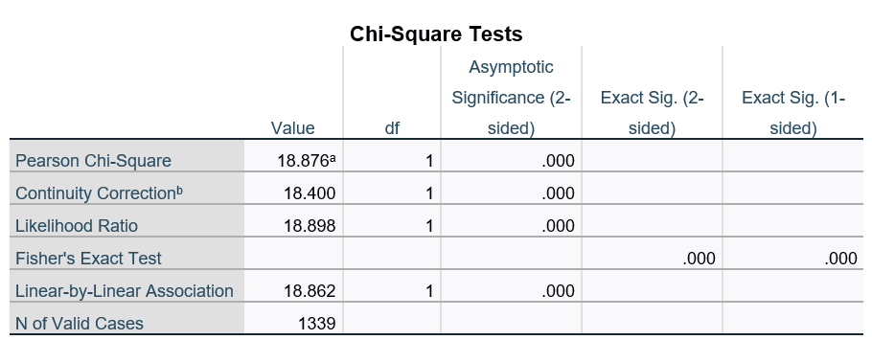

JRA Client Food Insecurity: Pre vs. Post Pandemic
Gianna LaFrance
Advisor Professor Laura Pyott
Department of Science and Mathematics: West Chester University
Abstract
Methodology
Conclusion
The Jewish Relief Agency of Philadelphia is a non-profit organization that provides a monthly food box to those in need. Every 2 years the JRA surveys its clients. 1800 surveys were mailed to a sample of JRA clients. The survey collects demographic data, food preferences, connections to the Jewish community, and the level of satisfaction with the agency. To date, over 800 surveys have been returned and have been entered into a database. My research question is if consumers receiving JRA services are more or less food insecure (FI) in 2022 than in 2020? I hypothesize that due to the coronavirus pandemic; more people are unable to fulfill their food needs. This could be due to unemployment, inflation, children not being able to receive school meals, etc. To assess for FI, questions 1 and 2 of the U.S. Household Food Security Survey are used. Question 1 is “We worried whether our food would run out before we got money to buy more in the last 12 months.” Question 2 is “The food that we bought just didn’t last, and we didn’t have money to get more in the last 12 months.” The answers to each question were either often, sometimes, never true, or don’t know. If the person responds either “often true” or “sometimes true” to either question, the person is considered FI. After a statistical analysis of the data, I found that the increase in FI in 2022 was statistically significant compared to FI in 2020.
To assess for FI, questions 1 and 2 of the U.S. Household Food Security Survey are used. Question 1 is “We worried whether our food would run out before we got money to buy more in the last 12 months.” Question 2 is “The food that we bought just didn’t last, and we didn’t have money to get more in the last 12 months.” The answers to each question were either often, sometimes, never true, or don’t know. If the person responded either “often true” or “sometimes true” to either question, the person is considered FI. I recoded the variables in the data set, setting “often true” and “sometimes true” equal to 1, and the rest equal to 0. Then I added up all of the 1’s to determine the proportion of people that are FI. Using SPSS, I made a bar chart and a 95% confidence interval of the proportions. Then I conducted a chi-square test for association between FI and year. All expected cell counts were greater than 5. The odds ratio (OR) measures the association between FI and year. This is necessary to determine if there was a higher chance of FI in 2020 or 2022. If OR = 1, there is no difference between FI and year. If OR > 1, people are more likely to be FI in 2022 than in 2020. If OR < 1, people are less likely to be FI in 2022 than in 2020.
Because we rejected the null hypothesis that FI and year are not associated, we conclude that FI and the year are associated. The OR was greater than 1 confirming that people were more likely to be FI in 2022 than in 2020. This is what I expected in 2022 due to the COVID pandemic. This means that people are more worried/don’t have as much money to spend on food in 2022 than in 2020. This is important to this agency because they give these people boxes of food each month. Knowing that their population of FI people has increased might enable them to receive more grants and thus give more food to their consumers and increase their outreach.
Results
The total sample size for 2020 was 846. We excluded the people that did not answer the question making our total sample size for Food Insecurity in 2020 to be 737. The valid percentage of people that responded yes to the FI question was 40.4% with 59.6% responding negatively.
The total sample size for 2022 was 868. We excluded the people that did not answer the question making our total sample size for Food Insecurity in 2022 to be 602. The valid percentage of people that responded yes to the FI question was 52.3% with 47.7% responding negatively
A chi-square test for association was conducted between Food Insecurity and year. All expected cell frequencies were greater than five. There was a statistically significant association between Food Insecurity and year, ${\text{χ}}^{2}$(1) = 18.876 , p < .000. The odds ratio of Food Insecurity in 2020 vs. 2022 is 1.617 (95% CI, 1.301 to 2.009).
Introduction
The Jewish Relief Agency (JRA) serves over 6,800 low-income individuals across Philadelphia. They started off serving the Jewish community but now they serve any low-income individual. Their goal is to relieve hunger, improve lives, and strengthen their community. They achieve this by sending out boxes that contain kosher food and essential home supplies. Because most of the individuals are elderly and/or disabled, they deliver these boxes directly to the home. Home delivery alleviates several barriers FI families may face such as the need to leave the house, lack of transportation, or access to healthy foods in nearby markers. Because one of their main goals is to relieve hunger, they are concerned about the Food insecurity of their clients. In 2020 with the pandemic, they increased their food box from 12 lbs to 15 lbs to meet the increasing needs of the community. Also, they decided to give an extra box to households over four and have started providing household goods like toilet paper and dish soap.
References
Hager, Erin R., et al. “Development and Validity of a 2-Item Screen to Identify Families at Risk for Food Insecurity.” Pediatrics, vol. 126, no. 1, 2010, pp. e26–32. Crossref, https://doi.org/10.1542/peds.2009-3146.
Szumilas, Magdalena. “Explaining odds ratios.” Journal of the Canadian Academy of Child and Adolescent Psychiatry = Journal de l'Academie canadienne de psychiatrie de l'enfant et de l'adolescent vol. 19,3 (2010): 227-9.
Jewish Relief Agency Home

