Slide 1
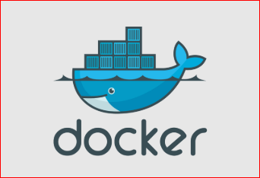
in detailed

Slide 2

Why Docker ?

Slide 3
why Docker came into IT world (Production/Environments)?
why Docker to be used?
what are advantage’s if we use Docker?

Slide 4
why Docker came into IT world
Docker is a containerization
It’s important that you understand the history behind containerization
History Before Containerization (Docker)
Before containerization came into the picture, the leading way to isolate, organize applications and their dependencies was to place each and every application in its own virtual machine.
These machines run multiple applications on the same physical hardware, and this process is nothing but Virtualization
Virtualization:
virtualization had few drawbacks such as the virtual machines were bulky in size.
running multiple virtual machines lead to unstable performance.
boot up process would usually take a long time and VM’s would not solve the problems like portability, software updates, or continuous integration and continuous delivery.
These drawbacks led to the emergence of a new technique called Containerization

Slide 5
Containerization
Containerization is the technique of bringing virtualization to the operating system level
While Virtualization brings abstraction to the hardware, Containerization brings abstraction to the operating system
Do note that Containerization is also a type of Virtualization
Containerization is however more efficient because there is no guest OS here and utilizes a host’s operating system
Containerization share relevant libraries & resources as and when needed unlike virtual machines
Application specific binaries and libraries of containers run on the host kernel, which makes processing and execution very fast
Even booting-up a container takes only a fraction of a second
Because all the containers share, host operating system and holds only the application related binaries & libraries. They are lightweight and faster than Virtual Machines

Slide 6
Reasons to use Containers(Docker)
Containers have no guest OS and use the host’s operating system. So, they share relevant libraries & resources as and when needed.
Processing and execution of applications are very fast since applications specific binaries and libraries of containers run on the host kernel.
Booting up a container takes only a fraction of a second, and also containers are lightweight and faster than Virtual Machines.

Slide 7
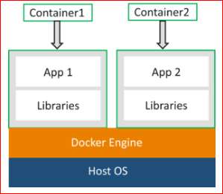
What is Docker?
Docker is a platform which packages an application and all its dependencies together in the form of containers
This containerization aspect of Docker ensures that the application works in any environment
each and every application runs on separate containers and has its own set of dependencies & libraries.
This makes sure that each application is independent of other applications, giving developers surety that they can build applications that will not interfere with one another
So a developer can build a container having different applications installed on it and give it to the QA team
Then the QA team would only need to run the container to replicate the developer’s environment

Slide 8
Docker Explained: Docker file, Images & Containers
Dockerfile, Docker Images & Docker Containers are three important terms that you need to understand while using Docker. we will go in details for each.
Dockerfile:
A Dockerfile is a text document which contains all the commands that a user can call on the command line to assemble an image
So, Docker can build images automatically by reading the instructions from a Dockerfile
You can use docker build to create an automated build to execute several command-line instructions in succession

Slide 9
Docker Images
Docker Image can be compared to a template which is used to create Docker Containers.
So, these read-only templates are the building blocks of a Docker Container
You can use docker run to run the image and create a container
Docker Images are stored in the Docker Registry.
It can be either a user’s local repository or a public repository like a Docker Hub which allows multiple users to collaborate in building an application

Slide 10
Docker Container
Docker Container is a running instance of a Docker Image as they hold the entire package needed to run the application.
So, these are basically the ready applications created from Docker Images which is the ultimate utility of Docker

Slide 11
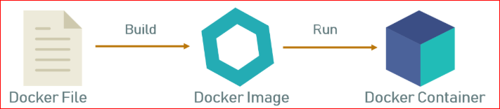
Docker Explained: Docker file, Images & Containers

Slide 12
Docker Registry
Docker Registry is where the Docker Images are stored
he Registry can be either a user’s local repository or a public repository like a Docker Hub allowing multiple users to collaborate in building an application
Even with multiple teams within the same organization can exchange or share containers by uploading them to the Docker Hub.
Docker Hub is Docker’s very own cloud repository similar to GitHub

Slide 13
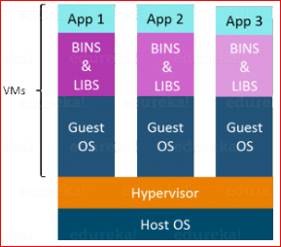
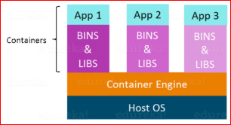
Advantages of Containerization over Virtualization
Containers on the same OS kernel are lighter and smaller
Better resource utilization compared to Virtual machine’s
Boot-up process is short and takes few seconds

