Slide 1

Analysis on repeat customers from July 2019 to January 2023

Slide 2
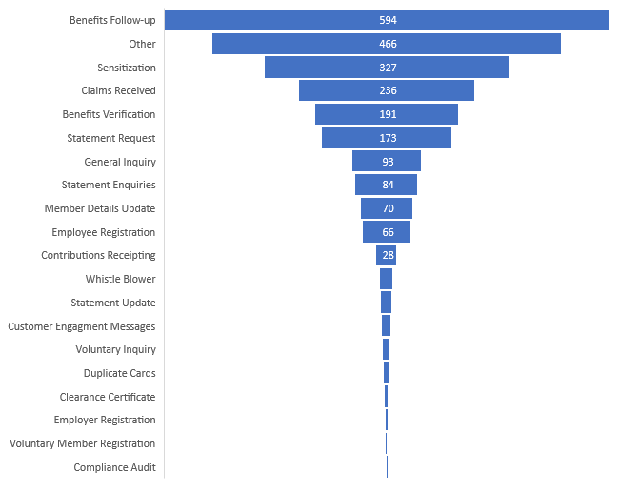
Average Repeat Customers per month
Benefits follow up have dominated the repeat visits on the different channels.
58% of customers categorized under other and sensitization have claim related queries, 30% balance inquiry while 10% are system and network related errors e.g., Call dropped and silent calls while 2% called back to appreciate the services provided.

Slide 3
Comparison between Jul- Dec 2019 and Jul – Dec 2022
All repeat customers have declined with an exception of Benefits related queries, Sensitization and voluntary registration.
Sensitization category is mainly composed of claims related queries as earlier indicated.
Voluntary Membership has also increased due to increased sensitization and awareness campaigns.

Slide 4
Comparison between Jul- Dec 2019 and Jul – Dec 2022
Repeat walkin customers have reduced by 22% in the first half of 2022/2023 while Online repeat customers have increased by 18% compared to the first half of 2019/2022
The increase in E channel usage could have also increased due to the lockdown and all campaigns were directed to online usage.

Slide 5
All subject categories show similar trends over the years with a difference in volumes. 2021/2022 had the highest volumes due to the amendment bill that saw more customers contacting the fund on different channels.

