Slide 1

Agriculture, forestry and fishing sector analysis

Slide 2
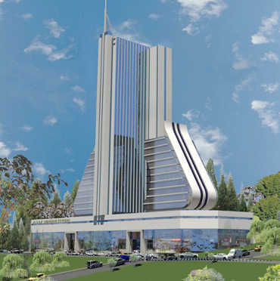
Composition by contribution
Monthly composition
Annual Composition
In both financial years, the sector has been consistent with average composition of 3% of the contributions monthly
and annually.

Slide 3
Members and Employer Composition
FY | FY 22/23 | FY 23/24
Members | 37,447 | 38,205
Employers | 592 | 646
Active Members | 734,839 | 749,042
Agriculture sector contributes 5% to total active members of the fund and 2% of the employer base(30,822 Active Employers)

