Slide 1
In-situ analysis with ADIOS
Scott Klasky, Norbert Podhorszki, Ana Gainaru

Slide 2
Outline
Part I: Introduction to Parallel I/O and HPC file systems (0.5 hours) (Beginner/Intermediate)
Lecture: Parallel I/O
Lecture: HPC Storage Systems – GPFS, Lustre, Burst Buffers
Part II: Self-describing I/O using ADIOS (1 hour) (Beginner/Intermediate)
Lecture: ADIOS framework, I/O abstraction, file format
Hands-on: use a parallel MiniApp to write self-describing data
Use ADIOS write API to write data in parallel
Write HDF5 files using the ADIOS API
Hands-on: Parallel data reading
ADIOS read API in Fortran90, C++, and Python
Read HDF5 files using the ADIOS API
Lecture: How to scale ADIOS I/O
BREAK
Part III: Data Compression (0.5 hour) (Intermediate)
Lecture: Overview of common data reduction techniques for scientific data
Introduction to compression
Introduction to lossy compression techniques: MGARD, SZ, and ZFP
Hands-on: Adding compression to previous examples
Part IV: In situ data analysis using I/O staging (1 hour) (Intermediate/Advanced)
Lecture: Introduction to “data staging” for in situ analysis and code coupling
Hands-on: Create a simple pipeline using the MiniApp that computes, and visualizes a derived variable using data staging
Hands-on: Add data reduction to the pipeline
Demonstration: In situ visualization with Visit and Paraview
Hands-on: Staging and converting with adios_reorganize tool
Wrap-up

Slide 3
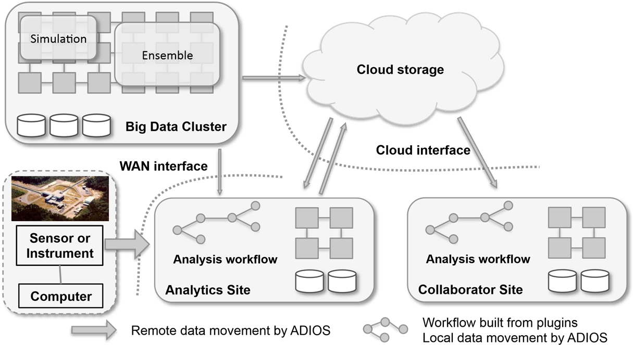
Vision: building scientific collaborative applications
Notes:
Collaborative scientific application

Slide 4
Data Staging in ADIOS
Sustainable Staging Transport (SST)
In-situ infrastructure for staging in a streaming-like fashion using RDMA, SOCKETS
DataMan
WAN transfers using sockets and ZeroMQ
SSC
One-sided MPI for strong coupling of codes
DataSpaces
Staging infrastructure providing a shared memory abstraction

Slide 5
Sustainable Staging Transport (SST)
Application
Direct coupling between data producers and consumers for in-situ/in-transit processing
Designed for portability and reliability.
Control Plane
Manages meta-data and control using a message-oriented protocol
Inherits concepts from Flexpath, DIMES, uses EVPath
Allows for dynamic connections, multiple readers and complex flow control management
Data Plane
Exchange data using RDMA
Responsible for resource management for data transfer
Uses libfabric for portable RDMA support
Threaded to overlap communication with computation and for asynchronous progress monitoring
Modular interface with the control plane supports alternative data plane implementations
ADIOS API
SST Engine
Control Plane
Connection Mgmt
Metadata Mgmt
Data Plane
libfabric
EVPath
IB
uGNI
OPA
TCP
…

Slide 6
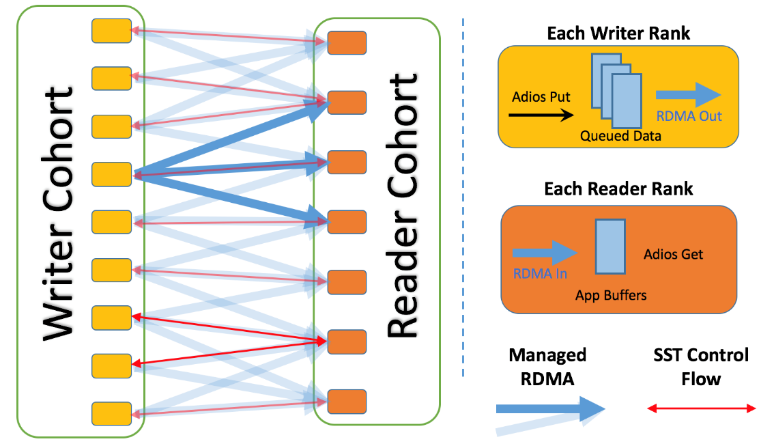
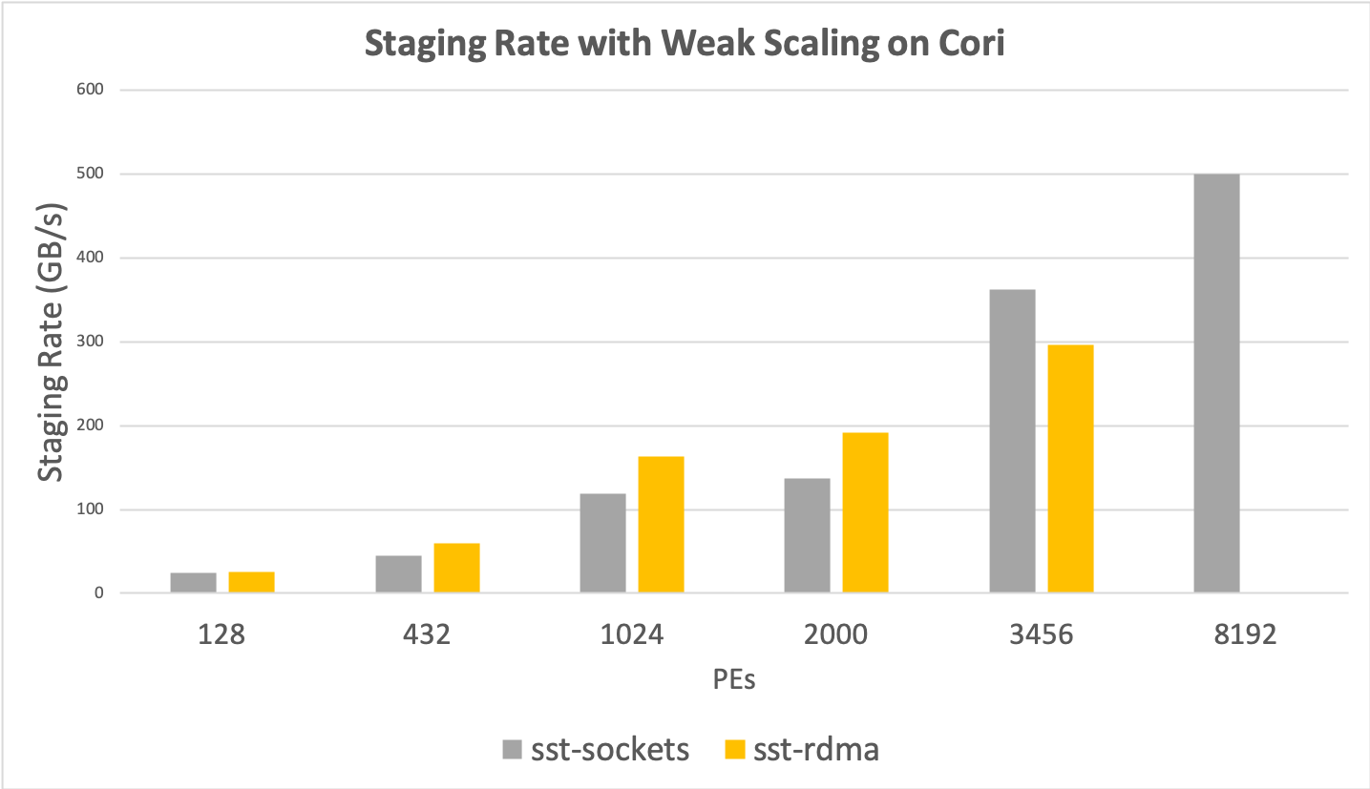
Sustainable Staging Transport (SST)
Data is staged in writer ranks’ memory.
Metadata is propagated to subscribed readers, reader ranks perform indexing locally.
Metadata structure is optimized for single writer, N reader workflows.
Supports late joining/early leaving readers.
Modular design
Well-encapsulated interface between DP and CP.
Multiple inter-changeable DP implementations.
RDMA for asynchronous transfer
Currently tested and performant for GNI, IB (verbs), OPA (verbs/psm2).

Slide 7
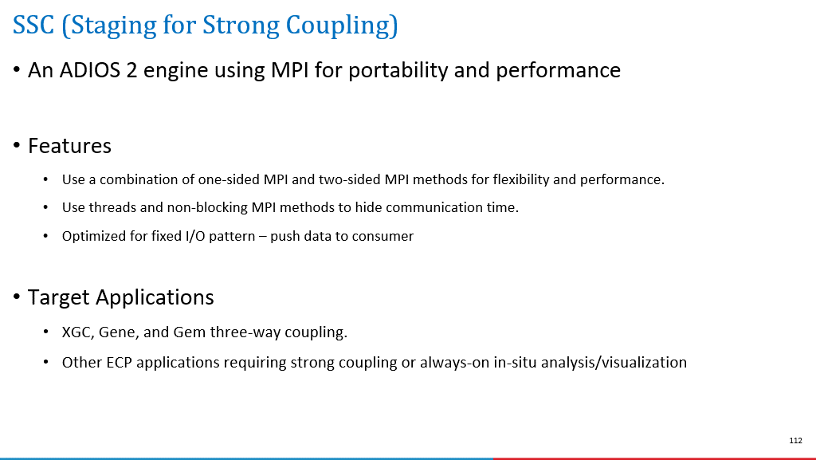
SSC

Slide 8
DataMan
An ADIOS 2 engine subroutine designed for wide area network data transfer, data staging, near-real-time data reduction and remote in-situ processing
Designed with following principles:
Flexibility: allowing transport layer switching (ADIOS BP file, ZeroMQ, google-rpc etc.)
Versatility: supporting various workflow modes (p2p, query, pub/sub, etc.)
Adaptability: allowing adaptive data compression based on near-real-time decision making
Extendibility: taking advantage of all ADIOS 2 transports and operators, and other potential third-party libraries. For example, DataMan can use ZFP, Bzip, SZ that have been built into ADIOS2, as well as any compression techniques that will be built into ADIOS 2 in future.
Target Applications:
ECP applications requiring wide area network data transfer and adaptive data reduction
Square Kilometer Array observational data
KSTAR fusion experimental data

Slide 9
DataMan: Supports three workflow modes
Push
Sender driven workflow
Senders are configured to send data to pre-defined receivers.
Query
Receiver driven workflow
Receivers are configured to query particular data (particular subsets of particular variables) from senders.
Subscribe
Ad-hoc workflow
Free combination of senders (publishers) and receivers (subscribers).
Senders and receivers can be launched in any order, and they can be attached and detached freely without affecting other senders or receivers.

Slide 10
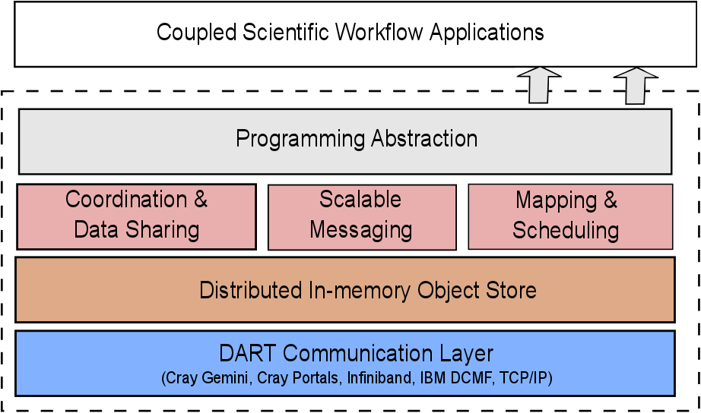
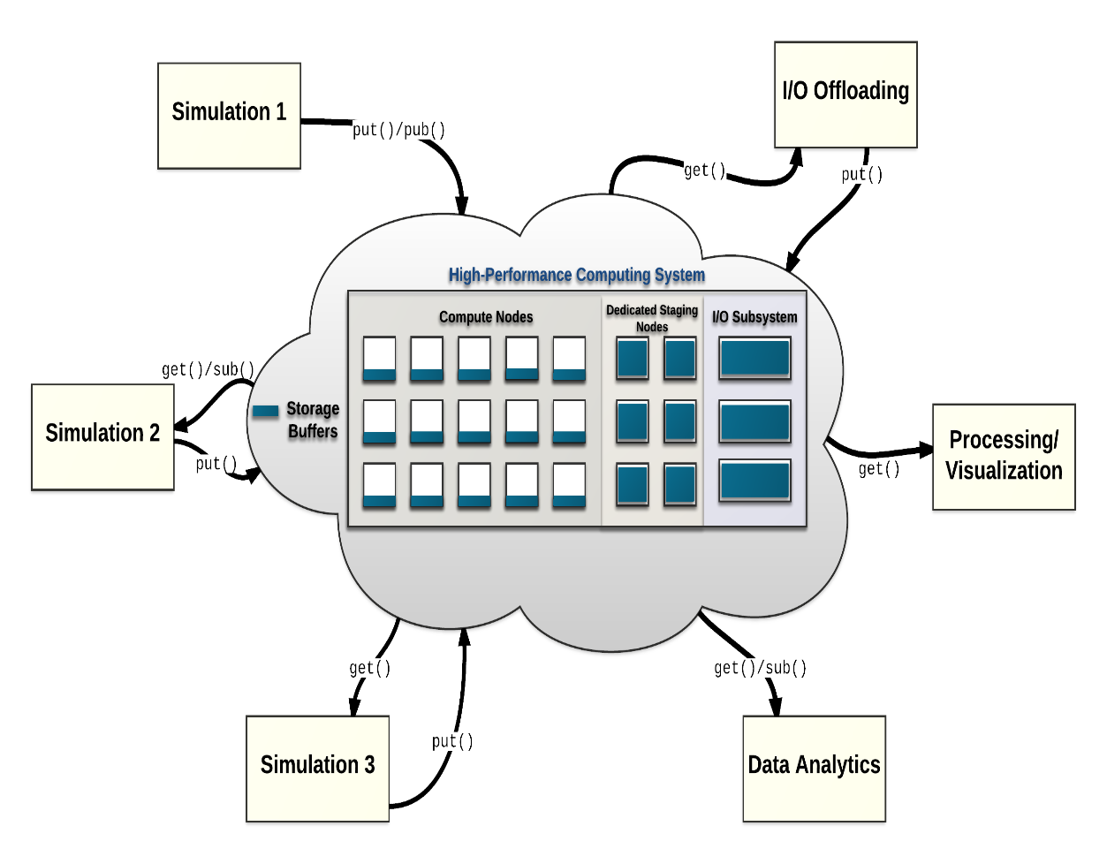
DataSpaces: Extreme Scale Data Staging Service
The DataSpaces Abstraction
Virtual shared-space programming abstraction
Simple API for coordination, interaction and messaging
Distributed, associative, in-memory object store
Online data indexing, flexible querying
Adaptive cross-layer runtime management
Hybrid in-situ/in-transit execution
Efficient, high-throughput/low-latency asynchronous data transport
www.dataspaces.org

Slide 11
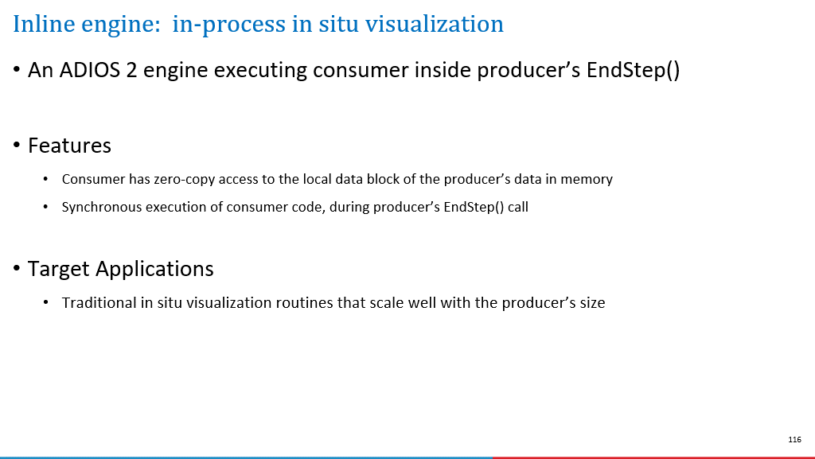

Slide 12
Application: Which staging method to use?
System considerations
Staging between machines/over a WAN? DataMan
Co-located execution? SST-SM+X
Availability of RDMA high-speed network? SST (and DataSpaces) optimized for this case.
Coupling considerations
Highly synchronized writer/reader and a highly optimized MPI? InsituMPI
Ensemble workflow / multiple independent writers / data lives independently of any given writer component? DataSpaces
1 writer, many readers streaming? SST optimized for this use case.
Performance considerations
Often application-specific, and not always obvious.
Here’s where it helps to have a flexible I/O framework…

Slide 13
Staging I/O Processing data on the fly by 1. Reading from file concurrently, or 2. Moving data without using the file system

Slide 14
Design choices for reading API
One output step at a time
One step is seen at once after writer completes a whole output step
streaming is not byte streaming here
reader has access to all data in one output step
as long as the reader does not release the step, it can read it
potentially blocking the writer
Advancing in the stream means
get access to another output step of the writer,
while losing the access to the current step forever.
Notes:
You can only advance forward, hence we call it stream

Slide 15
ADIOS concepts for the read API (get)
Step
A dataset written within one adios_begin_step/…/adios_end_step
Stream
A file containing of series of steps of the same dataset
Open for reading as a stream
for step-by-step reading (both staged data and files)
adios2::Engine reader = io.Open(filename, adios2::Mode::Read, comm);
Close once at the very end of streaming
reader.Close();
Notes:
lock_mode In case of real streams, a step may need to be locked in memory to be able to read all data of the step completely.
. timeout_sec >= 0:0: block until the stream becomes available but for max 'timeout_sec' seconds. 0:0: return immediately if stream is not available

Slide 16
Advancing a stream
One step is accessible in streams, advancing is only forward
adios2::StepStatus read_status =
reader.BeginStep(adios2::StepMode::Read, timeout);
if (read_status != adios2::StepStatus::OK) {
break;
}
float timeout: wait for this long for a new step to arrive
Release a step if not needed anymore
optimization to allow the staging method to deliver new steps if available
reader.EndStep();
Notes:
Advancing to step N informs the read method that all steps before N can be removed if space is needed. There is no way to go back to previous steps.
Next newsest or oldest avail step?

Slide 17
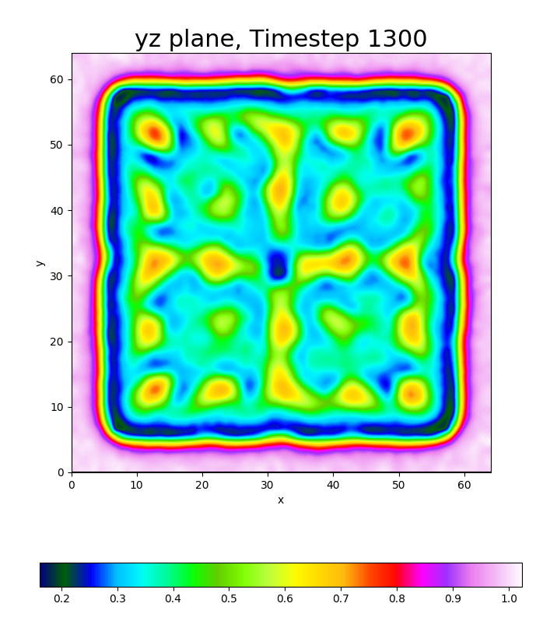
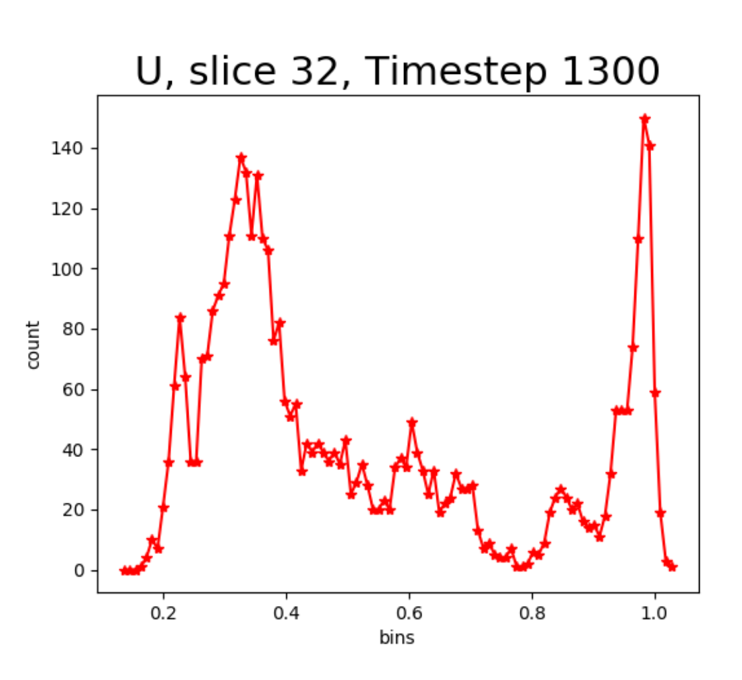

Gray-Scott example with staging
Gray-Scott
Staging
Staging
PDF Analysis
Staging

Slide 18
File-based in situ processing

Slide 19
The runtime config file: adios2.xml
<?xml version="1.0"?>
<adios-config>
<!--=====================================
Configuration for for Gray-Scott and GS Plot
======================================-->
<io name="SimulationOutput">
<engine type="BP4">
<parameter key="OpenTimeoutSecs" value="10.0"/>
</engine>
</io>
<!--=================================
Configuration for PDF calc and PDF Plot
==================================-->
<io name="PDFAnalysisOutput">
<engine type="BP4">
<parameter key="OpenTimeoutSecs" value="10.0"/>
</engine>
</io>
</adios-config>
Engine types
BP4
HDF5
SST
InSituMPI
DataMan

Slide 20
In Situ Visualization with ADIOS
Gray-Scott
edit adios2.xml: SimulationOutput, PDFAnalysisOutput uses BP4 engine
$ ./cleanup.sh data
$ mpirun -n 4 adios2-gray-scott settings-staging.json
Simulation writes data using engine type: BP4
========================================
grid: 64x64x64
steps: 60000
plotgap: 100
F: 0.02
k: 0.048
dt: 1
Du: 0.2
Dv: 0.1
noise: 0.01
output: gs.bp
adios_config: adios2.xml
decomposition: 2x2x1
grid per process: 32x32x64
========================================
Simulation at step 0 writing output step 0
Simulation at step 100 writing output step 1
ADIOS BP

Slide 21
In Situ Visualization with ADIOS
Gray-Scott
Staging
$ mpirun -n 4 adios2-gray-scott settings-staging.json
Simulation writes data using engine type: BP4
========================================
grid: 64x64x64
steps: 60000
…
PDF Analysis
$ mpirun -n 2 adios2-pdf-calc gs.bp pdf.bp 100
PDF analysis reads from Simulation using engine type: BP4
PDF analysis writes using engine type: BP4
PDF Analysis step 0 processing sim output step 0 sim compute step 0
PDF Analysis step 1 processing sim output step 1 sim compute step 100
PDF Analysis step 2 processing sim output step 2 sim compute step 200
PDF Analysis step 3 processing sim output step 3 sim compute step 300
PDF Analysis step 4 processing sim output step 4 sim compute step 400
PDF Analysis step 5 processing sim output step 5 sim compute step 500
PDF Analysis step 6 processing sim output step 6 sim compute step 600
...
ADIOS BP

Slide 22
In Situ Visualization with ADIOS
Gray-Scott
Staging
$ mpirun -n 4 adios2-gray-scott settings-staging.json
Simulation writes data using engine type: BP4
========================================
grid: 64x64x64
steps: 60000
…
PDF Analysis
$ mpirun -n 2 adios2-pdf-calc gs.bp pdf.bp 100
PDF analysis reads from Simulation using engine type: BP4
PDF analysis writes using engine type: BP4
PDF Analysis step 0 processing sim output step 0 sim compute step 0
...
Staging
$ python3 pdfplot.py -i pdf.bp
PDF Plot step 0 processing analysis step 0 simulation step 0
PDF Plot step 1 processing analysis step 1 simulation step 100
PDF Plot step 2 processing analysis step 2 simulation step 200
PDF Plot step 3 processing analysis step 3 simulation step 300
...

Slide 23
In Situ Visualization with ADIOS
Gray-Scott
Staging
Staging
$ mpirun -n 4 adios2-gray-scott settings-staging.json
Simulation writes data using engine type: BP4
========================================
PDF Analysis
$ mpirun -n 2 adios2-pdf-calc gs.bp pdf.bp 100
PDF analysis reads from Simulation using engine type: BP4
PDF analysis writes using engine type: BP4
PDF Analysis step 0 processing sim output step 0 sim compute step 0
...
Staging
$ python3 pdfplot.py -i pdf.bp
PDF Plot step 0 processing analysis step 0 simulation step 0
...
$ python3 gsplot.py -i gs.bp
GS Plot step 0 processing simulation output step 0 or computation step 0
GS Plot step 1 processing simulation output step 1 or computation step 100
GS Plot step 2 processing simulation output step 2 or computation step 200
...

Slide 24
Streaming in situ processing with SST engine

Slide 25
The runtime config file: adios2.xml
<?xml version="1.0"?>
<adios-config>
<!--================================
Configuration for the Simulation Output
===============================-->
<io name="SimulationOutput">
<engine type="SST">
</engine>
</io>
<!--==============================
Configuration for the Analysis Output
===============================-->
<io name="AnalysisOutput">
<engine type="SST">
</engine>
</io>
<!--===============================
Configuration for the Visualization Input
================================-->
<io name="VizInput">
<engine type="SST">
</engine>
</io>
</adios-config>
Engine types
BP4
HDF5
SST
InSituMPI
DataMan

Slide 26
In Situ Visualization with ADIOS
Gray-Scott
edit adios2.xml and change SimulationOutput to SST
PDFAnalysisOutput to BP4
$ ./cleanup.sh data
Staging
$ mpirun -n 4 adios2-gray-scott settings-staging.json
Simulation writes data using engine type: SST
========================================
grid: 64x64x64
steps: 60000
…
PDF Analysis
$ mpirun -n 2 adios2-pdf-calc gs.bp pdf.bp 100
PDF analysis reads from Simulation using engine type: SST
PDF analysis writes using engine type: BP4
PDF Analysis step 0 processing sim output step 0 sim compute step 0
PDF Analysis step 1 processing sim output step 1 sim compute step 100
PDF Analysis step 2 processing sim output step 2 sim compute step 200
PDF Analysis step 3 processing sim output step 3 sim compute step 300
PDF Analysis step 4 processing sim output step 4 sim compute step 400
PDF Analysis step 5 processing sim output step 5 sim compute step 500
PDF Analysis step 6 processing sim output step 6 sim compute step 600
...
ADIOS BP

Slide 27
In Situ Visualization with ADIOS
Gray-Scott
edit adios2.xml and change PDFAnalysisOutput to SST as well
$ ./cleanup.sh data
Staging
$ mpirun -n 4 adios2-gray-scott settings-staging.json
Simulation writes data using engine type: SST
========================================
grid: 64x64x64
steps: 60000
…
PDF Analysis
$ mpirun -n 2 adios2-pdf-calc gs.bp pdf.bp 100
PDF analysis reads from Simulation using engine type: SST
PDF analysis writes using engine type: SST
PDF Analysis step 0 processing sim output step 0 sim compute step 0
...
Staging
$ python3 pdfplot.py -i pdf.bp
PDF Plot step 0 processing analysis step 0 simulation step 0
PDF Plot step 1 processing analysis step 1 simulation step 100
PDF Plot step 2 processing analysis step 2 simulation step 200
PDF Plot step 3 processing analysis step 3 simulation step 300
...

Slide 28
In Situ Visualization with ADIOS
Gray-Scott
edit adios2.xml and change AnalysisOutput to SST
VizInput to SST
$ ./cleanup.sh data
Staging
Staging
$ mpirun -n 4 adios2-gray-scott settings-staging.json
Simulation writes data using engine type: SST
========================================
PDF Analysis
$ mpirun -n 2 adios2-pdf-calc gs.bp pdf.bp 100
PDF analysis reads from Simulation using engine type: SST
PDF analysis writes using engine type: SST
PDF Analysis step 0 processing sim output step 0 sim compute step 0
...
Staging
$ python3 pdfplot.py -i pdf.bp
PDF Plot step 0 processing analysis step 0 simulation step 0
...
$ python3 gsplot.py -i gs.bp
GS Plot step 0 processing simulation output step 0 or computation step 0
GS Plot step 1 processing simulation output step 1 or computation step 100
GS Plot step 2 processing simulation output step 2 or computation step 200
...

Slide 29
Changing the pipeline
Run both Plotting from PDFAnalysis output
Gray-Scott
Gray-Scott
Staging
Staging
Staging
Hints
pdf_calc: Add extra command-line argument to : YES to write U, V variables to pdf.bp
gsplot.py: Plot "pdf.bp" instead of "gs.bp"
Change on command line
PDF Analysis
PDF Analysis
Staging
Staging

