Slide 1
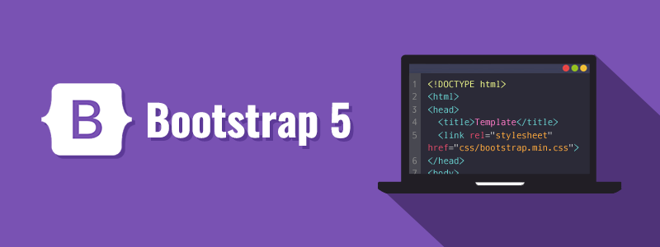

By : Anu Moly Poulose

Slide 2
INDEX
Bootstrap 5 installation and usage
Bootstrap 5 Components
Utilities and classes

Slide 3

BOOTSTRAP 5
Bootstrap 5 is the newest version of Bootstrap; with new components, faster style sheet and more responsiveness.
Bootstrap 5 supports the latest, stable releases of all major browsers and platforms. However, Internet Explorer 11 and down is not supported.
The most popular HTML, CSS, and JavaScript framework for creating responsive, mobile-first websites.

Slide 4
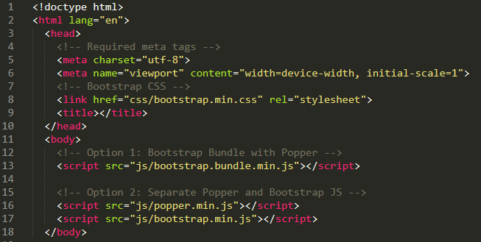
BOOTSTRAP 5 Installation and usage

Slide 5
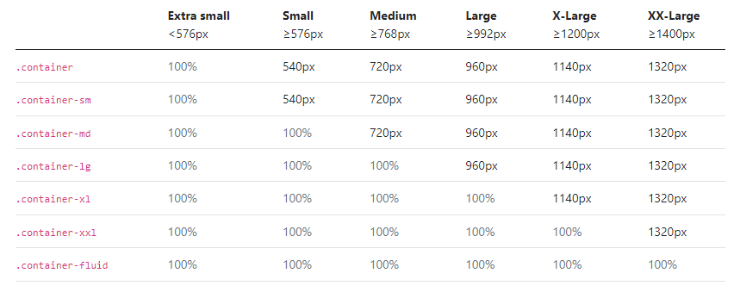
Responsive Containers
Containers are the most basic layout element in Bootstrap and are required when using our default grid system
container
container-fluid
container-{breakpoint}

Slide 6
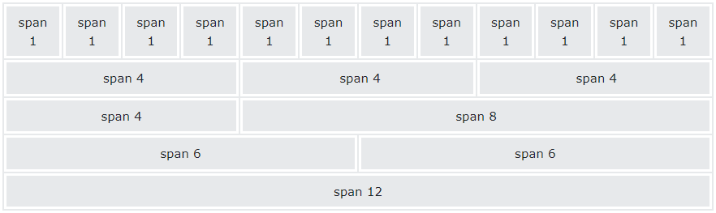

Grid Layout
Bootstrap's grid system is built with flexbox and allows up to 12 columns across the page.
If you do not want to use all 12 columns individually, you can group the columns together to create wider columns:
Make sure that the column sum adds up to 12 or fewer.
Don’t miss to add row while adding columns, else which cause alignment issues

Slide 7
Grid Layout
Grid supports six responsive breakpoints.
Containers center and horizontally pad your content.
Rows are wrappers for columns
Columns are incredibly flexible
Gutters are also responsive and customizable.
Equal width columns.
Setting one column width
variable width content – col-md-auto
Responsive classes

Slide 8
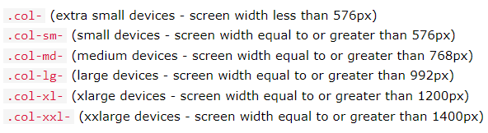
Grid Layout – Responsive classes
Bootstrap 5 has 6 tier grid system that includes xs, sm, md, lg, xl and xxl.

Slide 9
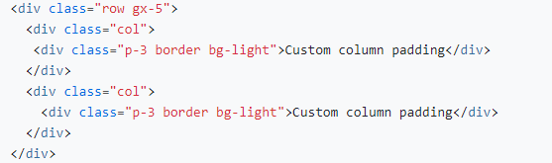
Grid Layout – Responsive gutter spacing
Gutters are the padding between your columns, used to responsively space and align content in the Bootstrap grid system
Gutters can be responsively adjusted. Use breakpoint-specific gutter classes to modify horizontal gutters, vertical gutters, and all gutters.
.gx-* classes can be used to control the horizontal gutter widths.
.gy-* classes can be used to control the vertical gutter widths.
.g-* classes can be used to control both horizontal and vertical gutter widths
EX : gx- {breakpoint} -*
gx-sm-2
gy-md-3
g-2

Slide 10
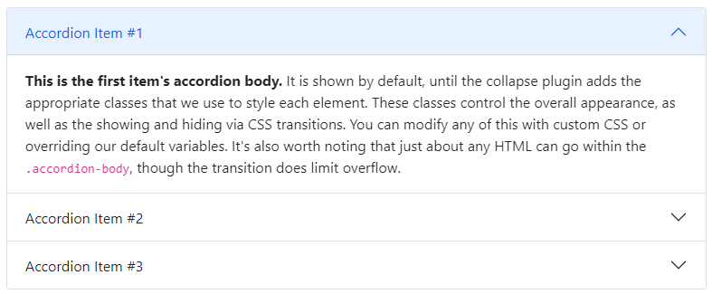
Accordion
Accordion is a vertically collapsing element to show and hide content via class changes.

Slide 11
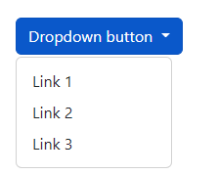
Dropdown
A dropdown menu is a toggleable menu that allows the user to choose one value from a predefined list:

Slide 12
Carousel
The carousel is a slideshow for cycling through a series of content, built with CSS 3D transforms and a bit of JavaScript. It works with a series of images, text, or custom markup. It also includes support for previous/next controls and indicators.

Slide 13
Modal
Modal Size
.modal-sm : Small modals (max-width 300px)
.modal-lg : Large modals (max-width 800px)
.modal-xl : Extra large modals (max-width 1140px)
EX : <div class="modal-dialog modal-sm">
Responsive Fullscreen Modal
.modal-fullscreen-sm/md/lg/xl/xxl-down - Responsive full screen modals
EX: <div class="modal-dialog modal-fullscreen-sm-down">

Slide 14
Modal
The Modal component is a dialog box/popup window that is displayed on top of the current page
Full screen modals : modal-dialog modal-fullscreen.
Scrolling long content : modal-dialog modal-dialog-scrollable
Vertically cantered : modal-dialog modal-dialog-centered

Slide 15

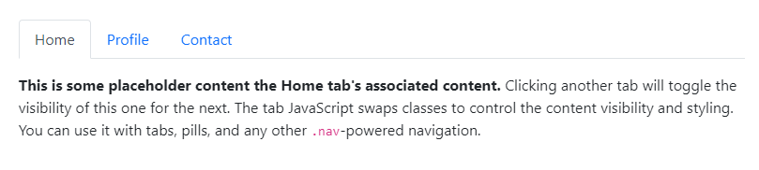
Navs and Tabs

Slide 16
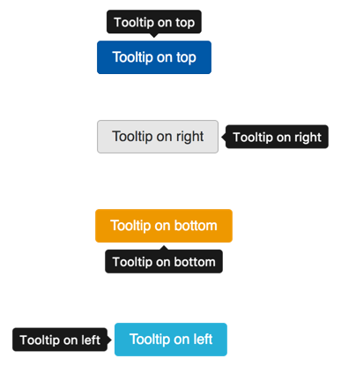
Tooltips
Bootstrap 3 & 4
<a href="#" data-toggle="tooltip" title=“Tooltip text"></a>
Bootstrap 5
<a href="#" data-bs-toggle="tooltip" title=“Tooltip text"></a>
Positioning Tooltip
data-bs-placement=“top”
data-bs-placement=“bottom”
data-bs-placement=“left”
data-bs-placement=“right”

Slide 17
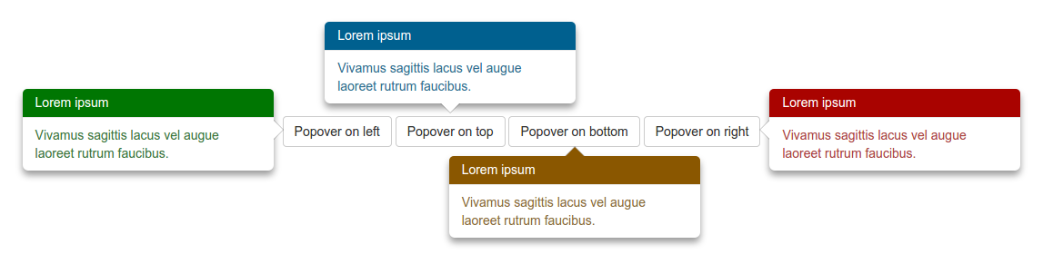
Popover
Bootstrap 5
<button type="button" class="btn btn-primary" data-bs-toggle="popover“
title="Popover Header" data-bs-content="Popover Body Content“
data-bs-placement="top" >Toggle popover</button>

Slide 18
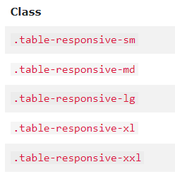
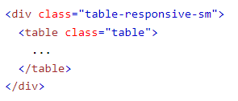
Table
The .table-responsive class creates a responsive table. should get a scrollbar, depending on 4 breakpoints (sm/md/lg/xl) .table-responsive-*

Slide 19
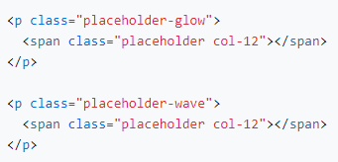


Placeholder and Spinner
Placeholder
placeholders indicate something may still be loading in the page
Spinner
To create a spinner/loader, use the .spinner-border class

Slide 20
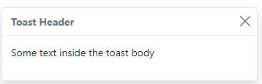
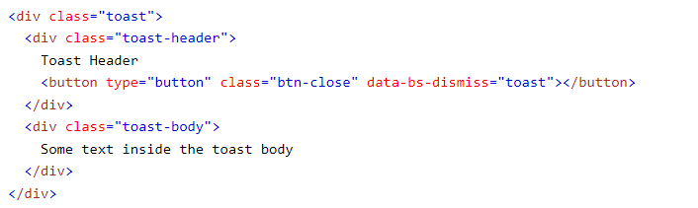
Toasts

Slide 21
Bootstrap utilities / helper classes
Responsive float
float-none
float-sm-start/end
float-md-start/end
float-lg-start/end
float-xl-start/end
float-xxl-start/end (Bootstrap 5)

Slide 22
Bootstrap utilities / helper classes
Responsive flex
d-flex
d- {breakpoint} -flex
d-inline-flex
d- {breakpoint} -inline-flex
flex-row : set a horizontal direction
flex-row-reverse
flex-column : set a vertical direction
flex-column-reverse
justify-content-start/end/center/between etc..
justify-content- {breakpoint} -start/end/center/between etc

Slide 23
Bootstrap utilities / helper classes
width
w-25 => width : 25%
w-50 => width : 50%
w-75 => width : 75%
w-100 => width : 100%
mw-100 : max-width :100%
mw-auto : max-width: auto
Height
h-25 => height : 25%
h-50 => height : 50%
h-75 => height : 75%
h-100 => height : 100%
mh-100 : max-height : 100%
mh-auto : max-height : auto

Slide 24
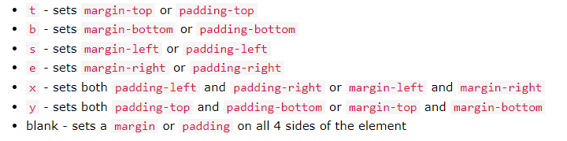
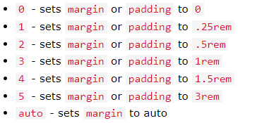
Margin and Padding utility classes
m-# / m-*-# (EX : m-1 / m-t-1 )
p-# / p-*-# (EX: p-1 / p-t-1 )
#
0 / 1 / 2 / 3 / 4 / 5 / auto
------------------------------------
*
s / e / t / b / x / y

Slide 25

Thank you

