Slide 1
Training presentation
Presented By
Anagha N

Slide 2
CONTENTS
JAVASCRIPT
TYPESCRIPT
BOOTSTRAP
MONGODB
VUE.JS
ASP.NET CORE
REVV DOMAIN

Slide 3
javascript
JavaScript is a high-level, interpreted programming language primarily used to create interactive and dynamic content on websites
What JavaScript Can Do:
Dynamically update HTML/CSS (DOM manipulation)
Validate forms before submitting
Create animations and sliders
Communicate with servers using AJAX or fetch
Power frontend frameworks like React, Vue, and Angular
Run on the server using Node.js

Slide 4

Functions and scope
Function Declaration
function add(a, b) { return a + b;}console.log(add(2, 3)); // Output: 5
01
Function Expression
02
const multiply = function(a, b) { return a * b;};console.log(multiply(4, 5)); // Output: 20
Arrow Functions
const divide = (a, b) => a / b;console.log
(divide(10, 2)); // Output: 5
03
Anonymous FunctionssetTimeout(function() { console.log("Executed after 1 second");}, 1000); // executed after 1 second(1000 means 1000 milliseconds = 1 second.
04

Slide 5



Scope in javascript
In JavaScript, scope defines the accessibility and visibility of variables, functions, and objects within different parts of your code. It determines where these elements can be accessed and modified.
Global Scope
Function Scope
Block Scope
D
Variables declared outside of any function or block reside in the global scope.
They are accessible from anywhere in the entire program, including within functions and blocks.
.
Variables declared inside a function (using var, let, or const) have function scope.
They are only accessible within that specific function and its nested functions.
Variables declared with let or const inside a block. This helps in creating more contained and predictable code, preventing unintended variable access outside their intended scope

Slide 6
Objects & Arrays
An object is a collection of key-value pairs where keys are strings (or Symbols) and values can be any type.
let person = {
name: "Alice",
age: 30,
isActive: true
};
An array is a list-like object used to store multiple values in a single variable.
let colors = ["red", "green", "blue"];
Common Methods:
push() / pop() → add/remove at end
shift() / unshift() → remove/add at start
slice() / splice() → extract/change content
forEach(), map(), filter(), reduce() → high-order functions

Slide 7
3.Object Destructuring
Extract values from arrays or objects into variables.
4.JavaScript Maps
A Map holds key-value pairs where the keys can be any datatype.
2.Arrow Functions
. Arrow functions allows a short syntax for writing function expressions.
5.JavaScript Sets
A JavaScript Set is a collection of unique values.
const set = new Set([1, 2, 2, 3]);
//set{1,2,3}
ES6
Features
1.Block Scope with let and const.
let and const introduced block-level scoping, replacing var for many use cases.
6.Array entries()
const fruits = ["Banana", "Orange", "Apple", "Mango"];
The entries() method returns an Array Iterator object with key/value pairs:

Slide 8
9. Array find () The find()
method returns the value of the first array element that passes a test function.
10. Array findIndex()
The findIndex() method returns the index of the first array element that passes a test function
8. Array keys
The keys() method returns an Array Iterator object with the keys of an array.
11.Array.every
Tests whether all elements in an array pass the provided function (predicate).
Returns true if every element passes the test; otherwise, returns false
ES6
Features
7. Array.from()
The Array.from() method returns an Array object from any object with a length property or any iterable object.
.
12.Array some()
Tests whether at least one element in an array passes the provided function (predicate). Returns true if any element passes the test; otherwise, returns false.

Slide 9
typescript
TypeScript is a superset of JavaScript designed to add static typing and other features that enhance JavaScript for larger, more complex projects.
npm install -g typescript
Write Code in .ts Files: Create a TypeScript file (e.g., example.ts).
Compile to JavaScript:
tsc example.ts
Advantages of TypeScript
Better Code Quality: Type checking catches many bugs before runtime.
Improved Collaboration: Explicit types make the code easier for teams to understand.
Easier Refactoring: Tooling helps prevent errors during code changes.
Optional Types: Developers can opt-in to static typing as needed.

Slide 10



Union Types
A union type allows a value to be one of several types. It's useful when a variable could hold different types of values.
Union Types
Advanced Typescript Features
Intersection Types
An intersection type combines multiple types into one. It represents a type that satisfies all the combined types.
Mapped Types
Mapped types transform existing types into new ones. You can apply transformations to all properties of a type

Slide 11
Conditional Types
Conditional types enable type logic, where the type is determined based on a condition
Eg: type IsString<T> = T extends string ? "Yes" : "No"; type Test1 = IsString<string>; // "Yes"type Test2 = IsString<number>; // "No"
Union Types
Advanced Typescript Features
Advanced Generics
Generics allow creating reusable and flexible type-safe code
Generic Functions
Generic Constraints
Literal Types
Literal types let you specify exact values a variable can have, restricting it to predefined options.
Eg: type Direction = "up" | "down" | "left" | "right“
function move(direction: Direction): void {
Move(“up”); // valid

Slide 12





Object-Oriented Typescript
01
Stages of Skill Development
Classes
A class is a blueprint for creating objects, providing initial values for state (fields) and implementations of behavior (methods).
Stages of Skill Development
02
Interfaces
Interfaces define the structure of an object, ensuring that objects adhere to a specific shape.
03
Inheritance
Classes can extend other classes to inherit properties and methods.
04
Access Modifiers
Access modifiers control the visibility of class members.
public: Accessible everywhere (default).
private: Accessible only within the class.
protected: Accessible within the class and its subclasses.

Slide 13
Object-Oriented Typescript
05
Stages of Skill Development
Abstract Classes
Abstract classes define a base class that cannot be instantiated and must be extended.
Stages of Skill Development
06
Static Members
Static members belong to the class, not an instance.
07
Encapsulation
Classes can extend other classes to inherit properties and methods.
08
Polymorphism
Polymorphism allows methods to behave differently based on the object calling them.

Slide 14
TypeScript & JavaScript Interoperability Table
Feature / Scenario | JavaScript in TypeScript | TypeScript in JavaScript
✅ Basic Compatibility | JS code is valid in TS without modification | TS must be compiled to JS before use
🧠 Type Inference | TypeScript infers types, but default is any | No type safety in JS
✍️ Type Declarations (.d.ts) | Can add .d.ts files for better type support | Not used in JS but can enhance TS consumption
📦 Module Support | Use import or require() to pull JS into TS | Use compiled .js files from TS exports
🔄 Common Use Case | Gradual TS migration of existing JS code | Using TS logic in JS environments
🛠 Tools Required | None extra (works in TS compiler) | TypeScript compiler (tsc) needed to generate .js
🌍 Real-World Scenario | Using JS libraries in a TS app | Calling compiled TS utils in Node.js

Slide 15
BOOTSTRAP
01
Popular open-source front-end framework by Twitter
02
Includes HTML, CSS, and JS components
03
Designed for mobile-first, responsive design
04
Faster development with prebuilt styles.
05
Combine Bootstrap utilities with custom CSS for unique branding

Slide 16
MongoDB
MongoDB is a popular NoSQL database used for storing and managing data in applications.
It's a document database, meaning it stores data in flexible, JSON-like documents.
{
"_id": "12345",
"name": "John Doe",
"age": 30,
"skills": ["Java", "MongoDB", "Python"],
"address": {
"city": "New York",
"zipcode": "10001"
}
}
Basic Query Operations – insertOne() , insertMany(),find() , updateOne( ), updateMany( ), replaceOne( ), deleteOne , deleteMany ,

Slide 17
MONGODB AGGREGATIONS
$match
Filters documents based on conditions.
{ "$match": { "city": "calicut" } }
$group
Groups documents by a field and performs aggregation operations like $sum, $avg, $max, etc. "$group": { "_id": "$city", "count": { "$sum": 1 }}
$project
Selects specific fields to include in the result, and can also create new fields.
{ "$project": { "name": 1, "age": 1 }
$limit
Limits the number of documents returned.
{ "$limit": 2 }
$Skip
skip a specified number of documents. { "$skip": 5 }-- This skips the first 5 documents in the dataset.

Slide 18
Backup in MongoDB
Mongodump and Mongorestore
Custom Backup Scripts
MongoDB Atlas Backups
Ops Manager/Cloud Manager
Use mongodump to export data to BSON files.
Specify database or collections to back up.
Use custom scripts to automate mongodump, mongorestore, or file system snapshots.
.
Configure backups in the Atlas UI.
Choose a backup schedule (e.g., daily, weekly).
Use the restore feature in the UI or API to recover data.
Install and configure Ops Manager or Cloud Manager.
Set up backup jobs with desired schedules and retention policies.
Monitor backups and perform restores as needed.

Slide 19
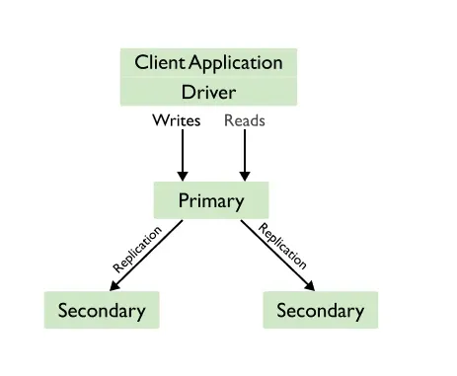
Replication
Replication is the process of duplicating data across multiple servers to ensure high availability, fault tolerance, and data redundancy.
Where is Replication Used?
In production systems to prevent downtime
In read-heavy applications (read from secondaries)
In backup strategies (pull backups from secondaries)
When to Use Replication?
When your application needs high availability
When you want zero-downtime maintenance
When you must scale reads
When your data is critical

Slide 20
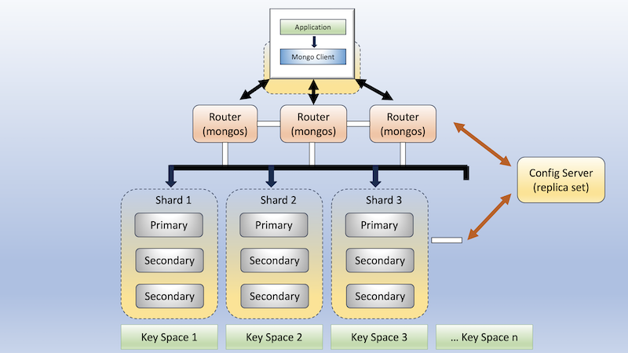
sharding
Sharding is the process of distributing data across multiple servers (shards) to handle large datasets and high-throughput operations.

Slide 21
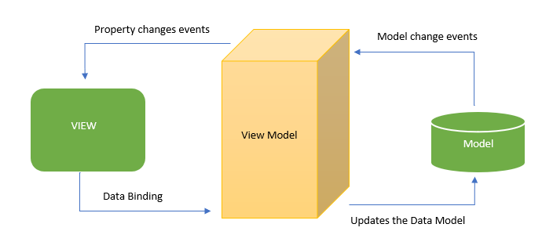
Vue.js
Vue.js is a progressive JavaScript framework for building user interfaces.
Reactive Data Binding – Automatically updates the DOM when data changes.
Component-Based Architecture – Reusable and modular components.
Directives – Built-in directives like v-if, v-for, v-bind, v-model.

Slide 22
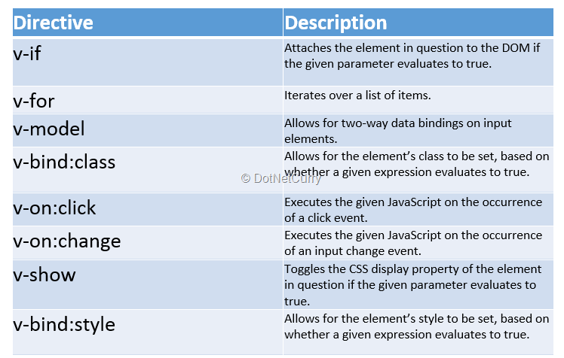
Vue-directives

Slide 23
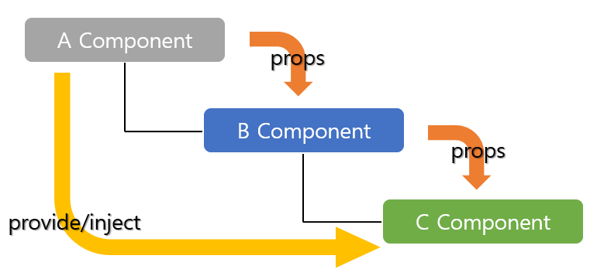
Provide and inject
Provide and inject are used to share data between a parent and its descendants, skipping intermediate components
provide makes a value available to all descendant components.
inject is used by child (or grandchild, etc.) components to access that value.

Slide 24
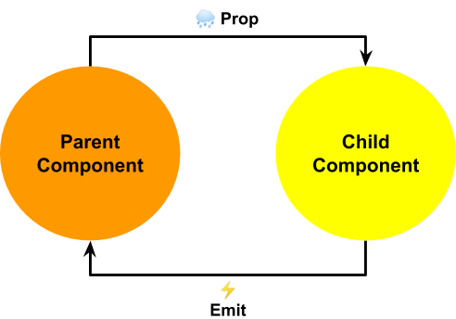
Props and emits
Props are one way parent-> child
To update prop value , the child emits an event
and the parent update the value.

Slide 25
Slots
slots are a powerful feature that allow you to inject content into a component from the outside, providing flexible component composition
Default Slot
Named Slots
Scoped Slots
Used when you want multiple content sections in a component.
Used when the child component passes data back to the parent via slot.
Used when you have only one slot or unnamed content.

Slide 26



Vue advanced topics
Vee-Validate
Vue-Router
Unit Testing
Validate forms declaratively or programmatically.
Integrate with form libraries and custom components.
Use built-in or custom validation rules.
Easily integrate with Composition API or <script setup>.
Official routing library for Vue.js.
Enables Single Page Applications (SPA) with navigation without page reloads.
Provides dynamic routing, nested routes, and navigation guards.
Testing individual components or functions in isolation.
Ensures components work as expected and reduces bugs.

Slide 27
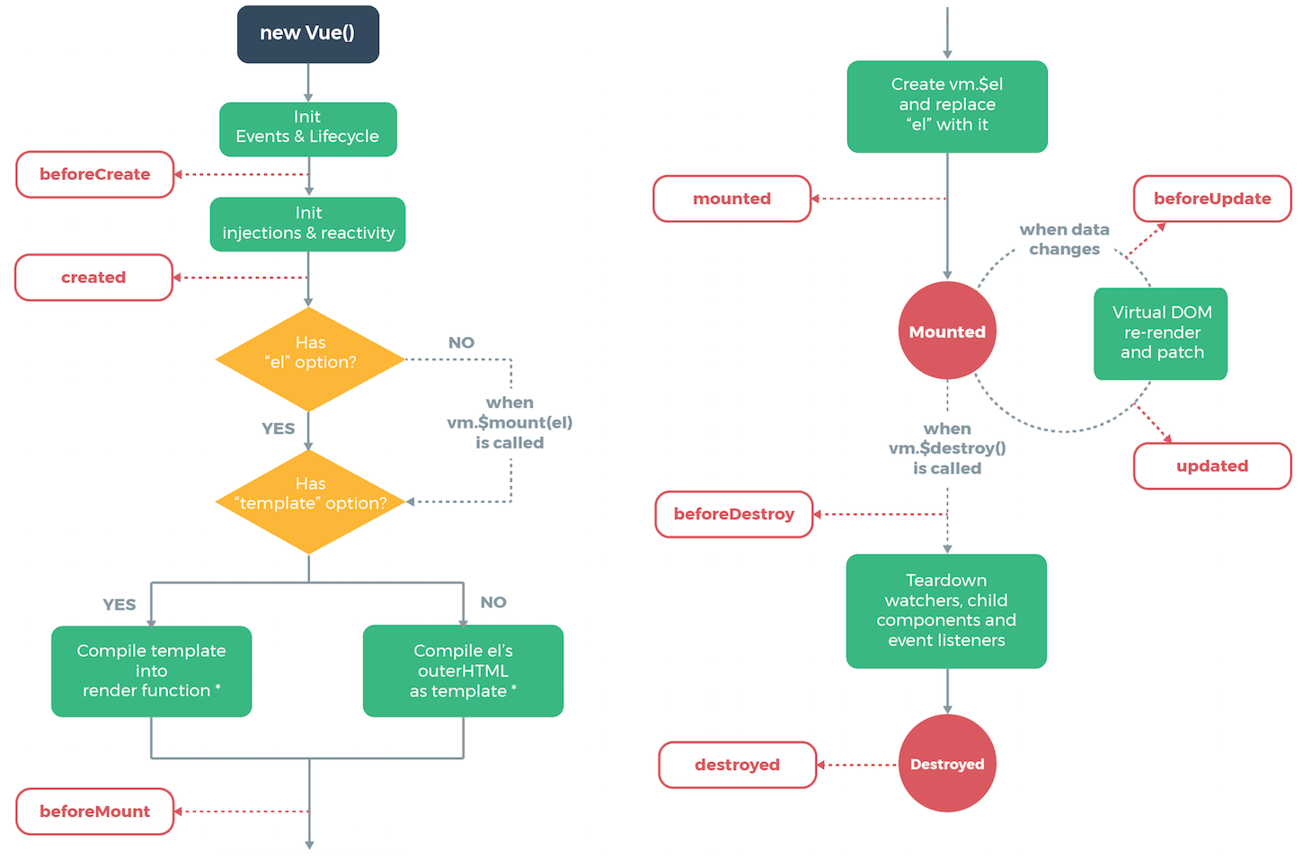
Lifecycle hooks

Slide 28
Asp.net
ASP.NET Core is a modern, open-source, cross-platform framework by Microsoft.
developers to build dynamic websites, web applications, and web services.
supports multiple programming languages such as C#, VB.NET, and F#.
Performance: High-speed processing with caching and optimization
Security: Built-in authentication, authorization, and HTTPS support

Slide 29
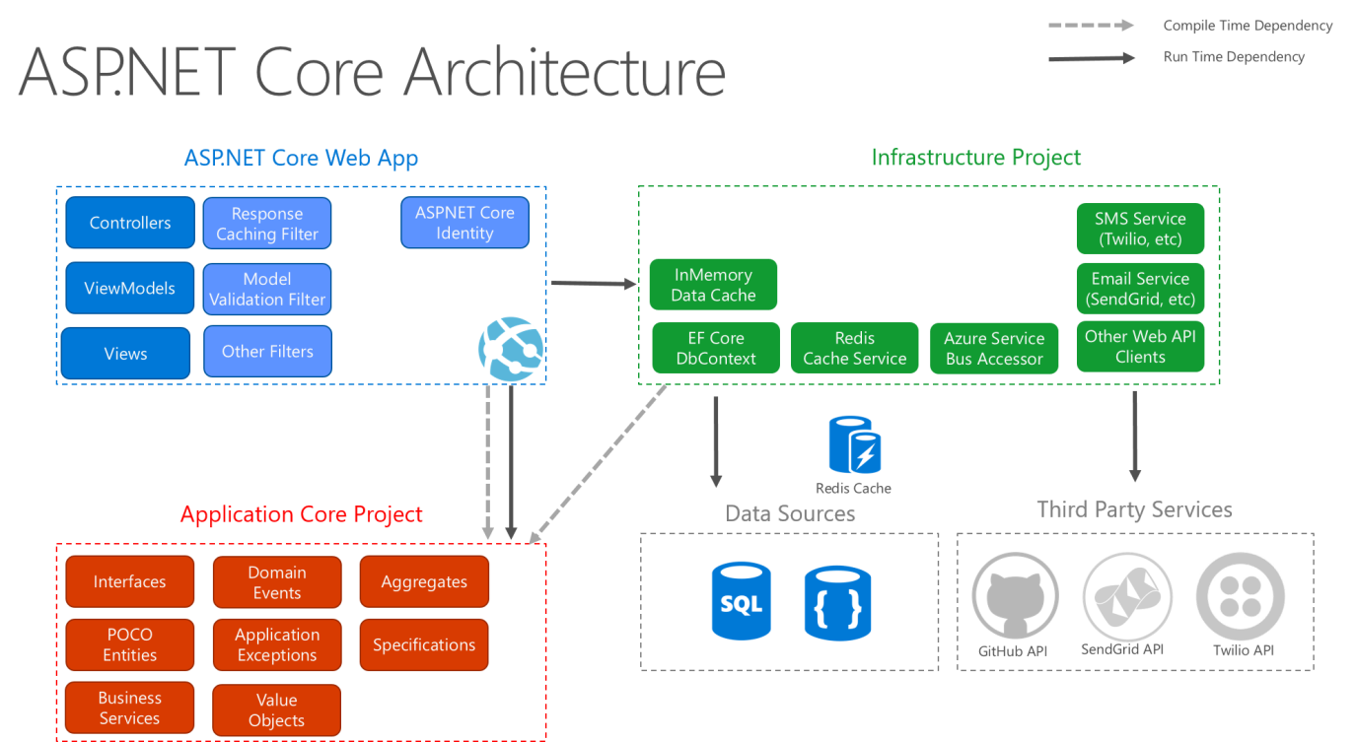

Slide 30
Asp.net core
Project Structure
Program.cs → Entry point with minimal hosting model
Startup.cs (optional in .NET 5 or earlier) → Configures services & middleware
Controllers → Handle requests
Views → Razor files for UI
Models → Data and business logic
ASP.NET MVC Pattern
Model → Data & Business Logic
View → UI / Presentation Layer
Controller → Handles user requests & responses

Slide 31
Dependency injection and ioc
Dependency Injection is a design pattern that implements Inversion of Control by providing dependencies to objects from the outside, instead of letting objects create them internally.
- constructor injection
- method injection
- setter injection
Singleton-One instance for the entire app :Logging, config providers, caching utilities.
Transient-- New instance every time it’s requested : Lightweight, stateless services.
Scoped - One instance per HTTP request : Business logic, services working with DB context.

Slide 32
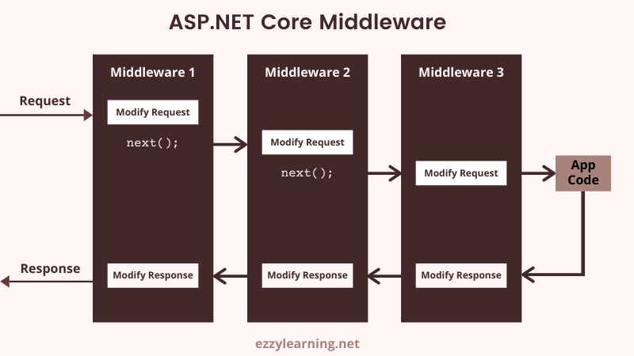
middleware

Slide 33
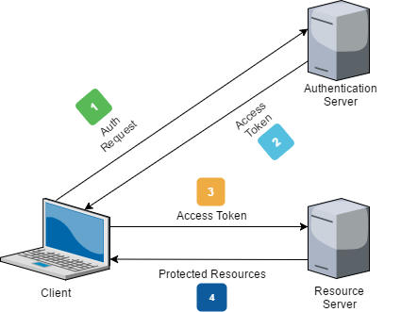
JWT
A JWT (JSON Web Token) is a compact, URL-safe, and self-contained token used to securely transmit identity and claims between parties. It’s an open standard (RFC 7519) used for authentication and authorization in modern applications.

Slide 34
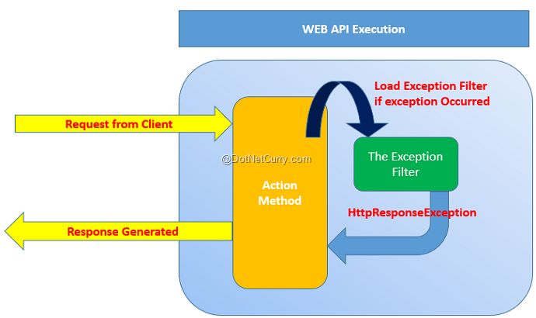
Exception handling
Exception handling is the structured approach to detect, catch, and handle these exceptions, ensuring the program can recover or fail gracefully.

Slide 35
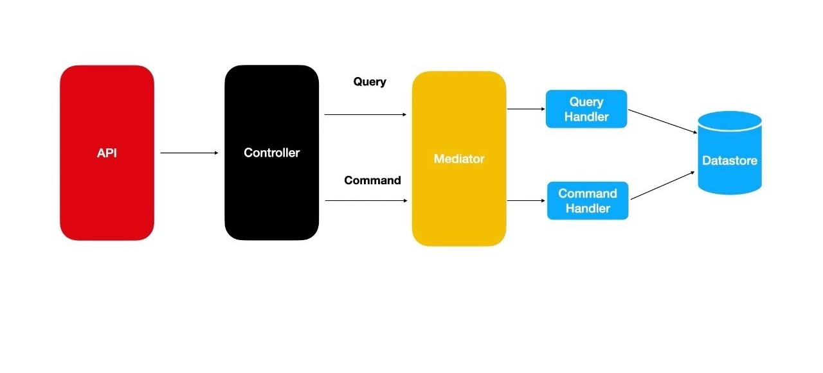
Cqrs design pattern
CQRS is a design pattern that separates read (queries) and write (commands) operations in a system.
Improves scalability, maintainability, and performance by handling reads and writes differently.

Slide 36
API (Red) → Entry point where HTTP requests arrive
Controller (Black) → Receives requests and decides if it's a Query (read) or Command (write)
Mediator (Yellow) → A middle layer that dispatches requests to the appropriate handler
Query Handler (Blue) → Handles read-only operations (e.g., fetching data from the datastore)
Command Handler (Blue) → Handles write operations (create, update, delete)
Datastore (Cyan) → The database or storage system
Flow Example
Query:
API → Controller → Mediator → Query Handler → Database (returns data)
Command:
API → Controller → Mediator → Command Handler → Database (updates/inserts/deletes data)

Slide 37
Mediator Pattern
The Mediator pattern is a behavioral design pattern that removes direct dependencies between objects by introducing a mediator object that handles the communication.
In .NET, commonly implemented using the MediatR library.
Without Mediator: Controller directly calls services or repositories, leading to tight coupling.
With Mediator: Controller sends a request object (Command/Query) to Mediator, which internally finds and executes the correct handler.
MediatR- This is the main MediatR package:
Contains full functionality: IRequest, INotification, dispatching, IMediator, ISender, IPublisher, pipeline behaviors, and dependency injection support.
MediatR.Contracts-This is the contracts-only package:
Contains only the definitions for IRequest<T>, INotification, IStreamRequest, and related contracts.

Slide 38
Onion architecture
Onion Architecture is a software architectural pattern that focuses on maintainability, testability, and separation of concerns.
To achieve loose coupling and strong separation of concerns.
Core Idea: Code is structured into concentric layers, where:
The core (center) contains business logic and domain entities.
The outer layers handle infrastructure and UI concerns.
Dependency Rule:
Inner layers never depend on outer layers.
Dependencies always point inward.
Easy to replace UI or database
Core logic independent of frameworks

Slide 39
Application
Domain Service
Domain
Shared

Slide 40
Layer | Contents | Responsibility
Application | Web API Controllers, MediatR Handlers (Commands & Queries), DTOs, Repository Interfaces | Handles API endpoints, orchestrates calls to services and domain logic
Domain Services | Interfaces, Service Logic (Use Cases), MediatR Handler | Implements business rules, coordinates actions, enforces business invariants
Domain | Entities / Models, Value Objects, Aggregates, Domain Events | Core business logic and rules with no external dependencies
Shared | Common Models, Utilities, Shared Contracts / Interfaces, Cross-cutting Concerns | Provides reusable components (logging, constants) shared across layers

Slide 41
REVV
Revv AI acts as an intermediary platform connecting car leasing companies, rental companies, banks, and corporate sellers with established car auction platforms such as IAAI and Manheim. The system facilitates the seamless listing, auctioning, and tracking of vehicle stock.
Team

Slide 42
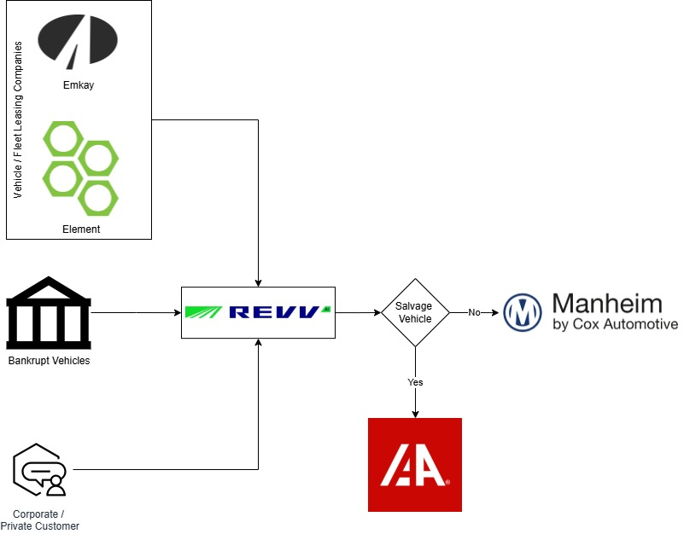
ARCHITECURE

Slide 43
Application Functionalities
User Management-Users can be created with role-specific permissions, ensuring data security and controlled access.
Create User and manage user.
Stock Management- Adding, editing, and tracking stock.
Users can add and manage stock, including:
Vehicle Details: Year, Make, Model, Color, Mileage.
Condition Assessment: , damage comments.
Auction Assignment: Set floor price, choose auction house.
Dashboard & Reporting: Real-time stock status and financial summaries.

Slide 44
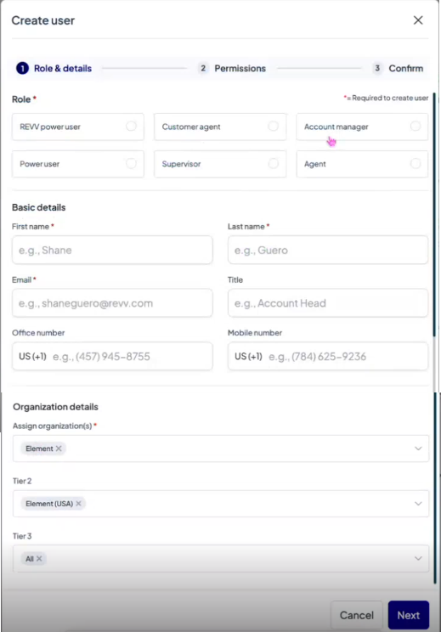
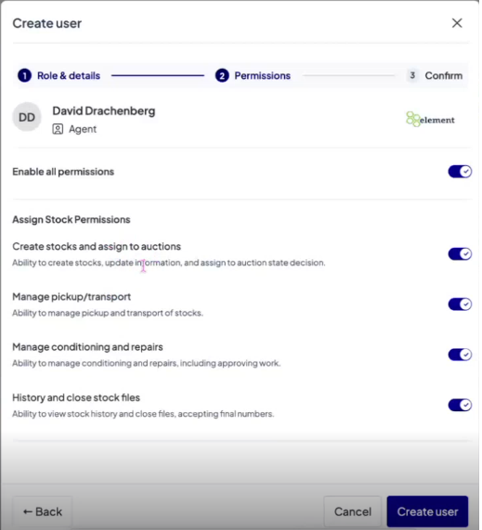
User management
Create user
Manage user

Slide 45
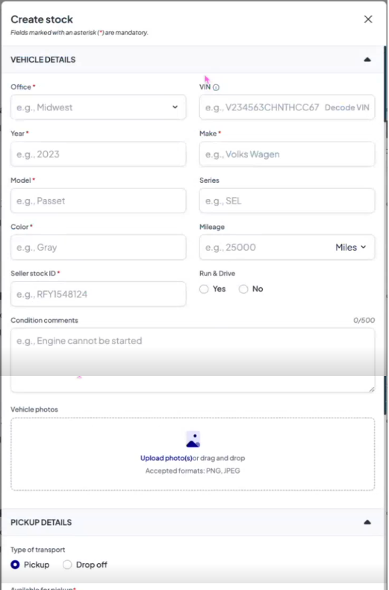
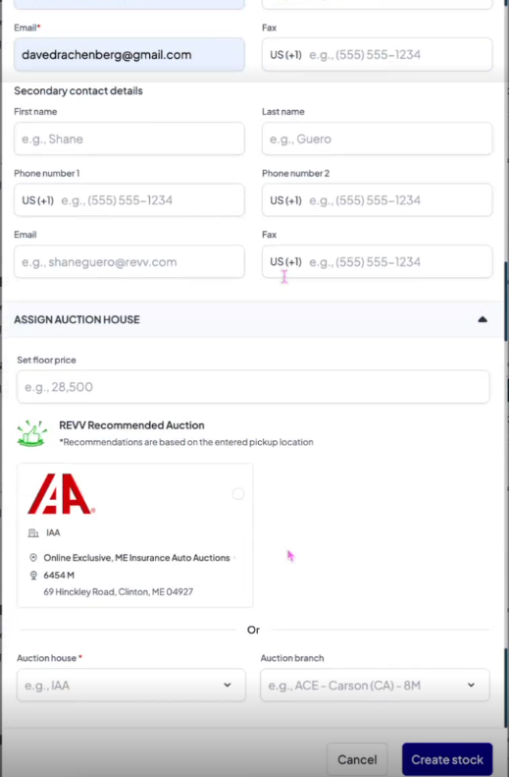
Stock management

Slide 46
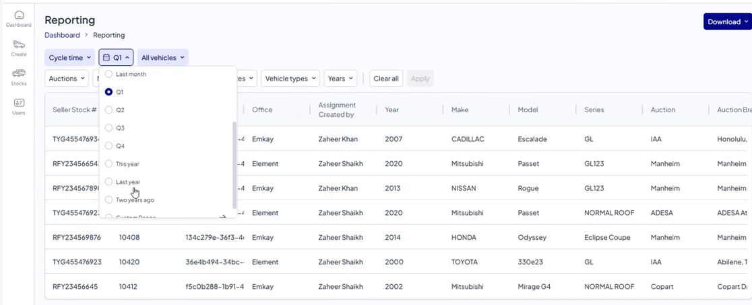
Reporting

Slide 47
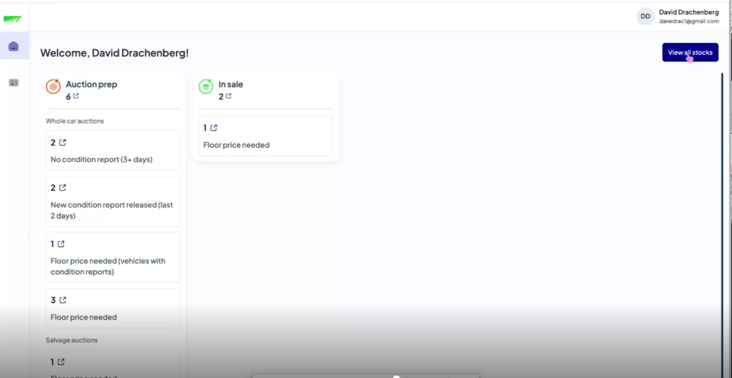
Dashboard

Slide 48
Thank you!

