Slide 1
PANDA challenge
Prostate cancer Gleason score detection from pathology images with a focus on interpretability, reproducibility, confidence metrics and pathologist decision support

Slide 2
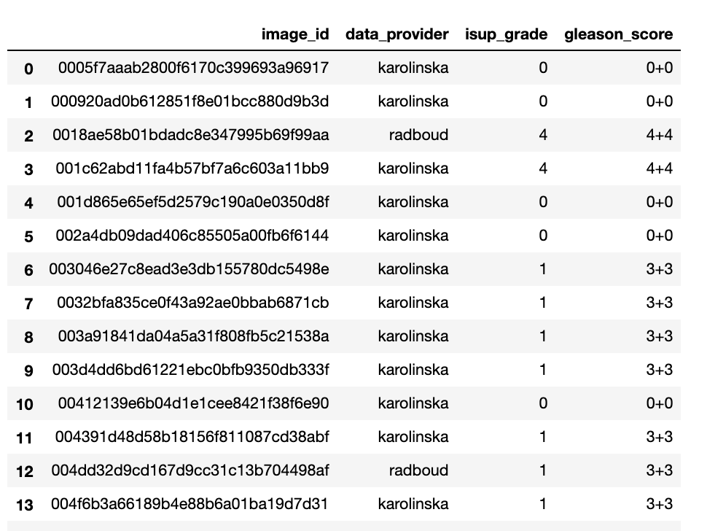
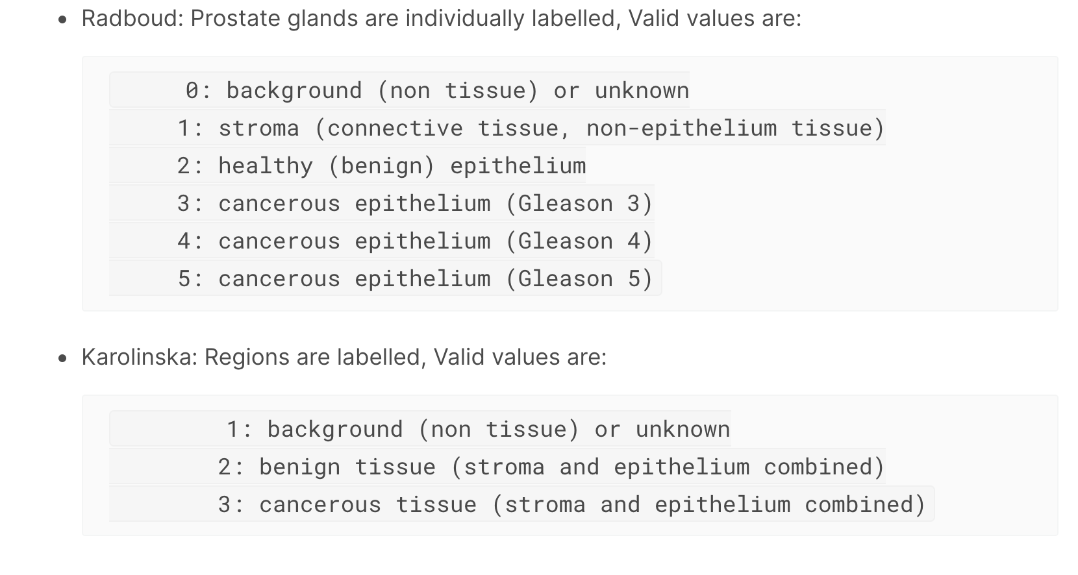
Data
Image and Gleason Score information
Mask labelling information
Training Data
Images with file name (image_id)
Masks for each image with the labelling
ISUP grade in a spreadsheet
Gleason Score in a spreadsheet
Consider only the Radboud images due to higher information content.

Slide 3
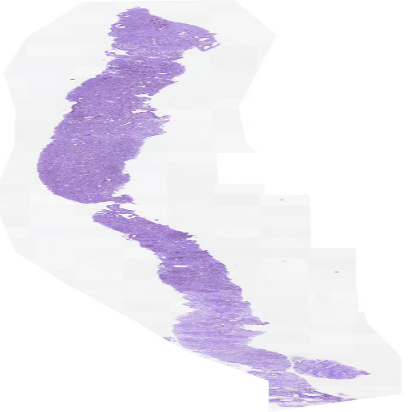
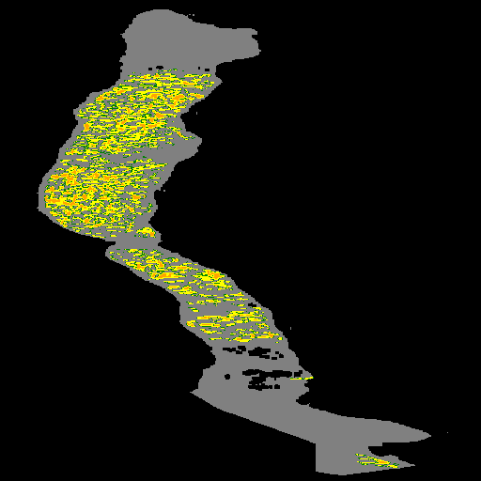
Image and Mask Examples

Slide 4
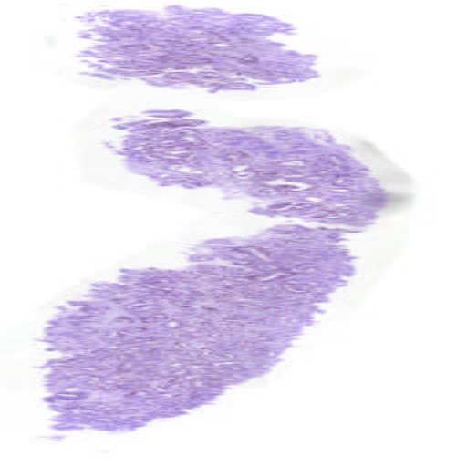
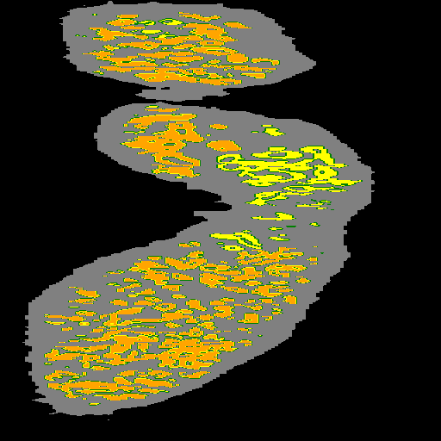
Image and Mask Examples (2)

Slide 5
ML Model pipeline and output
Training Data
Images with file name (image_id)
Masks for each image with the labelling
ISUP grade
Gleason Score
Semantic Segmentation ML model 1 to generate masks
Predict the mask information from image using ML semantic segmentation algorithm
Use EfficientNet + Unet in Keras / Tensorflow
Metric Generation
Generate ISAP score from Gleason score with table lookup
Generate confidence using confidence calculation (see next slide)
Generation involvement metrics (next slide)
Overlay mask on image for interpretability
Image Classification ML model 2
Use CNN model with a 2-output softmax classifier on mask data as input
Learn both Gleason scores separately with the two outputs

Slide 6
Confidence / Decision Support Algorithm
Select Radboud images for our study due to more fine grain detail
Confidence algorithm
Find number of pixels of 1, 2,3, 4, 5 labels
For an ISAP Grade 2 (Gleason 3+4) or Grade 3 (Gleason 4+3) cancer
Important to Quantify the absolute # of 4 and # to 3 (%age of Gleason 4)
Percentage involvement = ((#3 + #4 + #5) / (#1 + #2 + #3 + #4 + #5))
#3 to #4 ratio = # 3 / #4
For Gleason Scores (5+4 vs 4+5)
Find the absolute # of 4 vs the # of 5
Percentage involvement = ((#4 + #5) / (#1 + #2 + #3 + #4 + #5))
For ISAP Grade 1 (Gleason score 3+3)
Total core area of healthy = #2 / (#2 + #3 + #4 + #5)
Percentage involvement = ((#3 + #4 + #5) / (#1 + #2 + #3 + #4 + #5))

Slide 7
Decision Support Algorithm Pseudo-code
Saving Trained Keras Model from Segmentation model
Segmentation_model = train_segmentation_model();
Segmentation_model.save(”/path/to/segmentation_model”)
Saving Trained Keras Model from Gleason Prediction model
Gleason_model = train_prediction_model()
Gleason_model.save(“/path/to/gleason_prediction_model”)
Example of Loading Keras Model to make predictions
from tensorflow import keras;
seg_model = keras.models.load_model(“/path/to/segmentation_model”)
foreach image, actual_mask in test_set:
test_input = get_array(image)
predicted_array = seg_model.predict(test_input)
actual_array = get_array(actual_mask)
IOU = compare(actual_array, predicted_array)
Confidence Algorithm from predicted mask
# Get predicted Gleason and mask
predicted_gleason = Gleason_model.predict(test_image)
predicted_mask = Segmentation_model.predict(test_image)
# Counts of pixel types are stored in array
# 0: background, 1: stroma, 2: healthy, 3,4,5: cancerous
count_pixeltype_array = compute_counts(predicted_mask)
# Decision support Algorithm
if predicted_gleason is in [“3+4”, “4+3”]:
percent_involvement = (sum(count_pixeltype_array[3:5])
/ sum(count_pixeltype_array[1:5])) * 100
ratio_3_4 = count_pixeltype_array[3]/count_pixeltype_array[4]
else if predicted_gleason is in [“4+5”, “5+4”]:
percent_involvement = (sum(count_pixeltype_array[4:5])
/ sum(count_pixeltype_array[1:5])) * 100
else if predicted_gleason is in [“3+3”]:
percent_involvement = (sum(count_pixeltype_array[3:5])
/ sum(count_pixeltype_array[1:5])) * 100
healthy_core_area = (count_pixeltype_array[2]
/ sum(count_pixeltype_array[2:5])) * 100
Example Results of overall program
Predicted masks, original image and overlay
Predicted Gleason and ISAP score = “3+3”
3. Decision Support Metrics
Percentage Involvement = 33% [High]
Healthy Core Area = 67%
Ratio_Gleason3_Gleason4 = 1.4
Mask Prediction confidence bounds [84%]
Gleason Prediction confidence bounds [77%]

Slide 8
Multi-class segmentation model pseudocode
Key Libraries
Keras, tensorflow, opencv, albumentations, numpy, pandas, matplotlib, segmentation_models.Unet, efficientnet
Reading pre-processed images
x_train_dir = os.path.join(DATA_DIR, 'train')
y_train_dir = os.path.join(DATA_DIR, 'trainannot’)
# read data on demand for each image
image = cv2.imread(self.images_fps[i])
mask = cv2.imread(self.masks_fps[i], 0)
# extract certain classes from mask (e.g. background)
masks = [(mask == v) for v in self.class_values]
Model parameters
Learning Rate = 0.01,
Number of epochs = 10, 15, 20,
Batch_size = 8,
Optimizer = Adam,
loss optimization = Dice loss
Training Multiclass segmentation Model
# Setup model parameters
import segmentation_models as sm
CLASSES = ['background', 'stroma', 'healthy', 'gleason3', 'gleason4', 'gleason5’]
BACKBONE = ‘efficientnetB7’
model = sm.Unet(BACKBONE, classes=n_len(CLASSES), activation=‘softmax’)
# Compile keras model and train it.
model.compile(keras.optimizers.Adam(LR),
sm.losses.binary_focal_dice_loss,
sm.metrics.IOUScore())
history = model.fit(
train_dataloader,
steps_per_epoch=len(train_dataloader),
epochs=EPOCHS,
callbacks=callbacks,
validation_data=valid_dataloader,
validation_steps=len(valid_dataloader),
)
Model Evaluation
test_dataset = Dataset(x_test_dir, y_test_dir, classes=CLASSES)
test_dataloader = Dataloader(test_dataset, batch_size=1, shuffle=False)
# load best weights (from the training epoch)
model.load_weights('best_model.h5’)
scores = model.evaluate(test_dataloader)
print("Loss: {:.5}".format(scores[0]))
for metric, value in zip(metrics, scores[1:]):
print("mean {}: {:.5}".format(metric.__name__, value))
Training Epoch logs (on Google GPU)
45/45 [==============================] - 40s 887ms/step - loss: 0.1513 –
iou_score: 0.8887
f1-score: 0.9626
val_loss: 0.1709
val_iou_score: 0.8468
val_f1-score: 0.9247

Slide 9
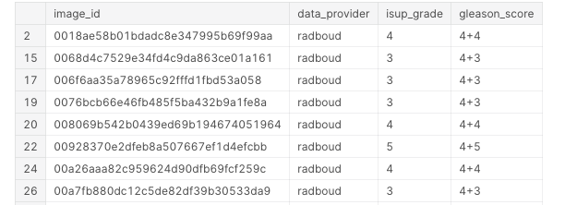
Gleason Prediction model pseudocode
Key Libraries
Keras, tensorflow, opencv, albumentations, numpy, pandas, matplotlib, segmentation_models.Unet, efficientnet.tfkeras
Reading pre-processed images
train_paths= os.path.join(DATA_DIR, 'train')
train_labels = pd.get_dummies(train['isup_grade']).astype('int32').values
train_dataset = (tf.data.Dataset
.from_tensor_slices((train_paths, train_labels))
.map(decode_image, num_parallel_calls=AUTO))
def decode_image(filename, label=None, image_size=(img_size, img_size)):
# read image from file and return numpy array
Model parameters
Learning Rate = 0.001,
Number of epochs = 10, 15, 20,
Batch_size = 8,
Optimizer = Adam,
loss optimization = Categorical cross-entropy
activation = softmax
Training an EfficientNet-based prediction Model
# Setup model parameters
CLASSES = ['background', 'stroma', 'healthy', 'gleason3', 'gleason4', 'gleason5’]
# Create model
def get_model( ):
base_model = efn.EfficientNetB7(weights='imagenet’,
pooling='avg’, input_shape=input_shape)
# Predict gleason score, with softmax activation.
predictions = Dense(len(CLASSES),
activation="softmax")(base_model.output)
return Model(inputs=base_model.input, outputs=predictions)
# Compile keras model and train it.
model = get_model()
model.compile(optimizer='adam', loss='categorical_crossentropy',metrics=['accuracy', tf.keras.metrics.Recall()])
history = model.fit(
train_dataset, validation_data = valid_dataset, steps_per_epoch=train_labels.shape[0] // BATCH_SIZE, validation_steps=valid_labels.shape[0] // BATCH_SIZE, callbacks=[lr_callback], epochs=EPOCHS )
Dataset with ISAP and Gleason score
Training Epoch logs (on Google TPU)
Epoch 00014: LearningRate 0.001.
Epoch 14/15
66/66 [==============================] - 91s 1s/step
accuracy: 0.9808
loss: 0.0650
recall: 0.9794
val_accuracy: 0.7917
val_loss: 0.9449
val_recall: 0.7878
lr: 0.01

Slide 10
Backup

Slide 11
Process
Train
Train Algo to learn the MASK levels per pixel and the 2 Gleason scores
Test
From the slide, learn the mask -> compute the # of pixels of each type.
Display
Show the mask
This gives the %age involvement, and confidence metrics (for 3+4 vs 4+3 and 4+5 / 5+4 etc.,)
Show the Gleason scores and ISAP grade
Show the confidence and involvement metrics

Slide 12
2 solution possibilities
Learn both the mask and the Gleason score with the same ML algorithm
Learn the mask first in one algorithm and use this as input in the second algorithm to learn gleason score. This is preferable because
This mimics how human experts would approach it and
the masks have only values 0-5 vs the original image has 0-255 for each pixel, so the learning problem is easier if you use the mask as input vs full image as input
The mask learning uses a dice loss vs the gleason classification uses categorical_crossentropy, and there doesn’t seem to be an easy way to combine both loss types in the same problem.
Note that the confidence and %age involvement can be calculated from the mask (by a ‘counting of pixels of different types’ procedure, not a machine learning procedure)

