Slide 1
THE AVOCADO DATASET
SHARANYA VENKAT
AISHWARYA M A RAMANATH
ANAGHA ANANTH
PES1201700218
PES1201700872
PES1201700301

Slide 2
WHAT IS OUR DATA ABOUT?
Starting in 2013, the table reflects an expanded, multi-outlet retail data set.
The Average Price (of avocados) in the table reflects a per unit (per avocado) cost, even when multiple units (avocados) are sold in bags.

Slide 3
TYPE conventional or organic
DATE
The date of the observation
AVERAGE PRICE
The average price of a single avocado
REGION
The city or region of the observation
TOTAL VOLUME
Total number of avocados sold
4046/4225/4770
Total number of avocados with this PLU sold

Slide 4
WHAT WE DID WITH OUR DATA
DATA CLEANING
DATA VISUALIZATION
CORRELATION
HYPOTHESIS TESTING

Slide 5
DATA CLEANING
The process of detecting and correcting corrupt or inaccurate records from a record set, table, or database; identifying incomplete, incorrect, inaccurate or irrelevant parts of the data and then replacing, modifying, or deleting the dirty or coarse data.
Using Python, we replaced the missing values of our categorical data with the values of the previous rows in the dataset, and for our numerical data, we replaced it with mean.

Slide 6
BEFORE
AFTER
NUMERICAL DATA

Slide 7
CATEGORICAL DATA
BEFORE
AFTER

Slide 8
DATA VISUALIZATION
Data visualization is the graphical representation of information and data.
By using visual elements like charts, graphs, and maps, data visualization tools provide an accessible way to see and understand trends, outliers, and patterns in data.
We have visualised the avocado dataset in the form of pie charts, bar graphs, line graphs , boxplots
and scatter plots.

Slide 9

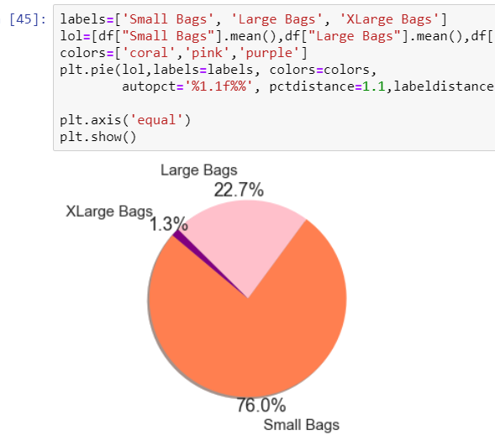
PIE CHART
This pie chart shows us the percentage of small bags, large bags and xlarge bags used during the purchase of avocados. 76% of the total bags are small bags and so the ratio of small, large and xlarge bags is 0.76:0.23:0.01.

Slide 10
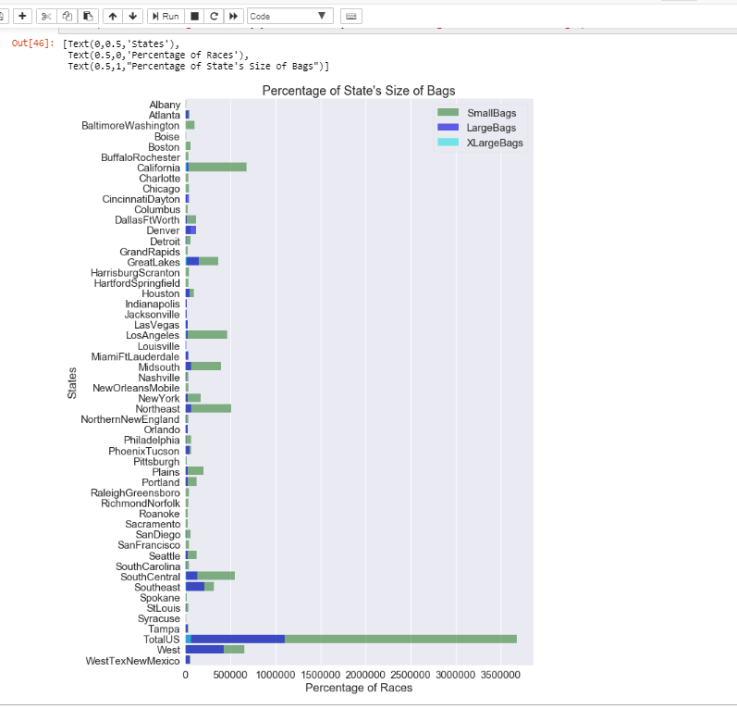

Slide 11
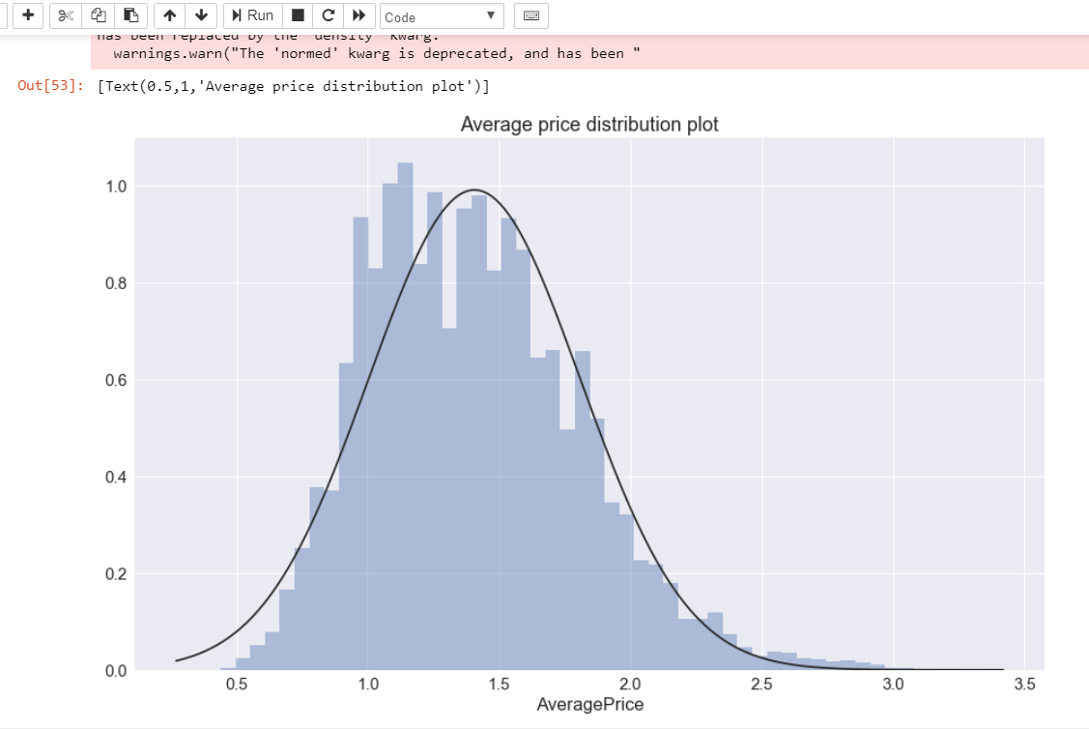
APPROXIMATELY NORMALLY DISTRIBUTED [SLIGHTLY RIGHT SKEWED]

Slide 12
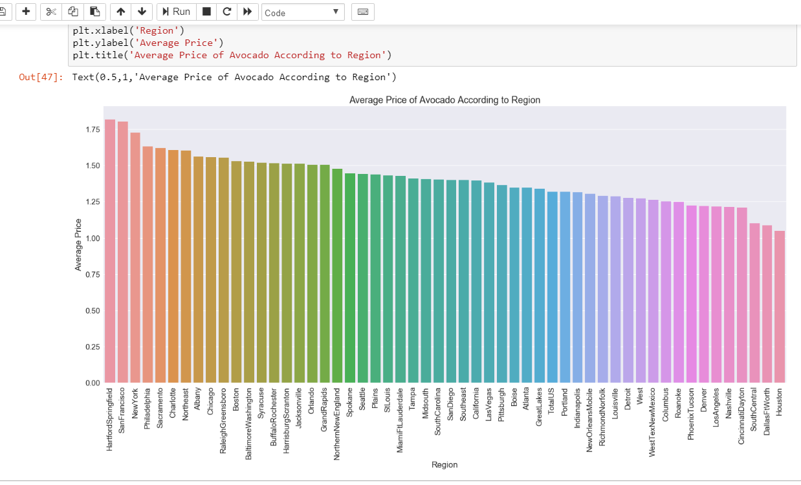
APPROXIMATELY SAME AVERAGE PRICE IN ALL REGIONS[VERY SLIGHT VARIATION]

Slide 13
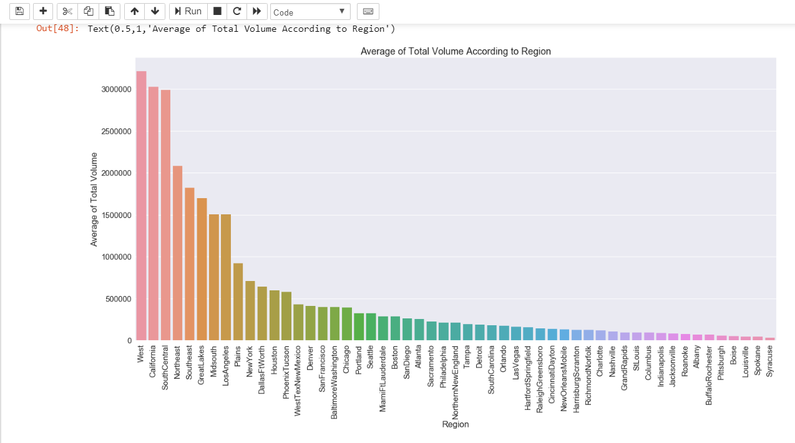

Slide 14
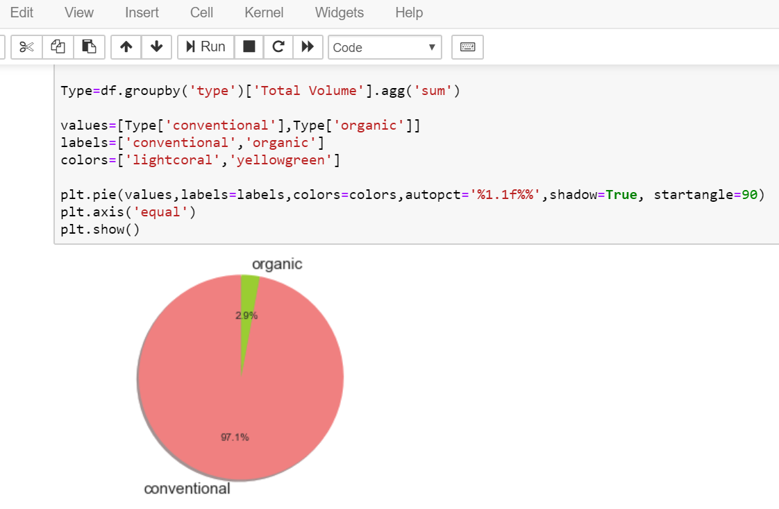
When compared to organic avocados, conventional avocados are more highly demanded.

Slide 15
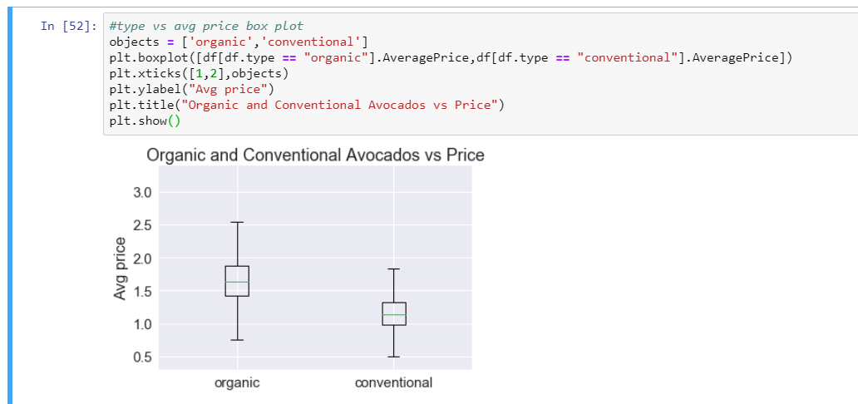
As seen in the previous slide, organic avocados make up only 2.7% of the total volume sold, possibly because it has a higher average price

Slide 16
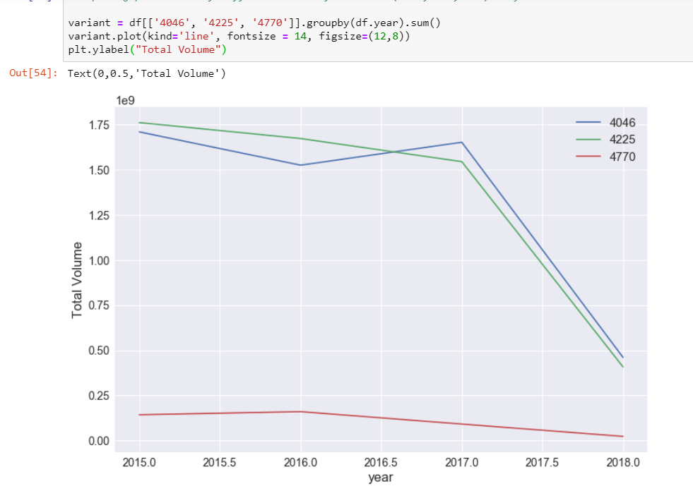
For the different PLUs, the behaviour of the line plot for total volume vs year is different. 4770 stays between 0 and 0.25 through the 3 years, whereas the other two drop from 1.75 to 0.50 from 2015 to 2018.

Slide 17
HYPOTHESIS TESTING
Restaurants in California will include an option for organic avocados in their menu if there has been at least a 20% rise in the mean volume of organic avocados from 2017 to 2018, given a statistical significance level of 10%.

Slide 18
NULL HYPOTHESIS: There has not been a 20% rise in mean volume from 2017 to 2018.
ALTERNATE HYPOTHESIS: There has been a 20% rise in mean volume from 2017 to 2018.

Slide 19
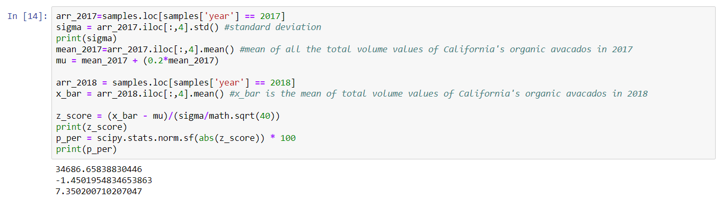
Since the p percentage value is 7.35, p value is equal to 0.0735. It is statistically significant at the 10% level, and therefore we reject the null hypothesis. Hence, the restaurant will include an option for organic avocados in their menu.

Slide 20
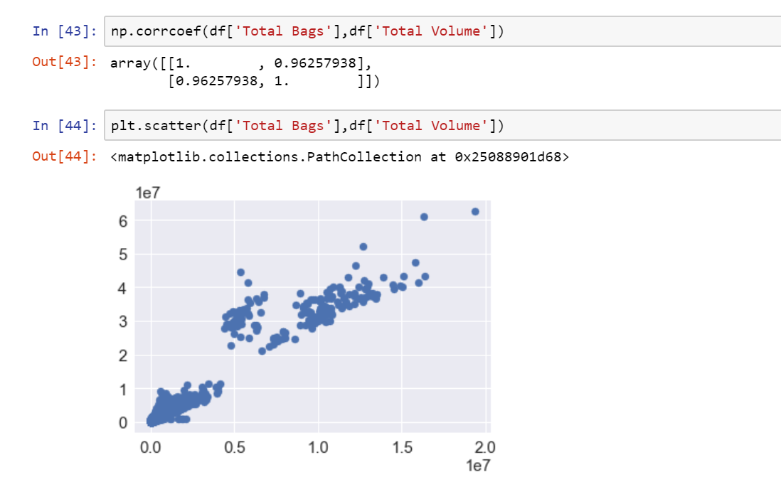
CORRELATION
TOTAL BAGS AND TOTAL VOLUME ARE STRONGLY POSITIVELY CORRELATED WITH A CORRELATION COEFFICIENT OF 0.9625

Slide 21
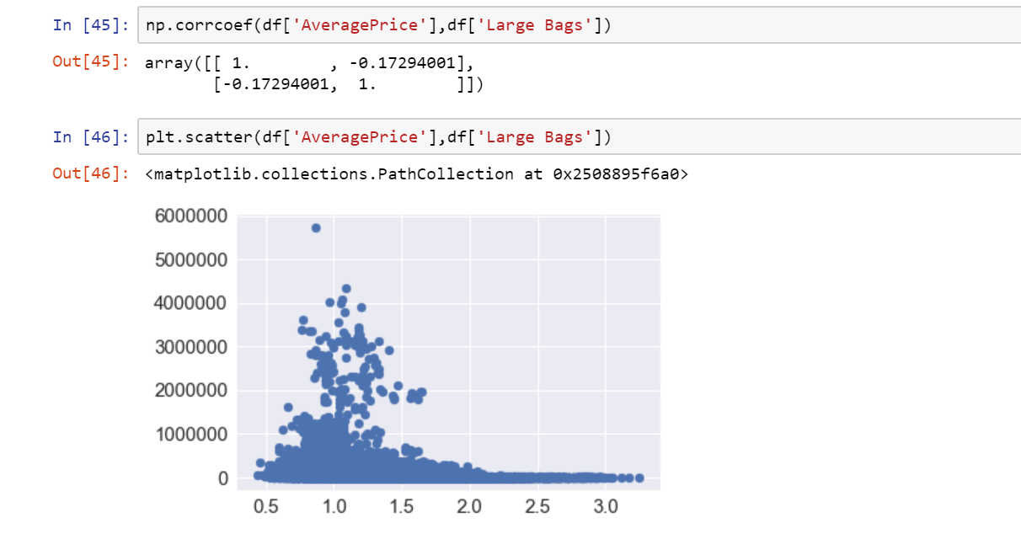
AVERAGE PRICE AND LARGE BAGS ARE WEAKLY NEGATIVELY CORRELATED WITH A CORRELATION COEFFICIENT OF -0.173

Slide 22
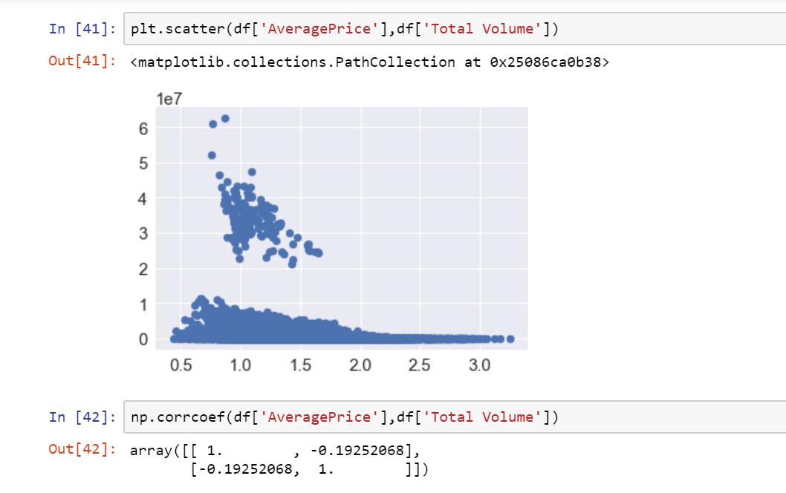
AVERAGE PRICE AND TOTAL VOLUME ARE WEAKLY CORRELATED WITH A CORRELATION COEFFICIENT OF -0.1925

Slide 23
THANK YOU

