Slide 1

Student Admission Management
System
Chirag Padyal_20104034
Vishal Bangar_20104084
Jaykumar Nayi_20104005
Anuj Kundar_20104047
Project Guide
Ms. Sonal Jain
Notes:
<number>

Slide 2
Contents
Introduction
Objectives
Scope
Features / Functionality
Project Outcomes
Technology Stack
Block Diagram if applicable
Notes:
<number>

Slide 3
1. Introduction
Our project topic in 2 points as follows
Problem Identified :
Educational institutions have to incur huge costs in maintaining academic records and have trouble in tracking bills and financial information.
Staff workload is heavy and resources are not optimized well to find the best students.
Solution Proposed :
An online admission system lets the student apply for a course online, submit mark sheets/documents, and check their application status
On the other hand, it allows the institutions to track the applicants, follow-up with them, schedule counseling sessions, accept digital documents, check eligibility, and accept/reject the application
Notes:
<number>

Slide 4
2. Objectives
To make User interfaces that are user friendly and attractive.
To make payment and admission cancellation process smooth.
To computerize the admission management system structure.
To track application status.
To automate the selection process.
To Save Students and College management members Time.
Notes:
<number>

Slide 5
3. Scope
Man Power Saving - Institutes don't need to allot additional manpower to manage heavy crowd.
Do not require printing & storing forms.
Does not require to collect forms of all the candidates and file them.
It is Rapid & Flexible.
Real-time reports & graphs for analysis.
Notes:
<number>

Slide 6
4. Feature /Functionality
The features & Functionality implemented are :
As a student, you can register & apply for online admission by login the student portal
for admission by entering your credentials.
Student can apply for any course and can also cancel the admission at few clicks.
Students Details Like personal details, Login details, mark-sheet details and other details
can be stored securely in a centralized system.
Student Can Upload Document and Picture Easily and Securely.
Simple and Easy UI.
Notes:
<number>

Slide 7
5. Outcome of Project
The final Outcome of the Project is as follows :
• Administrator has easy access to all student data.
• Student can more convenient take admission or cancel admission for any branch.
• Automatic Student get qualified based on his/her marks and So, reduces extra workload.
Notes:
<number>

Slide 8
6. Technology Stack
Write what you have planned to develop front end ( GUI ) & Backend (Database if applicable)
Language Used :- Java.
API ( Application Programming Interface) :- JDBC.
Framework :- Java Swing.
Database :- MySQL.
Notes:
<number>

Slide 9
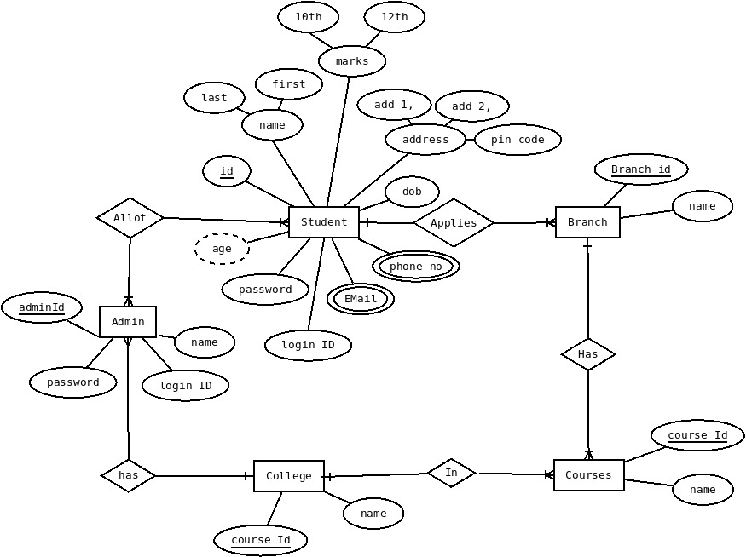
7. Block Diagram

Slide 10
Thank You...!!
Notes:
<number>

