Slide 1

ITM301 Java Movie Ticket
1:Shivam Gupta :-20104110
2:Rupesh Mishra :-20104100
3:Yashab Mahimi :-20104026
4:Meet Bohra :-20104057
Project Guide
VIDYA SHET

Slide 2
Contents
Introduction
Objectives
Scope
Features / Functionality
Project Outcomes
Technology Stack
• E R Diagram

Slide 3
1. Introduction
Problem’s Identified :
The traditional way of booking the ticket for the movie is the customer need to go to the specific theater where the desired movie was playing and stand in long queue and buy the ticket which consumes lots of time.
Purposed Solution :
View the list of movies present
View the trailer of the movie
View the list of theater based on show
Availability of seats
Book the ticket for specified movie at your home comfort

Slide 4
2. Objectives
To generate report on seats,booking,movie
To provide filter reports on customer,payment,shows
To increase efficiency of booking
To provide hassle-free service to the customer
To manage the payments for the customer

Slide 5
3. Scope
Can save the customer’s valuable time
Provide customer’s with hassle free and safe payment option.
To provide customer’s with detailed information about availability of seats and time of shows.
Any institute/company can book tickets for students/clients and special discounts will be provided to them.

Slide 6
4. Feature /Functionality
Feature 1 :
We are planning to add suggestion’s which will help the customer to pick movies easily based on his taste
Feature 2 :
We are planning to make a save and trustable payment options for the customer .
Feature 3 :
We are looking to add the imbd rating’s for the movies which can help the customer to classify movies better
Feature 4 :
We are looking forward to make the app better and user friendly so that our customer never face any issues

Slide 7
5. Outcome of Project
User can register
User can login and book tickets
User can search for the movies
User can book tickets by providing the following inputs
a) Genre
b) Actors,director
c)Name of the movie
Users will be provided with E-bills which will help to save paper
Users will be provided with the information like location,time of the show etc

Slide 8
6. Technology Stack
PROGRAMMING LANGUAGE :- JAVA
IDE :- ECLIPSE
DATABASE :- MYSQL

Slide 9
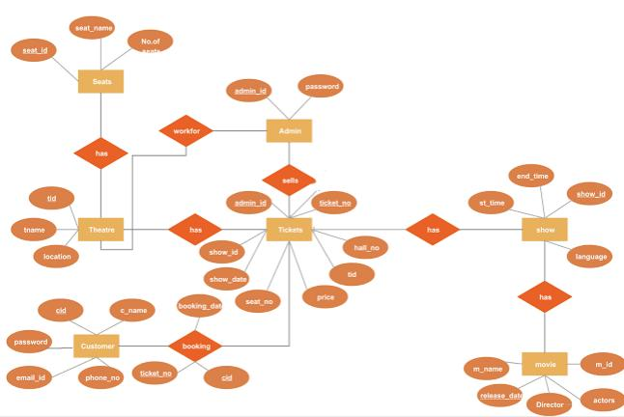
E R Diagram.

Slide 10
Thank You...!!

