Slide 1

Resume Builder
Presented by:
Tanmay Poyekar- 20104053
Hitesh Sachdev- 20104137
Jai Rao- 20104097
Project Guide
Prof. Vishal Badgujar

Slide 2
Content
Introduction
Objectives
Scope
Features/ Functionality
Project Outcome
Software Stack
ER- Model
Implementation
Conclusion/Summary
References

Slide 3
Introduction
A resume builder is an application developed to simplify the task of creating a resume for individuals.
A resume is a formal document that serves to show a person’s career background and skills. In most cases, it’s created in order to help a candidate to land a new job.
A resume consists of a professional summary, work history, and education sections.
It works like your job hunt marketing document.
The application provides an effective means of designing a resume.
Problem Identified :
Making resume manually consume more time.
Usually individuals get confused while creating a resume especially graduate students. They don’t get a clear idea of what things and information must be included in a resume.
There is no database to store and retrieve the data from MS-Word.

Slide 4
Introduction
Solution Proposed :
So our application is user friendly and easy to use . The individual just have to fill up a form regarding his/her personal , Qualification details, his/her Work experiences , Skills and so on .
Our system will store the entered data and generates a well structured resume.
Because of this computerization process , manual work has been eliminated and manual errors can be overcome easily.

Slide 5
Objectives
To give flexibility to users to design resume according to their requirement.
To eliminate the process of creating resume manually.
To detail your skills and training, work experience, education, and most importantly, the accomplishments you have made with past employers.
To create resume online which maintains proper records of user’s personal information, skills, qualification details, work experience.
To provide an easy way for creating a professional looking resume.

Slide 6
Scope
So our application is user friendly and easy to use.
The individual just have to fill up a form regarding his/her personal, Qualification details, his/her Work experiences, Skills and so on.
The main advantage of online resumes is that they are instant.
The application provides an effective means of designing a resume.

Slide 7
Features/ functionality
User login
User have to create an account by registering themselves. Then they can login and can utilize the services.
Resume form
User will be given an form to be filled. The form includes Personal details, Skills, Hobbies, Experience, Interest, and Qualification details.
Convert to PDF
User can even download his/her resume in pdf format.

Slide 8
Outcomes
User Can login & Signup.
User can create resume by filling up the details like: 1.Personal details 2.Qualification details 3.Skills 4.Work experience
User can update his/her details.
User can even Download his/her resume.
User will be able to make resume by selecting whether the user is fresher or experienced.

Slide 9
Software Stack
Development: Eclipse
Front End (GUI): JavaFx
Back end (Database): MYSQL

Slide 10
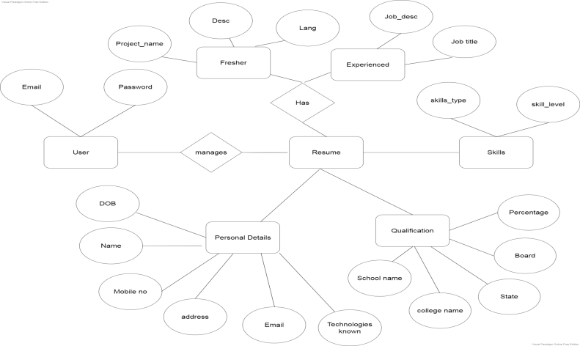
ER- Model

Slide 11
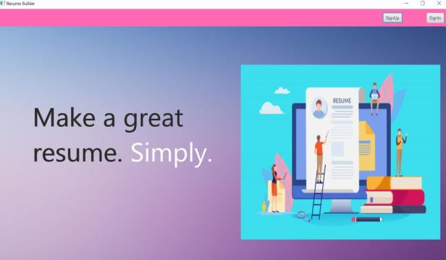
IMPLEMENTATION

Slide 12
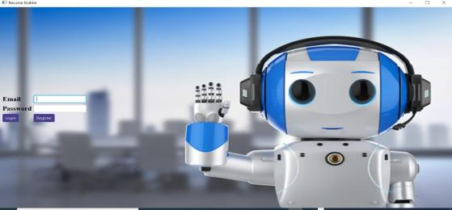
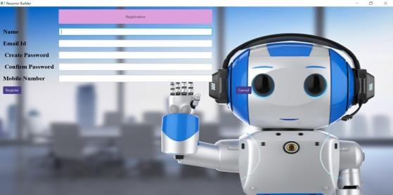
Login Page
User can login by entering valid Email and Password
Registration Page
New user has to fill registration for creating an account.

Slide 13
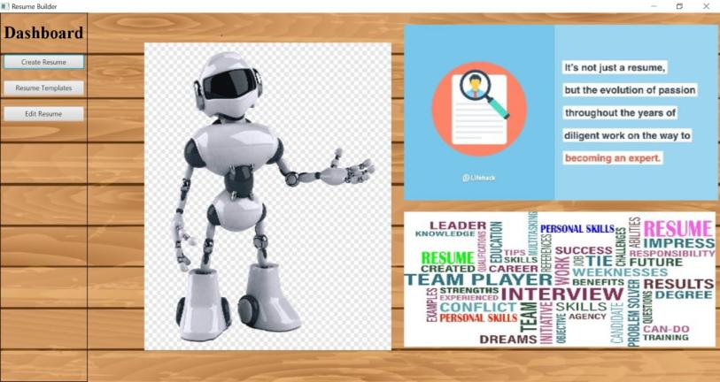

Slide 14
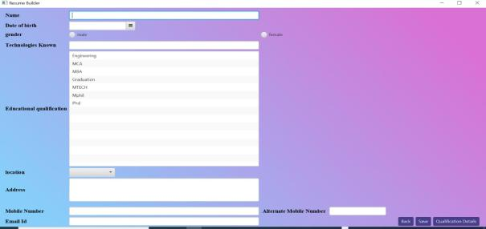
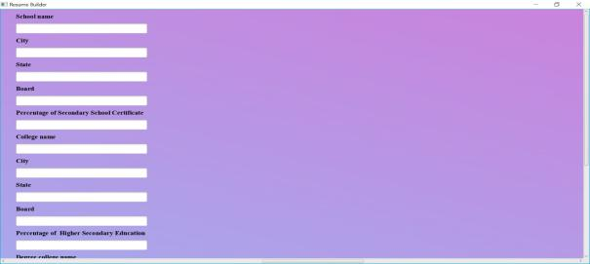

Slide 15

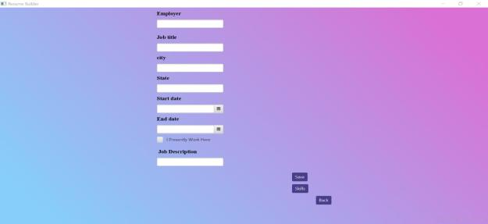

Slide 16
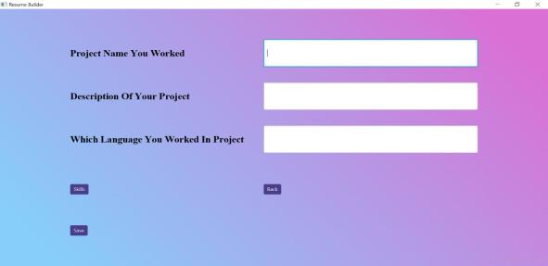
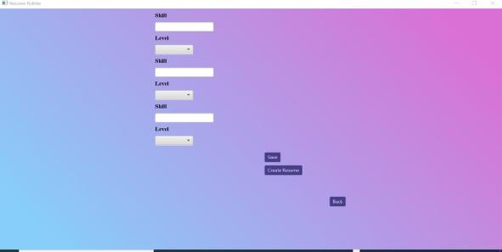

Slide 17
Conclusion
The online resume builder is one of the best systems for the people who are either fresher's in their domain or if they don’t have enough idea about the resume or don’t have enough time to create the resume of good designs or patterns then this platform is very productive place for them. It saves a lot of time and cost effective.

Slide 18
References
https://docs.oracle.com/javase/8/scene-builder-2/get-started-tutorial/jfxsb-get_started.htm
https://docs.oracle.com/javafx/2/get_started/form.htm
To open new window in javafx
https://www.quickprogrammingtips.com/java/how-to-open-a-new-window-in-javafx.html

Slide 19
Thank You..!!

