Slide 1

HR HELP DESK SYSTEM
Aagya Singh – 20104076
Bhushan Patil – 20104094
Mayur Shinde – 20104062
Muskan Rao – 20104096
Project Guide
Prof. Yaminee Patil

Slide 2
Contents
Introduction
Objectives
Scope
Features / Functionality
Project Outcomes
Technology Stack
Block Diagram

Slide 3
1. Introduction
•The main aim of this system is to develop a software which can provide the solution for all problem send by the workers of an organization.
This system will also track the issues raised by the employee so they can check whether their problem is solved or not.
•Problems - Huge number of emails, poor tracking, time consuming, inability to prioritize emails, lack of security are the problems.
•Solution - This system allows proper ticketing system resolving the issue of sending emails. In this system, the user can address their issues and track the status of their concerns based on priority in a secure environment.

Slide 4
2. Objectives
1. To develop an app so that the users can connect with the HR.
2. To develop an email free environment.
3. To develop an app for easy and efficient work.
4. To develop a safe and secure environment for the user and admin.

Slide 5
3. Scope
H R Helpdesk System can be used to resolve the issues related to HR.
It can be used by the employees to ask for payroll, disability leave, etc
Employees come to know about the company policies.
Employees can address their queries and at the same time track their Solution for it.

Slide 6
4. Feature /Functionality
1. Self-Service Portal :
Self-service portal option gives the control in the hands of employees to connect with HR directly instead of struggling through an endless chain of back and forth emails.
2. Inbuilt Ticketing System:
Ticketing System allows employees to raise their queries in the form of tickets, by which the admins can resolve the problems on priority basis.
3. Knowledge Base:
Knowledge Base lets the employees know about the company policies.
4. Reports and Analysis:
Requests- what types of employee requests are coming in the most and to which HR teams.

Slide 7
5. Outcome of Project
Improved employee engagement.
More efficient onboarding.
Give hours back to your HR team.
Head off issues before they have time to get worse.
Shorter, sweeter processes.

Slide 8
6. Technology Stack
- Netbeans IDE
- MySQL
- phpMyAdmin
-Xampp

Slide 9
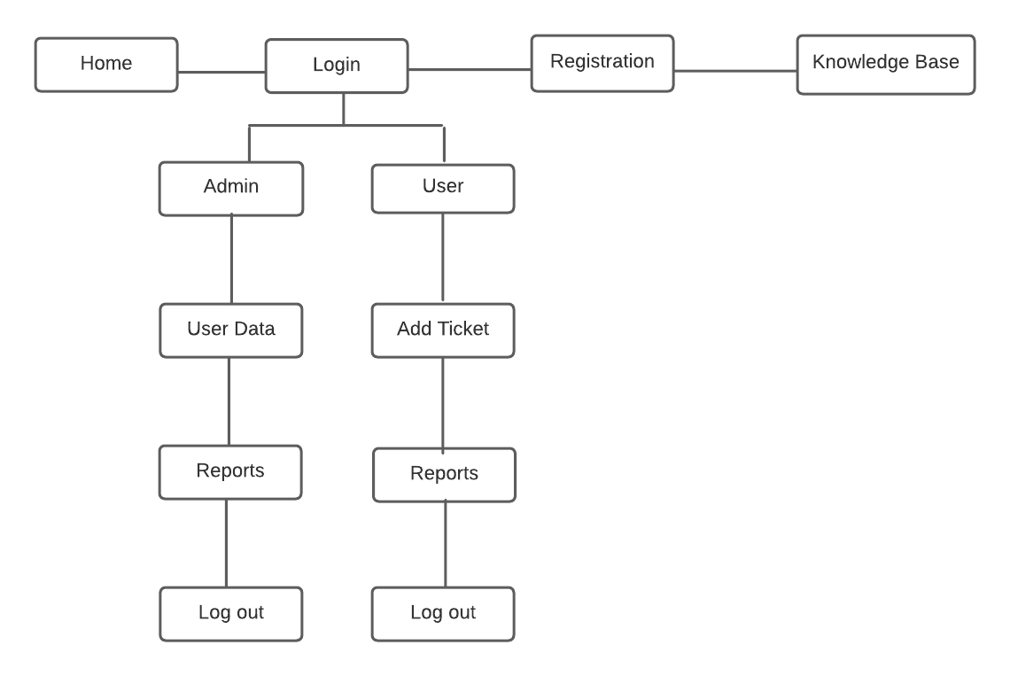
7. Block Diagram

Slide 10
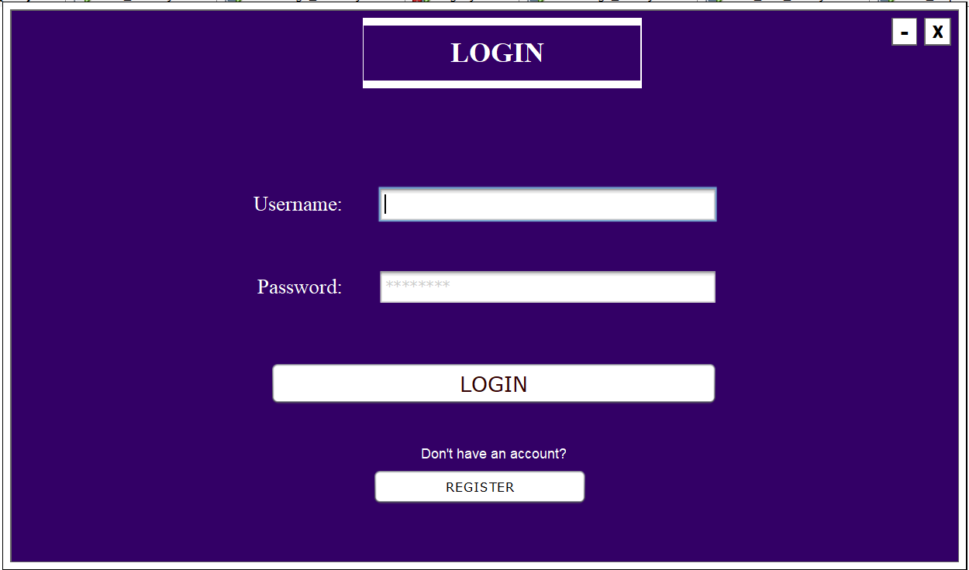
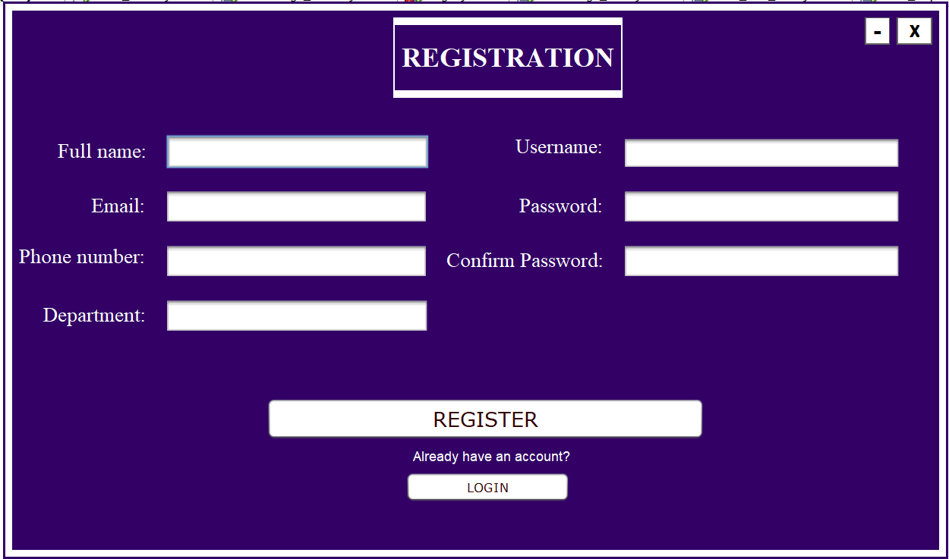
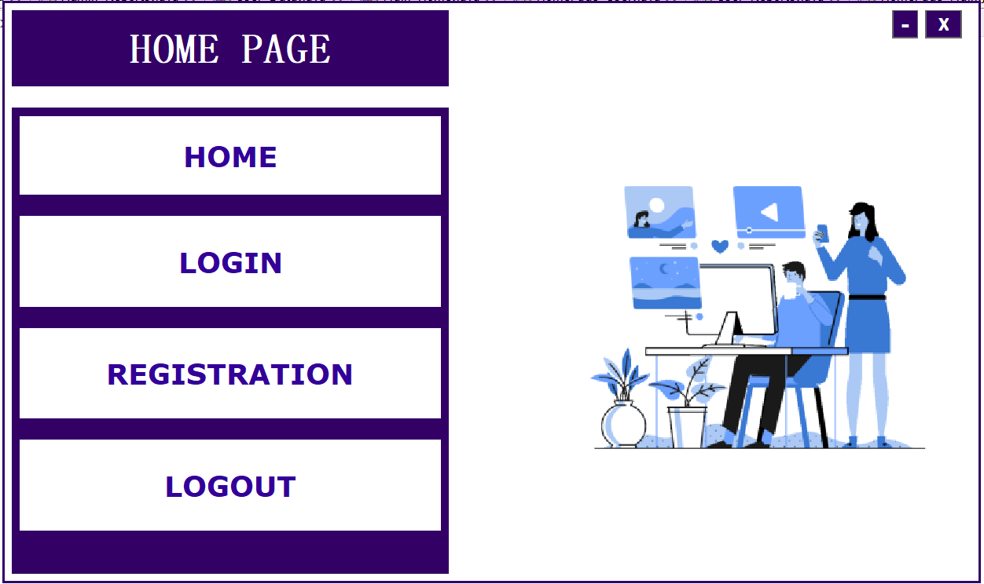
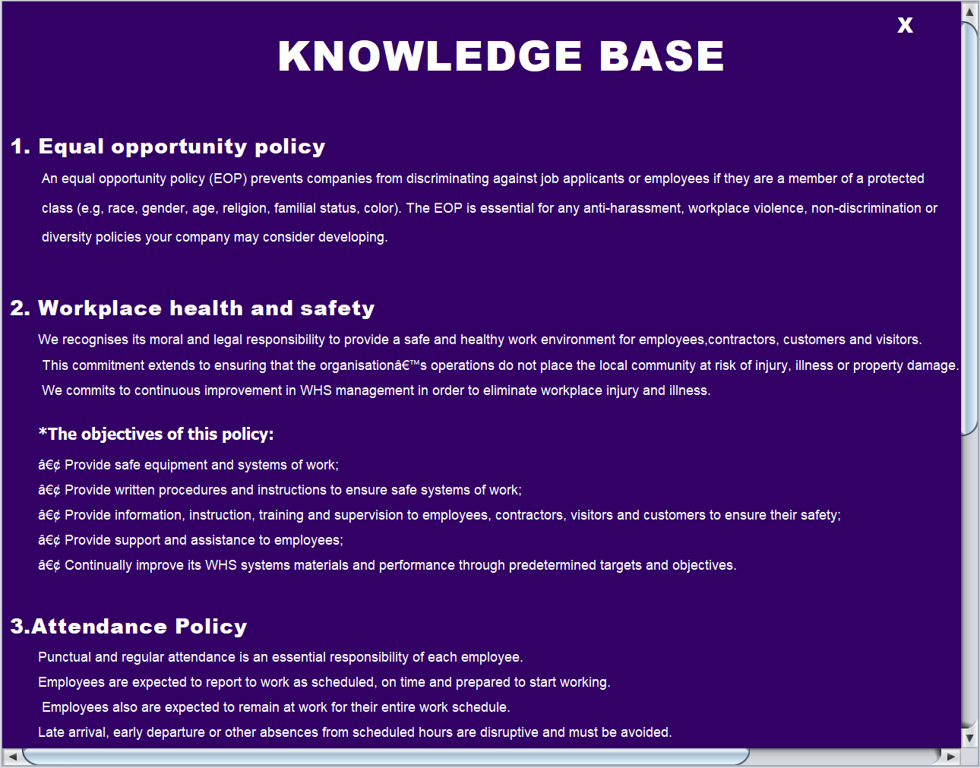

Slide 11
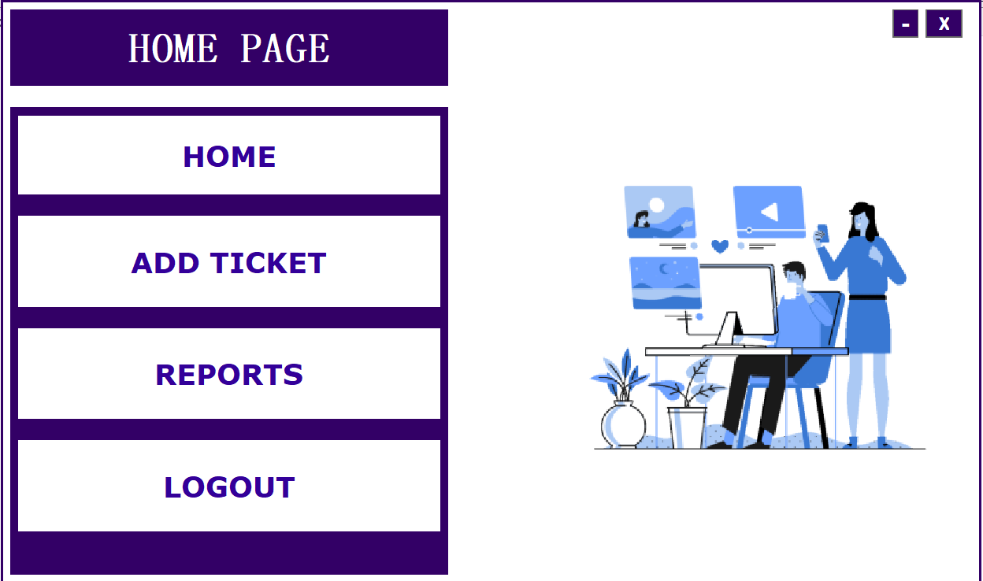
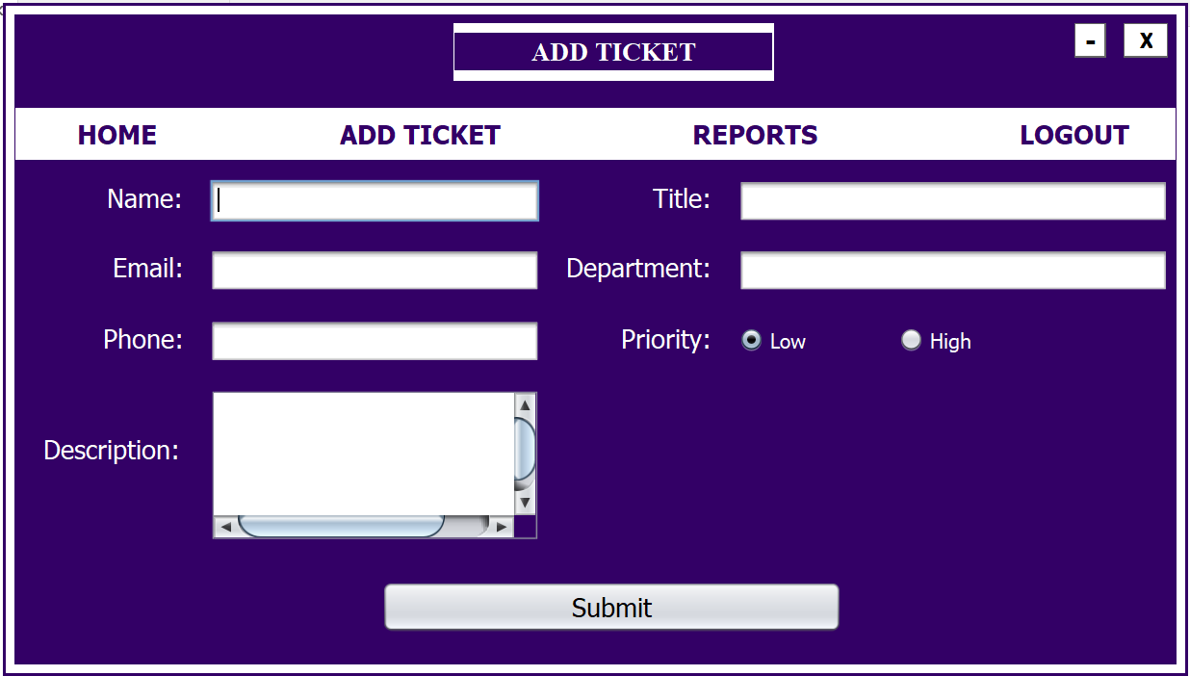
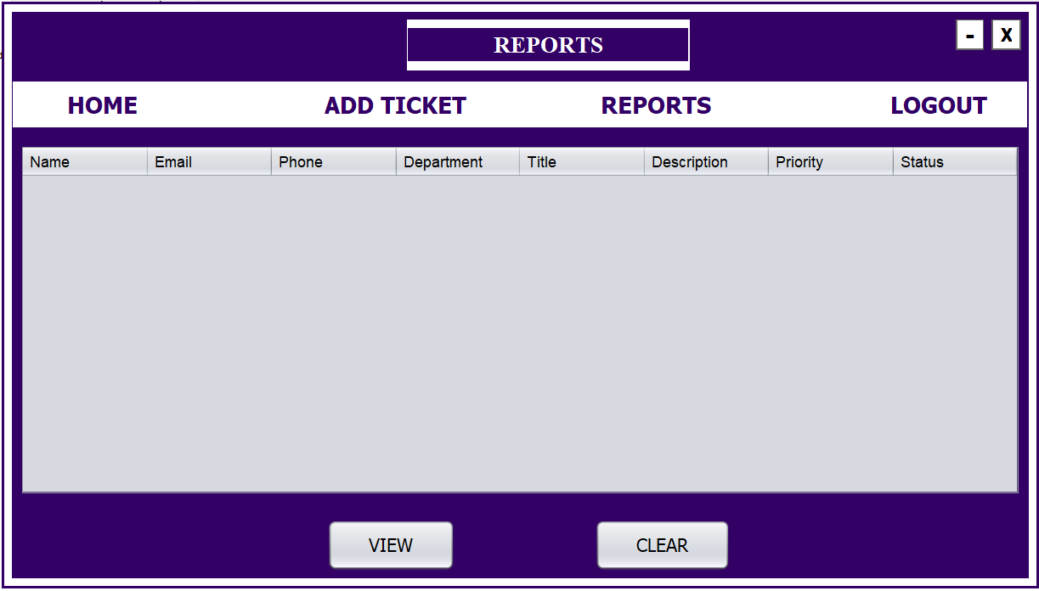

Slide 12

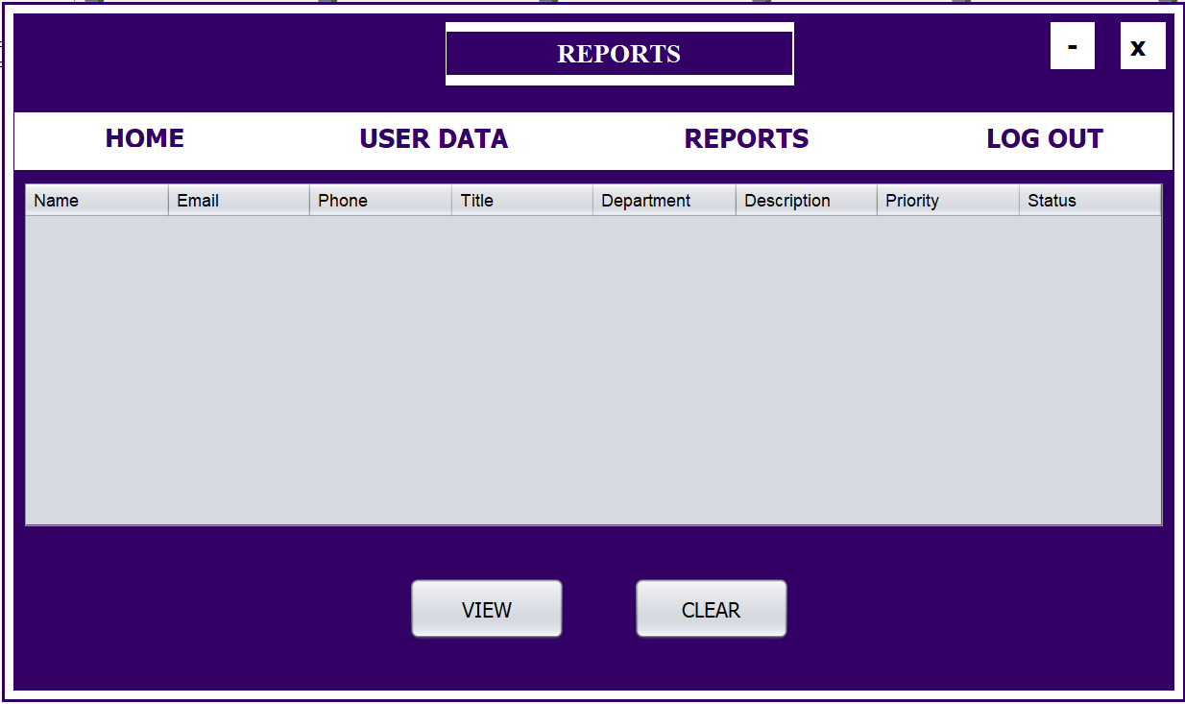
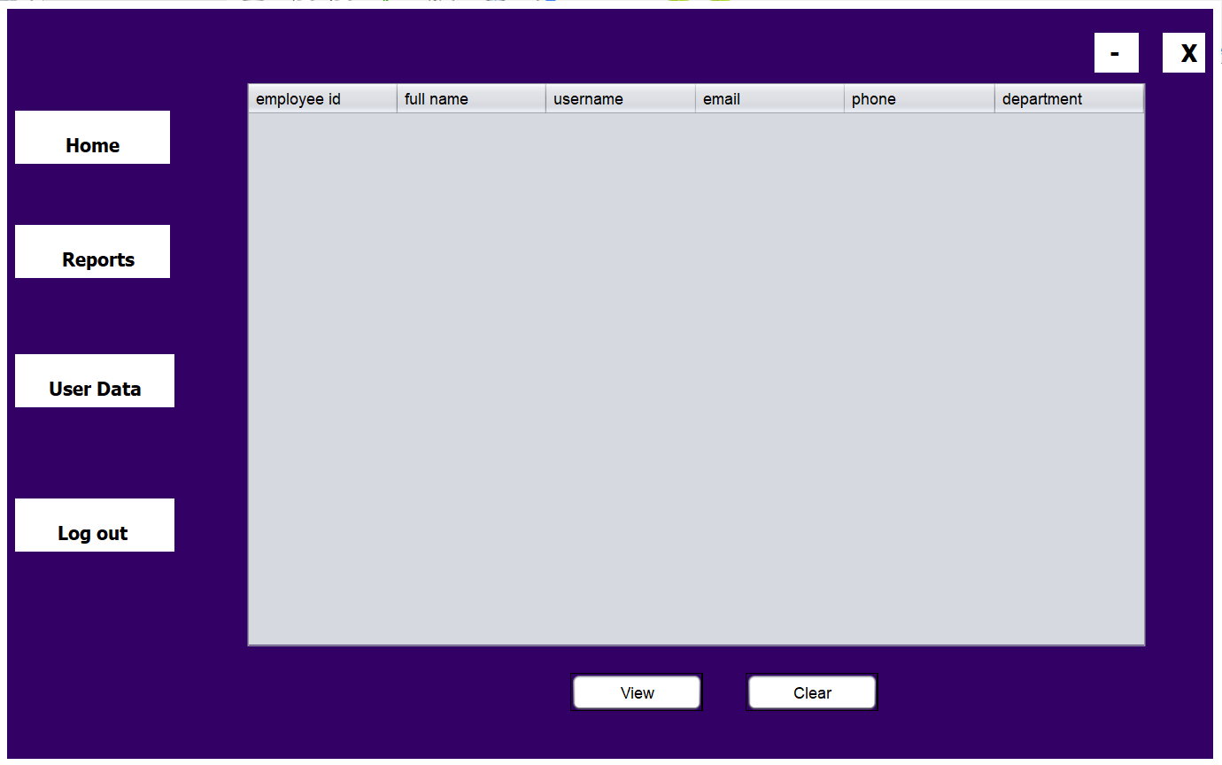

Slide 13
Thank You...!!

