Slide 1

ONLINE LAB DEADSTOCK MANAGEMENT
GROUP MEMBERS
1. Adarsh Singh (20104080)
2. Pooja Sharma (20104090)
3. Nainisha Sharma (20104042)
4. Aditya Waingade (20104099)
Project Guide: Prof. Geetanjali kalme

Slide 2
Contents
Introduction
Objectives
Scope
Features / Functionality
Project Outcomes
Technology Stack
Block Diagram
Implemented Page in UI
Conclusion

Slide 3
1. Introduction
Essential function of Online Lab Deadstock Management system is viewing the recorded data, deleting the unwanted data and modifying the data as the admin want.
Problem Identified :
Data records of particular lab’s deadstock was not easily stored and accessed
Solution Proposed :
Data Base is designed so that it is easy to store and access information about specified lab’s deadstock.

Slide 4
2. Objectives
To create user friendly environment for management of labs deadstock element in database.
To provide platform for permanent storage of data.
The access to the records will be given to admin only as the project is built at administrative end.
To track all the details about Lab Deadstock.
To reduce the manual work for managing the lab deadstock.

Slide 5
3. Scope
Our project aims at deadstock management, i.e. we have tried to computerize various processes of Deadstock Management System.
In computer system, it is not necessary to create the manifest but we can directly print it, which saves our time.
To assist the staff in capturing the effort spent on their respective working areas.
Our project can be used not only for lab deadstock management but also in other sectors.
Can be applied for different types of warehouses.
Can be applied in retailing sector.
Can be useful for chemist/drug shop managers.

Slide 6
4. Feature /Functionality
Laboratory deadstock elements tracking will be achieved.
Data will be efficiently managed, stored and will also be accessed easily
Data security will be achieved by providing access of database to user (with login ID and password)
Only validated values will be taken and invalid will be ignored.
Modification can be done if later the user wants to change something in the records.

Slide 7
5. Outcome of Project
User will be able to view, add, delete and update the data records.
There will be only one user that will have the rights to manage the data records and that is admin.
The user will be able to manage lab deadstock elements list easily, efficiently and economically.
For each lab user will be able to manage the data as they want.

Slide 8
6. Technology Stack
Front End: - Java (NetBeans).
Back End: - MySQL, DB Derby

Slide 9
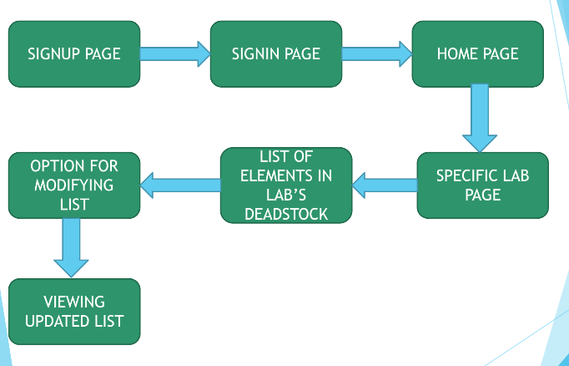
7.Block Diagram

Slide 10
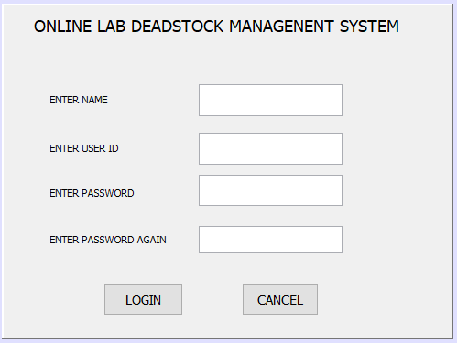
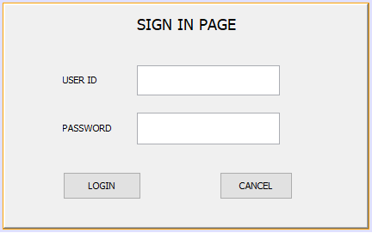
IMPLEMENTED PAGE IN UI
SIGNUP PAGE
SIGIN/LOGIN PAGE

Slide 11
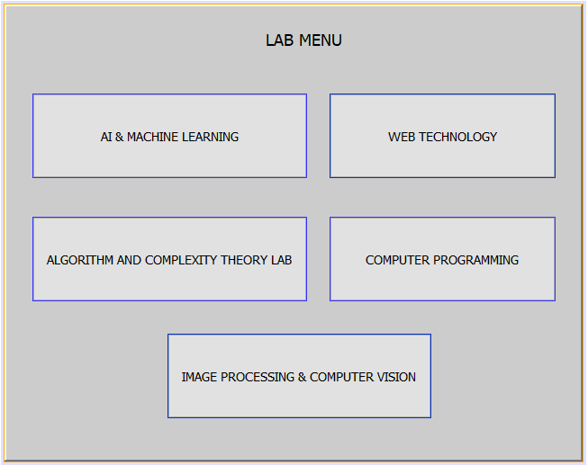
IMPLEMENTED PAGE FOR MENU IN UI

Slide 12
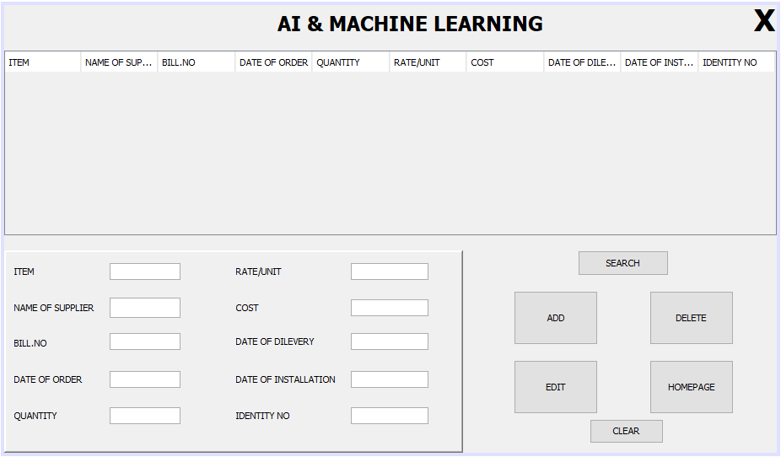
IMPLEMENTED PAGE FOR LAB IN UI

Slide 13
8. Conclusion
Thus we have created our system in such a way that the admin can manage the data records easily and efficiently.
The system is created in such a way so that it can satisfy all the requirement of the labs present in colleges.
The admin will be able to manage the records in less time as compared to before when the work was done manually.

Slide 14
Thank You...!!

