Slide 1
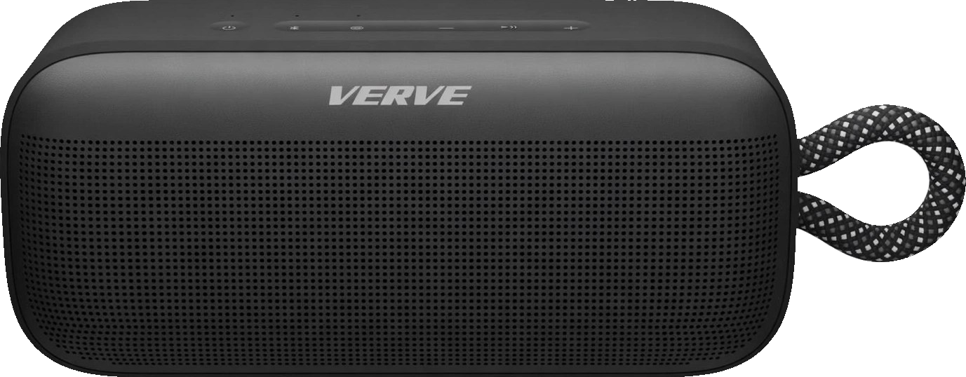

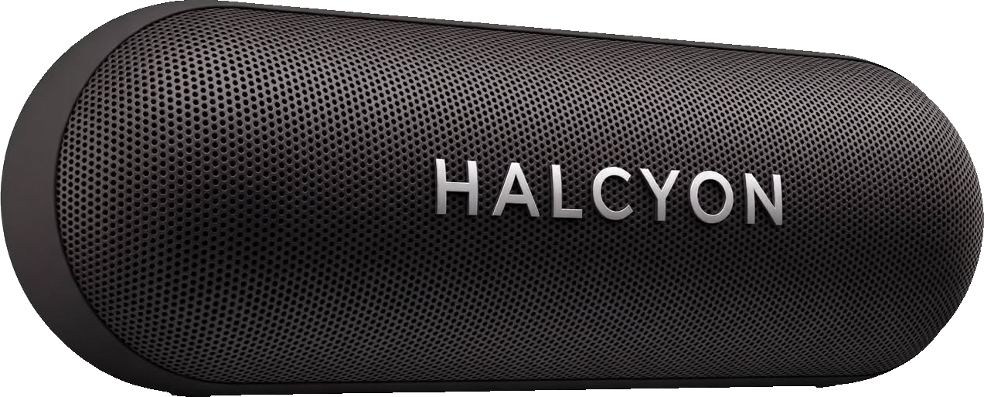
FINDINGS PRESENTATION
Why the Same Speaker
Can Win Alone and Lose Together
Testing Hsee's (1996) Evaluability Hypothesis, and whether an extrinsic cue can reverse it again
Global Customer Decision Making | Group Project Findings | October 2026
Notes:
Good morning, everyone. We are Group F. Our project asks a simple question: why can the same product look like the better choice when it is shown on its own, and the worse choice when it is shown next to a competitor? We will first walk you through our replication of Hsee's 1996 evaluability study, and then we will show you our extension, where we tested whether a celebrity endorsement can change the outcome of a side-by-side comparison.

Slide 2


THE PUZZLE AND THE THEORY
The Evaluability Hypothesis (Hsee, 1996)
Shown alone, shoppers may favor one speaker; shown side by side, they may switch to the other, with nothing about either product changed. Hsee (1996) explains why.
EASY TO EVALUATE
HARD TO EVALUATE
e.g., a star rating
e.g., a technical spec
A 4.7★ rating means something the moment you see it. No comparison needed. Everyone already knows the scale.
Is 0.3% distortion good? Most people have no idea. Once they see it standing next to 0.8%, the gap suddenly becomes obvious.
Alone → people lean on the easy attribute. Together → the hard attribute suddenly counts.
Global Customer Decision Making • Group Project Findings
2
Notes:
Here is the puzzle. When shoppers see one product at a time, they often prefer one option, but when they see both together, they can switch to the other, even though nothing about either product has changed. Hsee's explanation is that some attributes are easy to judge on their own and others are not. Everyone knows that a 4.7-star rating is good, so stars are easy to evaluate. Very few people know whether 0.3% distortion is good, so distortion is hard to evaluate until it sits next to another number. When a product is seen alone, people lean on the easy attribute, and when products are compared, the hard attribute finally starts to count.

Slide 3



STUDY 1: STIMULI AND HYPOTHESIS
Meet the Two Speakers
Verve Sound
Halcyon Sound
4.7
4.1
512 reviews
512 reviews
Distortion: 0.8%
Distortion: 0.3%
Higher distortion (lower fidelity)
Superior, but hard to judge alone
H1: Verve (better rating) earns a higher price when each speaker is seen alone; Halcyon (lower distortion) earns more when both are seen together. Review counts are identical (512) and brand names are fictional.
Global Customer Decision Making • Group Project Findings
3
Notes:
To test this, we created two fictional Bluetooth speakers. Verve Sound has the better star rating, 4.7 compared with 4.1, while Halcyon Sound has the better sound quality, with 0.3% distortion compared with 0.8%. We kept the review counts identical so that popularity could not explain the results. Our first hypothesis follows Hsee directly: when each speaker is seen alone, Verve should earn a higher price because of its rating, but when the two are seen together, Halcyon should earn more because its lower distortion becomes visible.

Slide 4



STUDY 1: SAMPLE AND PROCEDURE
Who Took Part, and How
1. Who
2. Where
3. How
4. Groups
111 respondents: 68% students, 32% non-students. Mostly aged 18 to 34; 57 men, 54 women.
Nine countries: US (49), India (33), Zimbabwe (15), South Africa (8), plus UK, Ghana, Rwanda, Uruguay, Vietnam.
Online Google Forms. Each of five members split contacts across all four forms; each person saw only one.
Verve alone 26 · Halcyon alone 28 · Both together 30 · Both + celebrity 27 (after cleaning).
Analysis: independent-samples t-tests in SPSS, plus robustness checks (within-person tests, choice shares, country and student controls)
Global Customer Decision Making • Group Project Findings
4
Notes:
We collected responses online through Google Forms from 111 people, about two-thirds of whom were students, living in nine countries, mainly the United States and India. Each of the five group members split their contacts across four forms, so every respondent saw only one version: Verve alone, Halcyon alone, both speakers together, or both speakers with the celebrity cue, which we will come back to in the extension. Respondents told us the most they would pay for each speaker, and we compared the groups using t-tests in SPSS.

Slide 5
MANIPULATION CHECK
Confirming the Setup Worked, Before Testing Anything Else
Hsee's design depends on one attribute being easy to judge alone and the other hard. Before testing either hypothesis, we checked that our two attributes actually behaved that way.
STAR RATING
DISTORTION
the easy-to-evaluate attribute
the attribute under test
Rated clear to judge on its own: mean 3.74 on a 1-to-5 clarity scale. A familiar scale, with no comparison needed.
Rated much harder to judge alone: mean 2.59 vs. 3.74, t(53) = 5.54, p < .001. It worked as the hard-to-evaluate attribute.
The design worked as intended: stars were easy to judge alone and distortion was hard, before either hypothesis was tested.
Global Customer Decision Making • Group Project Findings
5
Notes:
Before testing the hypothesis, we checked that our design worked the way Hsee's theory requires. We asked respondents who saw a single speaker how clearly they could judge each attribute. Stars scored 3.74 out of 5, while distortion scored only 2.59, and that difference is highly significant. This confirms that stars worked as the easy attribute and distortion worked as the hard one, so the foundation of the experiment was in place.

Slide 6
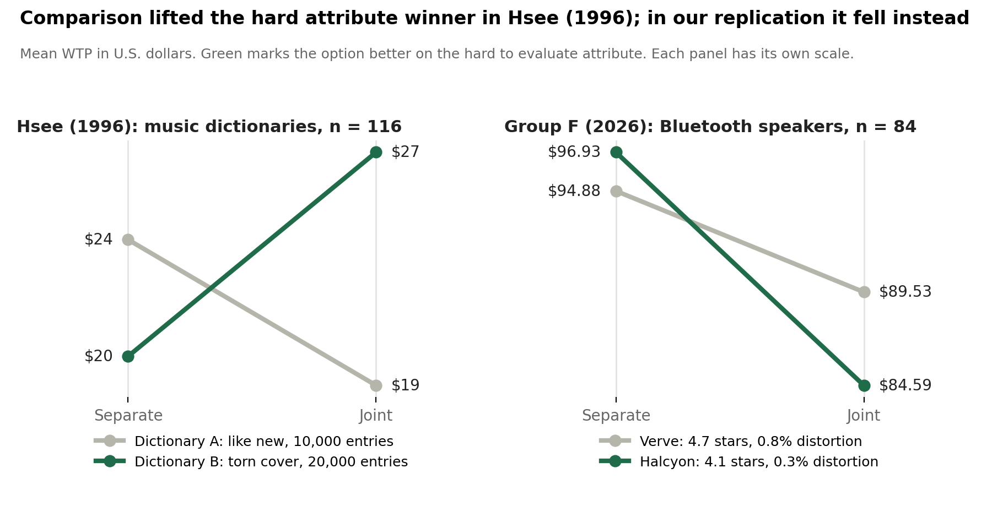
STUDY 1: RESULTS
Hypothesis vs. Actual Result
OUR RESULTS NEXT TO HSEE (1996)
H1
Predicted: In separate evaluation, Verve Sound wins. Its 4.7★ rating is easy to judge on its own.
Predicted: In joint evaluation, preference shifts to Halcyon Sound once its distortion advantage becomes visible.
Actual: Verve $94.88 → $89.53 (t = 0.59, p = .558). Halcyon $96.93 → $84.59 (t = 1.46, p = .149): it fell instead of rising. H1 not supported.
Note: the Halcyon joint mean excludes one $40 response below the survey's $50 to $200 range (Halcyon n = 29; Verve n = 30). Keeping it does not change the result.
Global Customer Decision Making • Group Project Findings
6
Notes:
Here are the results next to Hsee's original findings. In Hsee's study, the option with the better hard attribute gained value when the two options were compared. In our study, both speakers lost a little value when they were shown together: Verve fell from about $95 to about $90, and Halcyon fell from about $97 to about $85. Neither change was statistically significant, and Halcyon moved in the opposite direction from what we predicted, so our first hypothesis was not supported.

Slide 7
STUDY 1: WHY H1 WASN'T SUPPORTED
Six Likely Reasons
The easy-versus-hard distinction worked (manipulation check), so we looked at what else got in the way.
1
2
3
Distortion Was Easier to Read
The Star Gap Was Small
Both Speakers Looked Good
A plain 'Distortion' label and sub-1% values like 0.3% sound good even alone; Hsee used tiny THD decimals.
4.7 vs. 4.1 stars may both read as 'good': Verve earned no premium alone ($94.88 vs. $96.93).
When both options look attractive, comparison can lower both (Hsee & Leclerc, 1998), as we saw.
4
5
6
Sample Mix Differed by Form
Hsee's Own Effect Was Modest
Limited Power
Nine countries; non-students paid ~$26 more for Verve, and the Verve-alone form had more of them.
His separate-evaluation result was only a trend (p ≈ .10), and replications often find smaller effects.
About 28 people per group against a $27 to $41 spread; 80% power needs about 100 per group.
Robustness checks (direction-of-effect tests, within-person comparison, and controls for country and student status) all reached the same conclusion.
Global Customer Decision Making • Group Project Findings
7
Notes:
Since the manipulation check worked, we looked for other reasons the reversal did not appear. The most important is that our distortion attribute was easier to understand than Hsee's. We labeled it simply as distortion, a word everyone knows is bad for sound, and our values were below one percent, so 0.3% already sounds like very little distortion even when you see it alone. Hsee used a technical term, total harmonic distortion, with tiny decimals like .003% that are hard to picture. That is why Halcyon was valued as highly as Verve even when it was shown on its own. The gap between 4.7 and 4.1 stars was also small, because both ratings look good. When both products look attractive, comparing them can lower the value of both, which is exactly what we saw. Finally, our sample mix differed slightly between forms, Hsee's own effect in separate evaluation was modest, and our groups of about 28 people were too small to detect small effects.

Slide 8



STUDY 1: MANAGERIAL IMPLICATIONS
If H1 Holds: What Marketers Should Do
Invite comparison when your edge is hard to judge.
If you lead on a technical spec, like Halcyon's distortion, create side-by-side moments: comparison tables, 'compare similar items' widgets, and comparison shelf displays.
Win the single-product moment when your edge is easy to judge.
If you lead on ratings, like Verve, invest where products are seen one at a time (social ads, influencer posts, product pages) and avoid comparison tables with stronger-spec rivals.
Make hard specs easy to judge on your own page.
Add a benchmark, such as '0.3% distortion: clearer than most speakers under $150', so a technical edge counts even without a comparison; A/B test it against the raw spec.
Global Customer Decision Making • Group Project Findings
8
Notes:
If the evaluability hypothesis holds, it gives managers three practical lessons. First, a brand whose advantage is technical and hard to judge should invite comparison, for example through comparison tables and side-by-side displays. Second, a brand whose advantage is easy to judge, such as a strong rating, should focus on places where shoppers see one product at a time, like social media ads and product pages. Third, any brand can make a technical advantage easier to judge by adding a simple benchmark on its own product page. That brings us to our extension.

Slide 9
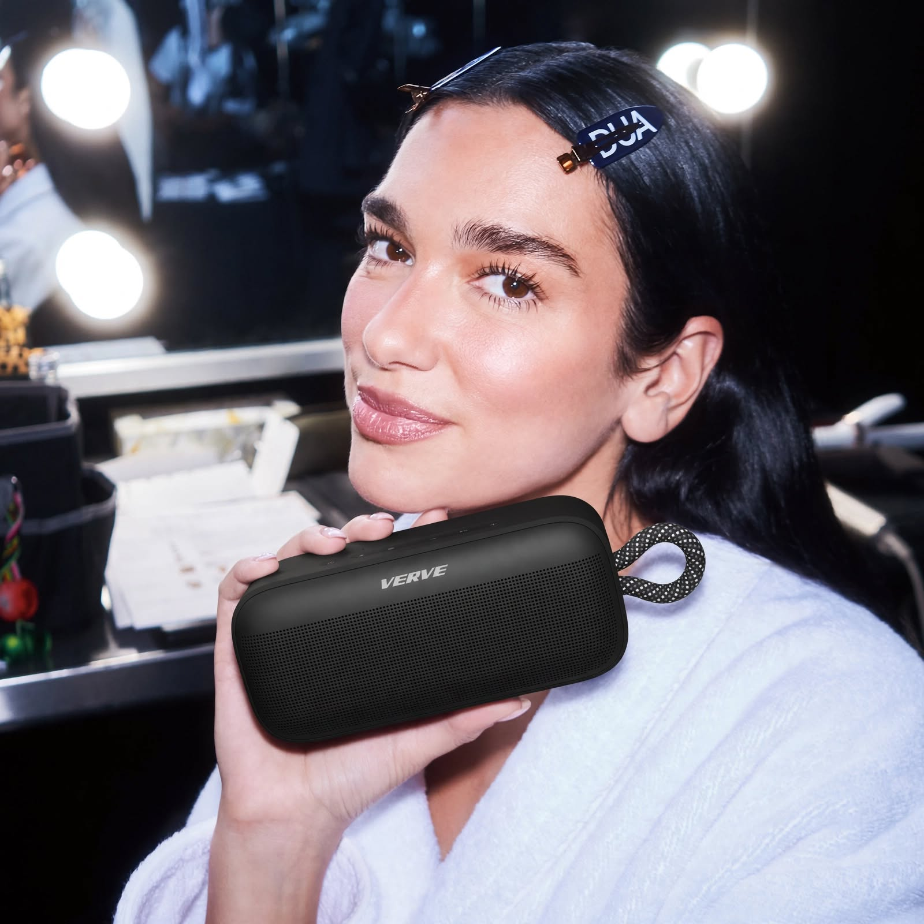
STUDY 2: EXTENSION
Can an Extrinsic Cue Change the Story?
According to Hsee's evaluability hypothesis, Halcyon should win when the speakers are compared, because comparison makes its lower distortion visible.
H2: Adding a celebrity association (an extrinsic cue) to Verve will widen Verve's price lead over Halcyon in a side-by-side comparison, even though its specs are worse.
EXTRINSIC CUE: INFLUENCER-STYLE POST
"Dua Lipa's Verve Era: Can't put it down, can't turn it off"
Global Customer Decision Making • Group Project Findings
9
Notes:
Our extension starts from the point where Hsee's theory leaves Verve. If Halcyon wins once shoppers compare the two speakers, is there anything Verve can do without changing its specifications? We tested an extrinsic cue, meaning a signal that comes from outside the product itself. Our second hypothesis is that adding a celebrity association to Verve will widen its price lead over Halcyon in a side-by-side comparison, even though its specifications are worse. We designed the cue as an influencer-style post showing Dua Lipa with the speaker under the caption, Dua Lipa's Verve Era.

Slide 10


STUDY 2: THEORY
Why We Think This Could Work
Two established theories both point the same way: when a product's real merit is hard to judge, a signal from outside the product can carry outsized weight.
CUE UTILIZATION THEORY
ELABORATION LIKELIHOOD MODEL
Olson & Jacoby, 1972
Petty & Cacioppo, 1986
Products send two kinds of signals. Intrinsic cues are part of the product itself, like our star rating and distortion rating. Extrinsic cues come from outside it, like price, brand, or an endorsement. When an intrinsic cue is hard to judge, people lean more on extrinsic cues instead.
People process persuasion two ways. The central route means engaging with real substance, like comparing distortion values. The peripheral route means relying on surface signals that take little effort, like a celebrity association. When the central route feels effortful, the peripheral route carries more weight.
Together: distortion is a hard-to-process intrinsic cue, which opens the door for an extrinsic, peripheral cue to carry outsized influence.
Global Customer Decision Making • Group Project Findings
10
Notes:
Two theories from class explain why we expected this to work. Cue Utilization Theory says that shoppers judge quality using both intrinsic cues, which are part of the product, and extrinsic cues, such as brand or endorsement, and that they rely more on extrinsic cues when the intrinsic ones are hard to interpret. The Elaboration Likelihood Model adds that when processing the real substance takes effort, people rely on easy peripheral signals, and a celebrity is a classic example. Distortion is exactly the kind of attribute that is hard to process, so we expected the celebrity to carry real weight.

Slide 11

STUDY 2: DESIGN
One New Condition, One Key Comparison
We keep all three replication groups, and add a fourth: the joint-evaluation screen, but with an extrinsic cue (a celebrity association) added to Verve Sound.
JOINT: BASELINE
JOINT + EXTRINSIC CUE → KEY TEST
Both speakers, no cue: our replicated joint-evaluation result (final n = 30)
Same comparison, but Verve's card shows Dua Lipa holding the speaker (final n = 27)
This single comparison, Joint-baseline versus Joint + Extrinsic Cue, is the entire extension experiment. Final N: 30 baseline, 27 with cue.
Global Customer Decision Making • Group Project Findings
11
Notes:
The design is a single, clean comparison. The baseline is our joint-evaluation group from the replication, which saw both speakers side by side. The new group saw exactly the same comparison, except that Verve's card showed Dua Lipa holding the speaker. We had 30 respondents in the baseline and 27 in the celebrity group. If our hypothesis is right, the celebrity group should value Verve noticeably more than Halcyon.

Slide 12
STUDY 2: RESULTS
Hypothesis vs. Actual Result
ACTUAL RESULTS, BY PRODUCT
H2
Predicted: As an extrinsic cue, the celebrity association is easy to evaluate alone, no comparison needed.
Predicted: We expected it to offset Halcyon's newly-visible distortion advantage, pulling preference back to Verve Sound.
Actual: Verve $89.53 → $104.96 (p = .139). Halcyon $84.59 → $100.33 (p = .055): both rose. Key test, the Verve − Halcyon gap: $6.31 → $4.63, t = 0.14, p = .890. H2 not supported.
Note: the no-cue Halcyon mean excludes one $40 response below the $50 to $200 range (n = 29). Celebrity-cue condition n = 27.
Global Customer Decision Making • Group Project Findings
12
Notes:
Here is what happened. The celebrity cue did raise Verve's price, from about $90 to about $105. However, Halcyon's price rose by almost exactly the same amount, from about $85 to about $100, even though the celebrity was attached only to Verve. The key test is the gap between the two speakers, and that gap barely moved, from about $6 to about $5, which is far from significant. In other words, the cue lifted the whole comparison rather than giving Verve an advantage, so our second hypothesis was not supported.

Slide 13
STUDY 2: WHY H2 WASN'T SUPPORTED
Six Likely Reasons
The cue was noticed (74% named Dua Lipa), so we looked at what else got in the way.
1
2
3
No Gap to Close
Pictures, Not Products
It Was Clearly a Survey
Hsee predicts Halcyon wins when compared, but Verve already led by $6.31 without the cue.
Respondents saw images and text, not a speaker they could hear or hold, a weak basis for judging value.
Respondents knew it was an academic survey, so prices were hypothetical, not real purchase decisions.
4
5
6
Dollars Mean Different Things
Who Answered Differed
Limited Power
Outside the US, $50 can sound cheap next to 5,000 rupees; unfamiliar currency leads to over- or underpaying.
Form 4 had more respondents from India; much of the shared price lift came from them.
With a ~$45 spread in the price gap, 56 respondents could not detect small effects.
Both prices rose about $15: a category-wide lift, not a Verve-specific gain. Controls and a recall-only check reach the same conclusion.
Global Customer Decision Making • Group Project Findings
13
Notes:
We know the cue was noticed, because about three-quarters of respondents correctly named Dua Lipa, so we looked for other explanations. The most important one is that there was no gap to close: Hsee's theory predicted that Halcyon would lead in the comparison, but without the cue Verve was already ahead by about six dollars. Respondents also saw pictures rather than real speakers, and they knew they were answering an academic survey rather than making a real purchase. Our international sample matters too, because for someone used to rupees, fifty dollars can sound cheap and lead to overpaying. Finally, the celebrity form happened to have more respondents from India, and our sample was too small to detect small effects.

Slide 14
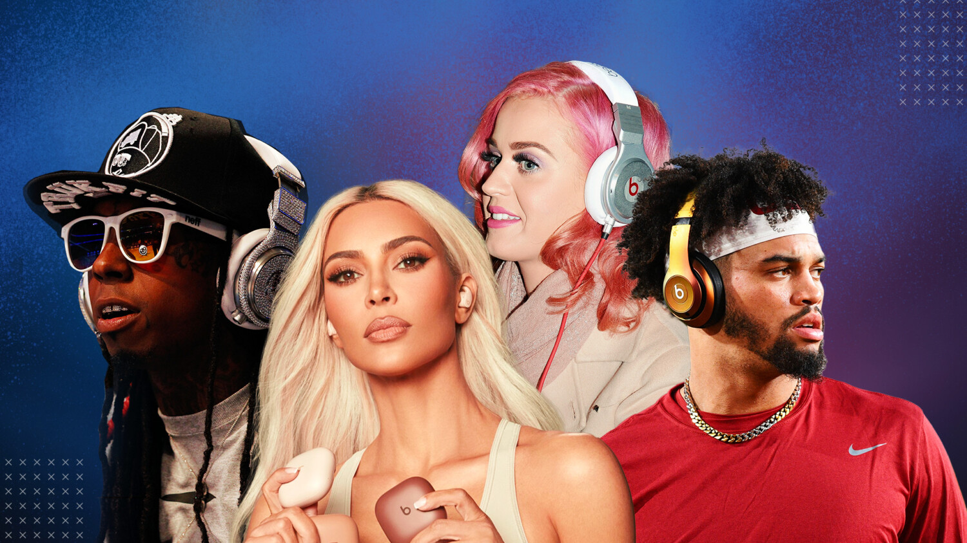
STUDY 2: REAL-WORLD PARALLEL
When Culture Outsells Specs
U.S. headphone brand ownership share, 2024
MEASURED LEADER
MEASURED LEADER
CULTURE LEADER
12.5%
11.4%
15.3%
BOSE
SONY
BEATS
Sennheiser and other pro-audio brands aren't tracked among leading consumer brands; that category is niche and enthusiast-driven, not mass-market.
Same parent, different playbook: Apple owns both. AirPods lean on specs and ecosystem (intrinsic cues); Beats leans on culture and celebrity (extrinsic cues), a deliberate choice, not an accident.
Correlation, not causation: real markets confound price, design, and marketing. Our experiment isolates the cue itself.
Source: ElectroIQ, “Headphones Statistics 2025” (U.S. consumer ownership data, 2024).
Global Customer Decision Making • Group Project Findings
14
Notes:
Even though our data did not confirm the hypothesis, the real market suggests that the idea behind it is sound. In the United States, Beats is used by more people than Bose or Sony, even though Bose and Sony are generally seen as the stronger brands on sound quality. Apple owns both AirPods and Beats, and it markets AirPods on features and ecosystem while it markets Beats on culture and celebrity. This is only a correlation, because real markets mix price, design and marketing, but it shows that extrinsic cues can win in the market, which is why our experiment tried to isolate the cue itself.

Slide 15





STUDY 2: MANAGERIAL IMPLICATIONS
If H2 Holds: What Marketers Should Do
1. Put the cue where comparison happens
2. Make the cue unmistakably product-specific
If you trail on a hard spec, place an easy extrinsic cue on comparison charts, shelf talkers and marketplace listings, not only in awareness ads.
Show the celebrity using the product with a visible brand mark, and judge success by price premium over rivals, not absolute willingness to pay.
3. Test other extrinsic cues, not only celebrities
Awards & Certifications
Celebrity Endorsement
Expert Recommendation
Country of Origin
Packaging Design
Retailer Prestige
Each cue works through a different mechanism, so each is worth testing wherever a brand must offset a technical disadvantage at the point of comparison.
Global Customer Decision Making • Group Project Findings
15
Notes:
If our extension hypothesis holds, managers can take three lessons from it. First, a brand that trails on a technical specification should put an easy extrinsic cue exactly where shoppers compare products, such as comparison charts and marketplace listings. Second, the cue must be clearly tied to the product, and success should be measured by the price premium over competitors, because our results show that a cue can lift the whole category. Third, celebrities are only one option, so managers should also test awards, expert recommendations, country of origin, packaging and retailer prestige.

Slide 16
CLOSING
Thank You
We are happy to take your questions.
Global Customer Decision Making • Group Project Findings
16
Notes:
To close, neither of our hypotheses was supported, but both studies showed us how sensitive these effects are to the way products and cues are presented. Thank you for listening, and we are happy to take your questions.

