Slide 1


PEARL CREDIT
UNION BANK
BUILT FOR YOU. OWNED BY YOU.
Presented By : GROUP 5
TGM 586 Global Entrepreneurship and Sustainable Business
Guided By: Professor Susan Harmeling

Slide 2
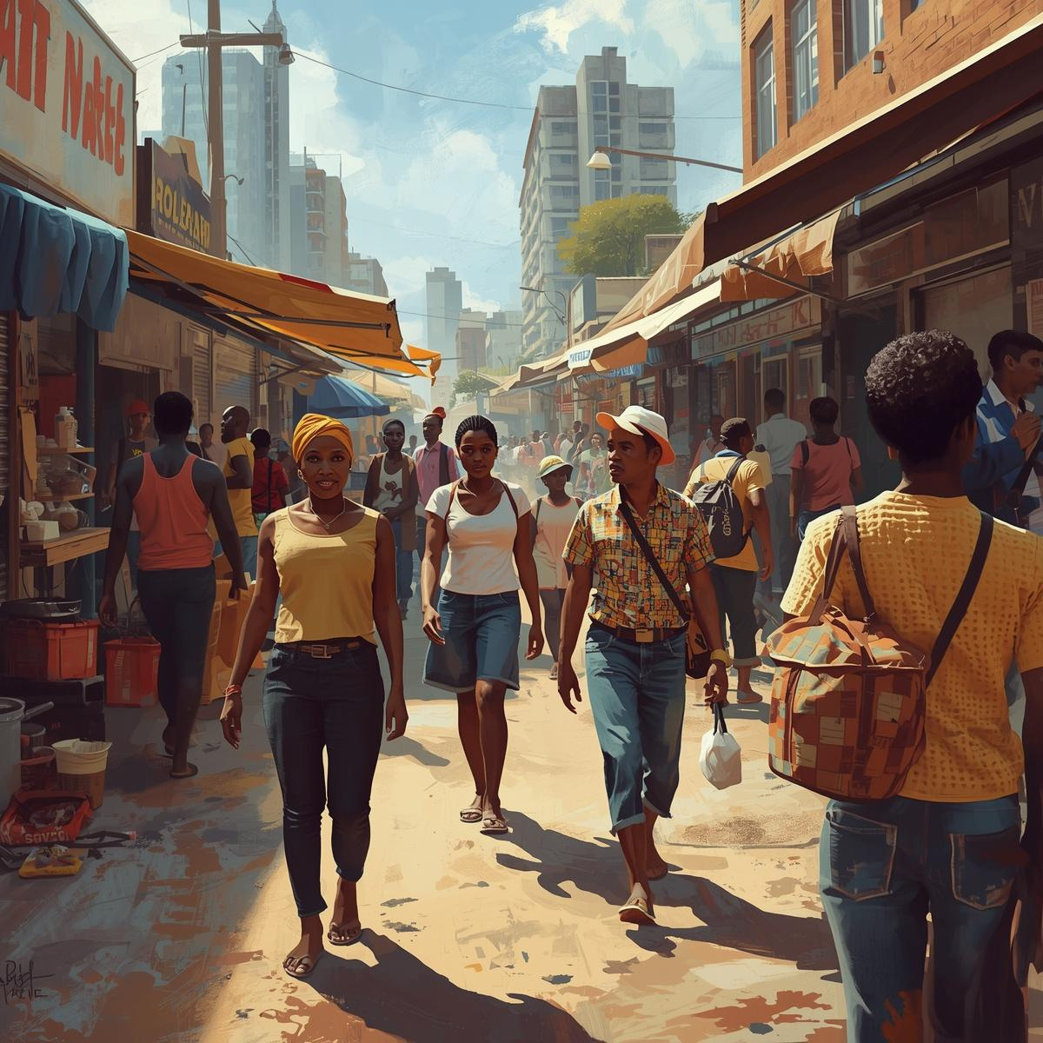


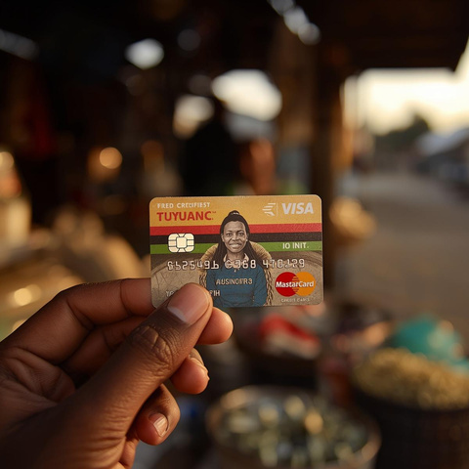
WHAT IS PCUB ?
BANKING FOR ZIMBABWE'S 80% : THE PEOPLE FORMAL BANKS LEFT BEHIND.
Zero-Fee Banking
Behavior-Based Credit
Branch-Light Digital Access
USD 14.2B
JOIN VIA MOBILE OR KIOSK (< 15 MIN)
BUILD CREDIT FROM DAILY TRANSACTIONS
INFORMAL ECONOMY LOCKED OUT OF FORMAL CREDIT IN ZIMBABWE
BUILT FOR YOU. OWNED BY YOU.
Access loans from USD 50 → mortgage

Slide 3
TARGET AUDIENCE
STARTING: HARARE
→ BULAWAYO · MUTARE · GWERU
INFORMAL SECTOR WORKERS
SALARIED PAYROLL EARNERS
PROFESSIONALS
  3 MILLIon ZimbabwEans abroad
  USD 2B in annual remittances
  Target for credit card & mortgage products (Year 3+)
  Market traders (5K/day)
  Welders & manufacturers
  drivers, Resellers
  Earn real income-denied banking for lack of paperwork
  500,000 workers nationwide
  teachers, nurses, police
  Entry-level & Seniors
  Private sector
.

Slide 4

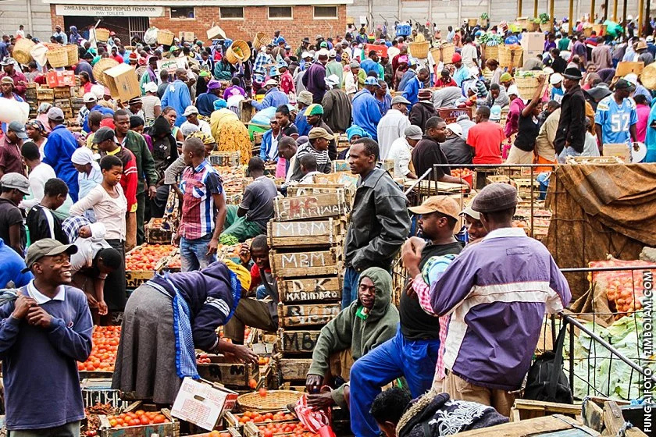

GO-TO MARKET STRATEGY
Physical Proximity
Be where customers already transact
Behavioral Trust-Building
Consistency replaces brand legacy
Ecosystem Integration
Embed into existing financial behavior

Slide 5

MVP- FIRST 6 MONTHS PLAN
FIRST 6 MONTH
Months 1 to 2
Start the mobile platform (basic version)
• Set up two or three test kiosks
Months 3 to 4
• Get early users (traders and workers) on board
• Begin with little loans ($50 to $500)
MONTHS 5–6
  Get information from users
  Make credit scores better
  Open up more places

Slide 6



Banking in Your Pocket
TESTING (CUSTOMER DISCOVERY INSIGHTS)
What We Learned from Interviews
  People don't trust banks
  Fees turn people off
  Mobile money is the most common way to pay every day.
  It's hard to get loans
  It takes patience to trust

Slide 7


WHAT WE CHANGED AFTER TESTING
Before
  Keep an eye on cheap fees
  Pay attention to online banking
After Interviews
  Price is not as crucial as trust
  Getting cash is really important
  Protecting the USD is important
  Keep it simple

Slide 8




WHERE DID WE GET THESE PROJECTIONS?
Reserve Bank of Zimbabwe
  August 2025 Mid-Term Monetary Policy Review
  February 2025 Monetary Policy Statement (CAR 34.89%)
  Banking Sector Quarterly Report, 31 March 2025
Market & Demand Data
  ZIMSTAT 2023 Economic Census
  FinScope MSME Survey 2022 (FinMark Trust, ZIMSTAT, RBZ, World Bank)
  ZIMSTAT 2025 GDP rebasing: USD 52.4B total economy
  Cross-checked: IMF Article IV July 2024 + US State Dept 2025
Pricing Benchmarks
  Parliamentary Budget & Finance Committee consultations, 2025 MPS
  Bank tariff analysis, March 2025 (AFC, Stanbic, FBC, CBZ, NMB)

Slide 9
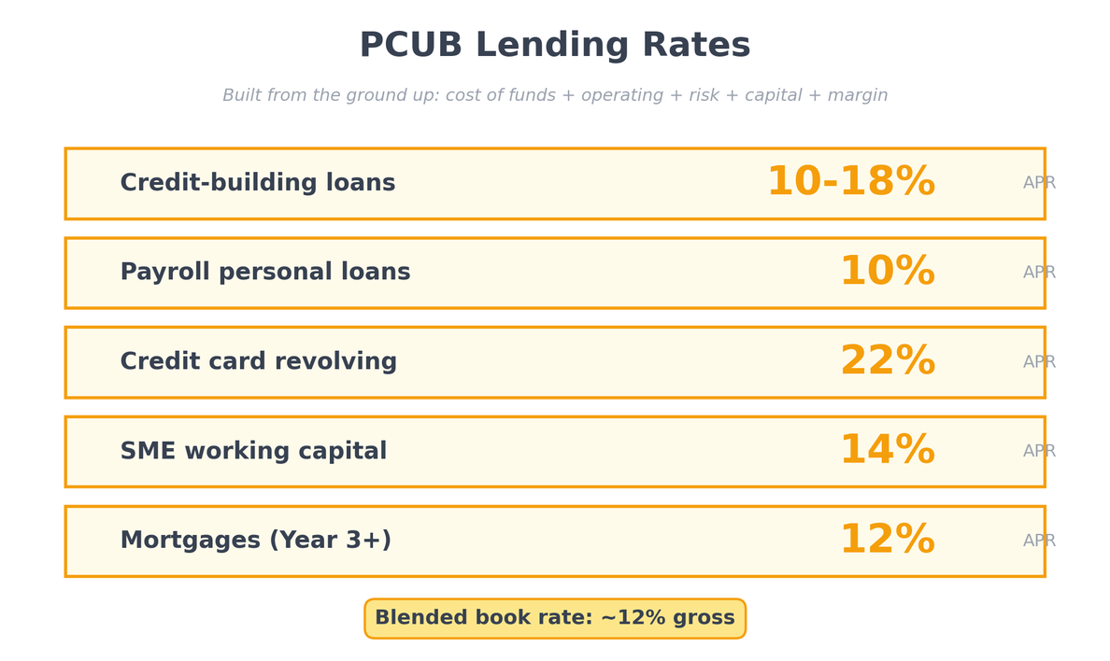
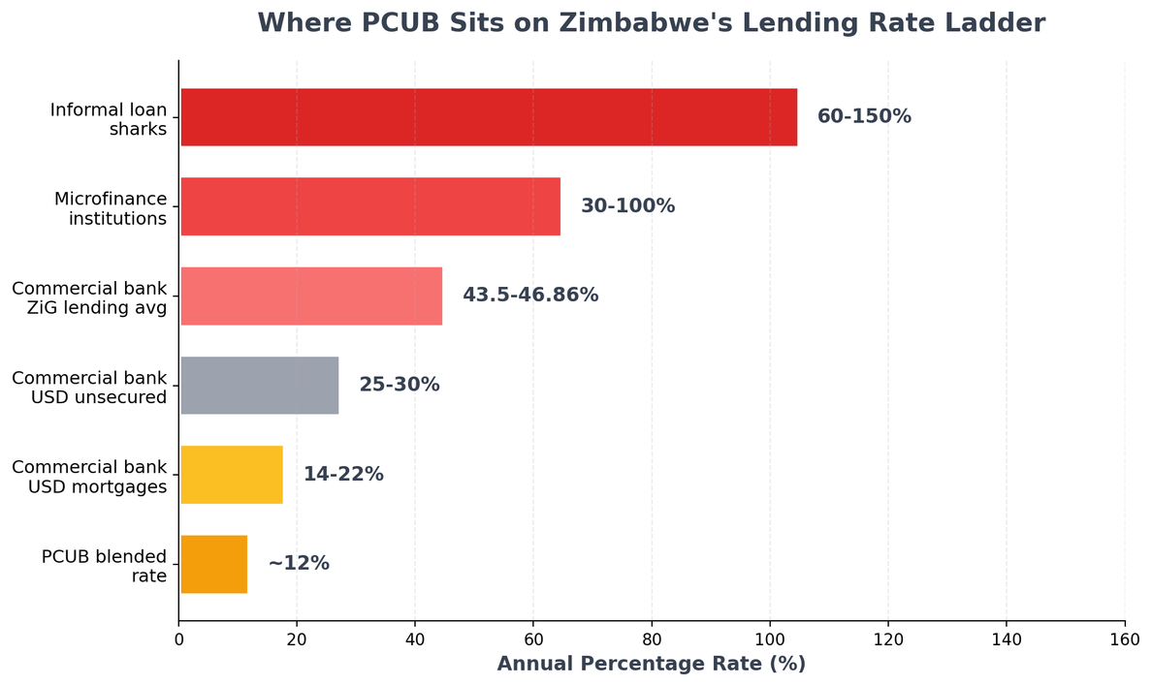
UNIT COSTS AND UNIT PRICES
  PCUB undercuts commercial banks on USD lending by 2 to 8 percentage points, while still turning a profit because our cost base is lower.
  On fees, we charge nothing for four out of five common services. The only fee we keep is a 1 percent over-the-counter withdrawal to cover cash handling at the kiosk. Why can we afford this? Because Zimbabwean banks pull 22 percent of their revenue from fees that are not tied to any real cost. That is extracted rent. We give it back to members and earn it back through lending volume.

Slide 10



THANK YOU!

