Slide 1


Indian Coin
Denomination
Classification
Shape & Texture Features · Classical ML · No Deep Learning
₹1 ₹2 ₹5 ₹10 ₹20
| Kaggle ICDD Dataset

Slide 2

Team & Project Overview
Angel George
Vishnumaya
Anagha C
BioAI
CSDA
DACS
Reg: 253203
Reg: 253013
Reg: 253126
Project Goal
Classify Indian coin denominations (₹1, ₹2, ₹5, ₹10, ₹20) from photographs using classical machine learning — no deep learning. Features extracted via shape, texture, and color descriptors after segmenting the coin using Circular Hough Transform.

Slide 3

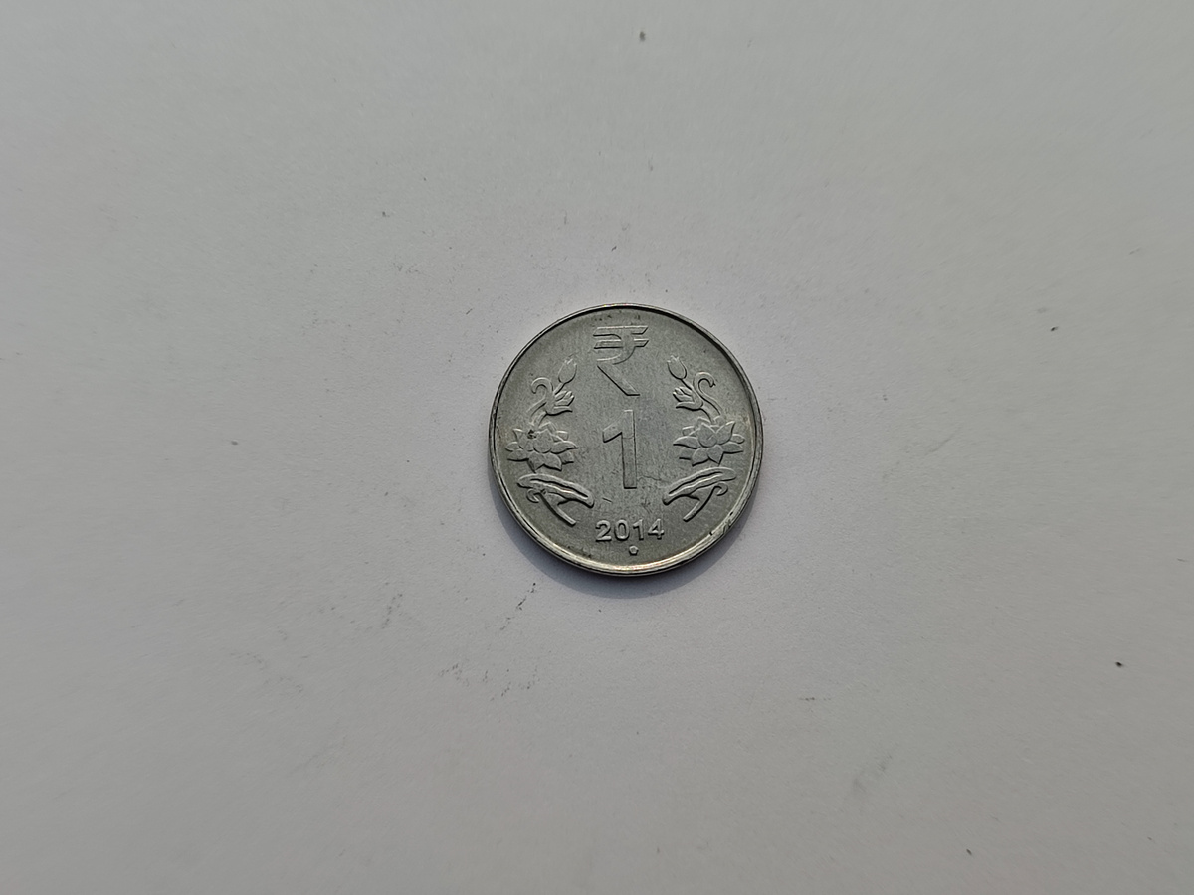
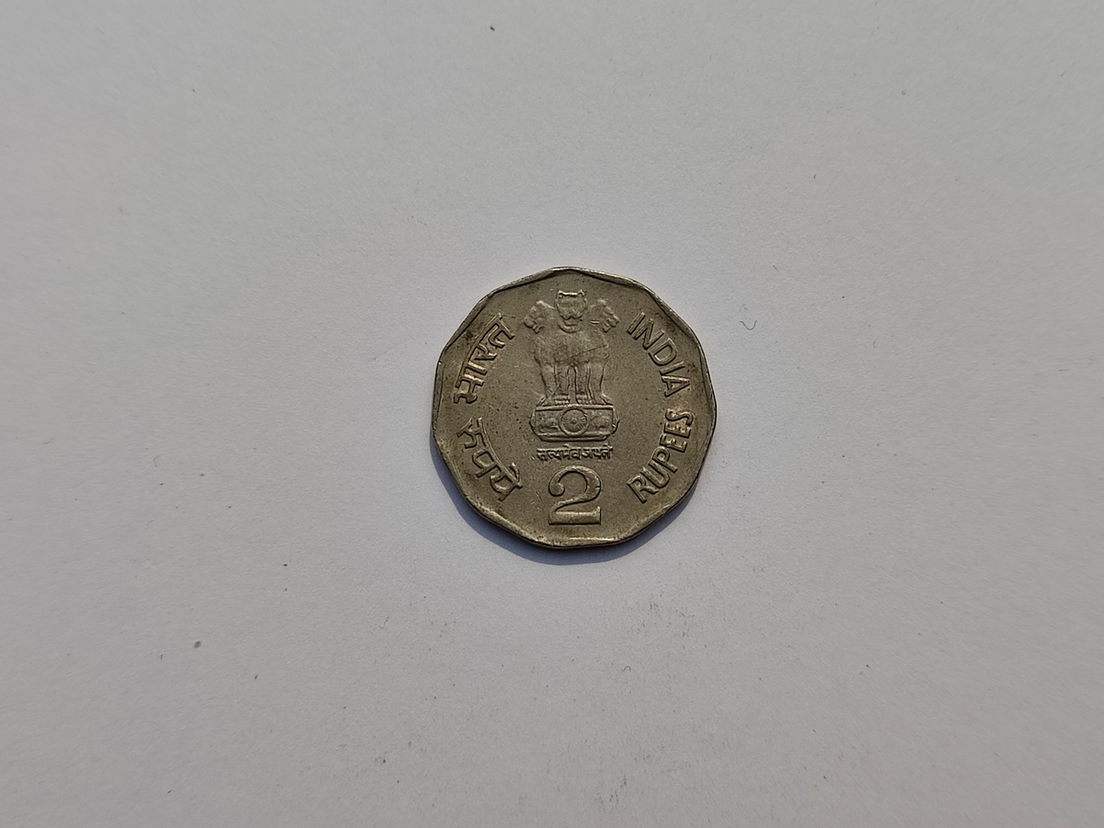
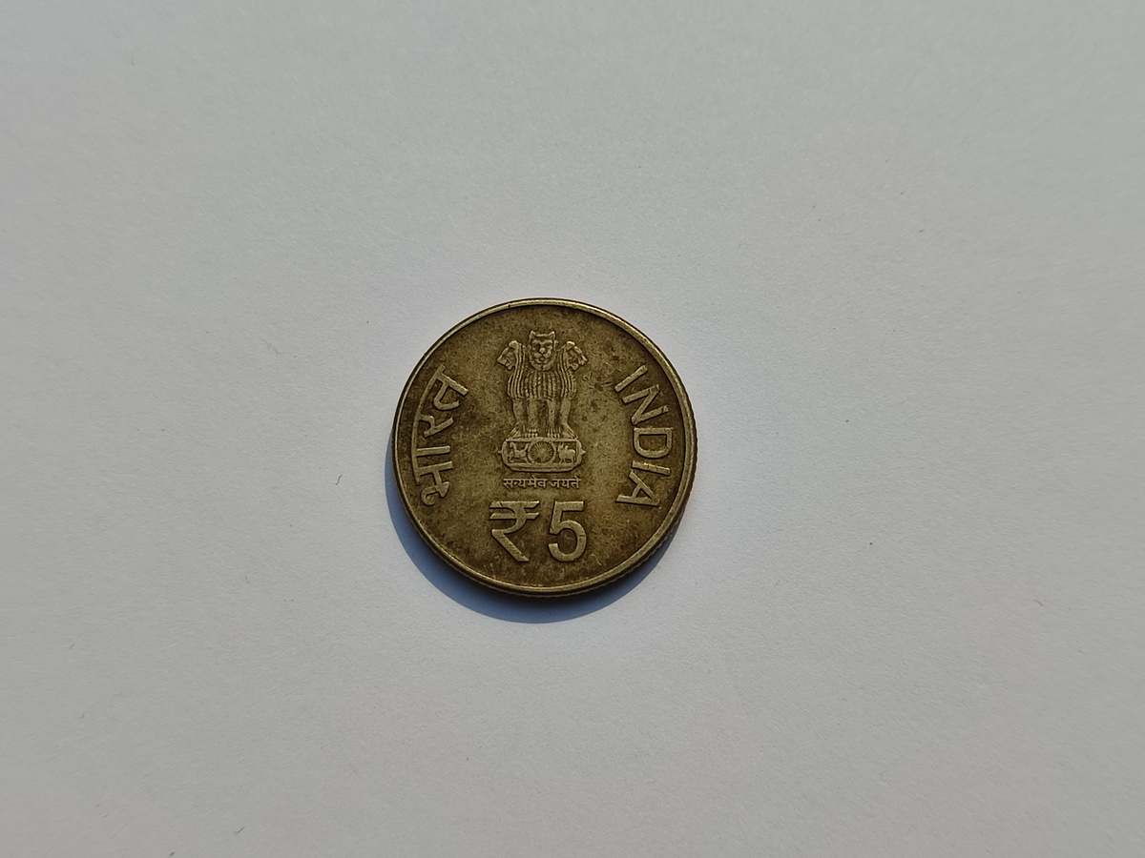
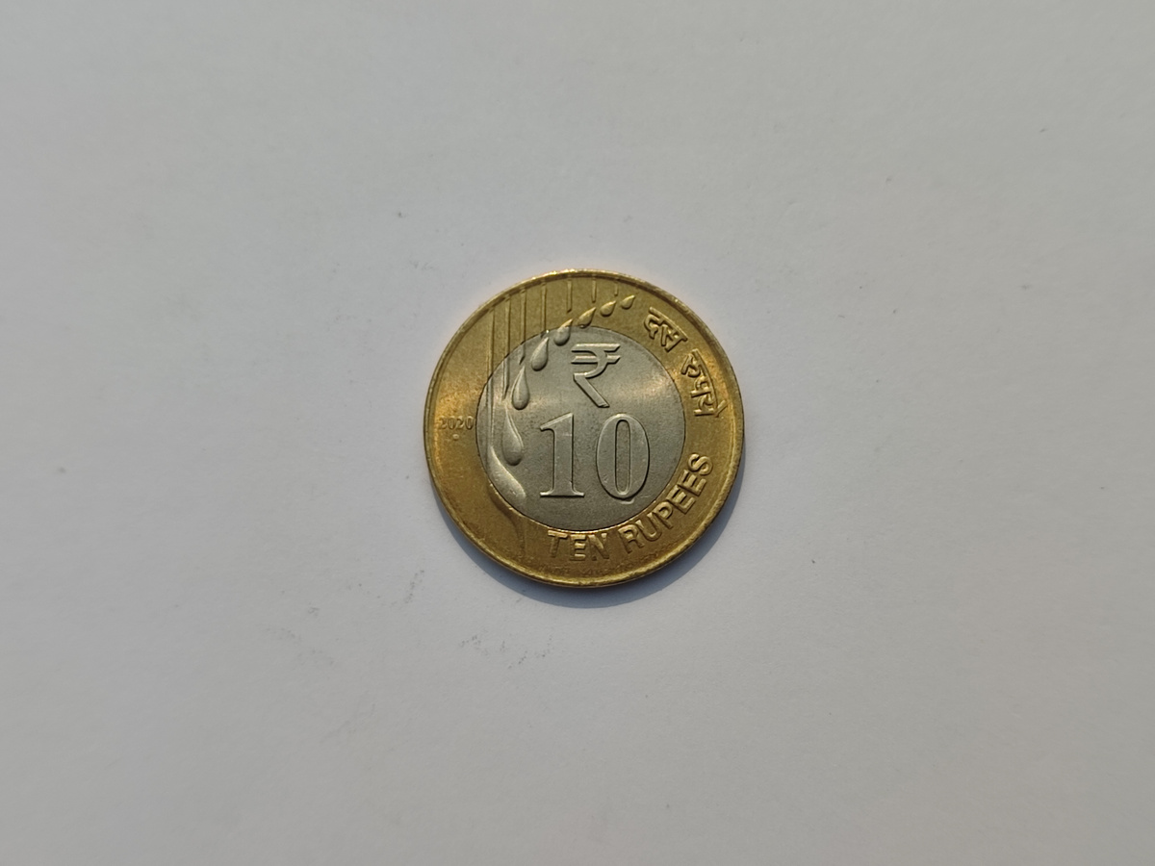
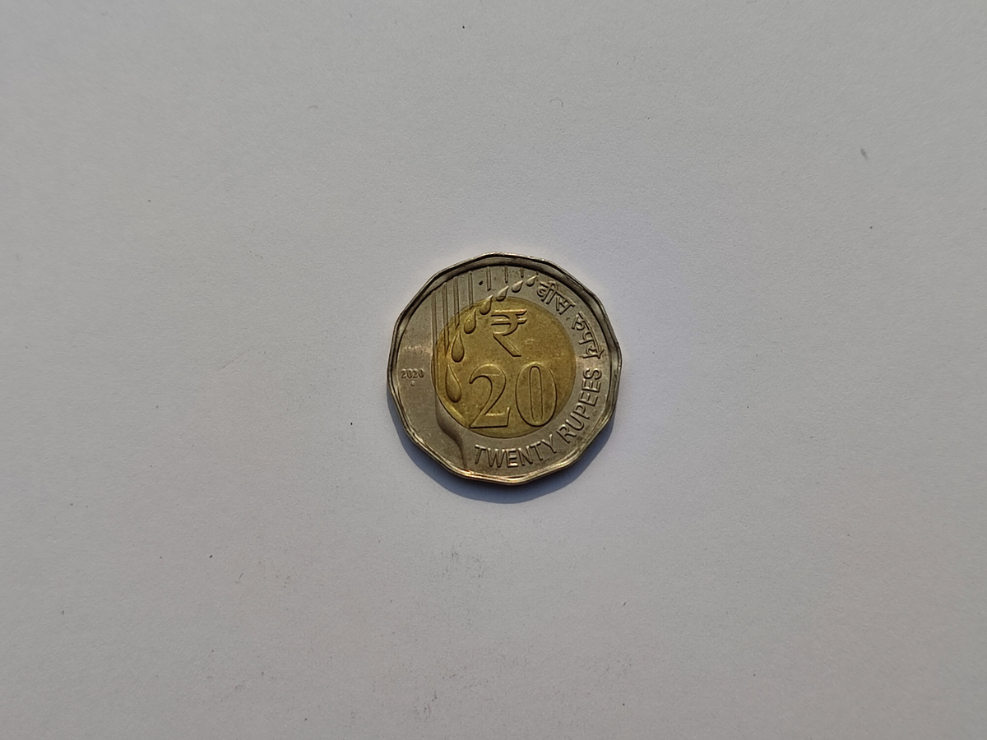
Dataset Overview
₹1
₹2
₹5
₹10
₹20
Ferrit. Steel · 21.9mm
Stainless · 25mm
Brass · 23mm
Bi-metallic · 27mm
Bi-metallic · 27mm
900
5
180
80/20
Total Images
Coin Classes
Per Class (avg)
Train/Test Split
Source: Kaggle — Indian Coin Denomination Dataset (ICDD)

Slide 4

Processing Pipeline
1
2
3
4
5
6
Input Image
Preprocess
Segment
Extract
Scale
Classify
Raw coin photograph
(JPG/PNG)
Resize 256×256
Gaussian Blur
Circular Hough
Transform
5 feature types
extracted
StandardScaler
normalization
ML model
prediction
Key Design Choices
• Circular Hough Transform isolates only the coin region, eliminating background noise
• If no circle detected, falls back to full grayscale image — robust to detection failures
• Feature vector combines shape (diameter), texture (LBP, HOG), and color (HSV) for a holistic descriptor

Slide 5

Feature Extraction
1
Diameter Ratio
dim: 1
radius / 128.0 — normalized coin size, differentiates denominations by physical dimension
2
Edge Density
dim: 1
Canny edge detector (100–200 thresholds) — captures embossing & engraving complexity
3
LBP Histogram
dim: 26
Local Binary Pattern (radius=3, 24 pts, uniform) — encodes surface texture & coin embossing
4
HOG Features
dim: 200
Histogram of Oriented Gradients (9 orientations, 16×16 cells) — captures structural edge layout
5
HSV Histogram
dim: 64
8×8 bin joint hue-saturation histogram — distinguishes silver, brass, bi-metallic coins
Total Feature Vector Length: 292 dimensions (1 + 1 + 26 + 200 + 64)

Slide 6

ML Classifiers Evaluated
🏆 Best
2nd
3rd
Random Forest
SVM (RBF)
KNN (k=5)
Accuracy: 70%
Accuracy: 58%
Accuracy: 61%
n_estimators=100, random_state=42
kernel='rbf', random_state=42
n_neighbors=5
Strengths
Strengths
Strengths
✓ Handles high-dimensional features well
✓ Effective in high-dimensional space
✓ Simple, interpretable
✓ Robust to noise & outliers
✓ Good for non-linear boundaries
✓ No training time
✓ No feature scaling needed (but used)

Slide 7

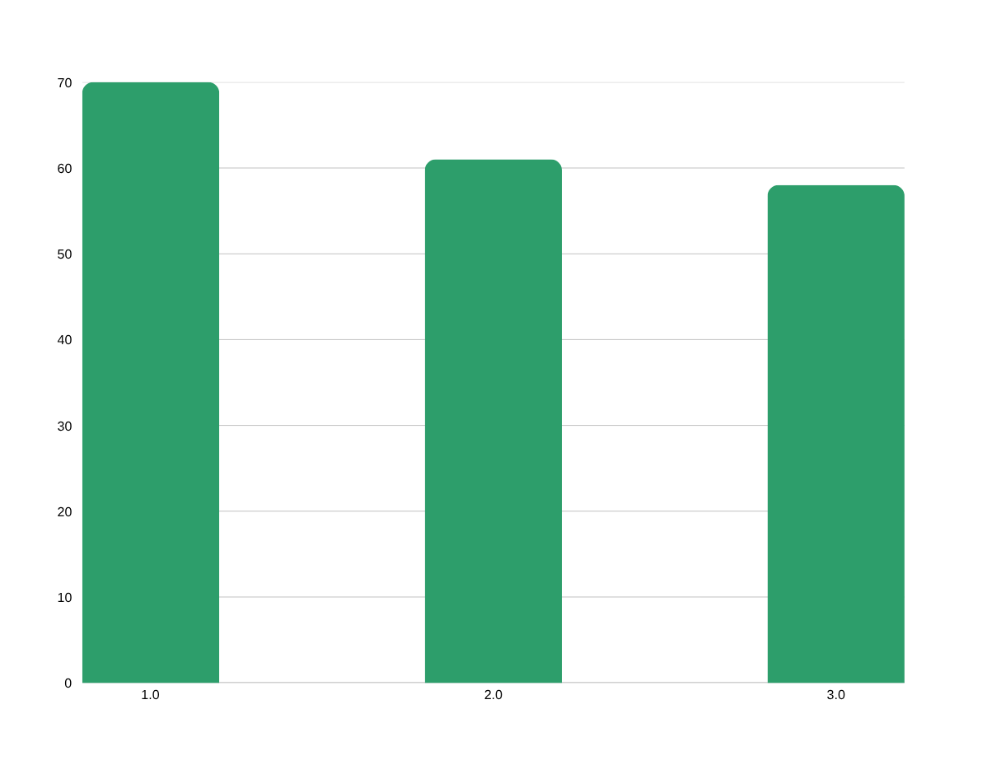

Model Performance Results
Random Forest — Per-Class Results
Class | Precision | Recall | F1
₹1 | 0.59 | 0.83 | 0.69
₹2 | 0.67 | 0.25 | 0.36
₹5 | 0.79 | 0.70 | 0.75
₹10 | 0.74 | 0.86 | 0.79
₹20 | 0.73 | 0.67 | 0.70
₹2 has lowest F1 (0.36) — its scalloped edge
& similar size to ₹1 confuses the model

Slide 8
Confusion Matrix — Random Forest
Predicted
₹1
₹2
₹5
₹10
₹20
₹1
35
1
1
2
3
Key Observations
Actual
₹10 → best recall (86%): distinctive bi-metallic ring
₹2
8
6
5
2
3
₹1 → good recall (83%): smallest, unique steel color
₹5
4
2
38
3
7
₹2 → weakest (25% recall): confused heavily with ₹1
₹10
2
1
1
31
1
₹20 → moderate (67%): scalloped edge helps somewhat
₹5 → solid (70%): brass color separates it well
₹20
3
2
5
2
16

Slide 9
SVM vs KNN — Detailed Comparison
SVM (RBF) — 58%
KNN (k=5) — 61%
Class | Prec. | Recall | F1
₹1 | 0.50 | 0.90 | 0.64
₹2 | 0.00 | 0.00 | 0.00
₹5 | 0.58 | 0.70 | 0.63
₹10 | 0.77 | 0.56 | 0.65
₹20 | 0.75 | 0.38 | 0.50
Class | Prec. | Recall | F1
₹1 | 0.52 | 0.69 | 0.59
₹2 | 0.43 | 0.38 | 0.40
₹5 | 0.80 | 0.52 | 0.63
₹10 | 0.62 | 0.89 | 0.73
₹20 | 0.75 | 0.50 | 0.60
⚠ Notable: SVM completely failed to predict ₹2 (0% precision & recall) — likely due to class imbalance and feature overlap with ₹1. KNN provides a more balanced performance across all classes despite lower accuracy than Random Forest.

Slide 10
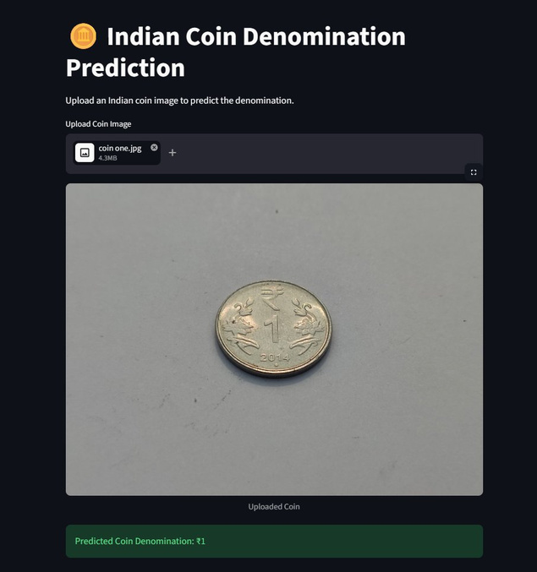
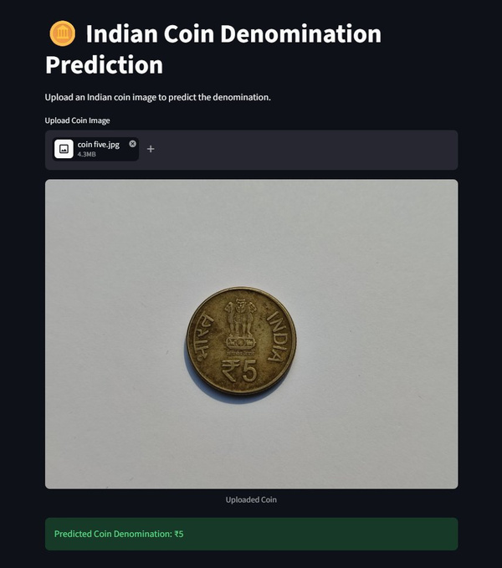
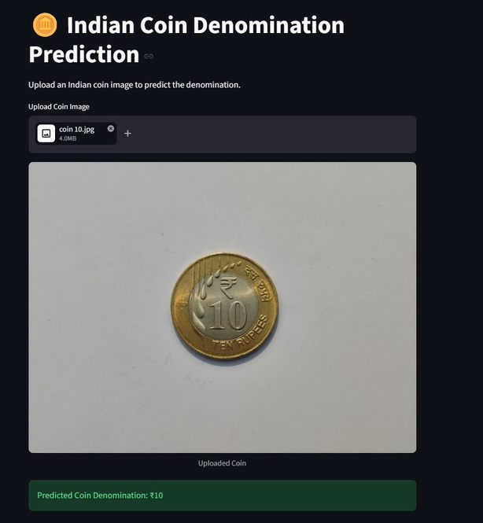
Live Streamlit Application
₹1 Predicted ✓
₹5 Predicted ✓
₹10 Predicted ✓
🔗 https://coin-denomination-classification.streamlit.app/
Upload any Indian coin image (JPG/PNG) → instant denomination prediction using the deployed Random Forest model

Slide 11

Limitations & Challenges
✓ Works Well
✗ Works Less Well
Dataset images (Kaggle ICDD) — 70% accuracy
Real-world photos with varied backgrounds
Clear, well-lit, centered coin photos
Low-light or overexposed images
Coins photographed against plain background
Heavily worn, old, or scratched coins
Standard modern Indian coin designs
Tilted or partially visible coins
₹10 and ₹1 — best per-class performance
₹2 — consistently weakest (F1: 0.36)

Slide 12
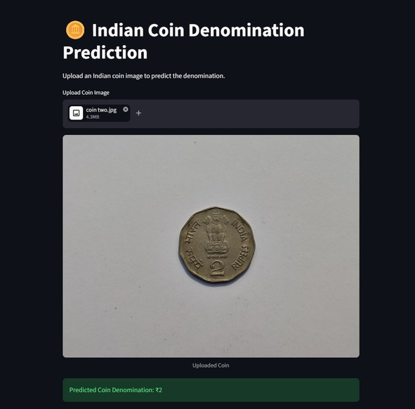
Deep Dive: Why ₹2 is the Hardest to Classify
Similar Size to ₹1
Scalloped Edge
Both coins are close in physical diameter, making the diameter_ratio feature a weak discriminator between these two classes.
The ₹2's distinctive wavy edge should help, but Circular Hough Transform treats it as a circle — losing the edge shape information.
Color Overlap
Fewer Samples
₹2 Rupee Coin
Both ₹1 (steel) and ₹2 (cupro-nickel) appear silver-toned. The HSV histogram cannot reliably separate them.
₹2 has only 24 test samples — the smallest support, making evaluation noisy and the class more prone to underfitting.

Slide 13

Future Improvements
01
Robustness
02
Data
03
Features
Better Segmentation
Augment Training Data
GLCM Texture Features
Replace Circular Hough Transform with a learned segmentation model (e.g. SAM or GrabCut) to handle worn coins, tilted angles, and non-circular shapes like ₹2's scalloped edge.
Apply rotation, blur, brightness jitter, and perspective transforms to simulate real-world conditions. Oversample the ₹2 class to address imbalance.
Add Gray-Level Co-occurrence Matrix (GLCM) features (contrast, correlation, energy) which are better suited to distinguishing coin relief patterns.
04
Model
05
Input
06
Features
Ensemble / Stacking
Multi-view Input
Edge Geometry Features
Stack RF + SVM + KNN with a meta-learner to combine complementary strengths of each classifier, especially for the harder ₹2/₹20 classes.
Capture both obverse and reverse of each coin — head + tail views together contain more denomination-specific information than a single face alone.
Explicitly encode edge contour shape (number of scallops, reeds) using Fourier descriptors or polygon approximation to leverage ₹2's unique border.

Slide 14
Conclusion
Successfully classified 5 Indian coin denominations using classical ML with 70% accuracy (Random Forest)
Feature engineering combining shape, texture (LBP, HOG), and color (HSV) is effective for coin recognition
Random Forest outperforms SVM and KNN, especially in cross-class discrimination
₹2 remains the hardest class — size and color similarity with ₹1 is the core challenge
Model works well on clean Kaggle dataset images but has limited robustness on real-world photos
Future work: better segmentation, data augmentation, and edge geometry features can push accuracy higher
Thank you • Questions welcome 🪙

