Slide 1

WILDFIRE RISK CLASSIFICATION
Using ML Models - SVM, Random Forest & XGBoost
Presented By:
Anagha Jayarajan (253201)
M R Lekshmi Priya (253011)
Akshay B S (253014)

Slide 2
PROBLEM STATEMENT
Predict wildfire risk level for a given location and environmental conditions.
Target classes:
Low (🟢): Minimal fire activity; low FRP and benign meteorological conditions.
Medium (🟡): Moderate conditions with potential for fire ignition/spread.
High (🔴): Elevated fire danger — high FRP, high temperature, low humidity, strong winds.
Success criteria:
High F1-macro and balanced precision/recall across classes (minimize missed high-risk areas and false high-risk alarms).
Robust performance on spatially separated test sets (generalizes to new regions).

Slide 3
DATASET — NASA FIRMS
Source: NASA FIRMS (Fire Information for Resource Management System) — public active-fire satellite dataset (MODIS/VIIRS).
Data Types: Satellite-derived detections + ancillary meteorological variables.
Key Features used in this project:
Spatial: Latitude, Longitude
Satellite-derived: Brightness, Brightness_T31, Scan, Track, FRP (Fire Radiative Power)
Detection: Confidence, Day/Night indicator, Detection time (timestamp)
Meteorological / Environmental: Temperature, Humidity, Wind Speed, Drought Index (where available)
Metadata: Source sensor, acquisition time
Usage in project:
Basis for feature matrix and target labels for SVM, Random Forest, and XGBoost
Spatial split used to evaluate geographic generalization
:
Key EDA takeaway: FRP and meteorological variables are primary predictors; spatial clustering and class imbalance require careful splitting and weighting.

Slide 4
PREPROCESSING & FEATURE ENGINEERING
Data cleaning:
Standardize column names and parse timestamps
Remove duplicates, invalid coordinates, and extreme outliers
Convert numeric-like strings to numeric types
Missing value handling:
Use SimpleImputer (median for numeric, most_frequent for categorical)
Drop rows with irrecoverable missing coordinates or timestamps
Encoding & scaling:
One-hot encode categorical flags (day/night, sensor)
Label-encode target classes
Scale numeric inputs (StandardScaler) inside a ColumnTransformer pipeline

Slide 5
Feature creation:
Derive risk bins from FRP / composite index (Low/Medium/High)
Temporal features: hour, day-of-year, season
Spatial features: lat, lon; optional clustering (region id)
Interaction features: FRP × temperature, humidity × wind_speed
Pipeline & persistence:
Build preprocessing pipeline with ColumnTransformer + Pipeline
Fit on training data; save fitted scaler, encoder, and pipeline with joblib
Ensure identical preprocessing during deployment (Streamlit app)
Spatially-aware data splitting: Create geographically disjoint train/test sets to prevent leakage (e.g., cluster coordinates and hold out clusters, or use GroupShuffleSplit with region IDs)
Rationale: Neighboring coordinates are correlated; random splits overestimate generalization
Stratification: Stratify splits by target class to preserve class proportions where possible

Slide 6
SuPPORT VECTOR MACHINE (SVM)
Type: Kernel-based classifier (e.g., RBF kernel)
Use: Baseline high-capacity classifier for tabular features
Pros: Good decision boundary flexibility; strong when features are well-separated
Cons: Sensitive to scale, slow on large datasets, and prone to leakage/overfitting with spatial data
Typical settings: C and gamma grid search; standardize inputs before training
Notes from project: Achieved very high accuracy (~99.5%) but likely affected by target leakage or overly easy random split

Slide 7
RANDOM FOREST CLASSIFIER
Type: Ensemble of decision trees (bagging)
Use: Interpretable baseline with built-in feature importance
Pros: Handles non-linearities, robust to noisy features, minimal scaling required
Cons: Can underperform gradient-boosted methods on complex patterns; may need many trees for stability
Typical settings: number of trees (n_estimators), max depth, class weighting for imbalance
Notes from project: Good interpretability; lower performance (~77.4% accuracy) relative to XGBoost

Slide 8
XGBOOST CLASSIFIER
Type: Gradient-boosted decision trees
Use: Final production model for best accuracy and spatial generalization
Pros: Excellent predictive performance, handles missing values, captures complex feature interactions, fast with optimized implementation
Cons: More hyperparameters to tune; risk of overfitting without proper CV
Typical settings: n_estimators, max_depth, learning_rate, subsample, colsample_bytree, early stopping on validation
Notes from project: Best overall — 92.2% accuracy and F1-macro 0.922; robust under spatial train/test splits, selected for deployment

Slide 9
┌─────────────────────┐
Data Collection
NASA FIRMS + APIs
└─────────┬───────────
▼
┌─────────────────────┐
Ingestion & Check
Parse + Validate
└─────────┬───────────┘
▼
┌─────────────────────┐
Data Cleaning
Missing + Outliers
└─────────┬───────────┘
▼
┌─────────────────────┐
Feature Engineering
Temporal + Spatial
└─────────┬───────────┘
▼
┌─────────────────────┐
Preprocessing
Scale + Encode
└─────────┬───────────┘
▼
┌─────────────────────┐
Train/Test Split
Spatial Holdout
└─────────┬───────────┘
▼
┌─────────────────────┐
Model Training
RF / SVM / XGBoost
└─────────┬───────────┘
▼
┌─────────────────────┐
Evaluation
Acc, F1, Confusion
└─────────┬───────────┘
▼
┌─────────────────────┐
Deployment
Streamlit Web App
└─────────────────────┘
PROJECT
PIPELINE

Slide 10
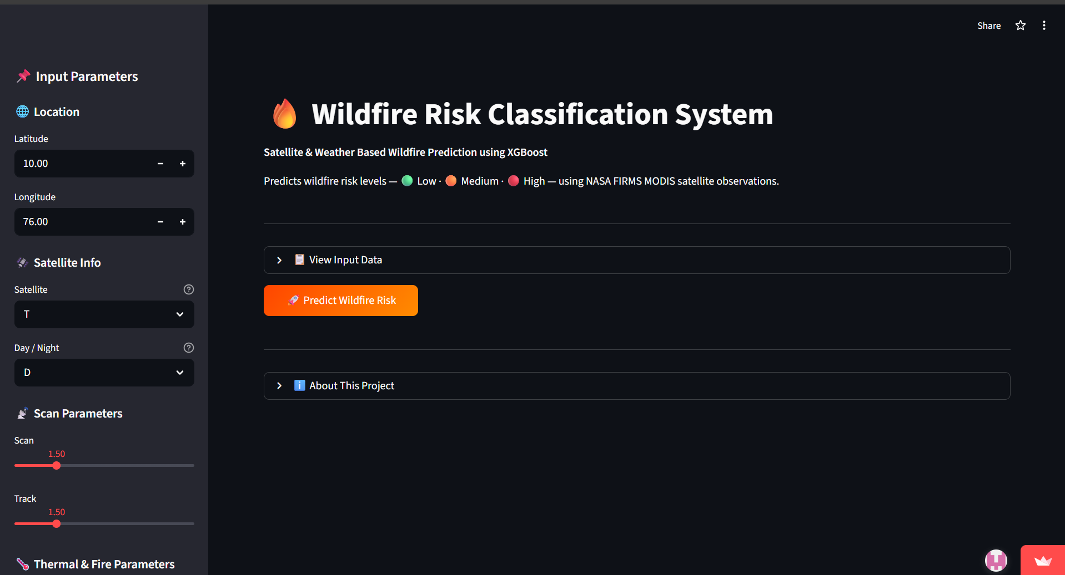
Deployed via Streamlit
Link: https://wildlife-risk-classification-hmhgxew5ym8wycpsdoegi8.streamlit.app/
PREVIEW

Slide 11
MODEL EVALUATION
SVM — Accuracy: 99.5% | F1‑Macro: 0.995 — likely target leakage / overly easy random split
Random Forest — Accuracy: 77.4% | F1‑Macro: 0.74 — Interpretable baseline, lower predictive power
XGBoost — Accuracy: 92.2% | F1‑Macro: 0.922 — Best balance of accuracy and robustness
Key takeaway: XGBoost maintains high, balanced performance while Random Forest underfits and SVM’s near-perfect score is suspicious.

Slide 12
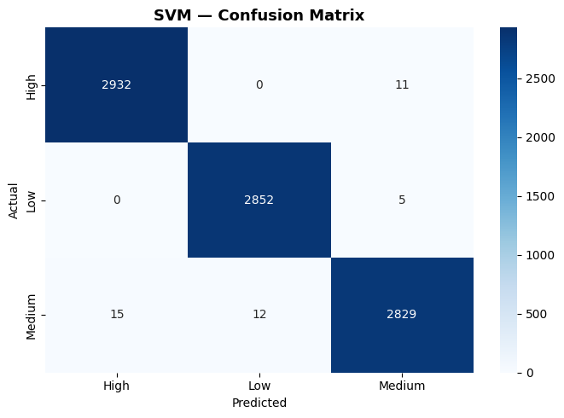
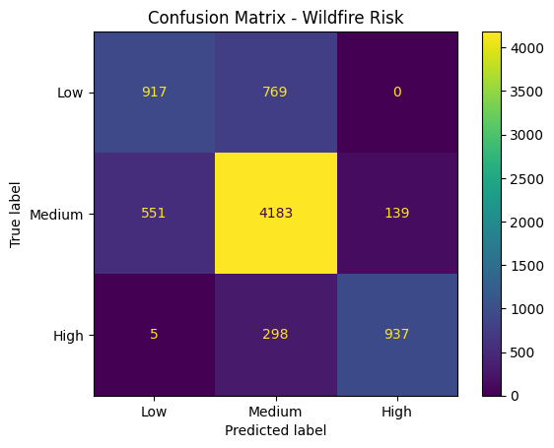
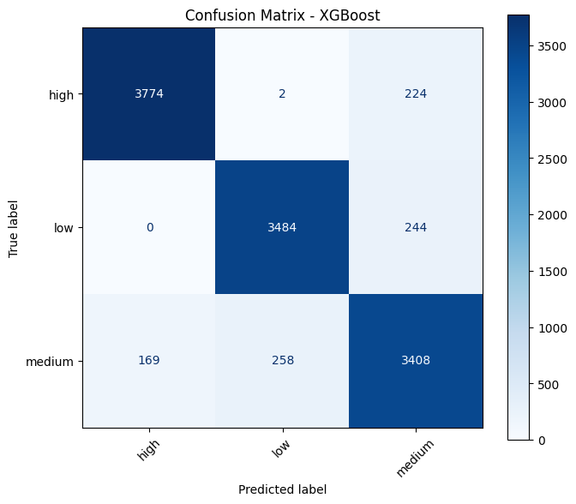
CONFUSION MATRICES

Slide 13
CONCLUSION
Project outcome: Built a reproducible pipeline to predict wildfire risk (Low / Medium / High) using NASA FIRMS satellite and meteorological data.
Best model: XGBoost chosen for production — 92.2% accuracy and 0.922 F1‑Macro, with good spatial generalization.
Reliability note: SVM’s near-perfect accuracy likely indicates data leakage; spatial train/test splits produce more realistic evaluation.
Limitations: Data limited to FIRMS, class imbalance, and static models (no streaming/temporal retraining).
Next steps:
Integrate live weather feeds and real-time satellite ingestion.
Add temporal models (LSTM/CNN) for spread prediction.
Improve spatial visualization (Folium/Kepler.gl) and mobile delivery.
Establish continuous retraining + monitoring for model drift.

Slide 14
THANK
YOU

