Slide 1
Digital Portfolio
STUDENT NAME: ANAGHA.K
REGISTER NO AND NMID: 2422J1164
DEPARTMENT: BCA
COLLEGE: COLLEGE/ UNIVERSITY:BHARATIAR UNIVERSITY

Slide 2
PROJECT TITLE
DIGITAL PORTFOLIO WEBSITE

Slide 3


AGENDA
Problem Statement
Project Overview
End Users
Tools and Technologies
Portfolio design and Layout
Features and Functionality
Results and Screenshots
Conclusion
Github Link
3/21/2024 Annual Review

Slide 4

PROBLEM STATEMENT
r.
Create a responsive personal portfolio website for Anagha K that showcases her skills, projects, and contact information. The site features a hero section with an animated avatar, dynamic project and skill cards rendered via JavaScript, interactive hover effects, a sticky navigation bar with theme toggle, and a contact section. The design uses CSS variables, gradients, shadows, and transitions to provide a modern, visually appealing, and user-friendly experience across all devices.

Slide 5

PROJECT OVERVIEW
The Anagha K Portfolio Website is a responsive and interactive personal website built to showcase Anagha’s skills, projects, and contact information. It features a modern design with a hero section, animated avatar, dynamic project and skill cards, and a contact section. The website uses HTML, CSS, and JavaScript, with CSS variables for theming, grid layouts for content organization, and smooth hover transitions for enhanced interactivity. The navigation bar includes a sticky header and light/dark theme toggle, ensuring a user-friendly experience across desktop and mobile devices.

Slide 6

WHO ARE THE END USERS?
The primary end users of this portfolio website are:
Potential Employers & Recruiters – looking to evaluate Anagha’s skills, projects, and professional profile for job opportunities or internships.
Clients & Collaborators – seeking web development, Python programming, or data visualization services.
Peers & Educators – interested in Anagha’s academic achievements, projects, and technical skills.
General Visitors – anyone interested in exploring Anagha’s work, skills, and professional journey

Slide 7

TOOLS AND TECHNIQUES
The portfolio website was built using HTML5, CSS3, and JavaScript, leveraging CSS Grid and Flexbox for responsive layouts. CSS variables were used for theming (light/dark mode), and hover transitions and subtle animations enhanced interactivity. Projects and skills are rendered dynamically with JavaScript, while the sticky navigation and smooth scrolling improve user experience.

Slide 8
POTFOLIO DESIGN AND LAYOUT
The portfolio website features a modern, clean, and responsive design with distinct sections for easy navigation:
Hero Section – Introduces Anagha with name, profession, a short description, and an animated avatar.
2.About Section – Highlights achievements, interests, and key personal details in card format.
3.Projects Section – Displays project cards dynamically with title, description, badge, and technology tags. Cards include hover effects to reveal additional details.
4.Skills Section – Shows skills as visually distinct “chips” arranged in a grid layout.
5.Contact Section – Provides contact information in a card format with email, phone, and location.
6.Navigation & Footer – Sticky navigation bar with smooth scrolling and theme toggle. Footer contains copyright information and current year.
The layout uses CSS Grid and Flexbox for responsive arrangement, cards for modular content, and transitions and animations for enhanced interactivity, ensuring a professional and user-friendly experience across devices.

Slide 9
FEATURES AND FUNCTIONALITY
Responsive Design – Adapts seamlessly to desktop, tablet, and mobile screens using CSS Grid and Flexbox.
2.Dynamic Content Rendering – Projects and skills are populated dynamically with JavaScript for easy updates.
3.Interactive Cards – Project and skill cards feature hover effects and smooth transitions for enhanced interactivity.
4.Light/Dark Theme Toggle – Users can switch between themes for a personalized viewing experience.
5.Sticky Navigation & Smooth Scrolling – Enables easy navigation across sections without losing context.
6.Animated Hero Section – Includes a floating avatar and subtle background effects for visual appeal.
7.Contact Section – Provides email, phone number, and location for easy communication.
8.Consistent Design – Uses CSS variables, shadows, gradients, and modular card layouts for a modern, cohesive look.

Slide 10
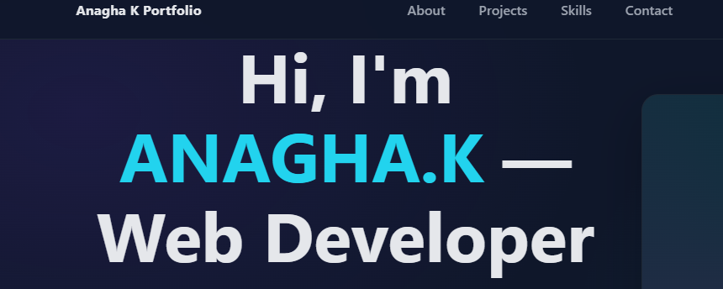

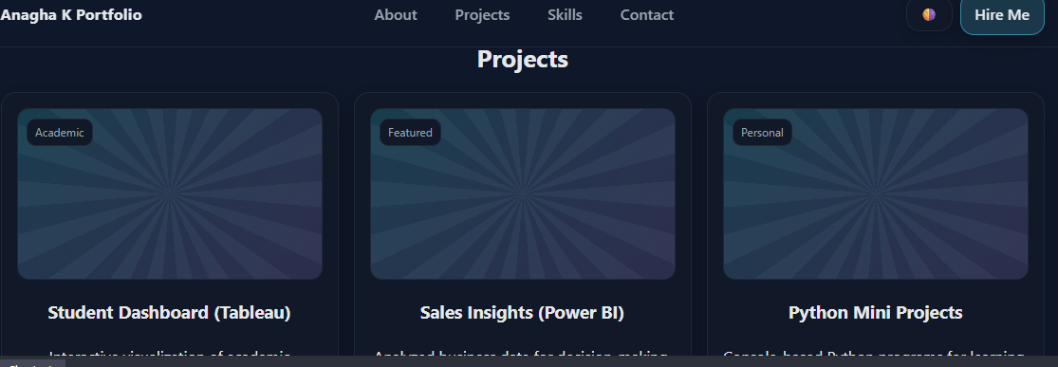
RESULTS AND SCREENSHOTS
3/21/2024 Annual Review

Slide 11
CONCLUSION
The Anagha K Portfolio Website successfully showcases her skills, projects, and achievements in a modern, interactive, and responsive format. By combining HTML, CSS, and JavaScript, the site provides dynamic content, smooth transitions, and a user-friendly experience across all devices. This portfolio effectively highlights Anagha’s technical expertise, creativity, and professional profile, making it a valuable tool for job opportunities, collaborations, and networking.

Slide 12
github link
https://github.com/anaghakrishnanunni1-cmd/NM-project

