Slide 1
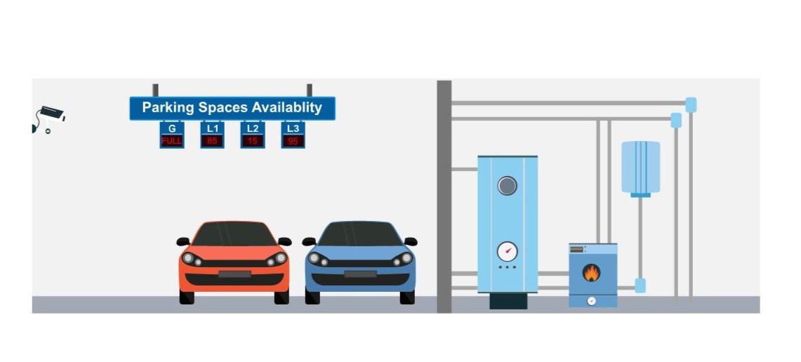
MULTI-LEVEL PARKING LOT MANAGER
Team No: 18
By: Anagha N K 2620030244
Nandhini Saikam 2620030347

Slide 2
Abstract
The Multi-Level Parking Lot Manager is a menu-driven Java program that helps manage vehicle parking across multiple levels. The model contains 3 levels with 5 slots per level. Users can park a vehicle, view available and occupied slots, search vehicle details, and remove a vehicle when it leaves. Java fundamentals, control flow, methods, arrays, classes, strings, file handling, collections, and streams are connected to the six course modules.

Slide 3
Understanding Problem Statement
Problem: manually tracking vehicles and free spaces across several parking levels can be confusing.
Objective: represent parking spaces clearly and update their status whenever a vehicle enters or leaves.
Inputs: menu choice, vehicle number, vehicle type, level and slot selection.
Processing: validate input, check availability, store vehicle details, search records and update the parking layout.
Output: parking confirmation, occupied/free slot status, search result or a helpful error message.
Assumption: 3 levels × 5 slots = 15 parking spaces.

Slide 4
CO 1 — From Problem to Program
Computational thinking: split the task into Park, Remove, Display and Search operations.
Algorithm: read the user choice → validate it → perform the selected operation → display the result.
Java structure: class declaration, main() method and statements.
Variables and data types: int for level/slot, String for vehicle number/type, boolean for slot status.
Operators: arithmetic for slot indexing; relational/logical operators for validation.
Console I/O: Scanner reads menu choices and vehicle details; println() displays results.

Slide 5
CO 2 — Control Flow: Selection & Iteration
Menu-driven selection uses switch to choose Park, Remove, Display, Search or Exit.
if / if-else checks whether a level and slot are valid and whether a slot is free.
for loops visit each level and slot when displaying the parking layout.
Nested loops represent the 2D parking structure: 3 levels and 5 slots per level.
while / do-while can keep the menu running until the user selects Exit.
break ends a menu case; continue can skip invalid or already occupied slots.

Slide 6
CO 3 — Methods, Recursion & Arrays
2D array: int[][] parking = new int[3][5] stores slot status (0 = free, 1 = occupied).
Object array: Vehicle[][] vehicles stores vehicle details for each level and slot.
Methods: parkVehicle(), removeVehicle(), displayParking() and searchVehicle() keep tasks modular.
Array traversal checks every slot; counting gives the total number of free spaces.
Searching compares a vehicle number against stored records.
The project uses iterative processing; recursion is not required for the current parking workflow.

Slide 7
CO 4 — Object-Oriented Design & Exceptions
Vehicle class models a vehicle using fields such as vehicleNumber, vehicleType, level, slot and hours.
ParkingManager class manages the parking arrays and operations.
Constructors initialize vehicle details; this refers to the current object.
Encapsulation: keep fields private and access them through methods where appropriate.
Method overriding / interfaces can be added for different vehicle categories if needed.
try-catch handles invalid numeric input; validation prevents invalid levels, slots and duplicate parking.

Slide 8
CO 5 — Strings, Algorithms & File I/O
String stores vehicle numbers and types; trim() removes extra spaces and equalsIgnoreCase() compares types.
Validation checks that the vehicle number is not empty before parking.
Searching scans stored vehicles to find a matching vehicle number.
Arrays.sort() or Comparator can be used to order vehicle numbers for a report.
File I/O extension: save parking records to a text file and load them when the program starts.
try-with-resources helps close file readers and writers safely.

Slide 9
CO 6 — Collections, Lambdas & Streams
ArrayList<Vehicle> can hold a flexible list of parked vehicles for reporting.
HashMap<String, Vehicle> can map each vehicle number to its vehicle record for quick lookup.
HashSet<String> can help detect duplicate vehicle numbers.
for-each loops can iterate through all parked vehicles.
Streams can filter vehicles by type, sort records, count parked vehicles and generate summaries.
Example: vehicles.stream().filter(v -> v.getVehicleType().equalsIgnoreCase("Car")).count()

Slide 10
Conclusion
The project applies Java to a familiar real-world parking problem.
A 2D array models the levels and slots, while classes represent vehicles and parking operations.
Selection and loops control the menu and validate parking actions.
Methods make the program easier to read, test and maintain.
Strings, file I/O, collections and streams provide clear pathways for storing and reporting parking data.
Future improvements: graphical interface, real-time sensors, ticket generation and fee calculation.

Slide 11
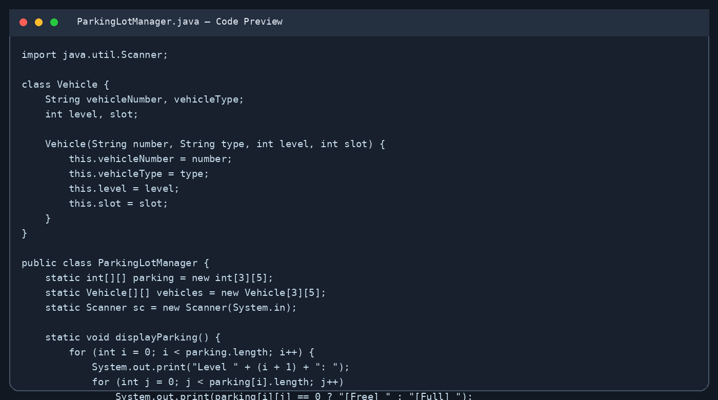
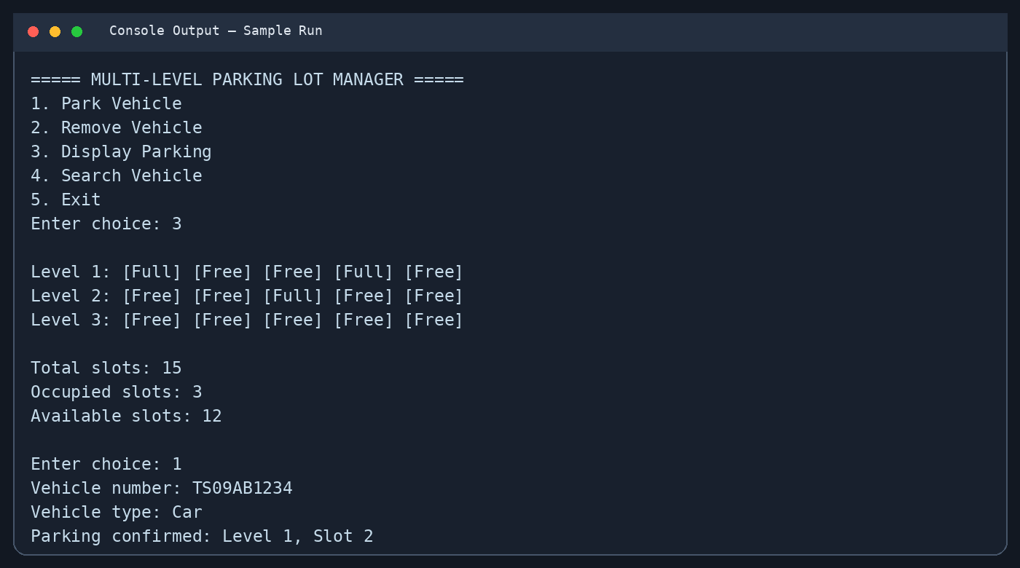
Screen Shots:
Code structure: Vehicle class, arrays and traversal
Sample output: parking status and confirmation
Note: replace these illustrative screenshots with screenshots captured from your final compiled and tested Java program before submission.

Slide 12
Geo-Tag Photo & GitHub Link
https://github.com/anaghakuruvinkopp/KLH_CSE_PSPJAVA_T18_MLPLM_TEAM

