Slide 1

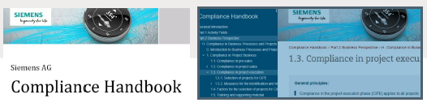
TEAM :GPT-DLC Challenge Name: Digital Legal and Compliance Officer Challenge Setter: Siemens AG

Slide 2
Current Problem
Specific handbooks and guidelines are accessible via webbooks and/or PDFs, in which employees need to look-up their questions.
Internal compliance chat bot /search tool that employees use to find answers to queries.
Currently manually add list of potential compliance related question answers pairs and store in database. –Time consuming/Redundant Task
Current tool not able to recognize synonyms or similar questions.-Not Efficient
Current alternate solution :Call Compliance officer

Slide 3
Our Solution
A Digital Compliance Officer that takes in any question related to compliance and gives human like answer.
Answers will be in short and simple terms so that users can understand.
User provided with answer and link to the compliance book.
No need for users to look up and read large documents to find answers.
Reduces dependency of human compliance officer.
Available 24 x7 .

Slide 4
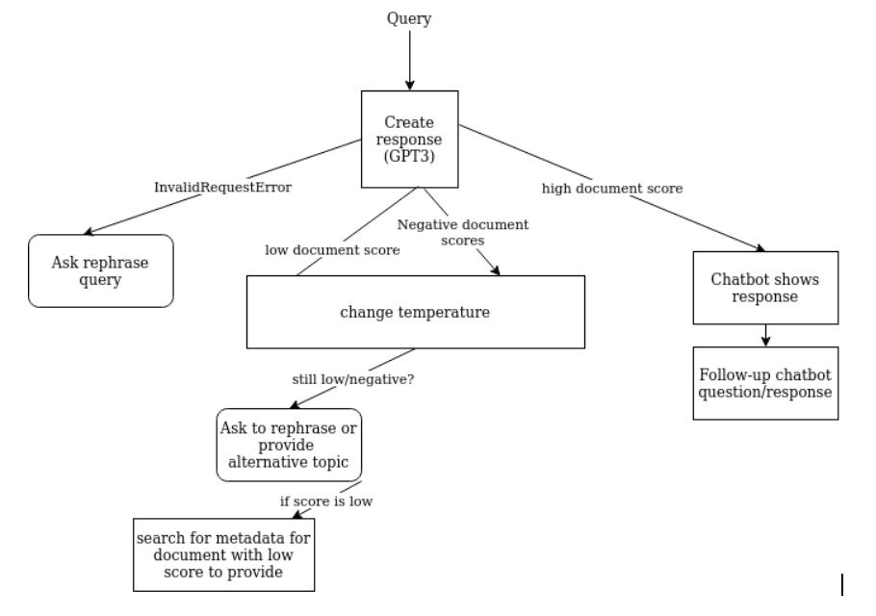
Solution Flowchart

Slide 5
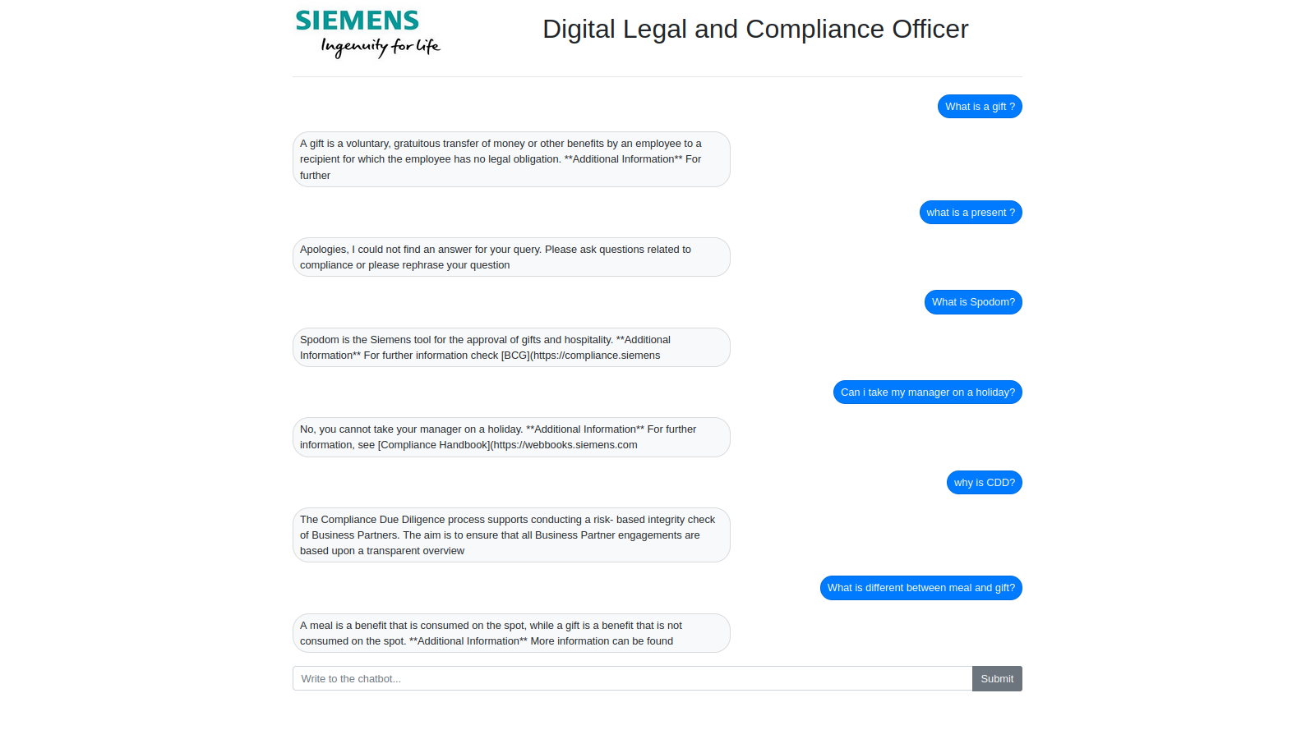
Digital Legal and Compliance Officer

Slide 6
Why our Solution?
Common Solution for Entire Company worldwide
No manual entry of Q and A pairs into database
Human like conversational experience.
dDigital Compliance Officer
[DCO]
Provide correct answer when asked similar answers /words
Available 24 x 7
Common point of contact for all employees

Slide 7
Market Segment
All Siemens Employees
External Business Clients and Employees related to Siemens

Slide 8
COMPETITION
Current Internal Query Solution
Human Compliance Officer
Outsource /External Chatbot Solutions from other companies.

Slide 9
TEAM
TEAM MEMBERS
MENTORS
Anagha Moosad
(NLP and AI)
Liliana Mamani Sanchez
(NLP and AI)
Büsra Bayzat
(Law)
Javed Ali
(NLP and UI)
Dino Roth
(Siemens)
Andrew Copland Cale
(Siemens)

Slide 10
ROADMAP
Query Answer from Document
(Answer and Link)
Answers based on Document Score
Back and forth Conversation
Multilingual Support

Slide 11
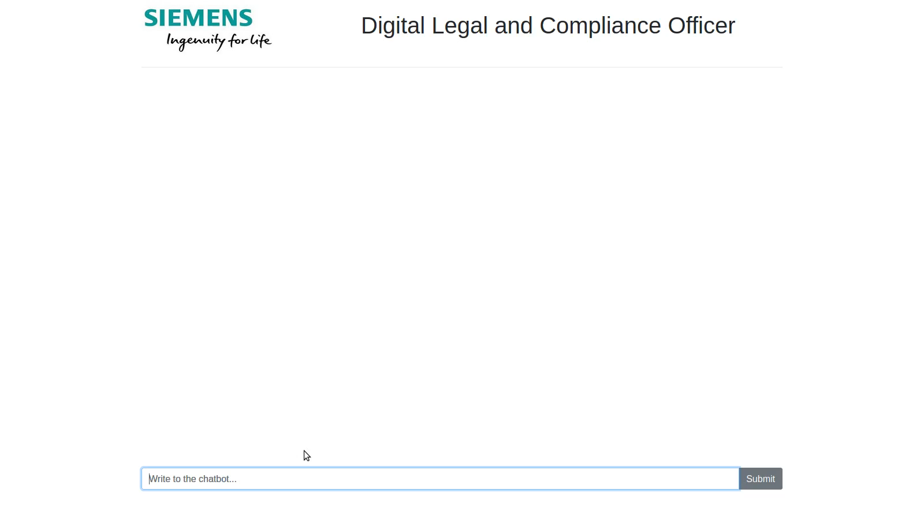
Demo

Slide 12
Thank you

Slide 13
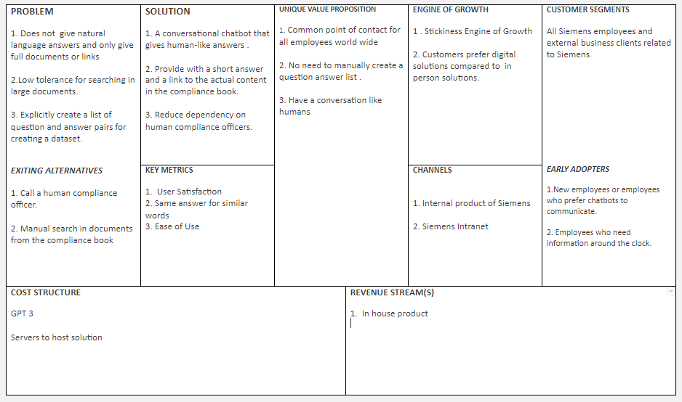
Appendex -Lean Canvas Model

