Slide 1
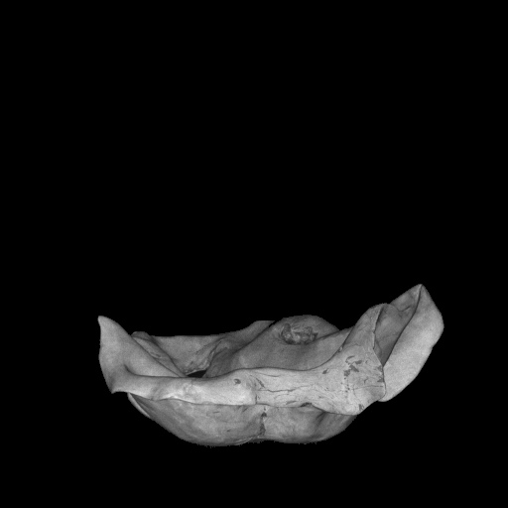
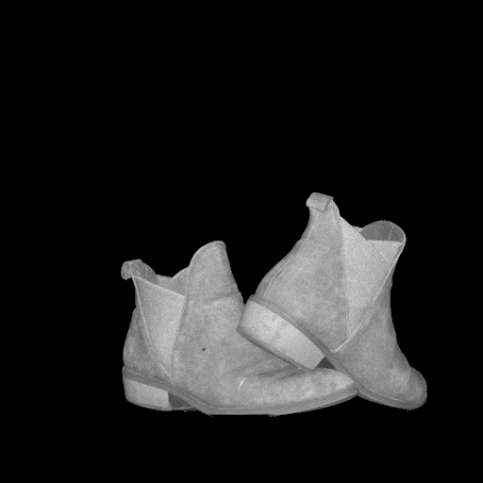

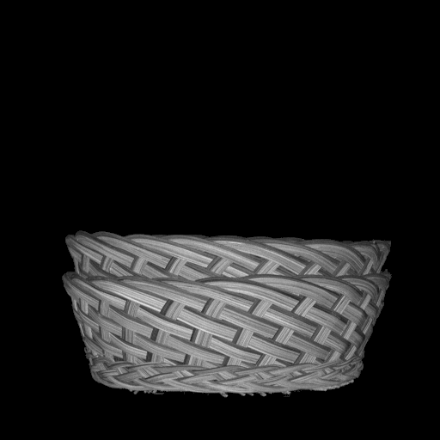

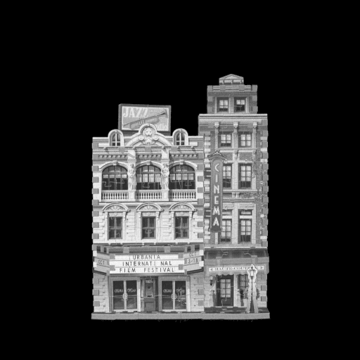
integrated lidar scans (intensity images)
Notes:
We also test our method on a dataset we capture using our prototype lidar system. The dataset consists of 6 scenes captured from 20 different viewpoints each using the prototype single-photon lidar.

Slide 2
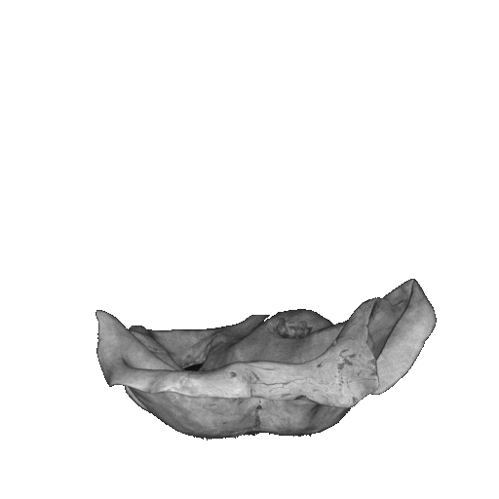
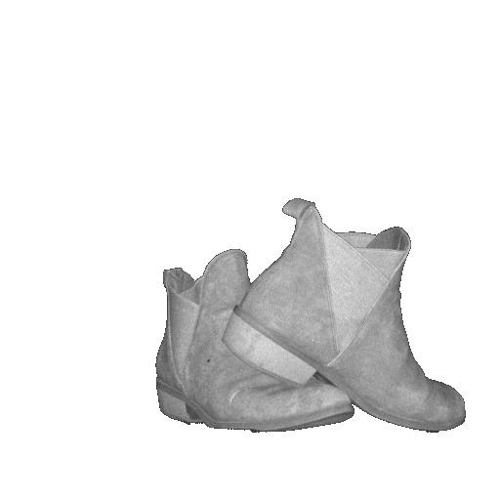

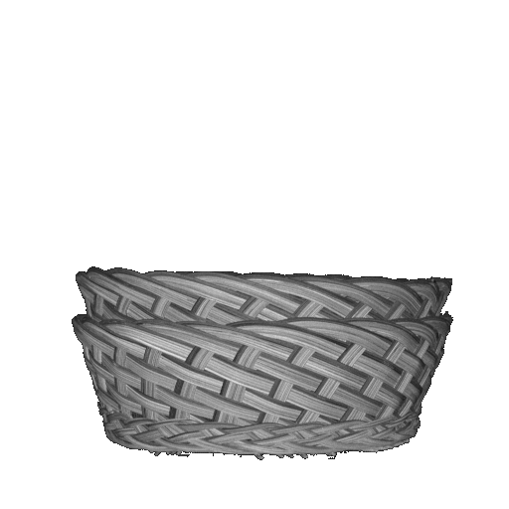

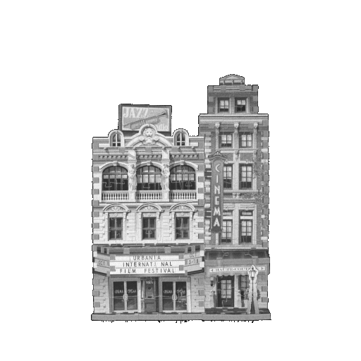
integrated lidar scans (intensity images)
Notes:
We also test our method on a dataset we capture using our prototype lidar system. The dataset consists of 6 scenes captured from 20 different viewpoints each using the prototype single-photon lidar.

