Slide 1
UML
Composed and researched by waseem

Slide 2
UML
What is UML
History of UML
Importance of software model
Various diagram of UML
Use of UML Diagram

Slide 3
What is UML
Unified modeling language (UML) for visualizing, specifying, constructing, documenting of artifact of a software system
The blueprint of a system is written in it
UML is also used for modeling non-software system
It is standard for building object oriented and component based software system
UML is a notation system though which we can visualize a model of a system
It describe only design or structure of system

Slide 4
History of UML
In early stages of model driven development there was a great need for some universal approach for modeling a software system
As deferent people understand the notation in different way if there is no universal model approach
At that time brooch, rumba, Jacobson gave there theories and universally accepted
All of three decided to build a notation language by merging all of three language and out product of that was UML (unified modeling language )

Slide 5
History of UML
In 1997 OMG (Object management group) a non profit organization standardized the UML
Since then they are making improvement in UML
Released versions of UML

Slide 6
Versions of UML
2.2 February 2009 http://www.omg.org/spec/UML/2.2
2.1.2 November 2007 http://www.omg.org/spec/UML/2.1.2
2.1.1 August 2007 http://www.omg.org/spec/UML/2.1.1
2.0 July 2005 http://www.omg.org/spec/UML/2.0
1.5 March 2003 http://www.omg.org/spec/UML/1.5
1.4.2 July 2004 ISO/IEC 19501
1.4 September 2001 http://www.omg.org/spec/UML/1.4
1.3 March 2000 http://www.omg.org/spec/UML/1.3
1.2 July 1998
1.1 November 1997

Slide 7
UML 1.1
Use case diagrams (fulfill purposed functionality)
Class diagrams (depict static view and relationship)
Object diagrams (depict view of instance of class )
Sequence diagrams (depict messages over time line)
Collaboration diagrams (like sequence diagram but define object roles)
State chart diagrams (depicts states of the object)
Activity diagrams (dynamic view like flow chart )
Component diagrams (depict components )
Deployment diagrams (depict physical layout of system )

Slide 8
New in UML2.0
Changes in activity diagram
The first noticeable change is that the nodes in activity diagrams are no longer called activities. They are called actions
These constraints are shown as notes attached to the action with the appropriate stereotype symbol
In UML 2.0, an action will not fire until each of the incoming flows triggers
new to UML 2.0, is the time signal. A time signal is received because a certain amount of time has passed

Slide 9
New in UML 2.0
The final addition to the basic activity diagram is the connector.
The connector indicates that a flow moves from one activity diagram to another.
UML 2.0 contains three new ways to group and decompose actions
UML 2.0 introduces activity partitions to handle problems

Slide 10
New to UML 2.0
Changes in Class diagram
Visibility is a single character representing whether the attribute is visible to the
public (+),
private (-),
protected (#),
or package (~).
The slash (/)
Indicates whether the attribute is derived

Slide 11
Use Case diagram
Changes in use case diagram
The exact extension point that is used between the two use cases

Slide 12
Importance of Software Model
If software is complex need of model
If a system is developed by the hundreds of People there is also need of model for smooth communication and understanding the software system
mange complexity in design
build and design architecture
Visualize the implementation
Design secure , scalable, robust and extendable system

Slide 13
UML 2.0 Diagrams
UML is divided in to two General set of Diagrams
Structured modeling diagrams It depicts the static view of the model
Behavioral modeling diagram Behavior diagrams depicts the varieties of interaction within a model as it 'executes' over time

Slide 14
Structural Modeling Diagram
Class Diagram
Object Diagram
Component Diagram
Package Diagram
Composite Structure
Deployment Diagram

Slide 15
Behavioral Modeling Diagram
Use Case Diagram
Activity Diagram
State Machine Diagram
Communication Diagram
Sequence Diagram
Timing Diagram
Interaction Over view Diagram

Slide 16
Class diagram
It depicts the static view of a model
It is the basic building block of the object oriented system
It illustrate the relation ship between classes in the system
Class diagram consist of:
Class diagram
It consist of rectangle with three compartments
Class name is added in this this compartment (teacher)
Class attribute is added in this department (name )
Class methods are placed in this compartments (teach)

Slide 17
Class diagram
+ sign with attributes or methods shows class member are public
- sign with attribute or methods shows class members are
private
Class name is added in this this compartment (teacher)
Class attribute is added in this department (-name)
Class methods are placed in this compartments (+teach)

Slide 18
Class diagram
Class diagram show relationship between class
Generalizations
A generalization is used to indicate inheritance.
Aggregations
Aggregations are used to depict elements which are made up of smaller components
Example composite-Aggregation
Address book and contact group and contacts

Slide 19
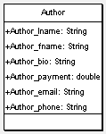
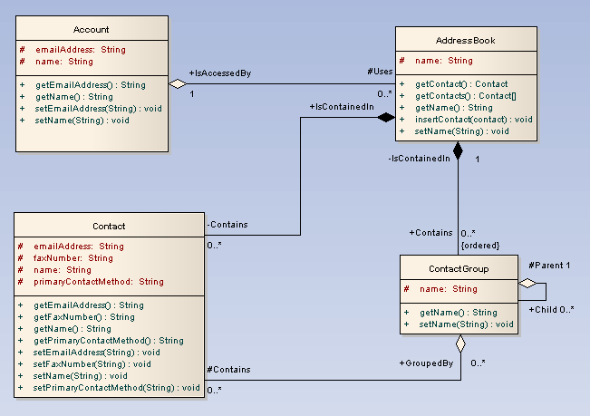
Class diagram

Slide 20

Association Relationship

Slide 21
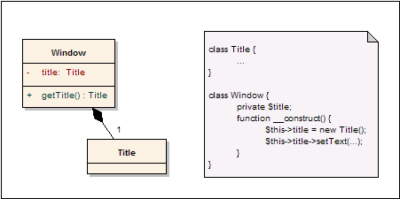
Composition

Slide 22
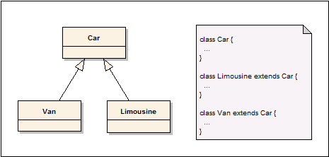
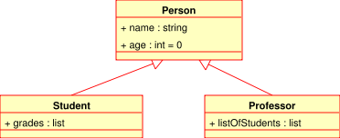
Generalization

Slide 23
Object diagram
An object diagram may be considered a special case of a class diagram
Object diagrams emphasize the relationship between instances of classes at some point in time
Object is shown by a rectangular with classifier name in the center f rectangular and under line
Object diagram shows complex relationship between classes
It is useful if we feel classes as more abstract abstract

Slide 24
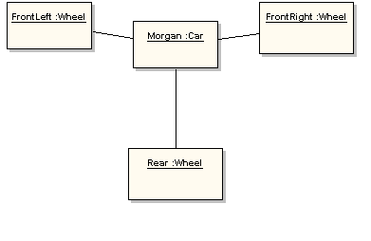
Object diagram

Slide 25
Package diagram
Package diagram are used to divide the model into logical containers and their interaction
Package diagram is used to show the high level view of the system
As software system have a lot of class (building block in object oriented system) to organize those in a package to show higher level view of the system
Package is used to structure your classes
Package diagram is used divide the complex system in to modules
And In large system to show the large elements and their communication
It is used in large and complex systems

Slide 26
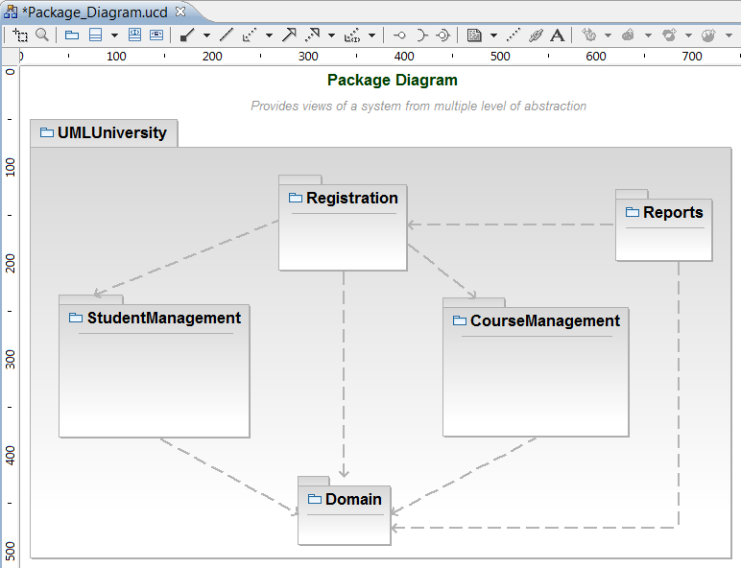
Package diagram (merge)

Slide 27
Package diagram
A «merge» connector between two packages defines an implicit generalization between elements in the source package

Slide 28
Component diagram
Component diagram shows the system in term modules
Components can be represented as encapsulated, reusable, replaceable
Component can be used as building block of the system
Component communicate with each other through interfaces
Component can do the same thing as class

Slide 29
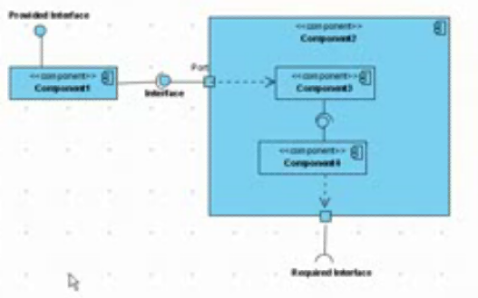
Component diagram

Slide 30
Component diagram
Component diagram are shown same as class instead of sign in the component diagram component port required interface provided interface

Slide 31
Component diagram
Ball represented provided interfaces
Provided interfaces that’s a component implements
Required interfaces that a component required to provide its functionality
Port is door way through communication pass
Component is useful to show the system in term of module

Slide 32
Deployment diagram
Deployment diagram model the physical layout of the system mapping software artifact to hardware in which they execute and their communication
Deployment diagram is used to show the physical deployment of the system
Deployment diagram has node which may be a hard ware or any device that host the software and my be a software that host another software (example operating system)
Artifacts shows the software that is implemented on the hardware

Slide 33
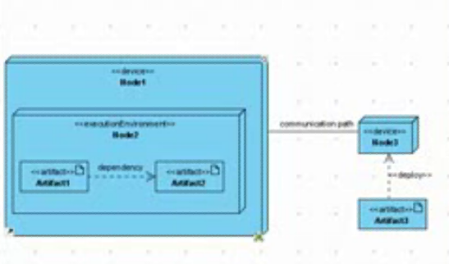
Deployment diagram

Slide 34
Behavioral Diagram
All Behavioral Diagrams

Slide 35
Behavioral Modeling Diagram
Use Case Diagram
Activity Diagram
State Machine Diagram
Communication Diagram
Sequence Diagram
Timing Diagram
Interaction Over view Diagram

Slide 36
Use Case Diagram
A USE CASE is an interaction between a system and external stimulate, that could a human and may be an external system
A USE CASE diagram is an purposed functionality of the system
USE CASE diagram is used to show a discrete unit of work
It is used at early stages of model
It is the simplest diagram
Example of USE CASE for a Stock trading system
Open an account
Close an account
Deposit funds
Draw funds

Slide 37
Use Case diagram
This diagram consist of:
Actor
It is represented by a human, either the actor is a human
Or and external system.
Actor is role
Use case
It is represented by an oval shape with title in it

Slide 38
Use Case diagram
USE CASE diagram have relationship
Include
It is relationship between a use case to another use case
In which a include use case in necessary to perform other use case, for example in place order use case every time the check funds use case is included to complete the place order use case
place order(use case) <include > (check funds) use case

Slide 39
Use Case diagram
USE CASE diagram have relationship
Extends
It is relationship between a use case to another use case
In which a extends use case in exceptionally called for example, if before modifying a particular type of customer order, a user must get approval from some higher authority then the <Get Approval> use case may optionally extend the regular <Modify Order> use case.
Modify order(use case) <extends> (Get Approved) use case

Slide 40
State diagram
It shows the dynamic view of the system
It is also called state chart or state machine diagram
It shows the behavior of the system in response to some external stimulate
State diagram is consist of:
States
super states
pseudo state
Transition

Slide 41
State diagram
State and super states are represented as a rounded box and sub states are in super state
Pseudo Psedu state
State Trantion
Super State Sub State 1 Transient sub state 2

Slide 42
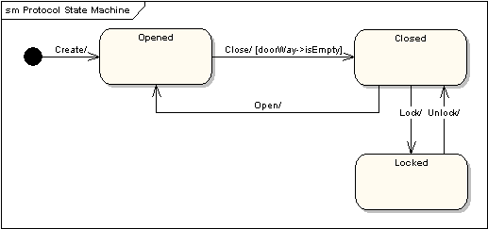
State diagram

Slide 43
Activity diagram
Activity diagram is also dynamic view of the system
Activity diagram similar to flow charts
Each activity consist of series of actions
Actions are represented by oval shapes
Actions are connected by arrows
Arrow shows the flow of the activity diagram
Activity diagram also shows decision points called decision node

Slide 44
Activity diagram
portions line starting point Actions Decision node action actions End point

Slide 45
Activity diagram
Activity diagram is used to describe the individual use case
Use case is used to describe the user goal
Activity diagram can be used where we can use flow charts

Slide 46
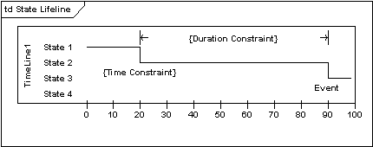
Timing diagram
Timing diagrams are used to display the change in state or value of one or more elements over time.
A state lifeline shows the change of state of an item over time
The X-axis displays elapsed time in whatever units are chosen
The Y-axis is label with a given list of states

Slide 47
Communication diagrams
A communication diagram, formerly called a collaboration diagram
It shows similar information to sequence diagrams
Communication diagram shows the objects relationship
Objects are shown with association connectors between them
Messages are added to the associations and show as short arrows pointing in the direction of the message flow

Slide 48
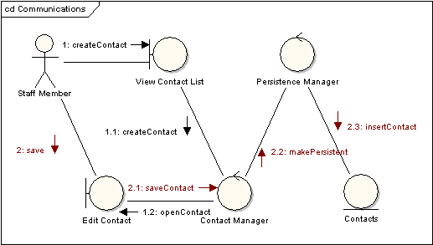
Communication diagram

Slide 49
Interaction Overview diagram
Interaction diagram is the combination of activity and sequence diagrams
It allow interaction fragments to be easily combined with decision points and flows
An interaction overview diagram is a form of activity diagram in which the nodes represent interaction diagrams.
Interaction diagrams can include sequence, communication, interaction overview and timing diagrams.
Most of the notation for interaction overview diagrams is the same for activity diagrams. For example, initial, final, decision, and join nodes are all the same.
Interaction overview diagrams introduce two new elements: interaction occurrences and interaction elements.

Slide 50
Interaction Overview diagram
Interaction occurrences are references to existing interaction diagrams.
An interaction occurrence is shown as a reference frame; that is, a frame with "ref" in the top-left corner
Interaction elements are similar to interaction occurrences, in that they display a representation of existing interaction diagrams within a rectangular frame

Slide 51
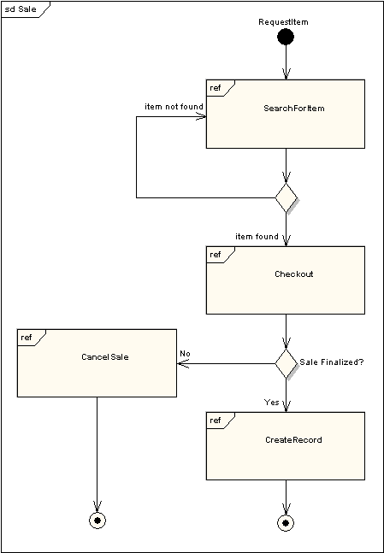

Slide 52
Interaction Overview Diagram

Slide 53
Interaction Overview
All the same controls from activity diagrams (fork, join, merge, etc.)
Controls can be used on interaction overview diagrams to put the control logic around the lower level diagrams.
The above example depicts a sample sale process

Slide 54
Sequence diagram
Sequence diagrams provide a graphical representation of object interactions over time
One sequence diagram typically represents a single Use Case 'scenario' or flow of events.
The diagrams show the flow of messages from one object to another, and as such correspond to the methods and events supported by a class/object.

Slide 55
