Slide 1
CSCI 130 project
By
Matthew, Roberto, Anahi, Jairo

Slide 2
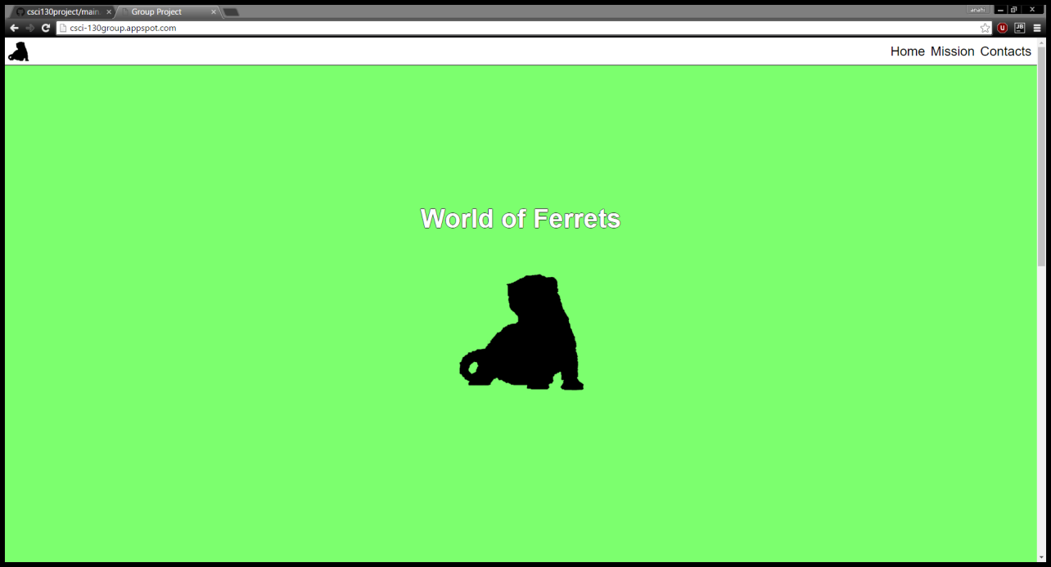
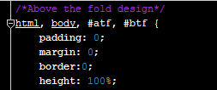
Above the fold
http://csci-130group.appspot.com/
Above the fold is what you see when you first open the website.
Upper half of the webpage, that is visible without scrolling.

Slide 3
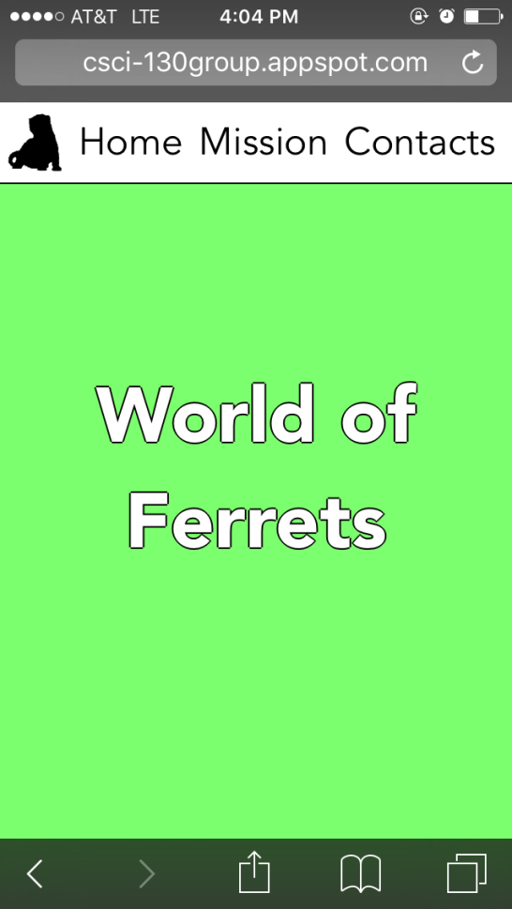

Media query
Media Query checks for the screen size and acts upon that.
Column structure
You can control what to show after a certain screen size.

Slide 4
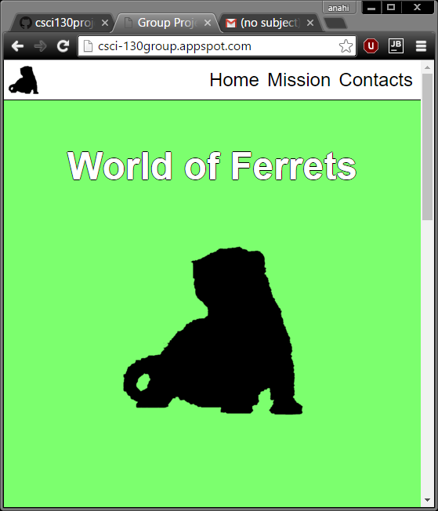
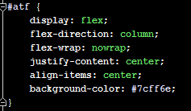
Flex box
Layout mode providing for the arrangement of elements on a page.

Slide 5
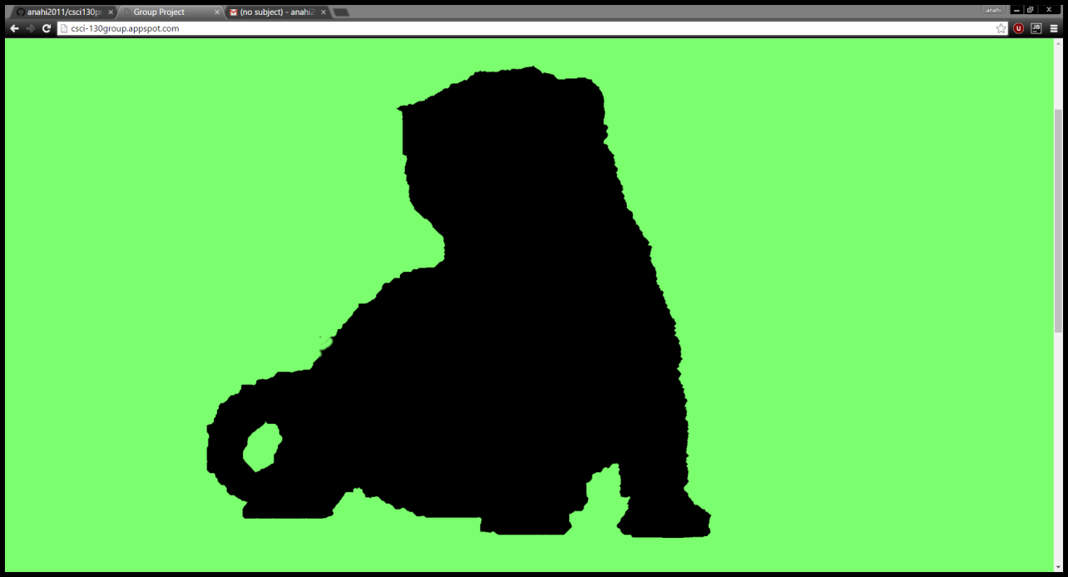
SVG
Scalable vector graphics(SVG)
Image format for two-dimensional graphics with support for interaction.
The image that uses SVG gets rid of pixelation.

Slide 6
questions
THANK YOU!

