Slide 1
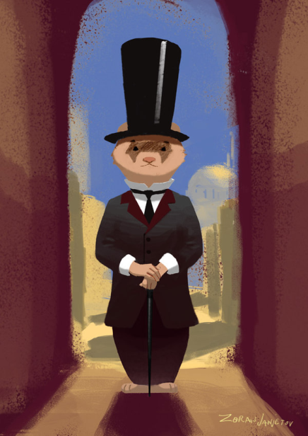
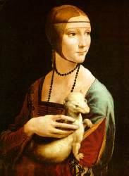
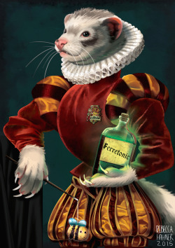

Serving World of Ferrets
Matthew Morado
Anahi Plasencia
Roberto Gorosave
Jairo Reyes

Slide 2
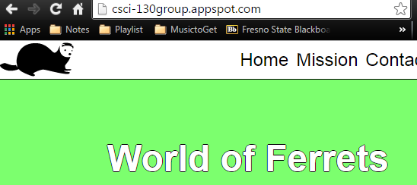
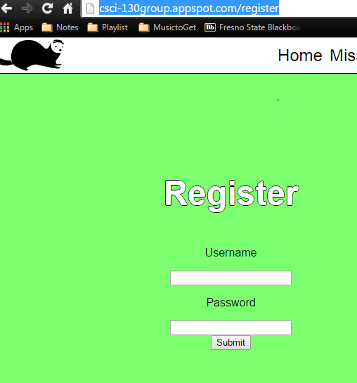
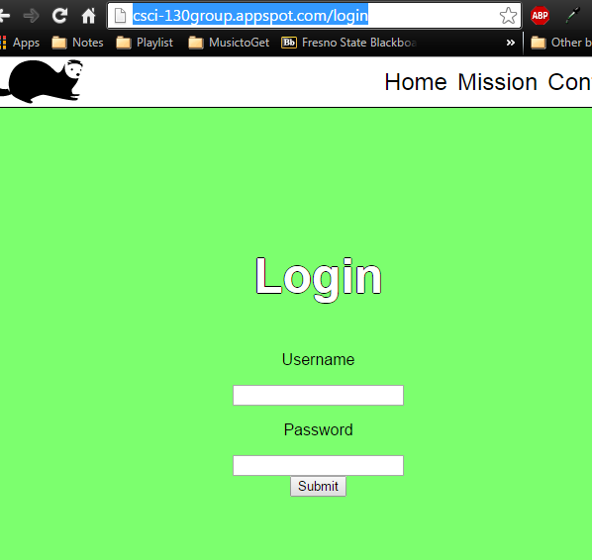

Serving pages

Slide 3

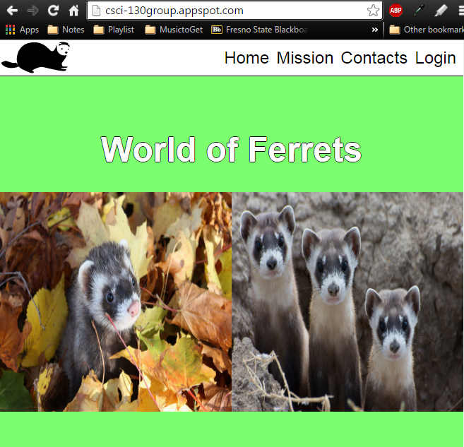
Serving all Resources

Slide 4
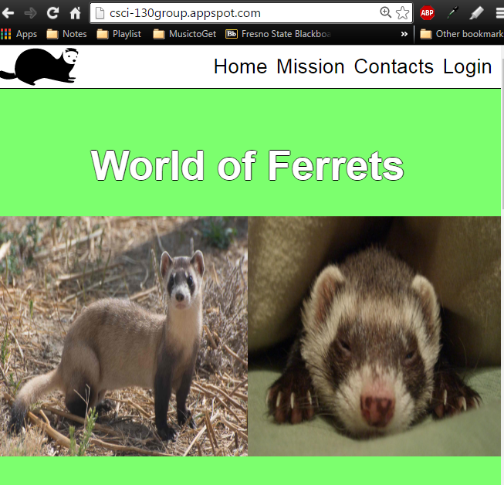
Accessible via web

Slide 5
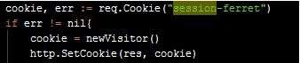
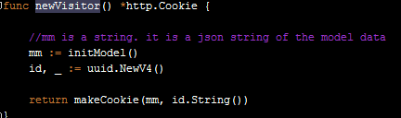
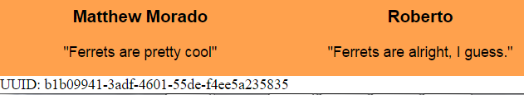
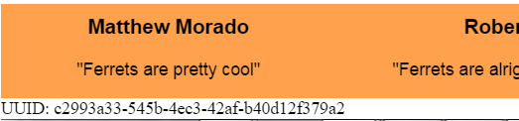
Creating a session & State
When user comes into the web page we checked if they have a “session-ferret” cookie, the cookie would have a uuid and if user doesn't have a “session-ferret” cookie, we make new one. Cookie is saved in primary storage the cookie will get a new uuid if user deletes the cookie or they close their browser.
Sessions:
Creating UUID & setting it in a cookie
Kept until user logs out, in this our case, until user closes browser
After closing browser

