Slide 1
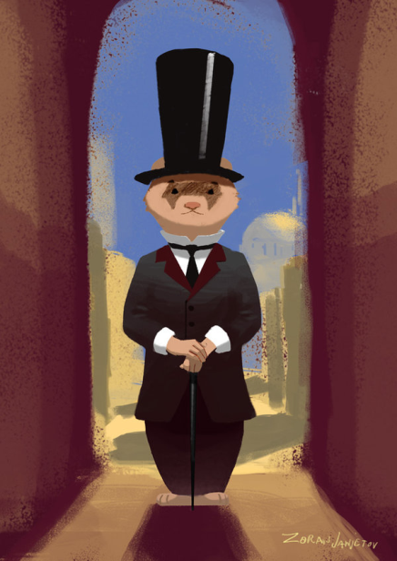
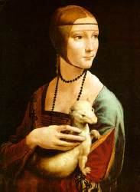


Serving World of Ferrets
Matthew Morado
Anahi Plasencia
Roberto Gorosave
Jairo Reyes

Slide 2
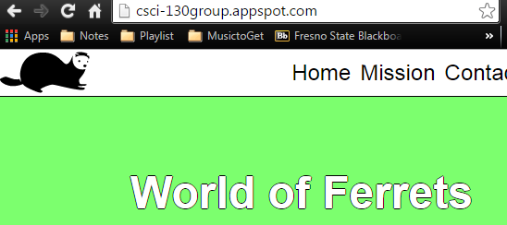
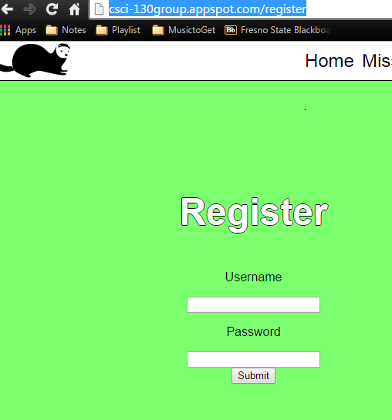
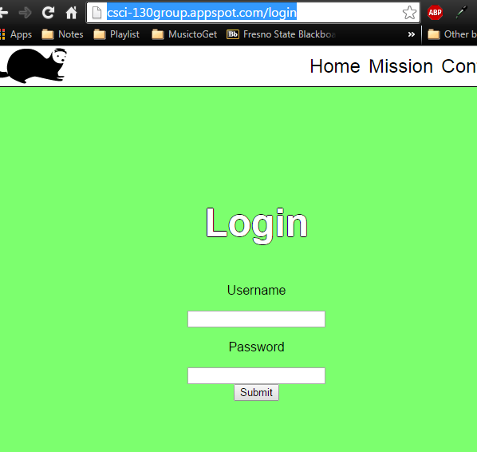

Serving pages

Slide 3

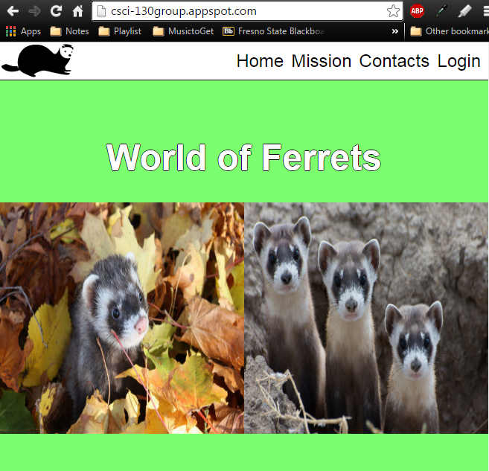
Serving all Resources

Slide 4
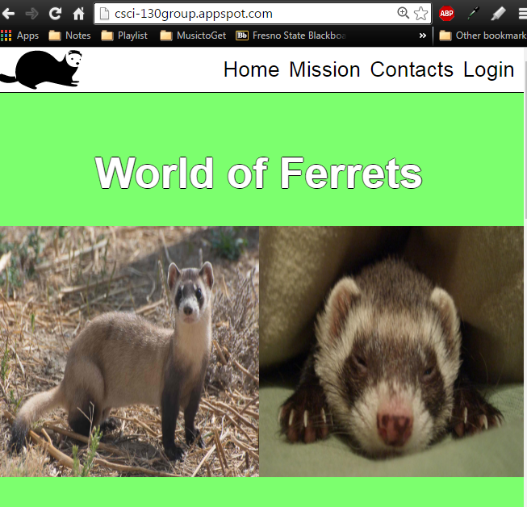
Accessible via web

Slide 5
Creating a session

