Slide 1
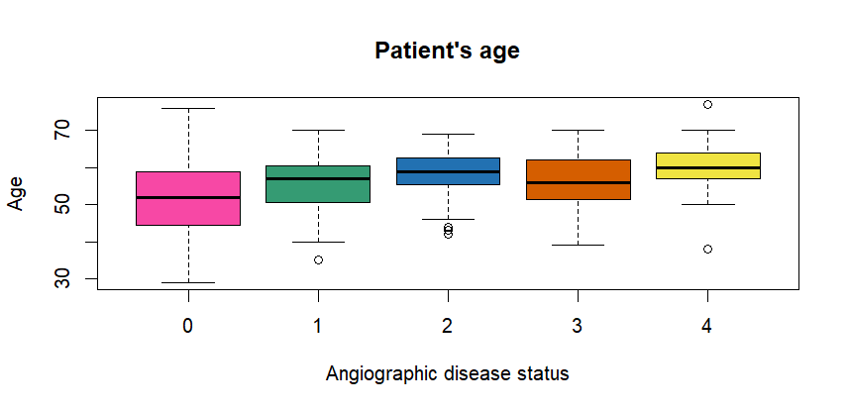
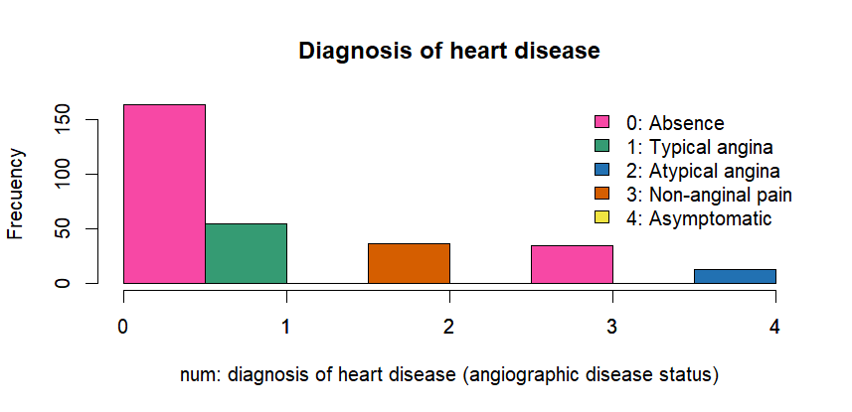
Heart Disease data
Total: 303 patients
Variable information:
Num: chest pain type
Typical angina → 55 people (18.15%)

Slide 2
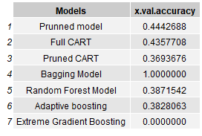
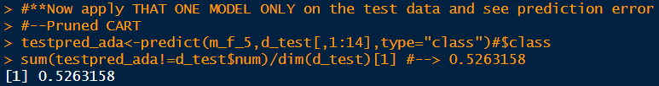
Results
Best x-val accuracy on the training data.
Problems
NA values (?)
Convert to → as.numeric or as.character
Overfitting
Pruned CART→ not the best model to the test data (25%)

