Slide 1

Stock Price Trend Analysis Dashboard
Presented by
Anaia Suvarna
Date: 16/09/2026

Slide 2

Agenda
Problem Statement
Overview
Prospective Users
Data Overview
Dashboard Design
Key Insights
Future Enhancements
Conclusion

Slide 3

Problem
Statement
What does this project help with?
Investors in the stock markets often find it a tedious task to compare different companies’ performances against each other.
The project investigates:
  the performance of NIFTY 50 companies and sectors over time
  the distribution of market capitalization among them
Helps identify market leaders, sector dominance, and concentration within the index.
Helps potential investors choose wisely by comparing leading sectors with each other as well as companies within sectors.

Slide 4

Overview
What does the dashboard show?
Performance of NIFTY 50 stocks over 20 years
Highlights individual performances of the dominating sectors and the companies within them
Compares the market cap contribution and stability of:
  the leading companies of the NIFTY 50
  the leading sectors of the NIFTY 50
Helps understand market cap concentration within the largest sectors and their leading companies

Slide 5

Who can use this dashboard?
Investors and retail buyers
  to assess the past performance of the stocks (by market cap)
Traders and stockbrokers
  to predict patterns and trends using the line graphs
  to anticipate future crashes in the stock market
Financial analysts and the executive boards of companies
  to foresee a company’s prospective growth
  to plan how to better equip the company to recover from possible losses
Prospective
Users

Slide 6
Data Overview
Data Source
Kaggle: https://www.kaggle.com/datasets/rohanrao/nifty50-stock-market-data?select=VEDL.csv
NSE website: https://www.nseindia.com/static/regulations/listing-compliance/nse-market-capitalisation-all-companies
Data Size
There are 15 sheets of data, each with:
  15 columns
  5000 rows of data
Data Fields
Date, symbol, series, previous close, open, high, low, last, close, VWAP, volume, turnover, trades, deliverable volume, % deliverable volume
Market capitalization (for 2020) in a separate sheet

Slide 7
Dashboard Design
KPI Cards
Total companies
Total market cap (as of Dec 2021)
Largest sector
Top company
Total market cap contribution of top companies
Pie Chart
% contribution of the top 5 sectors to the total market cap of the 50 companies
2-D Bar Chart
Contribution of each company to the overall market cap of the 50 companies
2-D Stacked Column Chart
Contribution of each company to the market cap of the sector it belongs to.
.
Line Chart
Closing stock prices of 5 top companies (in the top sectors) daily for a period of 20 years

Slide 8
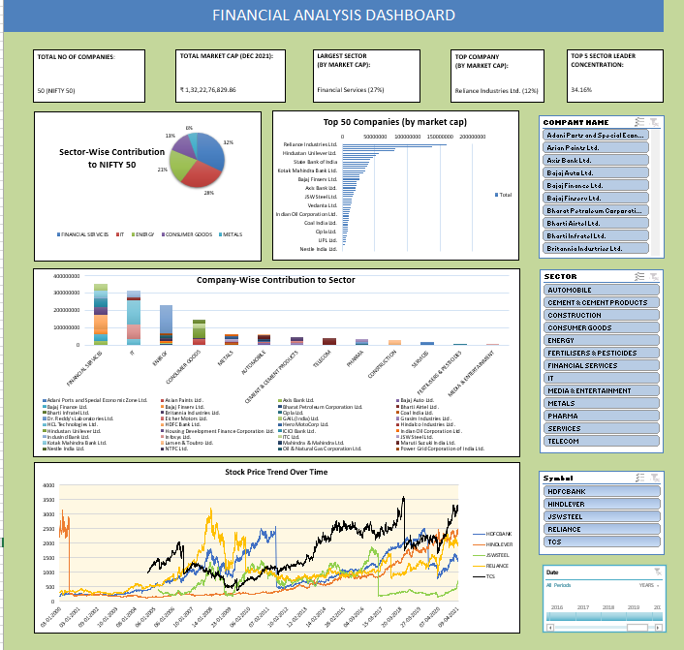
FINANCIAL ANALYSIS DASHBOARD

Slide 9
FLOWCHART OF STOCKS ANALYSED
TOP SECTORS IN THE NIFTY 50
FINANCIAL SERVICES
IT
ENERGY
HDFC Bank
ICICI Bank
HDFC
Reliance
ONGC
Powergrid
TCS
Infosys
Wipro
CONSUMER GOODS
Hindustan Unilever
Asian Paints
ITC
METALS
JSW
Tata Steel
Vedanta

Slide 10
Key Insights (KPIs)
TOTAL NO OF COMPANIES:
50 (NIFTY 50)
TOTAL MARKET CAP
(DEC 2021):
₹ 1,32,22,76,829.86
Total number of companies analysed:
50 (NIFTY 50)
Total market cap (as of December 2021):
₹ 1,32,22,76,829.86
Largest sector (by market cap):
Financial Services (27%)
Top company (by market cap):
Reliance Industries Ltd. (12%)
Top 5 sector leader concentration:
34.16% (Financial services, IT, Energy, Consumer Goods, Metals)
LARGEST SECTOR
(BY MARKET CAP):
Financial Services (27%)
TOP COMPANY
(BY MARKET CAP):
Reliance Industries Ltd. (12%)
TOP 5 SECTOR LEADER CONCENTRATION:
34.16%

Slide 11
Sector-Wise Contribution to
NIFTY 50
Financial Services and IT together account for approximately 50% of the total market-cap contribution.
This makes them the two dominant sectors.
Energy follows at 21% of the market-cap contribution.
Consumer Goods contribute 13% and Metals contribute 6% to the total market cap.

Slide 12
Top 50 Companies
(by Market Cap)
Reliance Industries and TCS have the largest market-cap contributions among the companies analysed.
They are followed by HDFC Bank and Infosys.
The gap between the top two companies and much of the remaining group indicates a relatively concentrated distribution of market capitalization.

Slide 13
Company-Wise Contribution to
Sector
Market cap is unevenly distributed within several sectors, with a few companies accounting for a substantial share of their sector's total.
Reliance dominates the Energy sector
TCS and Infosys are major contributors within IT
HDFC Bank is the largest contributor within Financial Services
JSW Steel and Hindustan Unilever dominate the Metals and Consumer Goods sector respectively

Slide 14
Stock Price
Trend Over
20 Years
The leading company in each of the top 5 sectors had substantially different long-term price trajectories
HDFC Bank, Reliance and TCS show strong increases in their closing prices over the period
JSW Steel experiences greater fluctuations in comparison.
Hindustan Unilever's price remains comparatively stable toward the end of the period.
The leading company by market cap at the end of 2021 is TCS (IT sector).

Slide 15
Price Trend Over 20 Years:
Financial Services Sector
The top 3 financial-services stocks show substantial long-term increases in closing prices.
Each company experiences significant fluctuations and periods of decline.
The three stocks therefore exhibit a broadly upward long-term trajectory despite short- and medium-term volatility.
HDFC recovers from a significant drop to emerge as the leading company.

Slide 16
Price Trend Over 20 Years:
IT Sector
The top 3 IT stocks show markedly different price trajectories.
TCS demonstrates sustained long-term growth.
Infosys and Wipro show much lower closing prices at the end of the period relative to their early observations
This highlights substantial variation within the sector.

Slide 17
Price Trend Over 20 Years:
Energy Sector
Reliance shows the strongest upward price trajectory among the three Energy stocks
Power Grid records a moderate increase
ONGC ends below its starting price after considerable fluctuations.

Slide 18
Price Trend Over 20 Years:
Consumer Goods Sector
Asian Paints shows a strong long-term increase in its closing price
Hindustan Unilever remains relatively stable toward the end of the period.
ITC finishes substantially below its initial recorded price.

Slide 19
Price Trend Over 20 Years:
Metals Sector
The Metals stocks exhibit considerable price fluctuations over the 20-year period.
Tata Steel shows a strong long-term increase.
JSW Steel and Vedanta experience pronounced peaks and declines before ending higher than their initial recorded prices.

Slide 20
Market Cap for
Top 5 Sectors
Industry | Top Company | Symbol | Market Cap (in lakhs) | % Contribution to Market Cap
Financial Services | HDFC Bank | HDFCBANK | ₹ 352780767.4 | 27%
IT | TCS | TCS | ₹ 311110839.8 | 24%
Energy | Reliance | RELIANCE | ₹ 228968152.6 | 17%
Consumer Goods | Hindustan Unilever | HINDUNILVR | ₹ 145851801.2 | 11%
Metals | JSW Steel | JSWSTEEL | ₹ 61807294.68 | 5%

Slide 21
Market Cap for
Top 5 Companies
Company Name | Industry | Symbol | Market Cap (in lakhs) | % Contribution to Market Cap
Reliance | Energy | RELIANCE | ₹ 160138207.04 | 12%
TCS | IT | TCS | ₹ 138283487.00 | 10%
HDFC Bank | Financial Services | HDFCBANK | ₹ 81983196.37 | 6%
Hindustan Unilever | Consumer Goods | HINDUNILVR | ₹ 55453878.17 | 4%
JSW Steel | Metals | JSWSTEEL | ₹ 15855757.48 | 1%

Slide 22

Future Advancements
Variety of Stock Assessment Parameters
Stock price alone does not provide a complete picture of company performance.
Future research could incorporate P/E ratio, dividend yield, earnings growth and trading volume to create a more comprehensive assessment of companies.
Daily return, intraday return, volatility and other parameters would offer different measures of comparison.
.
Statistical Prediction Models
The historical dataset could serve as a foundation for more advanced analysis using moving averages, trend analysis and correlation.
These could investigate relationships in the data without relying solely on visual observations.
Eventually statistical or machine-learning models could be used to forecast future performance of stocks by studying patterns in data.

Slide 23
Conclusion
Financial Services emerged as the largest contributor among the five sectors analysed, followed by IT and Energy.
HDFC Bank was the largest contributor within the Financial Services sector. However, at a company level, Reliance Industries had the highest market capitalization.
The leading companies of the five selected sectors account for 34.16% of the total market cap. This indicates that a relatively small number of large-cap companies have a substantial influence on the market.
The dashboard shows that the NIFTY 50 is not uniform in terms of sector contribution or company performance, and that market leadership and concentration are important factors when analysing the index.
Overall, the project demonstrates how historical financial data can be transformed into meaningful insights and provide a foundation for deeper analysis of risk, growth and market behaviour.

Slide 24

Thank you
Presented by Anaia Suvarna

