Slide 1
Classe #4
Building an End to End ML pipeline
In-depth: MLOps
SDD 2025/2026 — ISAE-SUPAERO

Slide 2
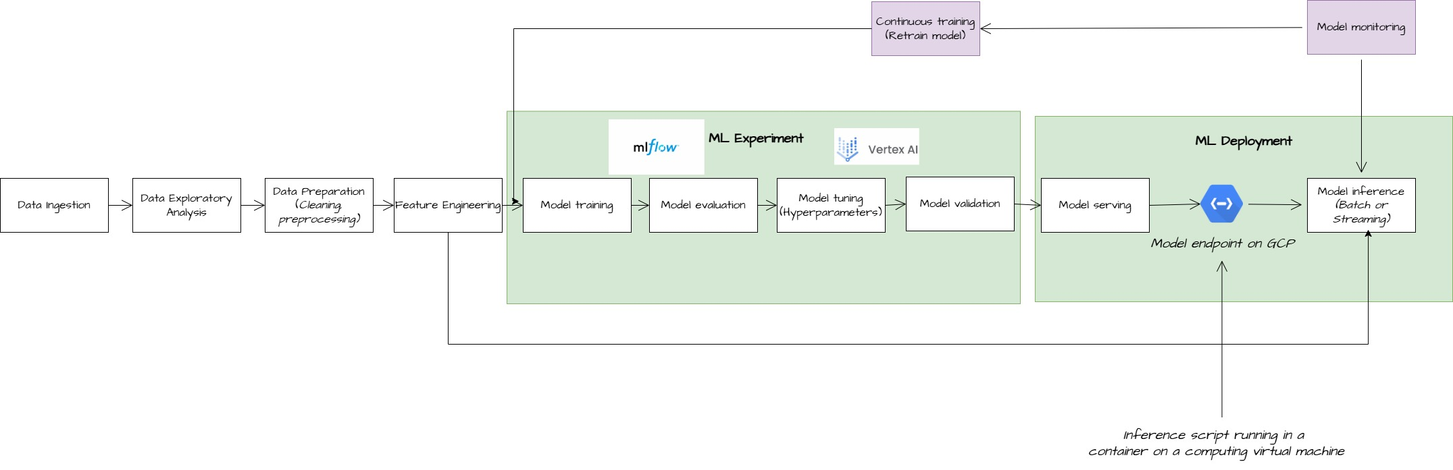
Reminder of what is a ML pipeline
Definition: A ML pipeline is a series of steps in order to serve a machine learning model for inference. It encompasses data acquisition, preprocessing, training, evaluation, and deployment.
In green the concepts seen in classes #1-2-3 /5
In purple the concept for today class

Slide 3


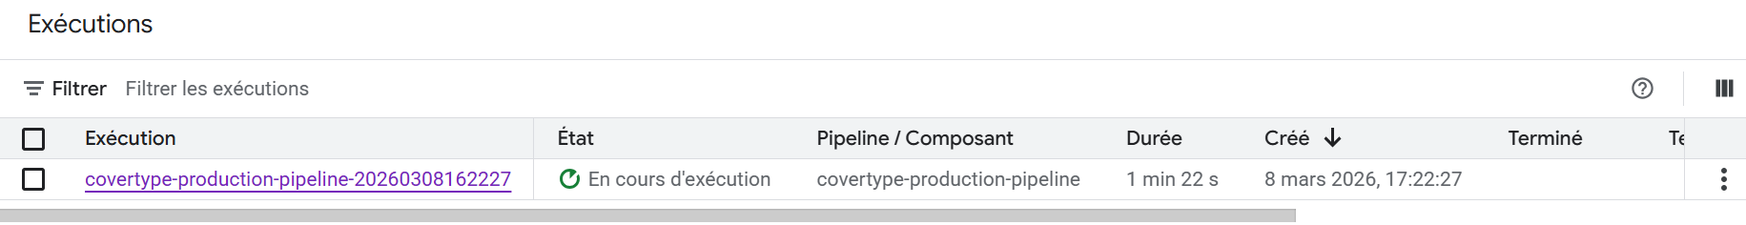
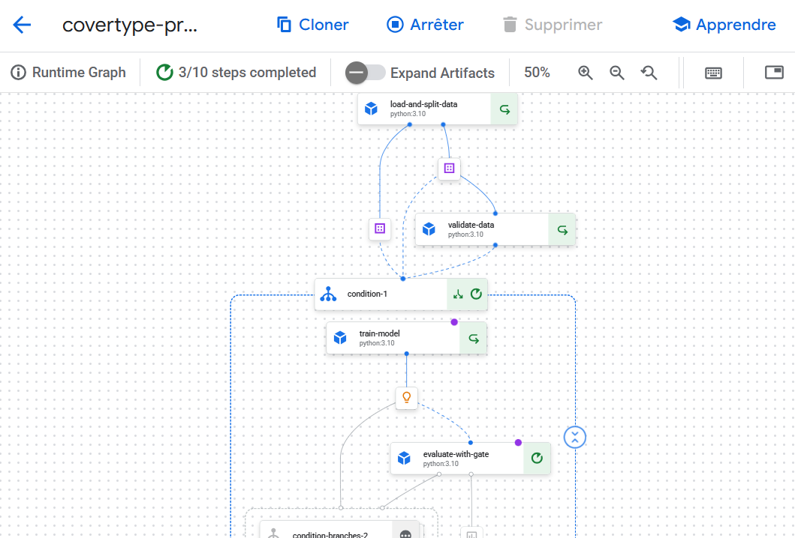
Orchestrate a full ML pipeline

Slide 4
KFP for building full End-to-End ML pipeline
What is Kubeflow Pipelines (KFP)?
An open-source framework for building and orchestrating ML workflows as reproducible, portable pipelines
Originally developed by Google, now a CNCF project with broad community support
Framework-agnostic: works with scikit-learn, PyTorch, TensorFlow, XGBoost — any Python-based ML library
Runs natively on Vertex AI Pipelines (managed, serverless) or on self-hosted Kubernetes clusters
Core concepts of KFP:
Component (@dsl.component): A self-contained step — data loading, training, evaluation, etc. Each runs in its own container.
Pipeline (@dsl.pipeline): A DAG of components wired together via typed inputs/outputs.
Artifacts (Dataset, Model, Metrics): Typed objects that flow between components — KFP handles storage and lineage.
Compiler: Converts the Python pipeline definition to a portable YAML specification.
Control flow (dsl.If, dsl.Condition): Conditional branching for quality gates and deployment decisions.
Pipeline Runner (aiplatform.PipelineJob): Submits the compiled YAML to Vertex AI for execution.

Slide 5
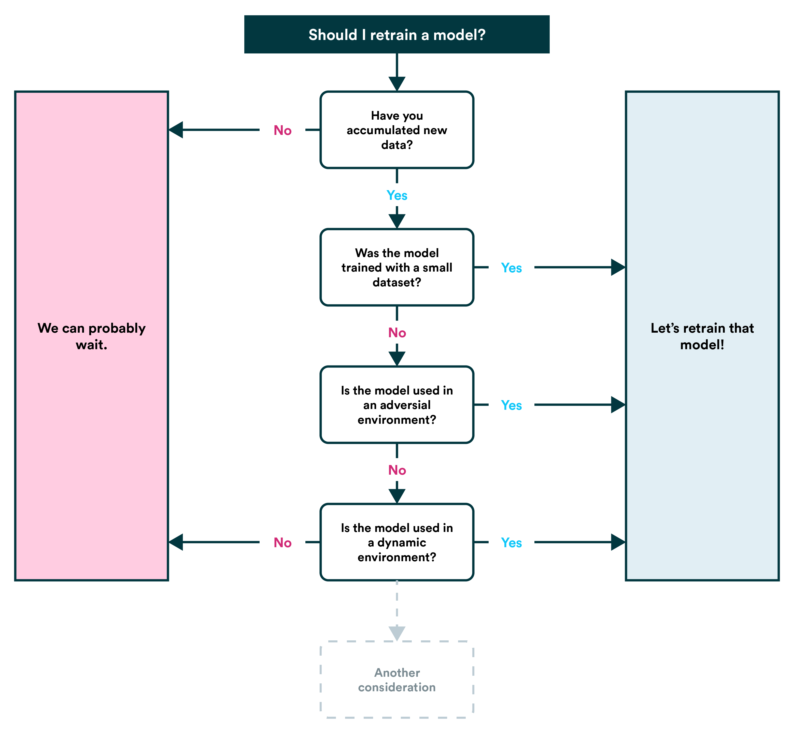
Continuous training (CT)

Slide 6
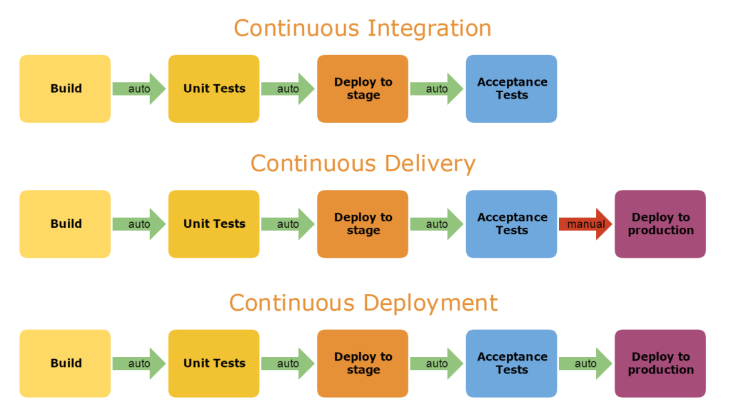
Continuous Integration (CI) and continuous Deployment / Delivery (CD)

Slide 7
Today’s Lab
Lab 04a — Kubeflow Pipelines Fundamentals (~1h00)
• Construire des composants légers avec @dsl.component (load data, train, evaluate)
• Composer un pipeline DAG avec @dsl.pipeline et le compiler en YAML
• Soumettre et monitorer le pipeline sur Vertex AI Pipelines
• Paramétrer le pipeline et relancer avec des hyperparamètres différents
Lab 04b — Production Pipeline Patterns (~1h15)
• Ajouter un composant de validation de données
• Implémenter un seuil de qualité sur l'évaluation du modèle (pass/fail)
• Utiliser dsl.If / dsl.Else pour le branchement conditionnel
• Enregistrer automatiquement le modèle dans le Model Registry si le seuil est atteint

Slide 8
Today’s Lab
Completed notebook must be sent to: jdiamant280@headmind.com
Let's get started!

