Slide 1
MeshNode UserManual

Slide 2
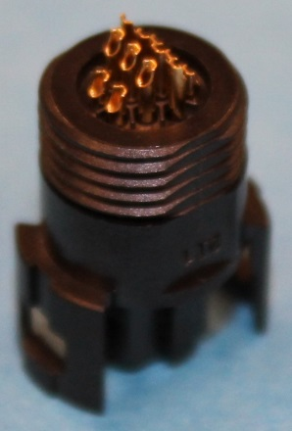
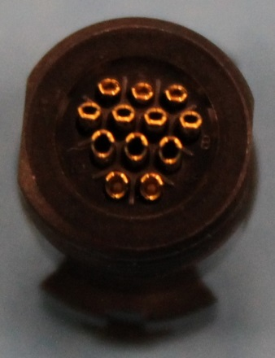
12-pin Connector
3
2
1
Pin | Function | Arduino Pin | Description
1 | Ground
2 | ID ADC | A1 | Used to ID what is plugged in
3 | Vcc |  | 3.3V (max 300mA)
4 | RAW |  | Raw voltage pass through
5 | DTR | DTR | Programming pin
6 | ADC/SCL | A5 | Analog to Digital Converter, I2C
7 | ADC/SDA | A4 | Analog to Digital Converter, I2C
8 | DIO/SCK | 13 | Digital I/O, SPI
9 | DIO/MISO | 12 | Digital I/O, SPI
10 | DIO/MOSI | 11 | Digital I/O, SPI, PWM
11 | DIO/TX | 1 | Digital I/O, Serial
12 | DIO/RX | 0 | Digital I/O, Serial
7
6
5
4
10
9
8
12
11
This is the pin-out viewed from the back of the cable-side connector, like this:

Slide 3
Configuration for 12pin to 2x6pin Connectors
Pin | Maps to | Description
1 | 2A, 2B | Ground
2 | Ground | Identifies configuration to the firmware
3 | 1A, 1B | Vcc, 3.3V (max 150mA, each)
4 | 4A, 4B | Raw voltage pass through
5
6 | 3B | Used to ID what is plugged in
7 | 3A | Used to ID what is plugged in
8
9 | 6B | Digital I/O
10 | 5B | Digital I/O, PWM
11 | 6A | Digital I/O, Serial
12 | 5A | Digital I/O, Serial
3
2
1
7
6
5
4
10
9
8
12
11
1
2
3
A
4
5
6
1
2
3
B
4
5
6

Slide 4
Configuration for 6pin Connectors
Pin | Function | Arduino | Description
1A | Vcc |  | 3.3V (max 300mA)
2A | Ground
3A | ID ADC | A4 | Connected to Ground for ID
4A | RAW |  | Raw voltage pass through
5A | Input | 0 | Digital Input (internal pull-up resistor) Grounding this pin sets trigger ON
6A | Output | 1 | Digital Output: Set HIGH when trigger (5A) is set ON
1
2
3
A
4
5
6
Pin | Function | Arduino | Description
1B | Vcc |  | 3.3V (max 300mA)
2B | Ground
3B | ID ADC | A5 | Connected to Ground for ID
4B | RAW |  | Raw voltage pass through
5B | Input | 11 | Digital Input (internal pull-up resistor) Grounding this pin sets trigger ON
6B | Output | 12 | Digital Output: Set HIGH when trigger (5B) is set ON
1
2
3
B
4
5
6

Slide 5
Alt Configuration for 6pin Connectors
Pin | Function | Arduino | Description
1A | Vcc |  | 3.3V (max 300mA)
2A | Ground
3A | ID ADC | A4 | Not implemented
4A | RAW |  | Raw voltage pass through
5A | RX | 0 | Serial Communication Receive
6A | TX | 1 | Serial Communication Transmit
1
2
3
A
4
5
6
Pin | Function | Arduino | Description
1B | Vcc |  | 3.3V (max 300mA)
2B | Ground
3B | ID ADC | A5 | Not implemented
4B | SCK | 13 | Raw voltage pass through
5B | MOSI | 11 | SPI Communication
6B | MISO | 12 | SPI Communication
1
2
3
B
4
5
6

Slide 6
Node two-way Heartbeat
From MeshNode | bytes | From UI
Latitude | 4
Longitude | 4
Altitude | 4
Voltage | 2
RSSI | 1
TriggerMask | 1
Triggers | 1
Trips | 1
OutputMask | 1
Outputs | 1
 | 1 | ForcedOutputMask
 | 1 | ForcedOutputs
 | 1 | IgnoreTriggerMask
 | 1 | ClearTrips

Slide 7
Deprecated Pin-Out
The following slides give the original pin-out for the 12-pin connector, which is no longer valid to avoid confusion.

Slide 8
Old Pin-Out Warning
The pin-out used in this document is the pin-out viewed from the back of the cable-side connector, like this:
1
2
3
This is the same as the pin-out on the PCB, viewed from the top of the board (where the connector is plugged in/where the GPS antenna is).
4
5
6
7
NO LONGER VALID
8
9
10
11
12
Note that this is NOT the Pin-Out specified by the connector manufacturer – it is the mirror image!

Slide 9
Old Pin-Out
1
2
3
Pin | Function | Arduino Pin | Description
1 | Vcc |  | 3.3V (max 300mA)
2 | ID ADC | A1 | Used to ID what is plugged in
3 | Ground
4 | ADC/SDA | A4 | Analog to Digital Converter, I2C
5 | ADC/SCL | A5 | Analog to Digital Converter, I2C
6 | DTR | DTR | Programming pin
7 | RAW |  | Raw voltage pass through
8 | DIO/MOSI | 11 | Digital I/O, SPI, PWM
9 | DIO/MISO | 12 | Digital I/O, SPI
10 | DIO/SCK | 13 | Digital I/O, SPI
11 | DIO/RX | 0 | Digital I/O, Serial
12 | DIO/TX | 1 | Digital I/O, Serial
4
5
6
7
8
9
10
11
12
NO LONGER VALID
This is the pin-out viewed from the back of the cable-side connector, like this:
Note that this is NOT the pin-out specified by the connector manufacturer – it is the mirror image!

Slide 10
Old Configuration for 12pin to 2x6pin Connectors
Pin | Maps to | Description
1 | 1A, 1B | Vcc, 3.3V (max 150mA, each)
2 | Ground | Identifies configuration to the firmware
3 | 2A, 2B | Ground
4 | 3A | Used to ID what is plugged in
5 | 3B | Used to ID what is plugged in
6
7 | 4A, 4B | Raw voltage pass through
8 | 5B | Digital I/O, PWM
9 | 6B | Digital I/O
10
11 | 5A | Digital I/O, Serial
12 | 6A | Digital I/O, Serial
1
2
3
4
5
6
7
8
9
10
NO LONGER VALID
11
12
1
2
3
A
4
5
6
1
2
3
B
4
5
6

