Slide 1

Analysis & Insights of Bicycle Thefts in Toronto
Using the Bicycle Thefts Open Data.

Slide 2
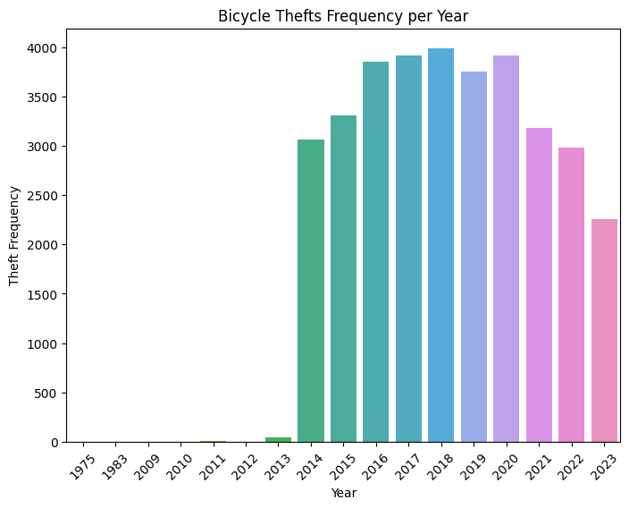
Bicycle Thefts Frequency per Year
The count plot displays the frequency of bicycle thefts per year. We observe a fluctuating trend in bicycle thefts from the year 2013 and then decrease from 2020.

Slide 3
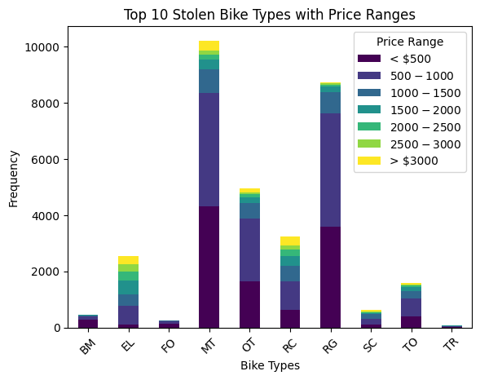
Top 10 Stolen Bike Types with Price Ranges
The stacked bar plot illustrates the frequency distribution of the top 10 stolen bike types categorized by price ranges. Each bar represents a bike type, segmented into different colors according to the price ranges.
Observations: Bike Type Frequency: Certain bike types, like "MOUNTAIN BIKE" and "ROAD BIKE," are more frequently stolen compared to others in the top 10.
Price Range Segmentation: Across bike types, lower-priced bikes (below $1000) seem to be more susceptible to theft.
Insights: High-Frequency Types: "MOUNTAIN BIKE" and "ROAD BIKE" are commonly stolen, lower-priced bikes appear to be targeted more, possibly due to their higher availability or lower security measures.
Recommendations: Security Measures: Emphasize security measures for commonly stolen bike types to deter theft incidents.
Awareness Campaigns: Educate bike owners, especially those with lower-priced bikes, about better security practices to safeguard against theft.

Slide 4
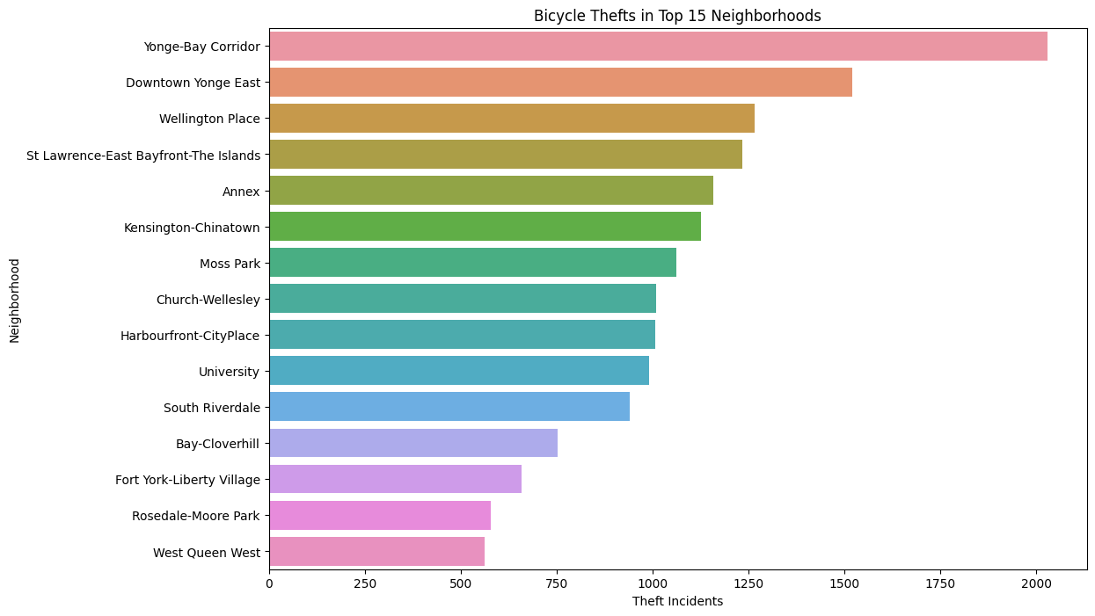
Count plot showcasing bicycle thefts across the top 15 neighborhoods
Analysis
Provides an overview of theft incidents in different areas.
Certain neighborhoods experience higher rates of bicycle theft. Identification of areas requiring increased security measures.
Recommendations
Implement targeted policing or surveillance in high-theft neighborhoods. Community engagement to raise awareness and prevent thefts in these areas.

Slide 5
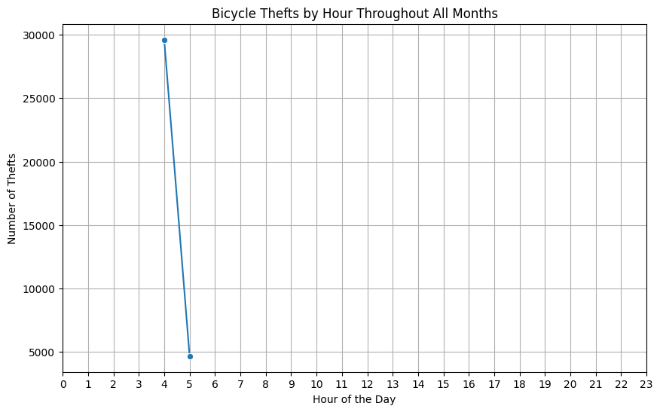
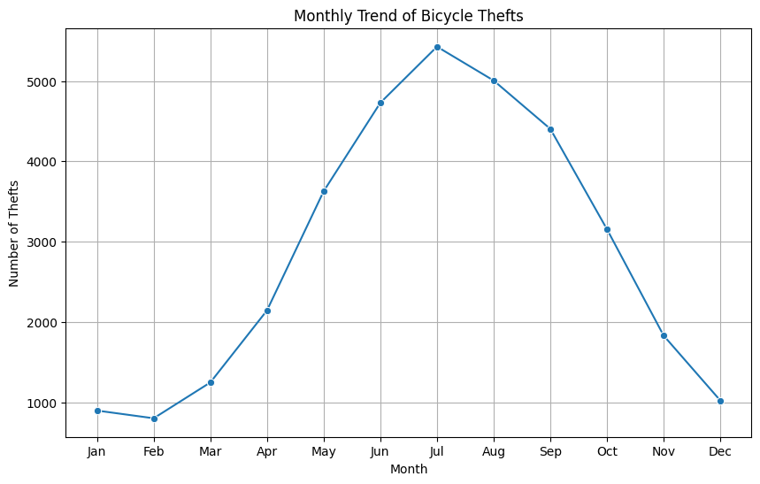
Temporal Analysis
Seasonal Impact
Certain months might exhibit higher theft rates, possibly influenced by factors like weather, holidays, or increased outdoor activities.
It is always at the same time of the night.
Recommendations
During months with increased theft rates, like during the summer, (between May and October) enhance surveillance and awareness campaigns. Warn the inhabitants of potential increase of Bicycle Thefts to raise their awareness.
Don’t park your bike outside during the night as it is when all the theft happened

Slide 6
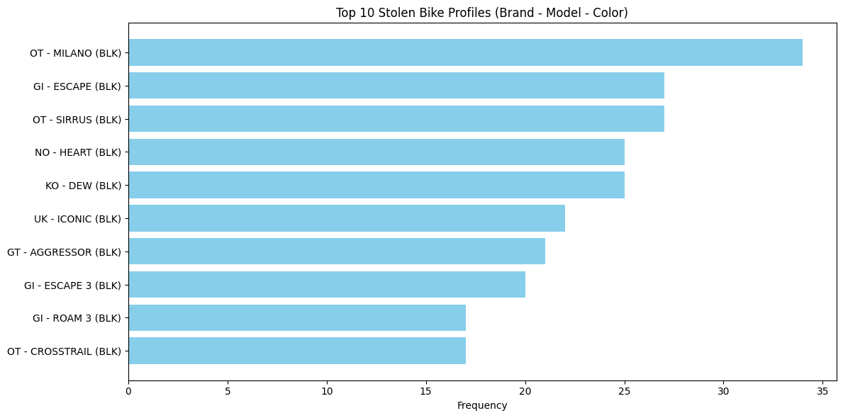
Top 10 Stolen Bike Profiles
Analysis
Understanding the detailed characteristics of stolen bikes—beyond just the brand or model—is crucial in identifying patterns and focusing preventive measures. The visualization helps in pinpointing specific bike profiles that require heightened attention for theft prevention strategies.
Recommendations
The most stolen Bike is black, Milano OT.
It means we should also advise the owner of those bikes to be extra careful when parking their bike outside.
The police can also have their eyes on those specific models.

Slide 7
Conclusions & Recommendations for preventive solutions
Insights
Insights: High-Frequency Types: "MOUNTAIN BIKE" and "ROAD BIKE" are commonly stolen, suggesting a higher demand for these types in the stolen bike market.
Price Influence: Lower-priced bikes appear to be targeted more, possibly due to their higher availability or lower security measures. Recommendations: Security Measures: Emphasize security measures for commonly stolen bike types to deter theft incidents. Awareness Campaigns: Educate bike owners, especially those with lower-priced bikes, about better security practices to safeguard against theft.
The police can also have their eyes on the most stolen bicycle type, in the most popular neighborhood for theft ath the most popular time of the year and the day to arrest more thiefs.

