Slide 1
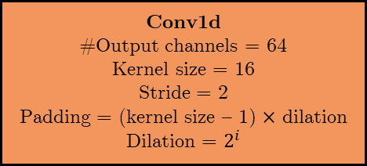

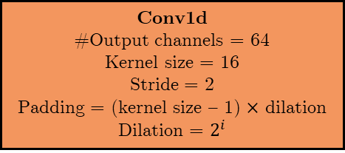



$$x$$
Conv1d
#Output channels = 64
Kernel size = 16
Stride = 2
Padding = (kernel size – 1) $×$ dilation
Dilation = $2^{i}$
Conv1d
#Output channels = 64
Kernel size = 16
Stride = 2
Padding = (kernel size – 1) $×$ dilation
Dilation = $2^{i}$
BatchNorm1d
#Output channels = 64
BatchNorm1d
#Output channels = 64
Tanh
Sigmoid
$$×$$
+
$$y_{res}$$
$$y$$

Slide 2

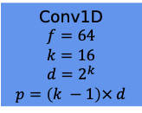






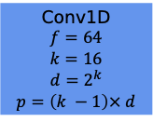




v
v
v
v
Residual $y_{res}$
$$+$$
$$×$$
$$+$$
1 x 1
ReLU$⁡$
Dense
ReLU$⁡$
Dense
Softmax$⁡$
Output
$$tanh⁡$$
$$σ$$
(1856, 50)
(50, 1)
Batch
Normalization
Batch
Normalization
Skip
Connections $y$
Conv1D
$$f=64$$
$$k=16$$
$$d=2^{k}$$
$$p=\left(k −1\right)× d$$
Conv1D
$$f=64$$
$$k=16$$
$$d=2^{k}$$
$$p=\left(k −1\right)× d$$
$k$modules
Input $x$

Slide 3
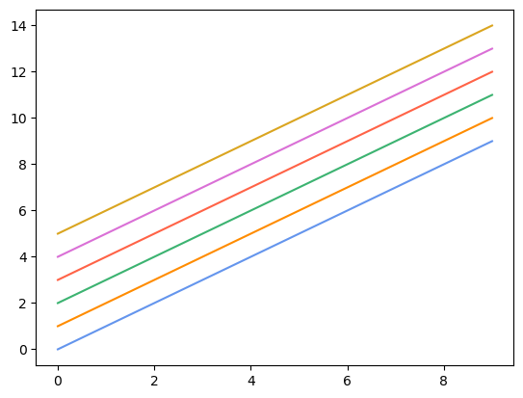
Sample colors

