Slide 1
A flexible and easy way to connect and extend enterprise applications in a cloud-native world

Slide 2
This is the divider page

Slide 3
This is the divider page

Slide 4

What is Kyma?
Kyma is an open source project
designed natively on Kubernetes.

Slide 5
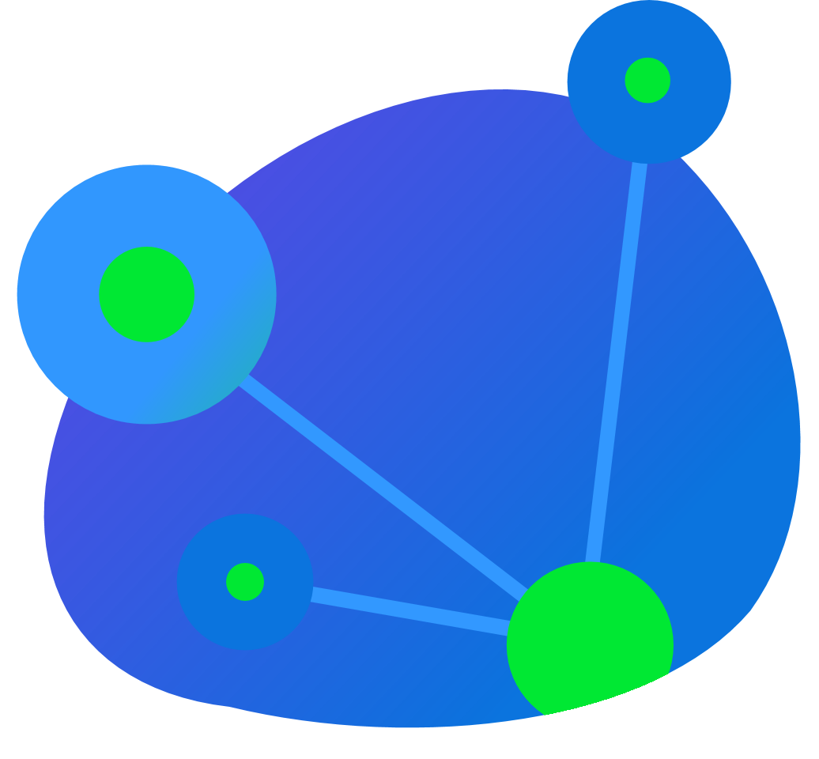
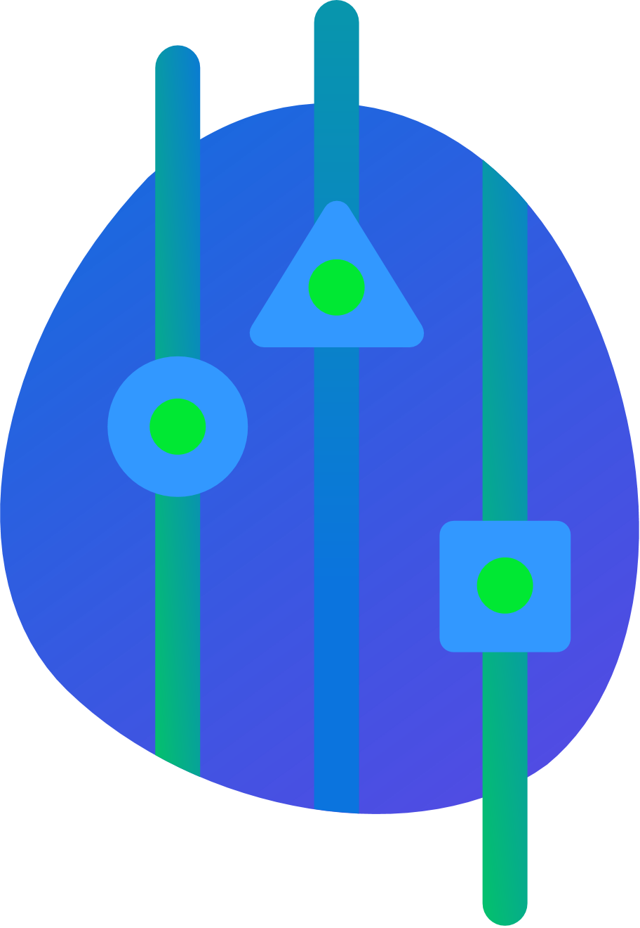

Kyma features
Application Connector
Service Management
Serverless

Slide 6
Kyma Color Palette
RGB: 50-152-255
RGB: 77-16-225
RGB: 44-133-222
RGB: 9-94-179
RGB: 9-94-179
RGB: 252-209-0
RGB: 0-232-51
RGB: 11-116-222

Slide 7
Thank you
Contact information:
Name Title Address Phone number

