Slide 1
Iranian License Plate Recognition
Using Deep Learning for Automatic Identification
Abolfazl Najar Deep Learning Course spring 2025

Slide 2
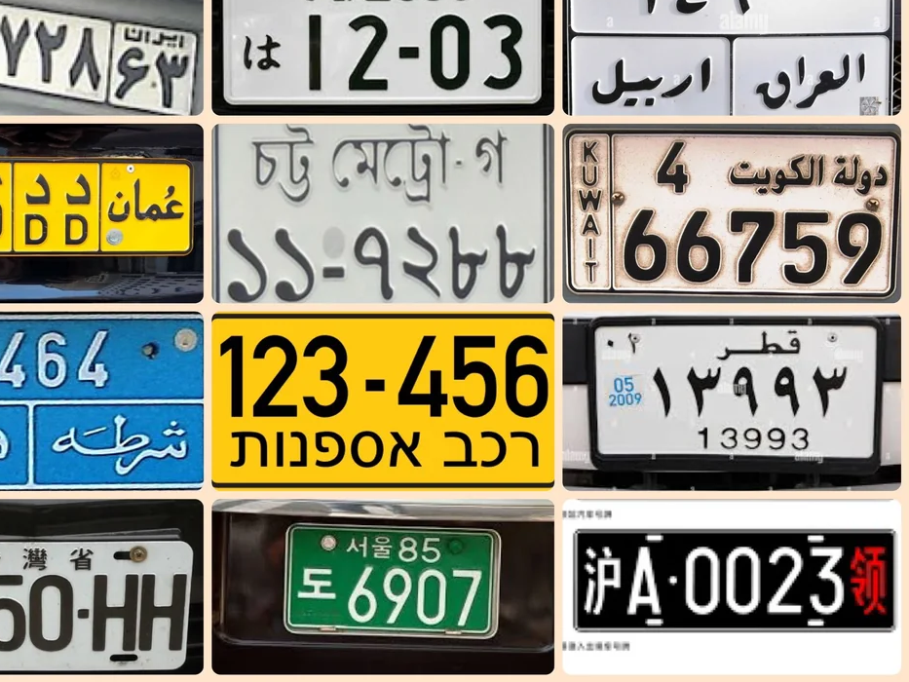
Introduction
Plate recognition is a critical problem in many countries

Slide 3
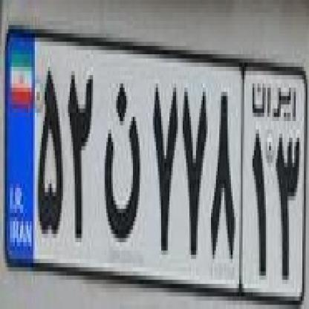
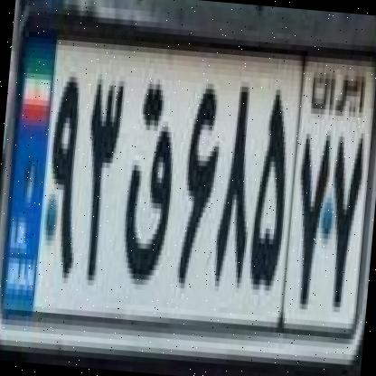
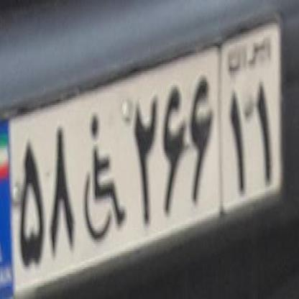
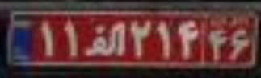
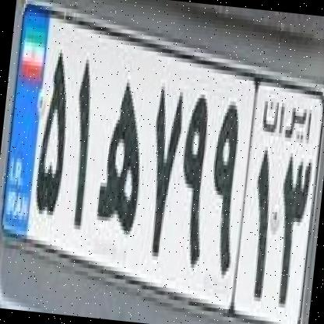
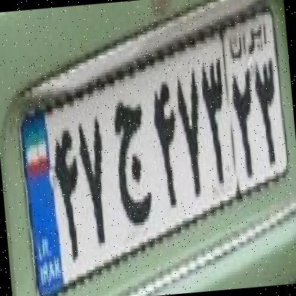
Introduction
License Plate Recognition (LPR) is crucial for law enforcement, parking management, and surveillance.
Challenges include variations in lighting, angle, and font styles, especially for Farsi characters.

Slide 4
Dataset & Challenges
Datasets for Iranian plates are limited; new datasets provide annotated images for detection and OCR.
Challenges include occlusions, diverse backgrounds, and various plate formats.

Slide 5
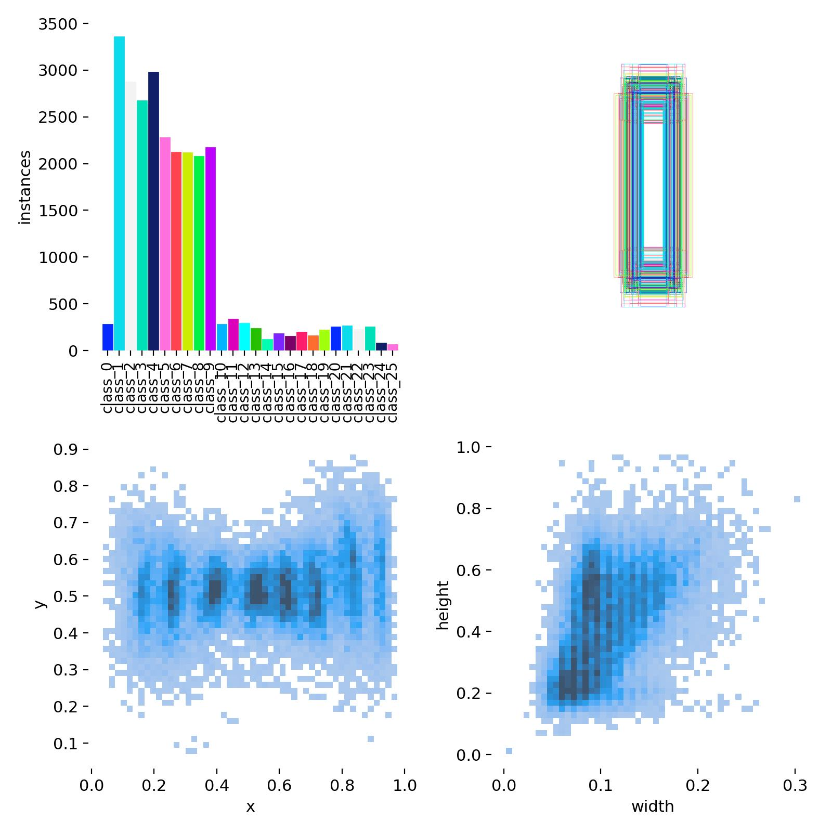
Dataset & Challenges

Slide 6
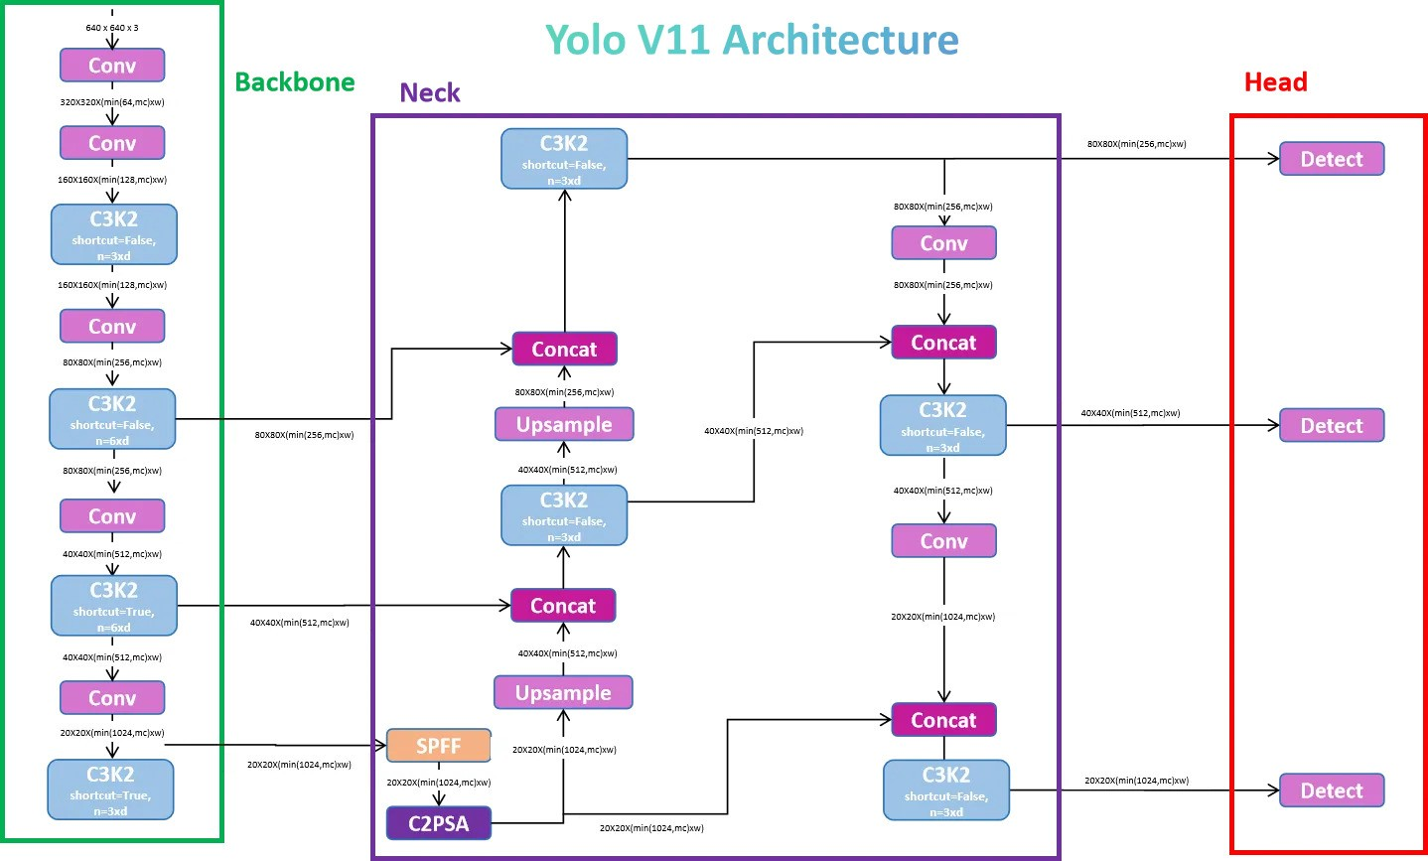
Yolo v11

Slide 7
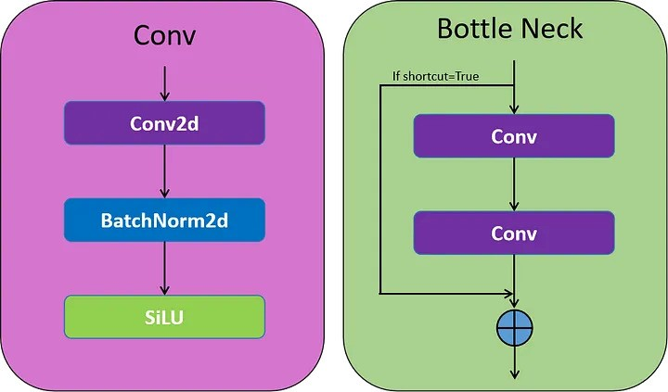
New Blocks

Slide 8
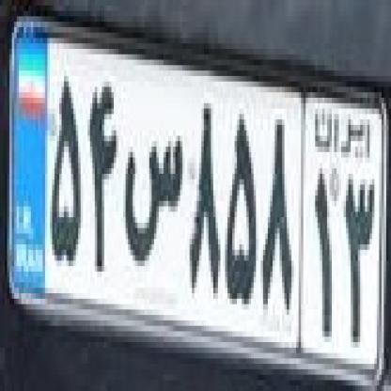
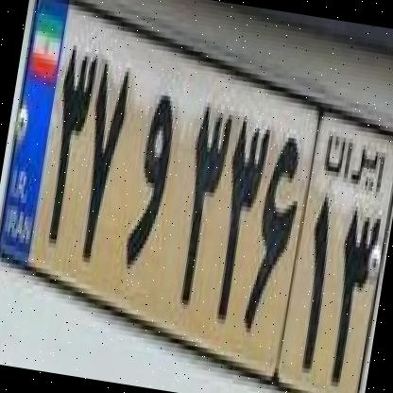
Dataset Origin
This database contains 3300 trains, 153 tests, and 231 validation images.
Data has a good diversity from different plates in terms of taking pictures from different angles and variation in resolution and characters.
https://universe.roboflow.com/shahab-jafari-1vorv/persian-plate-characters-mvinj

Slide 9
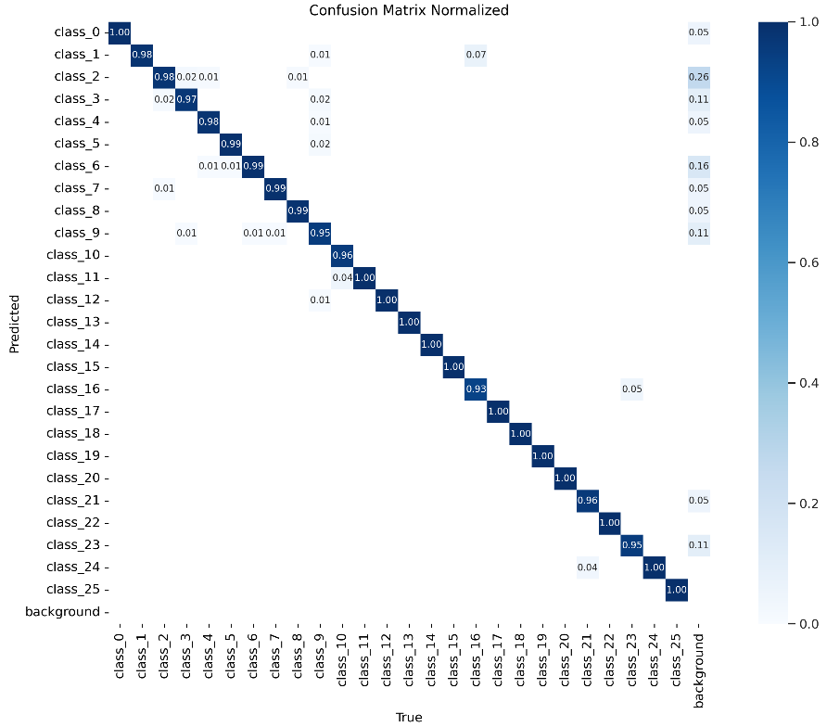
First Attempt on Training

Slide 10
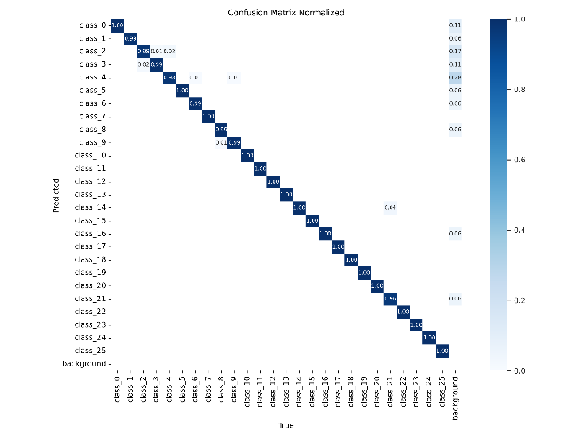
Modifying dataset and Second Training
First version of Dataset
Second version of Dataset

Slide 11
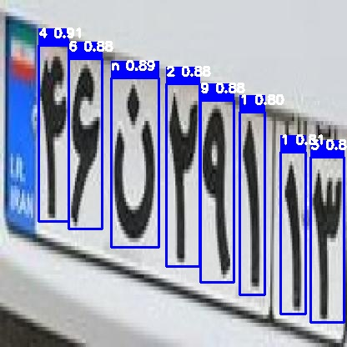
Model Performance

Slide 12
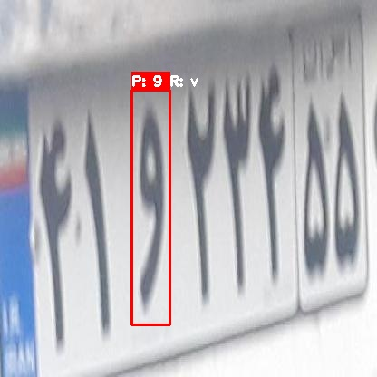
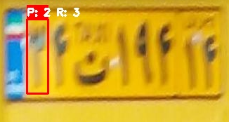
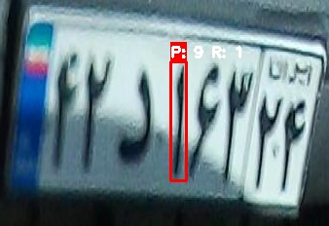
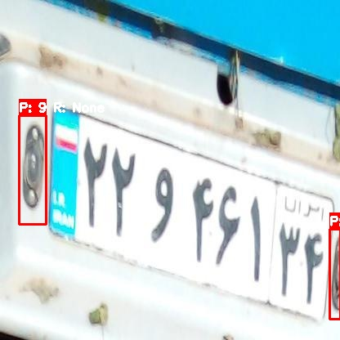
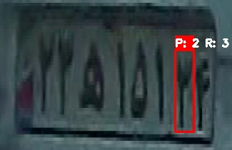
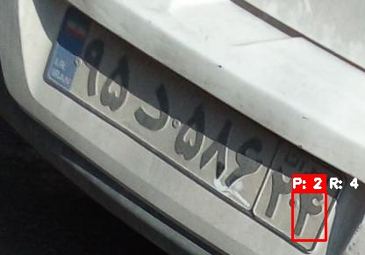
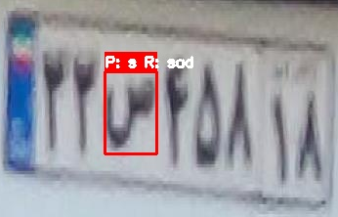
Faul Analysis

Slide 13
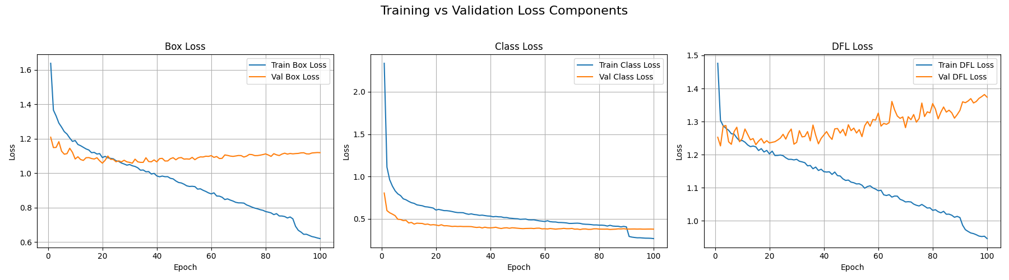
Loss functions

Slide 14
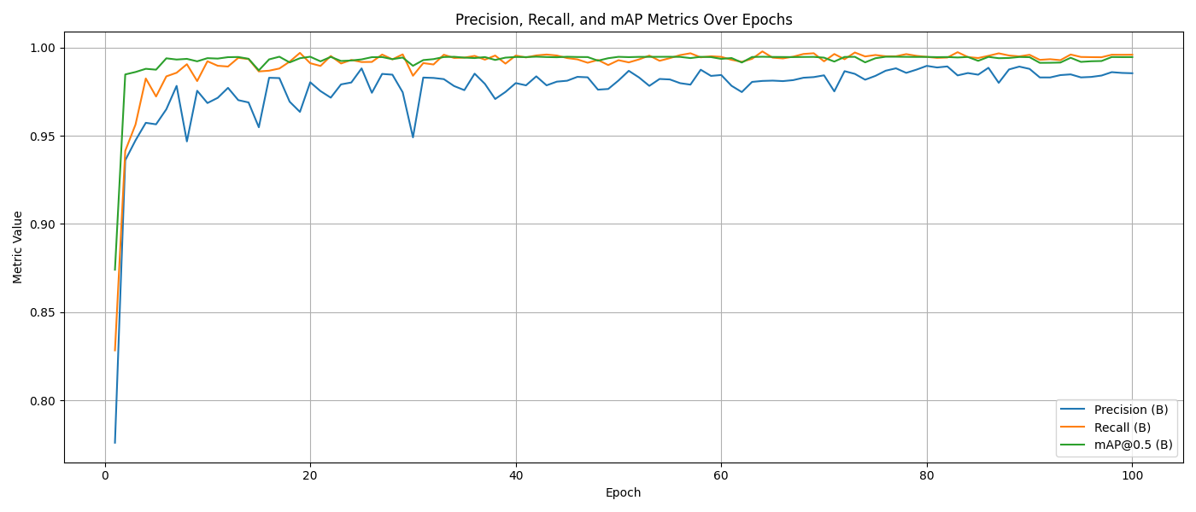
Precision, Recall, and mAP
gfa

Slide 15
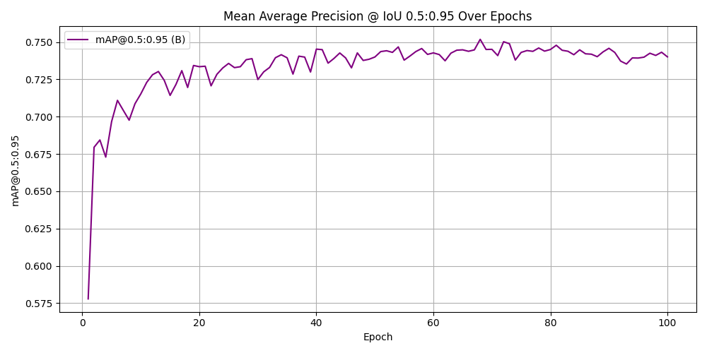
mAP 0.5:095
gfa

Slide 16
Comparing with other schemes
Metrics | Precision | Recall | mAP50 | mAP50-95
My Approach | 0.98286 | 0.99634 | 0.99464 | 0.75185
[2] | 0.954 | 0.956 | 0.982 | 0.817
[3] | 0.9033 | - | - | 0.732
[7] | 0.8722 | - | - | -
[8] | 0.9045 | - | - | -

Slide 17
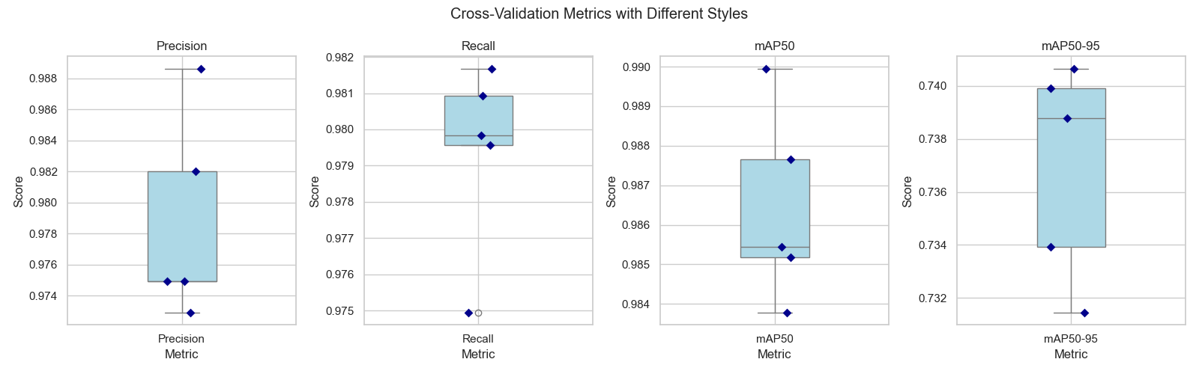
Cross Validation

Slide 18
Cross Validation

Slide 19
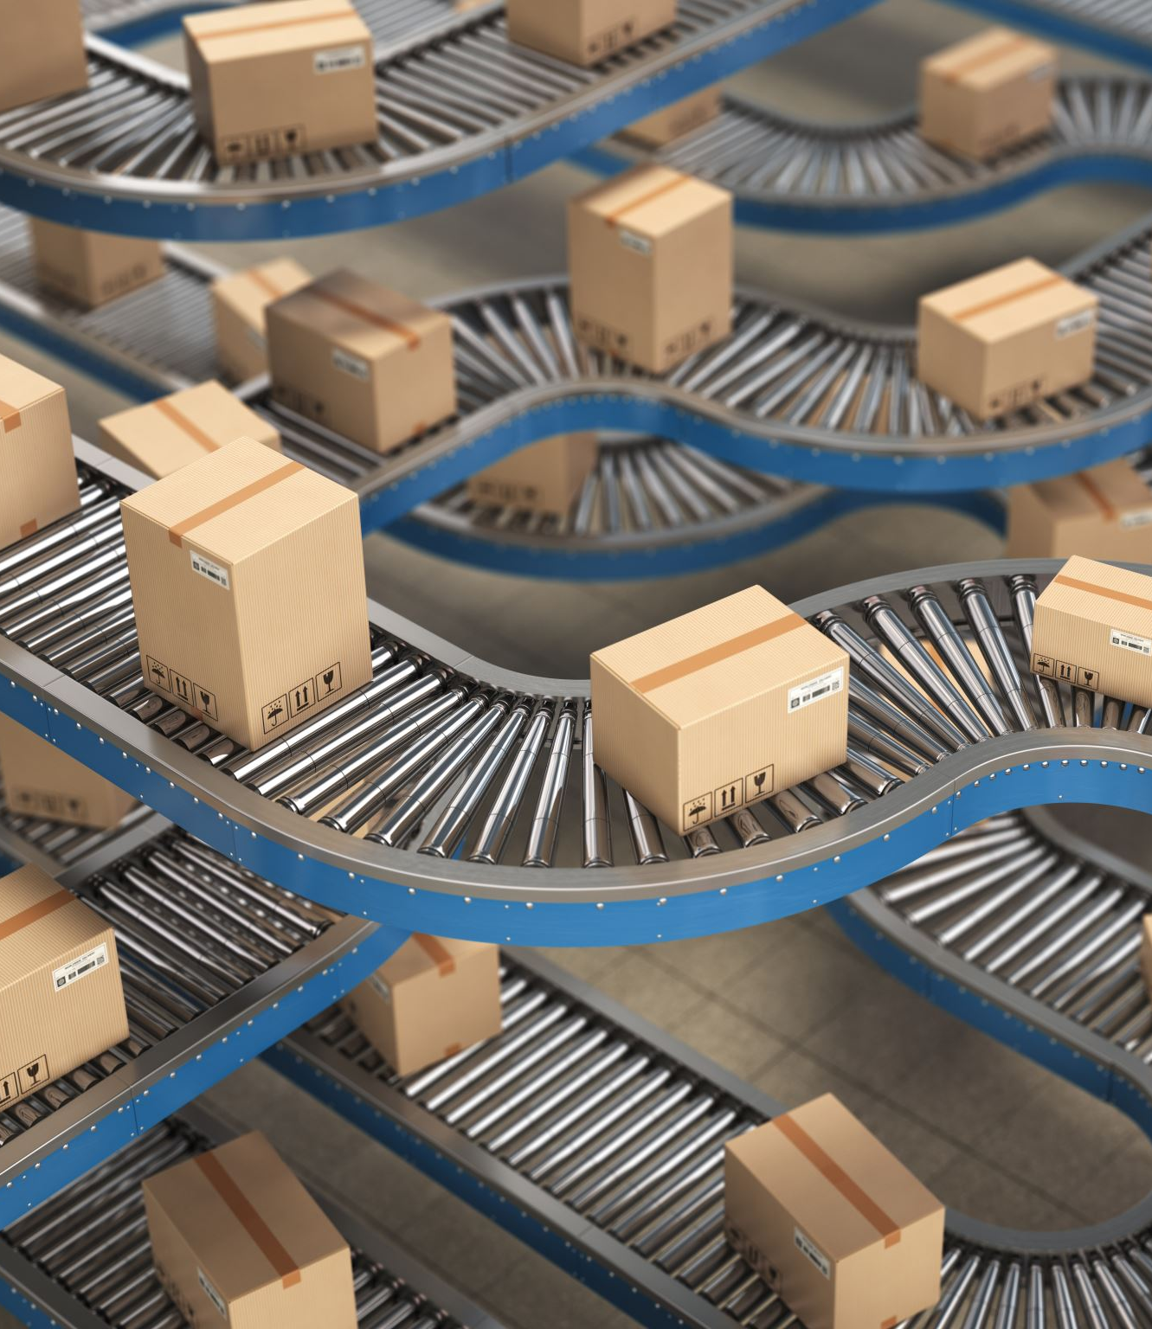
Applications & Conclusion
Iranian LPR systems can be applied to:
- Traffic monitoring and law enforcement
- Automated toll collection
- Smart parking systems
Deep learning enhances accuracy, making LPR systems more reliable and efficient.

