Slide 1
Computational Modeling of Social Systems
Fariba Karimi, Ana Jaramillo, Pavle Savković
March – June 2025

Slide 2
About the teaching team
Fariba Karimi
- Professor and team lead of the Computational Social Science (CSS) lab at TU Graz
- Faculty member and group leader at the Complexity Science Hub Vienna
Ana Jaramillo
- Postdoctoral researcher at CSS lab
Pavle Savković
- Teaching assistant and CSS master student

Slide 3
Overview
1. Why models? Complex Social Behavior
2. Agent-Based Modelling (ABM)
3. ABM Example: Date Choice Model
4. About this Course

Slide 4
Why models?
Models are the construction of reality and a way of explaining what we see in the world.
Without models, we can’t explain why we see what we see. Models make us smarter and help us not only understand the world but also say something about the future or even build the future
In a broader sense, model thinking allows us to frame the world, make logical connections, and also reframe the world.
Notes:
Models are construction of reality and the way of explaining what we see in the world. Without models, we can’t explan why we see what we see. Models make us smarter, help us to not only understand the world, but also say something about future. Or even, build the future
In a broader sense, model thinking allows us to frame thw rold, make logical connections and also reframe the worlds.

Slide 5
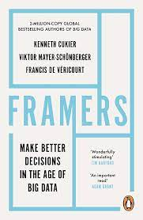
Model thinking helps us become framers
Framers is defined by the idea that when we “frame” something, we “create a mental model enabling us to see patterns,” almost able to see into the future of our ideas.
Framing helps us in 3 dimensions:
Causality
Counterfactuals (what-if scenarios)
Constraints
Notes:
Something that machine might not be able to accomplishes. Machine is like a baby that have a lot of information in it. But can it connect the dots between various concepts, and use that to frame a new situation?
These days with the overload of information around us, it is easy to get lost and forget the big picture. Models allow us to focus on the big picture, find mechanisms that are necessary to understand how things work and evolve.

Slide 6
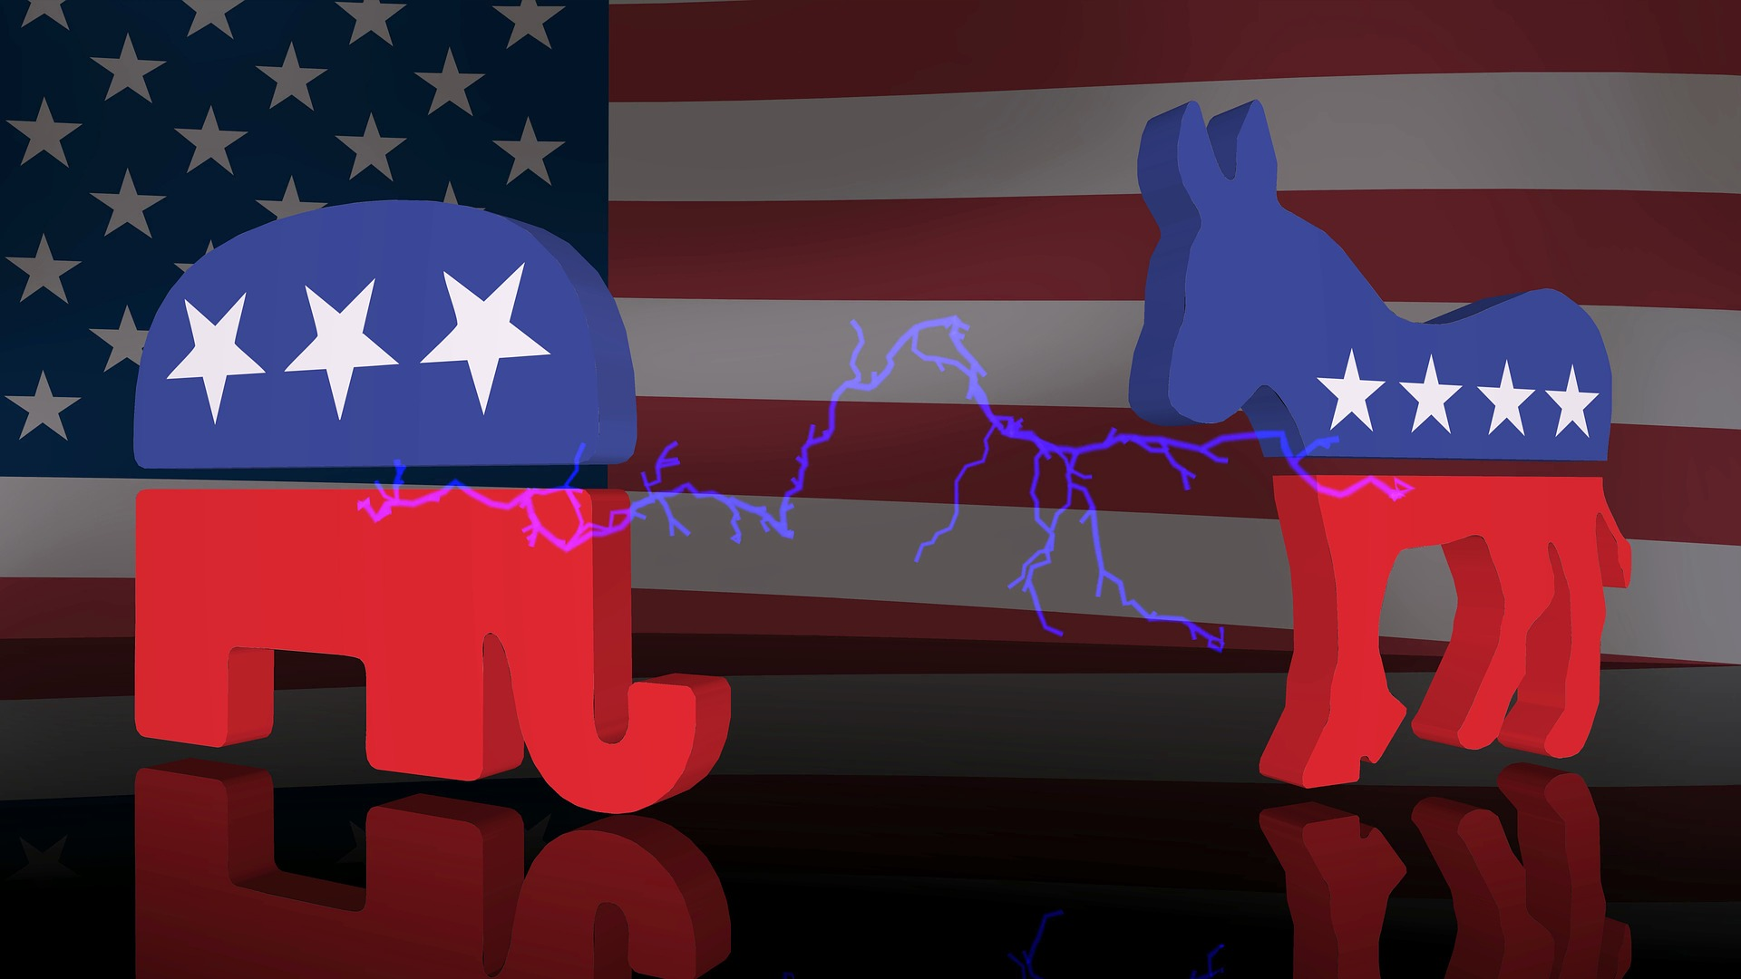
Complex social behvior: extreme opinion and polarization
Two opposing groups can become more extreme due to their perception of the behavior and opinions of the other group.
Individuals in isolation do not naturally tend to have extreme opinions.
Notes:
Our world is complex and we are not acting in isolation. Think about the problem of polarization in the world.
Do you think if we have individuals in isolation, do they go to extreme opinions about the world?

Slide 7
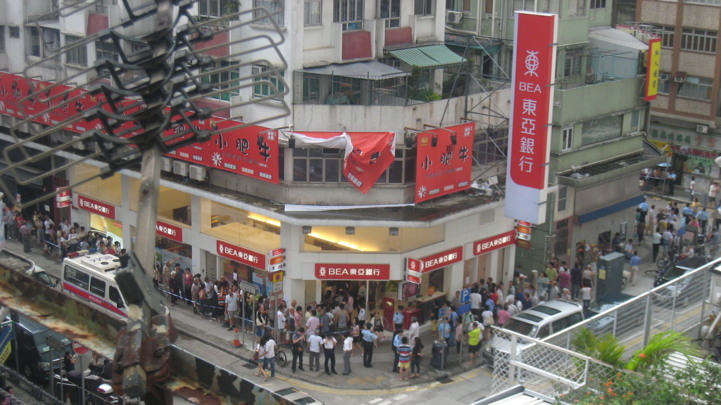
Complex social behavior example: Bank runs
A run on a bank of East Asia branch in Hong Kong, caused by "malicious rumours" in 2008
Banks operate without all the savings in their reserves
If customers believe that many others withdraw their money, they will do it too
The rumor and spreading distrust results in a bank run (the tragedy of the commons)
Would customers in isolation create a bank run??
Notes:
As a bank run progresses, it may become a self-fulfilling prophecy: as more people withdraw cash, the likelihood of default increases, triggering further withdrawals. This can destabilize the bank to the point where it runs out of cash and thus faces sudden bankruptcy.

Slide 8
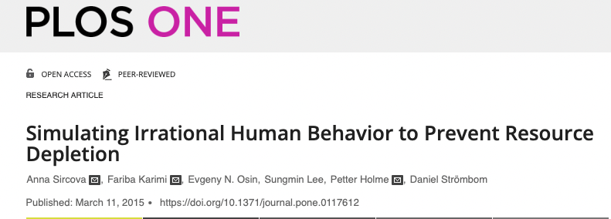

Tragedy of the commons/social traps/social dilemmas
Notes:
In a small village of 150 inhabitants in the north of the Nether- lands, an energy deficiency situation arose because of the severe winter of 1978/1979. The village was cut off from the power sup- ply by heavy snow-falls. However, the local blacksmith owned a generator, which permitted a short term technical solution: ever- ybody could use one but only one lamp and could operate a central heating circulation pump, if they had one. The village's two farmers could also alternate the milking of their cows (since electrical equipment was used). However, this solution to the "energy crisis" did not turn out to be a viable one - - so many villagers violated the preceding conditions that the generator was overloaded. In order to be able to continue the electricity supply, one villager regularly had to go out and identify those who violated the conditions agreed upon, a situation lasting un- til the connection to the power supply was repaired.

Slide 9
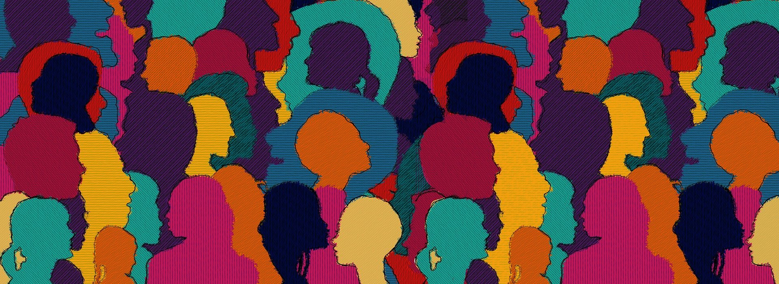
Complex social behaviors: Activation and inhibition
Individuals demonstrating in isolation are peaceful, but in a group a riot can emerge without a clear antecedent
People alone in the street offer help, but when many are watching they don't act (bystander effect)

Slide 10
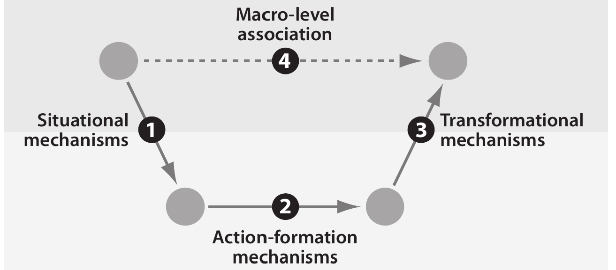
The micro-macro gap
Causal Mechanisms in the Social Sciences. Peter Hedström and Petri Ylikoski. Annual Review of Sociology, 2010.
Notes:
Example of heat and crime: hotter days have higher average crime rates
Does that help us to do something about it?
Imagine this data is given to ML algorithms; they would in the best case scenarios tell us the probability of crimes as a function of temperature. Is that really helping us solve the problem?

Slide 11
The micro-macro gap
Causal Mechanisms in the Social Sciences. Peter Hedström and Petri Ylikoski. Annual Review of Sociology, 2010.
Notes:
A basic point of the mechanistic perspective is that explanations that simply relate macro properties to each other (arrow 4) are unsatisfactory. These explanations do not specify the causal mechanisms by which macro properties are related to each other. Deeper explanatory understanding requires opening up the black box and finding the causal mechanisms that have generated the macro-level observation. Rather than analyzing relationships between phenomena exclusively on the macro level, one should identify the situational mechanisms by which social structures constrain individuals’ action and cultural environments shape their desires and beliefs (arrow 1),
describe the action-formation mechanisms according to which individuals choose how to act (arrow 2),
and single out transformational mechanisms by which individuals, through their actions and interactions, generate various intended and unintended social outcomes (arrow 3).
Only by understanding the whole chain of situational, action- formation and transformational mechanisms, have we made sense of the observed macro- level relationship

Slide 12
Interdisciplinarity in complex social behavior
Sociology, political science, macroeconomics
Norms, institutions, inequality, conflict
Computer Science
Math, physics, statistics, data science
Simulations, networks, dynamical systems
Psychology
Cognitive Science
Opinions, emotions, beliefs, social contacts

Slide 13
Overview
1. Why models? Complex Social Behavior
2. Agent-Based Modelling (ABM)

Slide 14
Agent-Based Modelling (ABM)
Agent-Based Model: A computational analogy of a social system that is composed of a set of agents (actors) that represent discrete individuals
Agents have internal states, perceive the actions of other agents, and interact with other agents and their environment (situated)
Agents are active: they have a behavioral repertoire, they are not just particles
Agents might have access only to limited information in their environment
Agents might have internal goals that determine their behavior and can adapt to the behavior of other agents or the environment
Agent-Based Modeling: A New Approach for Theory Building in Social Psychology. Eliot Smith and Frederica Conrey, 2007
Steinbacher et al. "Advances in the agent-based modeling of economic and social behavior." SN Business & Economics 1.7 (2021): 99.

Slide 15
Explaining behavior with ABM
Observed collective behavior or effects are explananda: empirical facts that are missing an explanation.
Example: hotter days have higher average crime rates
ABM offers explanations: theories that generate the observed behavior and link it to other empirical facts
Example: heat makes people spend longer in the street, facilitating crime
ABM is part of a larger theoretical approach called Analytical Sociology, where everything in a model of social behavior must be explicit
Example: coding a simulation of people going out depending on temperature and crimes happening outdoors as a function of more people interacting

Slide 16
Explaining behavior with ABM
Are simulation results alone evidence that
humans behave in one way or another?
Notes:
Does ABM provide empirical evidence?

Slide 17
Explaining behavior with ABM
ABM do not provide empirical evidence
Simulation results alone are not evidence that humans behave in one way or another. Beware of conclusions based on ABM alone!
They can generate hypotheses, for example, on the consequences of policies in simulations or formulate predictions
They can reconcile empirical observations across individual behavior and collective behavior levels

Slide 18
Beyond exploration: computational theory and framing
ABM are for analysis, not just exploration
Exploring what happens in a simulation is fine, but ABM can do much more!
Behavior calibration of individual agents with experiments or surveys: integrating social and behavioral findings in an ABM
Analysis of observable outcomes versus parameters of behavior or alternative mechanisms/policies
Testing outcomes with large-scale data (e.g. digital traces from computational social systems), across conditions and over time
From factors to actors: Computational Sociology and Agent-Based Modeling. Michael Macy and Robert Willer. Annual Review of Sociology, 2002.

Slide 19
Properties of good ABM
They model causation: agent actions and conditions have counterfactuals, and dynamics are not ad hoc to get an outcome
Counterfactual: expressing what has not happened but could, would, or might under differing conditions.
They have measurable outcomes: collective behavior can be aggregated into one or more quantities that can be measured in many simulations and across conditions
They have quantifiable designs: individual dynamics are based on metrics that can be tested with empirical methods (e.g. experiments, surveys)
Are minimal and modular: you can test the sensitivity of outcomes with different blocks of dynamics and include only what is necessary
Ockham’s razor principle: if you have two competing ideas to explain the same phenomenon, you should prefer the simpler one.
Notes:
Now there are many ways to create a bad ABM models. … Too many parameters, too many rules,

Slide 20
Why Ockham’s Razor principle?
In modeling social systems, applying Ockham’s Razor is beneficial for several reasons:
Avoiding Overfitting – Social systems are complex, but models that include too many variables may fit past data well while failing to predict future behavior. A simpler model captures general trends without overfitting to noise.
Enhancing Interpretability – Social models inform policies, decisions, and interventions. A simpler model is easier to understand and communicate to policymakers, stakeholders, and the public.
Improving Generalizability – Models with fewer assumptions are often more robust across different contexts, whereas overly complex models may be too specific to a single dataset or situation.
Reducing Data and Computational Requirements – Social data is often incomplete, noisy, or biased. A simpler model requires fewer variables, making it easier to collect reliable data and reducing computational complexity.
Facilitating Theory Development – Scientific progress often relies on elegant and parsimonious theories. Simplified models help identify core causal mechanisms rather than getting lost in extraneous details.

Slide 21
Overview
1. Why models? Complex Social Behavior
2. Agent-Based Modelling (ABM)
3. ABM Example: Date Choice Model

Slide 22
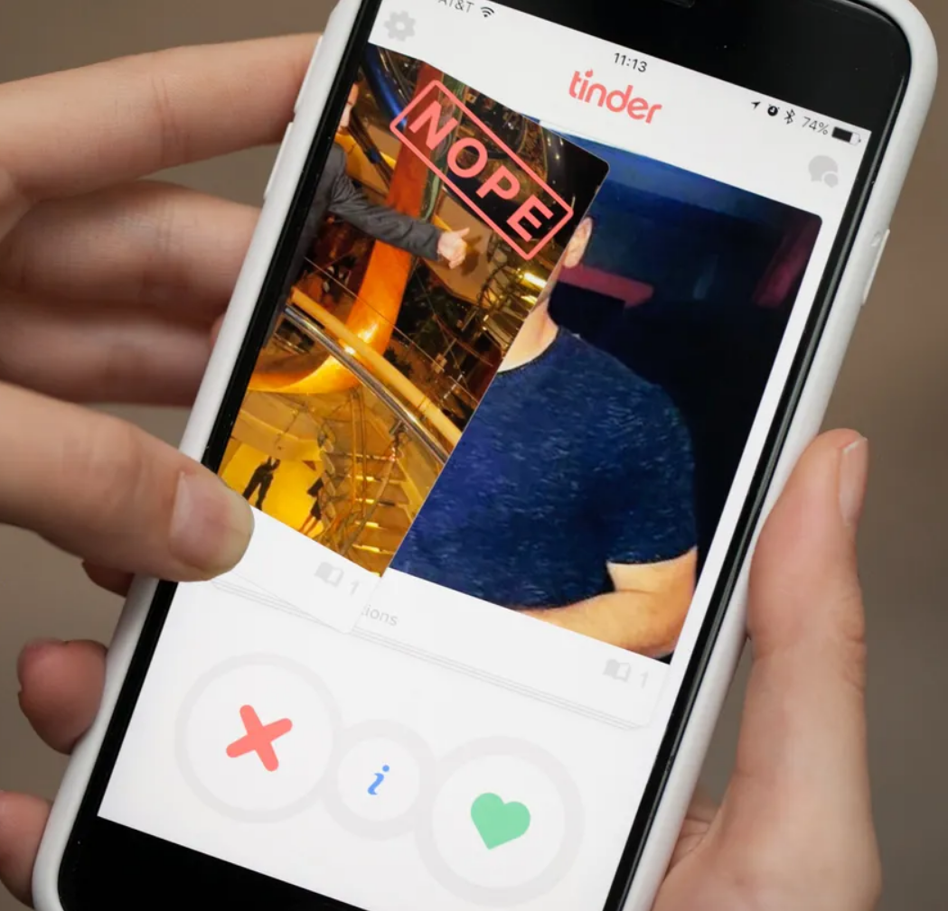
Dating choice
Tender!
tinder!
Notes:
How do people select their date? Do they go randomly and unintentionally select right and left or do they prefer attractive persons?
Next time you get a message, think twice!

Slide 23
The question of attractiveness matching
Example: Kalick and Hamilton (1986) date choice model
Question: do people seek dating mates that are as attractive as possible or matching their own perceived attractiveness?
Conflicting evidence:
In experiments (micro), participants seek to maximize partner attractiveness; participant attractiveness is barely relevant
In observational data (macro), the attractiveness of couples is correlated ( r∼0.6 ) and correlation is stronger for more committed couples
The matching hypothesis reexamined. Michael Kalick and Thomas Hamilton. Journal of Personality and Social Psychology, 1986.

Slide 24
The dating model
How would you model this to consolidate these two competing hypotheses?
Work in group of 2; 15 min

Slide 25
The Kalick and Hamilton dating model
Start with N male and N female agents, all are uncoupled
Each agent has a constant attractiveness number randomly sampled between 1 and 10 at the beginning of the simulation
Repeat while there are uncoupled agents:
All male and female agents are randomly paired for a date
Dates consist on each individual accepting or rejecting their partner. The probability of accept is based on a rule taking into account their attractiveness levels (e.g. matching or seeking attractiveness)
Dates with both agents accepting form a couple and leave the dating pool

Slide 26
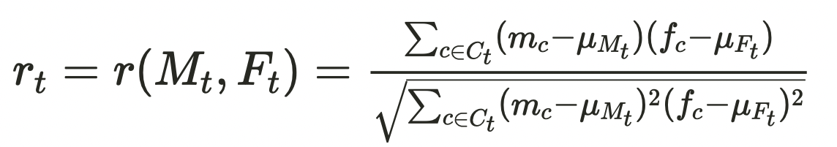
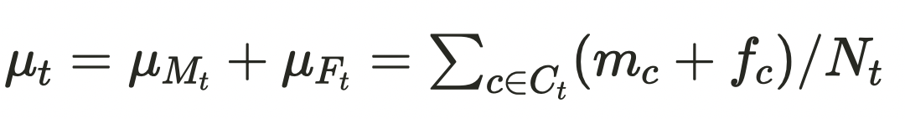
Model metrics
Model "time" t: Percentage of agents that are in a couple
It grows with simulation iterations, starting from 0 and approaching 100
Correlation coefficient between paired couples ( r_t ) at time t:
M_t and F_t are the vectors of male and female attractiveness in couples formed up to time t, denoted as Ct
Mean attractiveness of the N_t paired couples at time t:

Slide 27
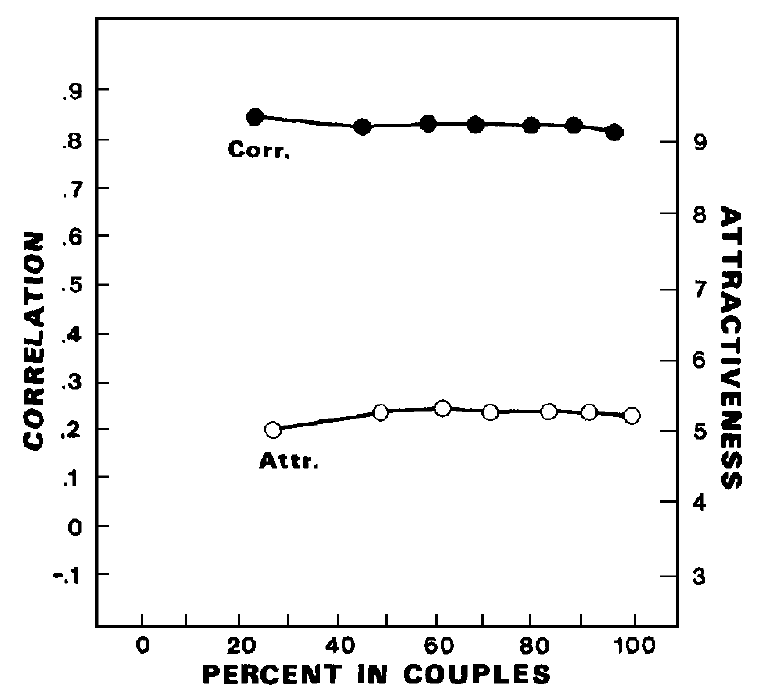
Seeking similar match: outcomes
Outcomes over simulation time (% matched couples) for the case of seeking similar partners
Correlation starts very high (0.8)
. No real trend in correlation
. Mean couple attractiveness is around the average the whole simulation

Slide 28
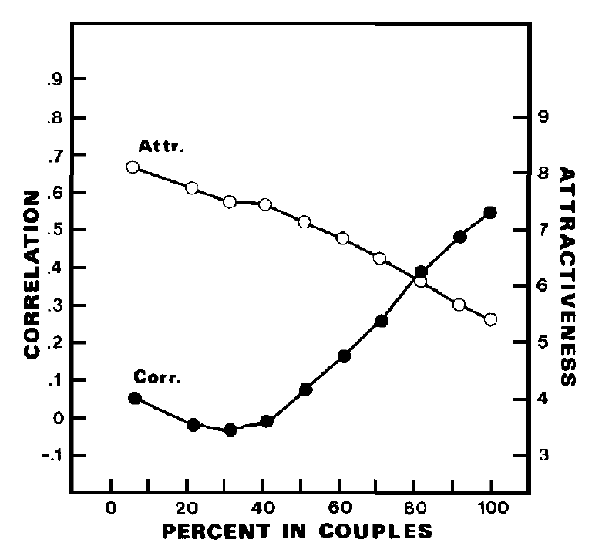
Maximizing partner attractiveness
Outcomes over simulation time (% matched couples) for the case of preferring attractive partners regardless of own attractiveness
Correlation starts low but raises pretty fast up to about 0.55
Mean couple attractiveness starts much above average and approaches average
Attractive agents couple earlier

Slide 29
Results of dating model
Main result: attractiveness matching is not necessary for observed correlations, they can be produced by attractiveness seeking alone.
ABM reconciles apparently conflicting empirical results
Comparison with empirical data: observed empirical correlation is closer to 0.55 than to 0.9
This could also be due to measurement error in attractiveness
Many simplifications
The matching hypothesis reexamined. Michael Kalick and Thomas Hamilton. Journal of Personality and Social Psychology, 1986.

Slide 30
Overview
1. Why models? Complex Social Behavior
2. Agent-Based Modelling (ABM)
3. ABM Example: Date Choice Model
4. About this Course

Slide 31
Course objectives
Understanding how to formulate and analyze computational models of social systems.
Integrating knowledge about social dynamics and analytic tools to understand the complex behavior of social systems.
Acquiring programming skills to implement, simulate, and visualize computational models of social systems

Slide 32
Course topics:
1- Basics of agent-based modeling: the micro-macro gap
2- Modelling segregation: Schelling's model Tutorial: ABM basics in Python with Mesa
3- Modelling cultures Tutorial: ABM basics in Python with Mesa
4- Basics of spreading: Granovetter's threshold model
5- Opinion dynamics
6- Information spreading dynamics Guest lecture by Prof. Jana Lasser

Slide 33
Course topics:
No class between 14.04.2025 and 25.04.2025: Easter holidays
7- Basic network models
8- Modelling small worlds
9- Scale-free networks
10 - Game theory
11- Project final presentations, 4 hours , 15.06.2025

Slide 34
Time, place
Lecture time: Wednesdays at 15:00 (sharp)
Lecture place: HS A (NT01004)
Exercise group 18:00 – 19:00 HS E (NT01088)
Handouts, codes, and data can be found on the TC and Github repository of the course: github ComputationalModellingSocialSytems2025
1-2 readings for each lecture: Links on github and PDF on Teach Center
Computational Modelling of Social Systems
2 Assignments 25 points each: replicating 2 selected modelling papers
25 points: poster presentations
25 points: submitting report

Slide 35
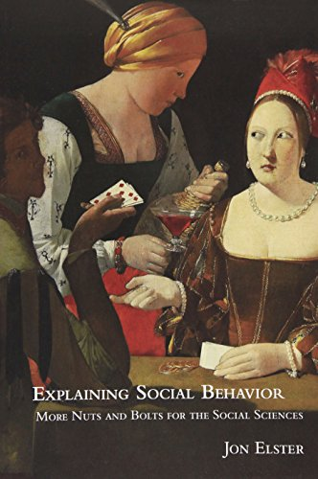

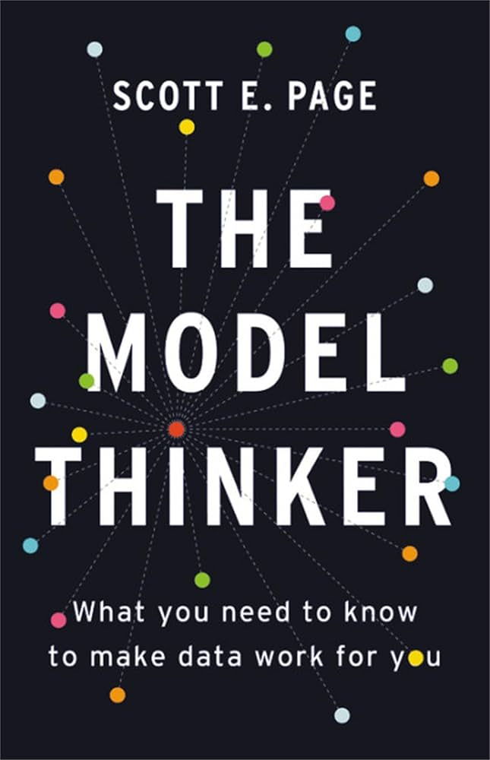
Suggested inspirations for modeling exercise and final presentation

Slide 36
Attention!!!
Until next week please!!!
Update Python to version 3.11 or newer
Update install Mesa with version 3.1 or newer

