Slide 1
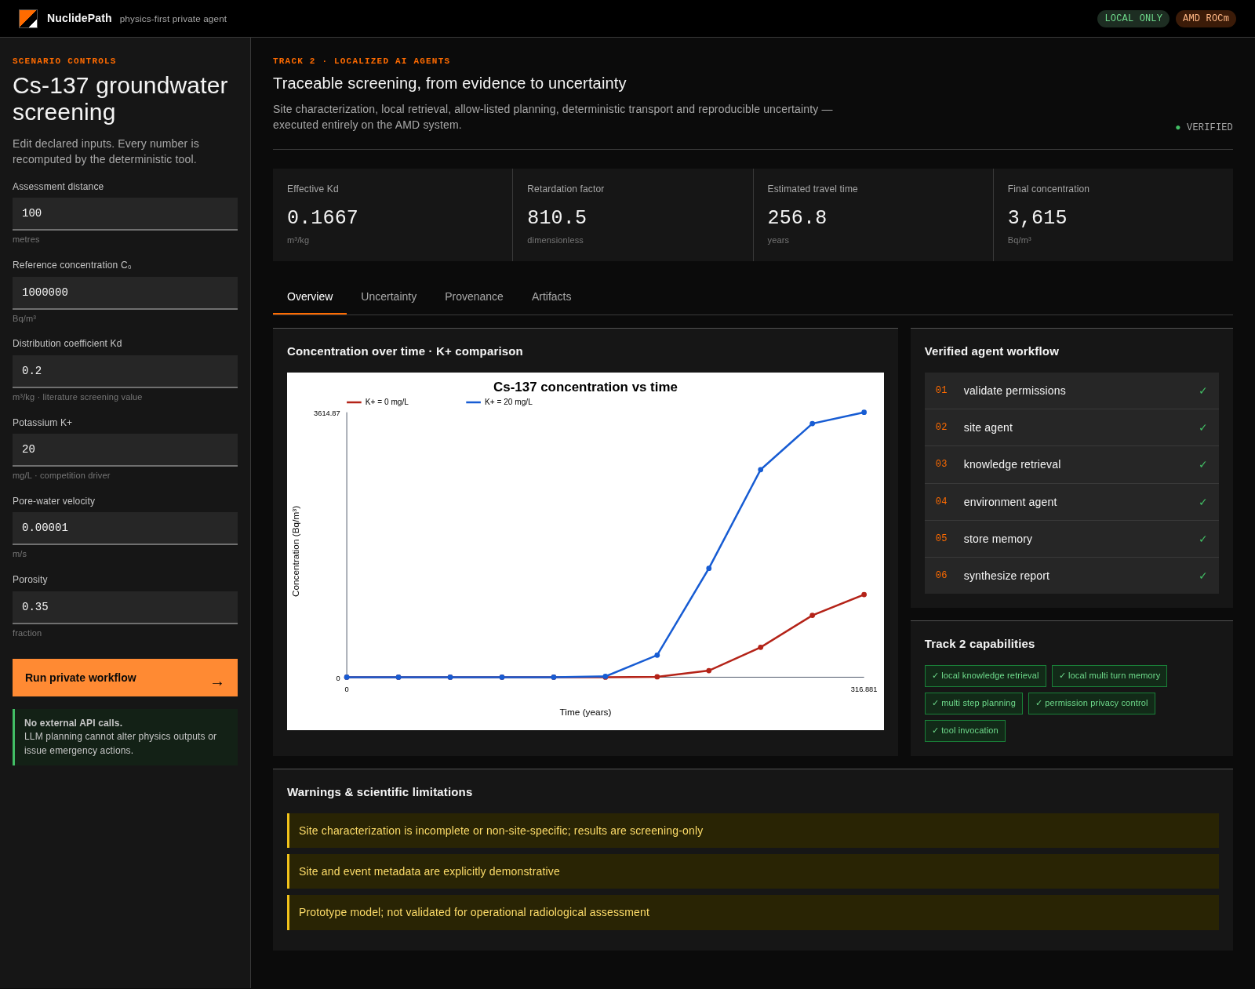
AMD AI DEVMASTER 2026 · TRACK 2
NuclidePath
Private agents.
Deterministic physics.
A local AI workflow for traceable Cs-137 groundwater screening — with cited evidence, uncertainty and zero LLM-generated physics.
LOCAL ONLY
AMD ROCm
5/5
231
377/15
Track 2 capabilities
AMD core snapshot
latest CI gate
PHYSICS-FIRST AI
Stefano Rigante · Nuclear engineer
Notes:
Open with the core promise: AI coordinates the workflow, but deterministic code owns every physical number.

Slide 2
THE TRUST GAP
Technical AI fails when language becomes calculation
NuclidePath makes the responsibility boundary explicit and testable.
01 · The failure mode
02 · The boundary
03 · The outcome
A general-purpose LLM can invent parameters, equations, units or reassuring conclusions — all unacceptable in emergency-analysis workflows.
The model returns only a six-step allow-listed plan. Strict schemas feed deterministic physics, retrieval and uncertainty tools.
Every value is versioned, reproducible and tied to inputs, assumptions, sources, warnings and SHA-256 artifacts.
PLAN
TOOLS
EVIDENCE
PHYSICS-FIRST AI · AMD AI DEVMASTER 2026 · TRACK 2
02
Notes:
Explain the failure mode, then the boundary and auditable result. Avoid claiming operational validation.

Slide 3
SYSTEM DESIGN
A private workflow with an immutable physics boundary
The AMD-local model plans. Five deterministic subsystems execute and report.
PHYSICS-FIRST AI · AMD AI DEVMASTER 2026 · TRACK 2
03
Notes:
Walk left-to-right. Emphasize localhost, permission gate, local RAG, deterministic transport and checksummed outputs.

Slide 4
TRACK 2
All five private-agent capabilities are implemented
Each capability is exercised in the same end-to-end run and covered by tests.
01
Local retrieval
02
Tool invocation
03
Multi-step planning
Ranked excerpts, local paths, source URLs and transparent scores.
Environment Agent calls a strict, versioned JSON physics contract.
Deterministic fallback or Qwen3.5-9B returns six safe steps.
VERIFIED
VERIFIED
VERIFIED
04
Multi-turn memory
05
Permissions + privacy
5/5
Session JSONL stays local, mode 0600, with explicit deletion.
Role allowlist, recursive redaction and denied operational actions.
capability flags true
VERIFIED
VERIFIED
One workflow. One privacy boundary. No cloud dependency.
PHYSICS-FIRST AI · AMD AI DEVMASTER 2026 · TRACK 2
04
Notes:
The official requirement is at least two of five; NuclidePath implements all five.

Slide 5
SCIENTIFIC CORE
The LLM never calculates transport
Model 0.3 declares PDE, source and boundaries, then uses a verified analytical solution.
231
0
R ∂C/∂t = D ∂²C/∂x² − v ∂C/∂x − λRC
C(x,0)=0 · C(0,t)=C₀ · C(∞,t)=0
A = √(v² + 4λRD)
C/C₀ = ½[exp((v−A)x/2D) erfc(z₋)
+ exp((v+A)x/2D) erfc(z₊)]
AMD core snapshot
LLM physics values
Independent analytical cases
Ogata–Banks limit · source boundary · reactive steady state · finite rejection
Explicit limitation
Constant-source 1-D screening — not a dose code, regulatory model or calibrated site prediction.
REACTIVE OGATA–BANKS
Multicomponent bridge (opt-in)
GCS K/Na competition + NH₄ on FES; extended K/Na/Ca/Mg path is process-qualified, not promoted.
PHYSICS-FIRST AI · AMD AI DEVMASTER 2026 · TRACK 2
05
Notes:
Describe the formulas and say validation means software/formula verification, not regulatory validation. The multicomponent K/Na/Ca/Mg bridge is opt-in and process-qualified only; the canonical Cs–K GCS path remains authoritative.

Slide 6
RECENT EXTENSIONS
Traceable post-merge science
The latest work adds deterministic, auditable layers around the canonical screening path.
388/2
4
2×
0
AMD post-merge tests
ions · K/Na/Ca/Mg
fixtures · brine/recharge
unqualified claims
PHREEQC bridge
Opt-in scenario compiler: declared water chemistry, CEC and Cs + K/Na/Ca/Mg into SOLUTION/EXCHANGE/TRANSPORT input
Arithmetic oracle
Independent machine-readable checks for units, grid mapping, non-negativity and exchange-site occupancy
Calibration gate
Dependency-free traceable Cs calibration/hold-out contract with fail-closed promotion; no data bundled
Benchmark registry
Separate EPA/Fuller/Dubus external Cs registry with source digests and calibration_eligible: false
PROCESS-QUALIFIED ONLY
Canonical transport-prototype-0.3 remains authoritative; the bridge is opt-in and does not replace it.
PHYSICS-FIRST AI · AMD AI DEVMASTER 2026 · TRACK 2
06
Notes:
Present the recent work as deterministic, tested and honestly scoped: the PHREEQC bridge is process-qualified, not calibrated chemistry. The canonical screening path is unchanged and authoritative.

Slide 7
AMD DEPLOYMENT
Qwen3.5-9B Q8 runs locally on Radeon + ROCm
The measured local model fits in VRAM and produced the verified allow-listed plan.
2,877.30
67.66
19.9692 s
8.86 GiB
prompt tokens/s · 512 tokens
generation tokens/s · 128 tokens
AMD v0.3 LLM pipeline
Q8 model size
GPU
AMD Radeon Graphics · gfx1100
Stack
ROCm 7.2.1 · llama.cpp HIP Release
OFFLINE ≡ LLM-PLANNED
Offload
-ngl 99 · all model layers
Identical physical runs
for the same scenario
Context
8192 tokens · reasoning off
Network
127.0.0.1:8000 only
PHYSICS IDENTICAL
Integrity
SHA-256 verified model file
PHYSICS-FIRST AI · AMD AI DEVMASTER 2026 · TRACK 2
07
Notes:
Quote measured numbers only. The dated AMD v0.3 core-platform snapshot is verified; the equality check compares physical runs, not timestamped memory files.

Slide 8
PRODUCT EXPERIENCE
A technical dashboard, not an AI chat box
Inputs, workflow, evidence, uncertainty and artifacts remain visible in one place.
Editable physics
Kd, K+, velocity, porosity, distance and C₀.
Visible agency
Six completed steps and 5/5 capability badges.
Auditable output
Ten downloadable artifacts plus a checksum manifest.
PHYSICS-FIRST AI · AMD AI DEVMASTER 2026 · TRACK 2
08
Notes:
Run the live UI in the video. This slide is a fallback visual and repository preview.

Slide 9
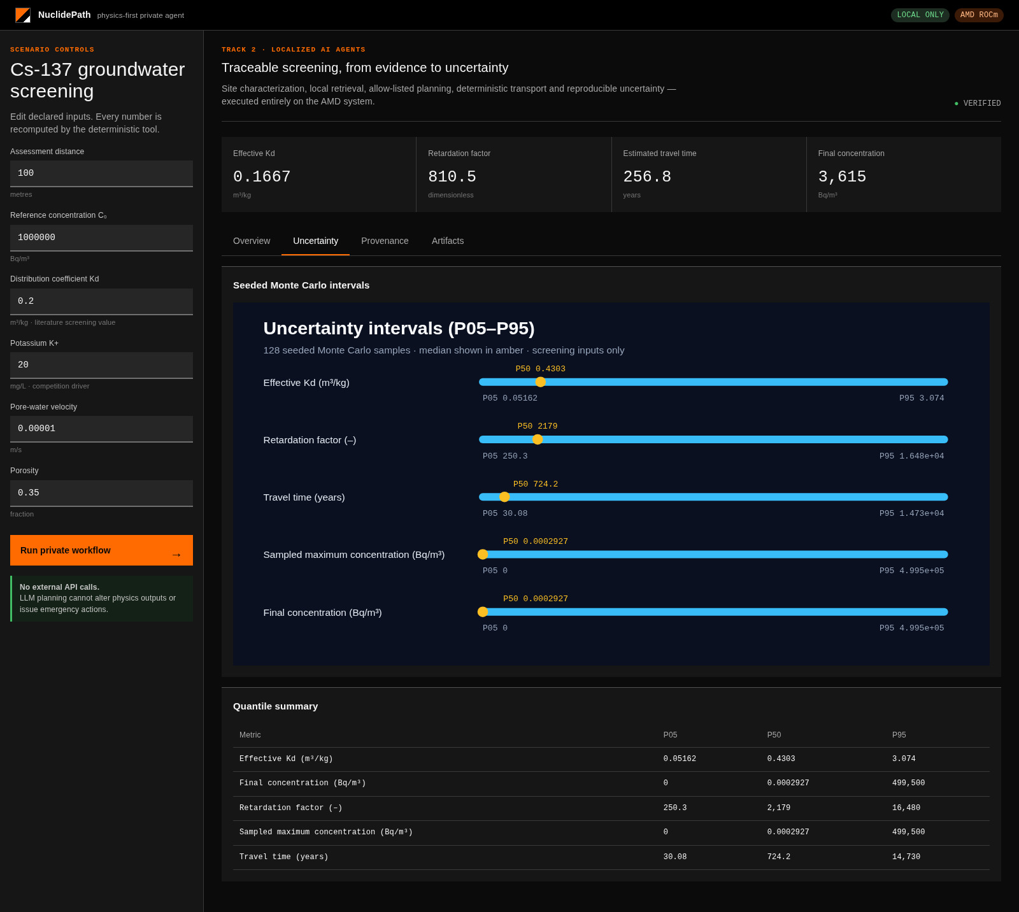
TRUST LAYER
Uncertainty is declared, classified and reproducible
The project distinguishes literature evidence from demonstration inputs.
Literature-informed range
Cs Kd: 0.05–5.0 m³/kg · IAEA TECDOC-2095
Demonstration ranges
Hydraulics, dispersion, K+ and empirical competition are never presented as site truth.
Reproducible propagation
Seeded Monte Carlo · P05/P50/P95 · JSON/CSV/SVG
PHYSICS-FIRST AI · AMD AI DEVMASTER 2026 · TRACK 2
09
Notes:
Stress that reported intervals are input-range propagation, not total predictive uncertainty.

Slide 10
WHY NUCLIDEPATH WINS
Private AI without
scientific surrender.
The proof
5/5
388
Track 2 capabilities
AMD tests (post-merge)
132.8×
0
LOCAL
Qwen3.5-9B + RAG + memory on AMD
FP64 platform (post-merge)
cloud calls
VERIFIABLE
388 AMD post-merge tests + FP64 parity + SHA-256
USEFUL
One-click workflow from case to report
Track 2 · Physics-First AI · NuclidePath
Official AMD Track 2 PR package
HONEST
PHREEQC bridge explicit; no unqualified science
TECHNICAL BUILD VERIFIED
THANK YOU
Notes:
Close on current evidence: local, tested, reproducible and honest about scope. The 132.8× result is the measured device-resident FP64 primary-GCS to receptor pipeline versus the scalar reference, reproduced in the 5 August post-merge AMD rerun alongside the 388 passing tests (the 28 July core snapshot measured 137.09× on the same pipeline). This is a performance result, not environmental validation.

