Slide 1

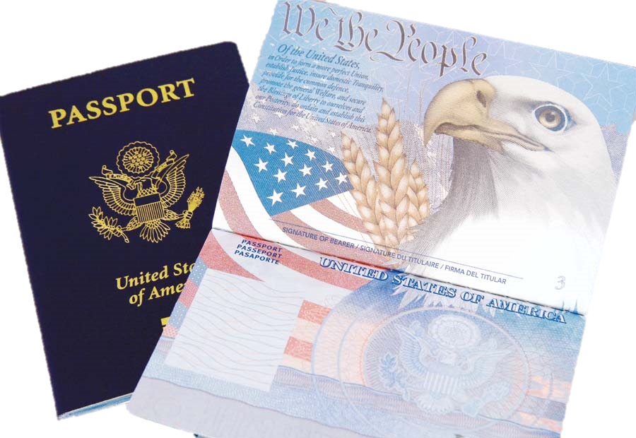
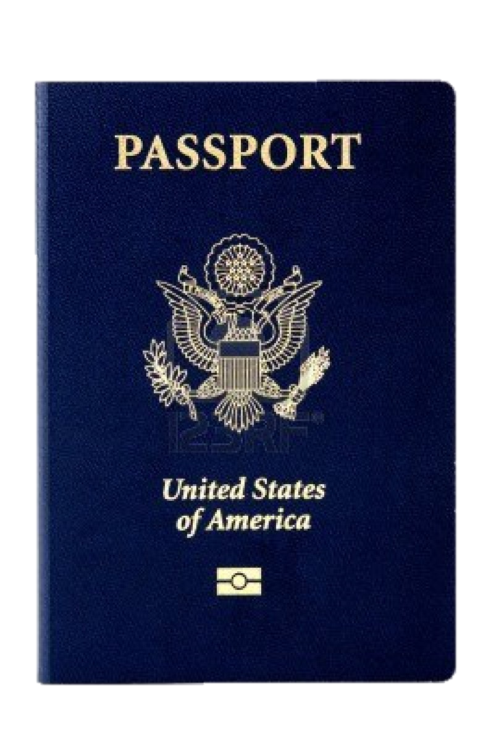
Immigrant Song
Nick Melnyk
Ana Parra

