Slide 1

Jaringan Multimedia
Teknik Coding dalam Internet Multimedia

Slide 2
Digital Coding
Concept of digital conversion
  Analog (continous) wafeform
  Information already in digital form
Why conversion?
  Transporting data into medium
Raw data

Slide 3
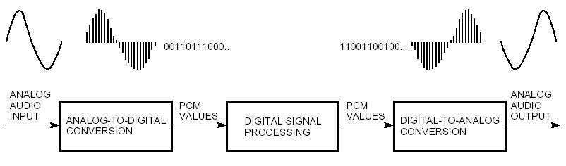
Digital Signal Processing
Quantization

Slide 4
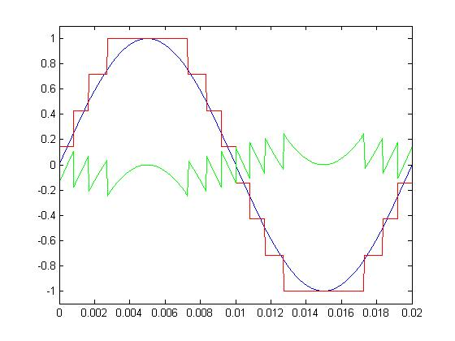
Quantization
Quantization Noise is the difference between the analog signal and the digital representation, and arises as a result of the error in the quantization of the analog signal.
N Bits => 2^{N} levels

Slide 5
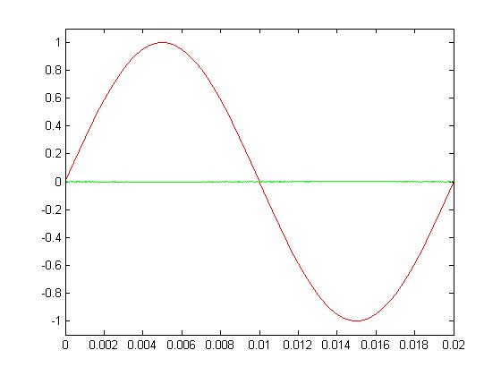
Quantization
3 | 8
4 | 16
5 | 32
8 | 256
16 | 65536
With each increase in the bit level, the digital representation of the analog signal increases in fidelity, and the quantization noise becomes smaller.

Slide 6
Types of coding
Usually signals have to be transmitted with a given fidelity, but not necessarily perfectly identical to the original signal
Compression can be achieved by removing:
  Redundant information that can be reconstructed at the receiver
  Irrelevant information that is not important for the listener

Slide 7
Types of Coding
Source coding
  Empasis on redundancy removal
    Speech coding: a model of the vocal tract defines the possible signals, parameters of the model are tranmitted
    Works poorly in generic audio coding, any kind of signals are possible and can even be called music
Perceptual coding
  Emphasis on the removal of perceptually irrelevant information
    Minize the audibility of distorsions

Slide 8
Types of Coding
Lossless
  No degradation of the original material
  Able to reconstruct perfectly the original samples
  Compression ratios approximately 2:1
  Can only utilize redundancy reduction
  ex. MPEG-1
Lossy
  Removing redundancy in statistical mode: spatial domain; time domain or frequency domain
  Not able to reconstruct perfectly the original samples
  Compression rations around 10:1 or 20:1 for perceptual coding

Slide 9
Steps in Coding
Source Coding
  Transform original media information into a compressed digital file or system
Channel Coding
  Convert digital information into signal appropriate for storage media or transmission channel.
Codec: a combined coder/decoder for 2-way communication

Slide 10
Trade-off Performance Parameter
Coding efficiency
Coding delay
Coder complexity
Ultimate quality of the decoded information

Slide 11
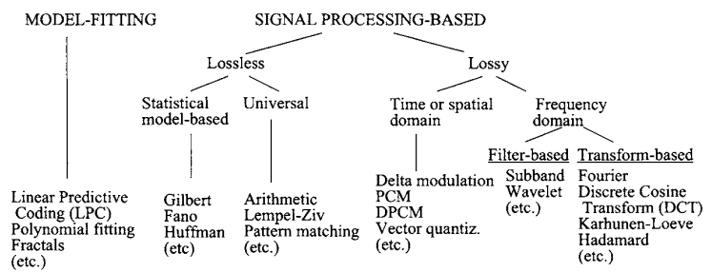
Compression Method

Slide 12
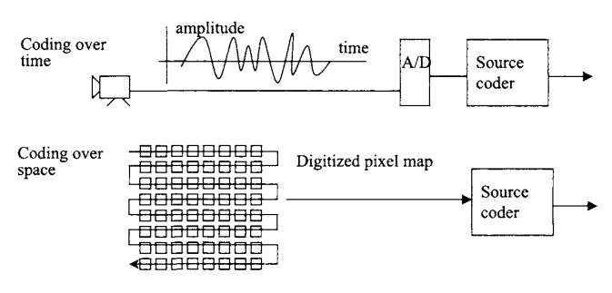
Coding Waveforms

Slide 13
Lossless Entropy Coding
Huffman code
Arithmetic Coding
Free lossless Audio Codec (FLAC)
Tag Image File Format (TIFF)
Audio Interchange File Format (AIFF)
Windows Audio/Video (WAV)

Slide 14
JPEG
JPEG – Joint Photographic Expert Group
.jpg extended to .tiff .eps
24 bit color files
Photographic images

Slide 15
Speech Coding
Procedure to represent a digitized speech Signal using few bits as possible
  It has to maintain at the same time a reasonable level of speech quality
Aka speech compression
Speech sound converted into electrical signal by a transducer
Human speech contains signals below 4 kHz

Slide 16
Speech Coding Techniques
Attributes:
  Bitrate : 800 bps – 16kbps
  Delay: 3 – 4 times the block size
  Quality:
    Mean Square Error (MSE) applicable to waveform coding only
    Mean Opinion Score test, uses 20-60 untrained listeners to rate what is heard.
  Complexity

Slide 17
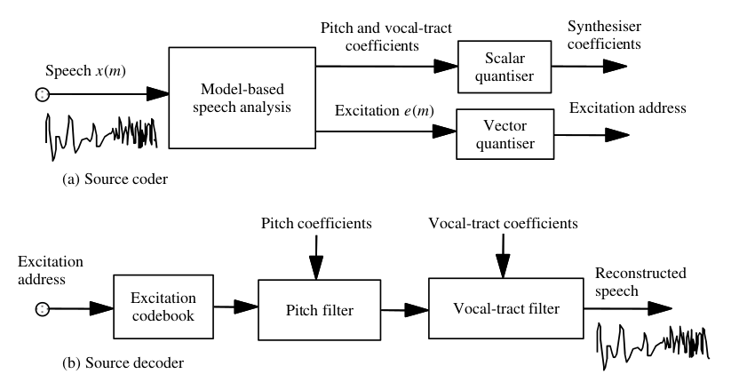
Block Diagram

Slide 18
Speech Coding System
Speech
Source
Filter
Sampler
A/D
Converter
Source
encoder
Channel
Encoder
channel
Channel
Decoder
Source
decoder
D/A
converter
Filter
Output
speech

Slide 19
LPC
Linear Predictive Coding
Reduce to around 8 kbps with almost no perceptible loss in quality
LPC MOS value ranging from 2.7 to 3.3
Speech Coding standard based LPC:
  Regular Pulse Excitation (RPE): used by GSM
  Code-excited linear prediction (CELP): used by CELP, G728, VSELP
  Multiple Pulse Coding (MPC): used by G.723.1 and G.729

Slide 20
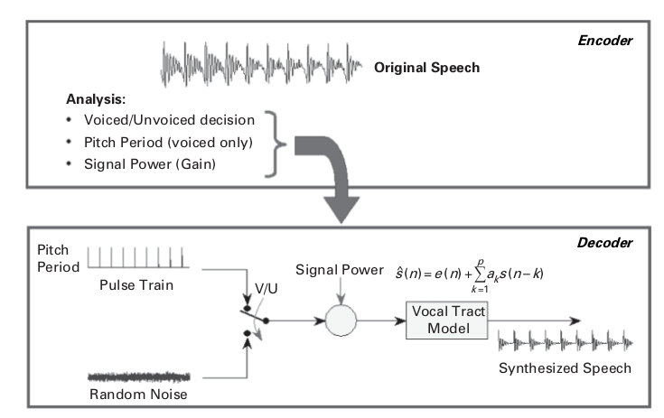
LPC based Speech Codec

Slide 21
Reguler Pulse Excitation with long term prediction
GSM Standard
Defined by ETSI (European Telecommunication Standard Institute)

Slide 22
Audio Coding
Speech and non speech audio
Audio usualy refers to non-speech audio
Audio signals typically
  Sampling rate is higher
  Dynamic range is wider
  Power spectrum varies more
  High Quality is more crucial than in the case of speech signals
  Stereo and multichannel coding can be considered

Slide 23
Audio Coding
Transmission bandwidth increases continously, but the demand increases more → need for compression technology
Application of audio coding
  Audio streaming and transmission over Internet
  Mobile music players
  Digital broadcasting
  Soundtrack of digital video

Slide 24
Requirements for audio coding system
Compression efficiency: sound quality vs bit-rate
Absolute achievable quality
Complexity
  Computational complexity
  Storage requirements
  Encoder vs decoder complexity
Algorithmic delay
Editability
Error Resilience

Slide 25
Digital Audio
CD Audio:
16 bit encoding
2 Channels (Stereo)
44.1 kHz sampling rate
2 * 44.1 kHz * 16 bits = 1.41 Mb/s
+
Overhead (synchronization, error correction, etc.)
CD Audio = 4.32 Mb/s

Slide 26
Audio Compression
High data rates (ex. CD audio 4.32 Mb/s) incompatible with Internet and wireless apps
Required to be compressed to a smaller size, but not affecting signal quality (minimizing quantization noise)
Datarate = sampling rate * quantization bit * channels (+ control information)
  Digital audio
    44100 Hz; 16 bits; 2 channels
    Generates about 1.4M of data per second, 84M per minutes; 5G per hour

Slide 27
Perceptual Audio Encoding
Basic idea is to hide quantization noise below the signal dependent threshold of hearing (masked threshold)
Encoding of audio signals, incorporating psychoacoustic knowledge of the auditory system, in order to reduce the amount of bits necessary to faithfully reproduce the signal
    MPEG-1 Layer III (mp3)
    MPEG-2 Advanced Audio Coding (AAC)

Slide 28
MPEG
Motion Picture Experts Group
Family of encoding standards for digital multimedia
  MPEG-1: standard for storage and retrieval of moving pictures and audio on storage media
    Layer I
    Layer II
    Layer III (MP3)
  MPEG-2: standard for digital television including high-definition television (HDTV) and addressing multimedia applications
    Advanced Audio Coding (AAC)
  MPEG-4: standard for multimedia application, with very low bit-rate audio visual compression for those channel with very limited bandwidths (ex. Wireless channels)
  MPEG-7: a content representation standard for information search

Slide 29
MPEG-1 Audio
Layers 1, 2 and 3
Low bit-rate audio coding standards → lossy compression of audio
Use for TV Broadcasting and Audio on CD-ROM

Slide 30
MPEG-1 Audio Layer II
Called MP2
Dominant standard for audio broadcasting
Came out of MUSICAM codecs with bit rates 64-196 kbps
Sampling rates 32, 44.1, 48 kHz
Bit rates: 32, 48, 56, 80, 96 … 384 kbps
Format: mono, stereo, dual channel

Slide 31
MPEG-1 Audio Layer III
MP3 format
Popular for PC and Internet applicatons
Goal to compress to 128 kbps
Utilization of psychoacoustics
Problem: copyright infrigement

Slide 32
MPEG-2 AAC
Advanced Audio Coding
48 full bandwith audio channel
Default audio format for iPhone, iPad, Nintendo, PlayStation, Nokia, Android, Blackberry
Introduced 1997 as MPEG-2 Part 7
In 1999 updated and included in MPEG-4

Slide 33
AAC over MP3
More sample frequencies (8 – 96 kHz)
Higher effiency and simpler filterbank
Used in Windows Media Audio

Slide 34
MPEG-4 Audio
Applied to
  General audio signlas
  Speech signals
  Synthetic audio
  Synthesized speed
Includes variety of audio coding technologies
  Lossy speech coding (ex. CELP)
  General Audio Coding (AAC)
  Text-to-speech interface
  Structured audio (ex. MIDI)

Slide 35
MPEG-4 Part 14
Called MP4
Multimedia container format
Stores digital video and audio streams and allows streaming over Internet
Container or wrapper format
Bit-rate 2-64 kbps
Scalable for variable rates

Slide 36
Another Audio Coding
Ogg Vorbis
  Open source
  Quality around MP3 but varies greatly between samples
Windows Media Audio
  Proprietary
  Large user base through windows
  Better than MP3, WMA9, much close to AAC quality
  Includes lossless and multichannel coding

Slide 37
Video Coding
Video coding rarely done in lossless form → too much information on it
No storage medium has enough capacity to store practical sized lossless video file
  Lossless DVD video – 221 Mbps
  Compressed DVD video – 4 Mbps
  50:1 compression ration

Slide 38
Video coding
Bit rate
  Information stored/transmistted per unit time
  Usually measured in Mbps (mega bit per second)
  Ranges from < 1 Mbps to > 40 Mbps
Resolution
  Number of pixels per frame
  Ranges from 160x120 to 1920x1080
FPS (frames per second)
  Usually 24, 25, 30 or 60
  Dont need more due to limitation of human eye

Slide 39
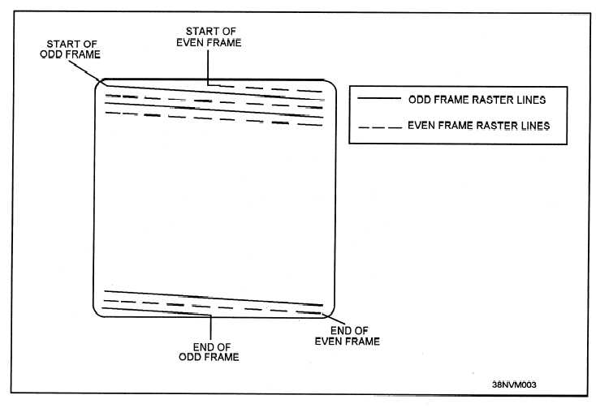
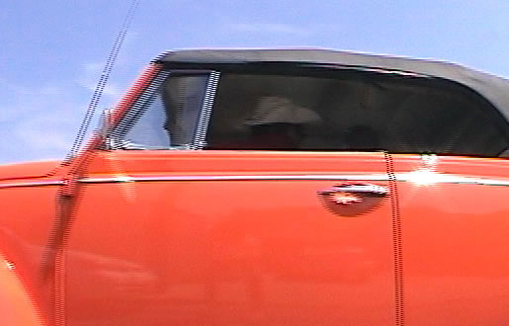
Interlaced scan
Interlaced scan
  Odd and even lines displayed on alternate frames
  Initially used to save bandwidth on TV transmission
  When displaying interlaced video on a progressive scan display, can see “comb effect”

Slide 40
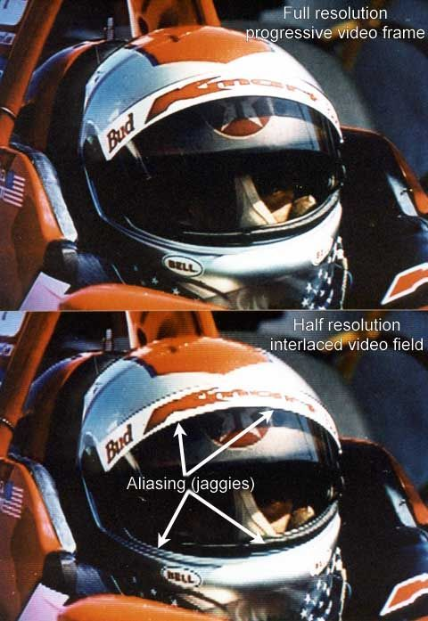
Scan types
Progressive scan
  Display all lines on each frame
  New “fixed-resolution” displays (such as LCD, Plasma) all use progressive scan
  Deinterlacing is not a trivial task

Slide 41
MPEG video spatial domain processing
Spatial domain handled very similarly to JPEG
  Convert RGB values to YUV colorspace
  Split frame into 8x8 blocks
  2-D DCT on each block
  Quantization of DCT coefficients
  Run length and entropy coding

Slide 42

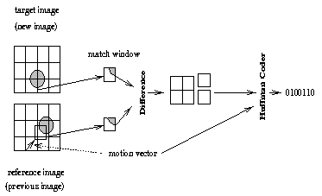
MPEG video time domain processing
Totally new ballgame (this concept doesn’t exist in JPEG)
General idea – Use motion vectors to specify how a 16x16 macroblock translates between reference frames and current frame, then code difference between reference and actual block

Slide 43
Types of frames
I frame (intra-coded)
  Coded without reference to other frames
P frame (predictive-coded)
  Coded with reference to a previous reference frame (either I or P)
  Size is usually about 1/3rd of an I frame
B frame (bi-directional predictive-coded)
  Coded with reference to both previous and future reference frames (either I or P)
  Size is usually about 1/6th of an I frame

Slide 44
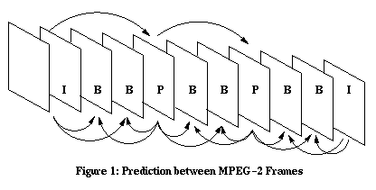
GOP (Group of Pictures)
GOP is a set of consecutive frames that can be decoded without any other reference frames
Usually 12 or 15 frames
Transmitted sequence is not the same as displayed sequence
Random access to middle of stream – Start with I frame

Slide 45
Bitrate allocation
CBR – Constant BitRate
  Streaming media uses this
  Easier to implement
VBR – Variable BitRate
  DVD’s use this
  Usually requires 2-pass coding
  Allocate more bits for complex scenes
  This is worth it, because you assume that you encode once, decode many times

Slide 46
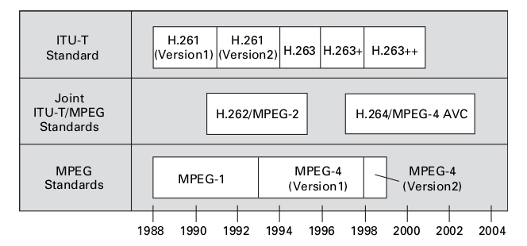
Evolution of digital video standards

Slide 47
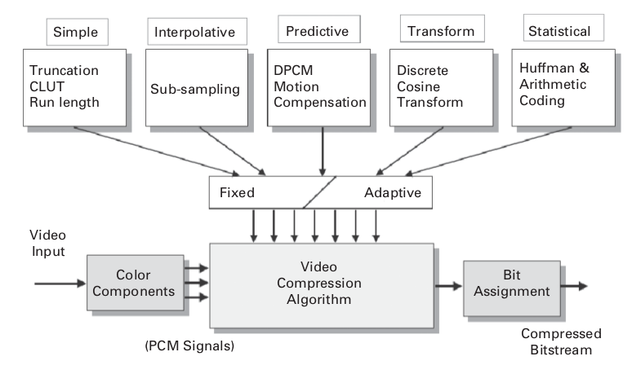
Techiques used in video coding

Slide 48


Real time video encoding
Motion estimation will be worse, so need higher bitrate to compensate
Very hard to do in software, need dedicated hardware or hardware assistance
Tivo, ReplayTV do this

Slide 49
Streaming media
Common types include Flash, RealVideo, Quicktime
Usually have low bandwidth available, need to optimize as such
Want dedicated network protocols for this purpose
  TCP will wait indefinitely for retransmission, so is often not suitable

Slide 50
Network-aware Coding
Adapt to reality of the Internet
  Content created once; sent many times under different circumstances
  No guarantees concerning throughput, jitter or packet loss
  Sending rate not more than TCP rate
  Cant send at best available encoding rate

Slide 51
Approaches
Simulcast
Scalable coding
  SNR scalability
  Temporal Scalability
  Spatial Scalability
  Fine Grained Scalability
Multiple Description Coding

Slide 52
Simulcast
Choose a set of sending rates
  During content creation
    Encode content in best possible quality below that sending rate
  During transmission
    Choose version with the best admissable quality
3 simulcast rates
Quality
Single rate codec
Sending rate

Slide 53
Scalable Coding
Layer Coding
A base layer provides basic quality and must always be transferred
Enhancement layer for improve quality and if possible be transfered
Enhancement layer
Best possible quality at possible sending rate
Quality
Base layer
Sending rate

Slide 54
Temporal Scalability
Frames can be dropped
  In a controlled manner
  Frame dropping does not violate dependencies
  Low gain example: B-frame dropping in MPEG-1

Slide 55
Spatial Scalability
Base layer
Enhancement layer
If enhancement layer arrieves at client
  Decode both layers
  Add layer
raw video
DS
DCT
Q
VLC
base layer
-
DS - downsampling
DCT – discrete cosine transformation
Q – quantization
VLC – variable length coding
+
DS
DCT
Q
VLC
-
enhancement layer
+
DCT
Q
VLC
enhancement layer 2

Slide 56
SNR Scalability
Signal-to-Noise
Base Layer
Enhancement layer
If enhancement layer arrives at client
  Add base and enhancement layer before running inverse DCT

Slide 57
SNR Scalability
raw video
DCT
Q
VLC
base layer
+
-
IQ
Q
VLC
enhancement
layer
DCT – discrete cosine transformation
Q – quantization
IQ – inverse quantization
VLC – variable length coding

Slide 58
Fine Grained Scalability
Cut of compressed tail bits of samples
Base layer as SNR coding
Enhancement layer
  Use bit plane coding for enhancement layer
  Cut tail bits off until data rate is reached
Best possible quality at possible sending rate
Goal of FGS
Quality
Sending rate

Slide 59
Fine Grained Scalability
raw video
DCT
Q
VLC
base layer
+
-
IQ
Q
BC
enhancement
layer
DCT – discrete cosine transformation
Q – quantization
IQ – inverse quantization
VLC – variable length coding
BC – bitplane coding

Slide 60
Multiple Description Coding
Encode data in two streams
Each stream has acceptable quality
Both Streams combined have good quality
Redundancy between both streams Is low
Problem:
  Same relevant information must exist in both streams
  Old problem started for audio coding in telephony

Slide 61
Conclusion
Multimedia Coding Technology is adapting to user demand
Still more problems

Slide 62
Questions?

