Slide 1
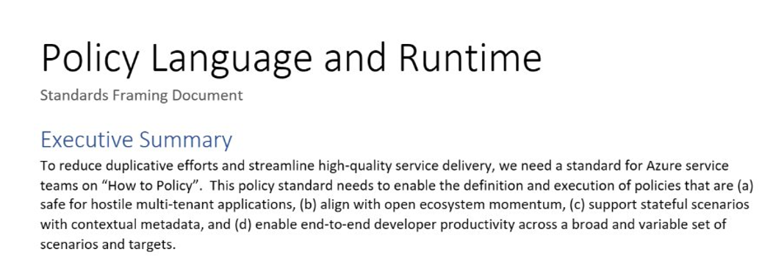
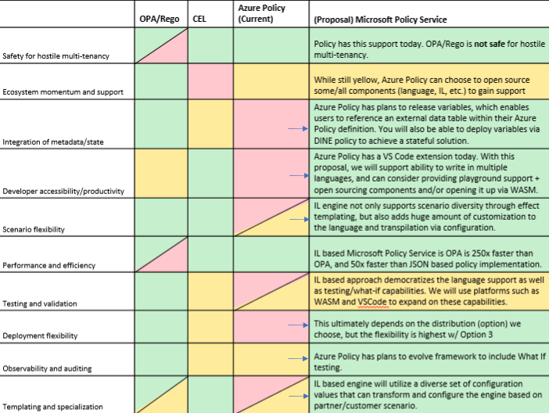
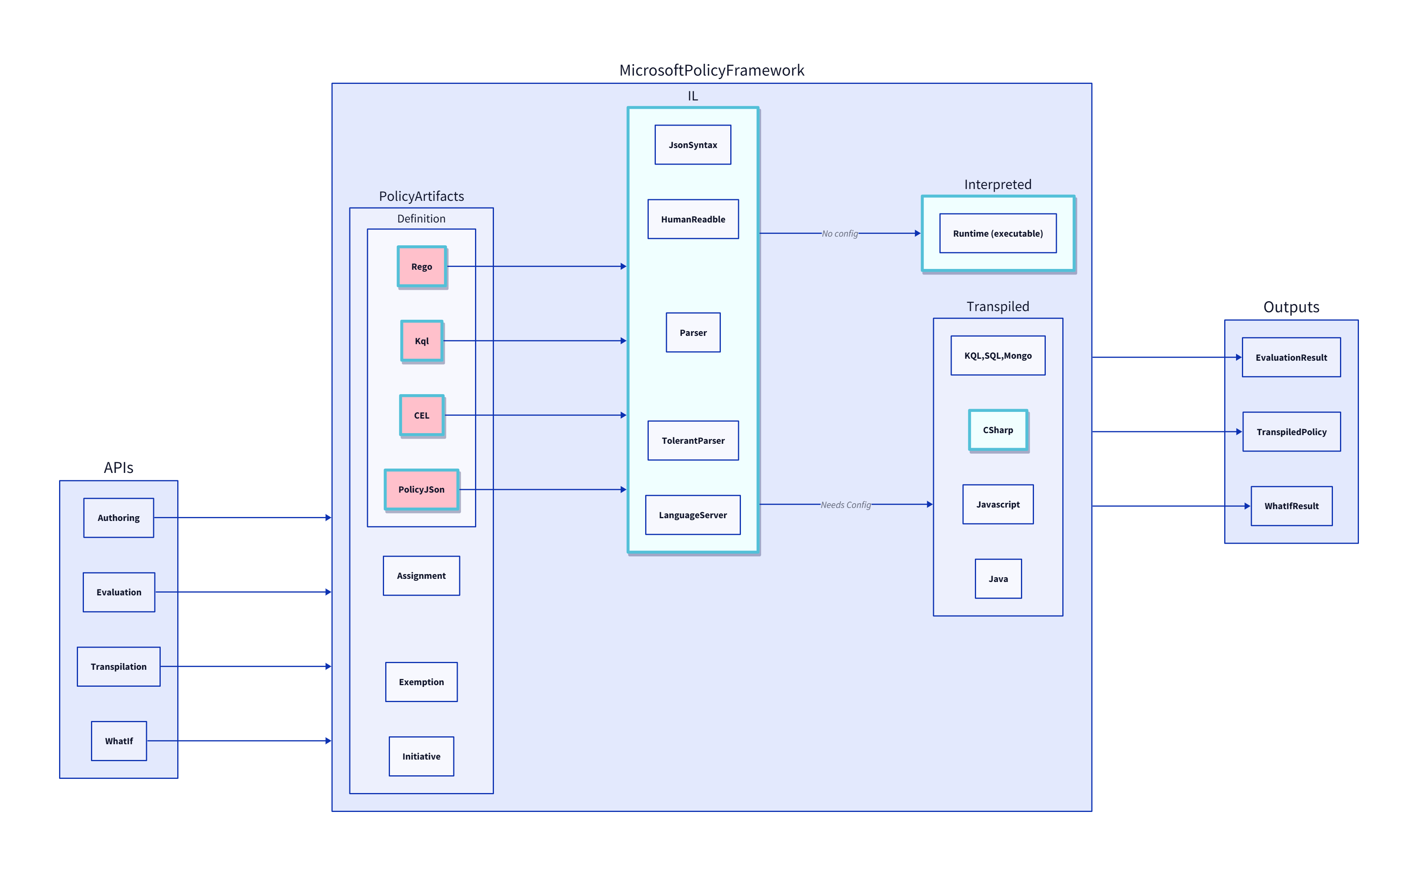
Background: Azure CTO Memo: “How to Policy”/OPA
Investigation
Gaps in OPA
Intermediate Language
Green Light (Mark Russ, Brendan Burns)
Multi Tenancy
Scalability
Lifecycle
Notes:
Go quicker
How we started focusing on this (CTO suggestion to align on a policy engine – OPA)
Issues with OPA
Our solution: standardize on a common policy engine & framework, with flexibility when it comes to the interface language
Green light from Mark Russ, BBurns

Slide 2
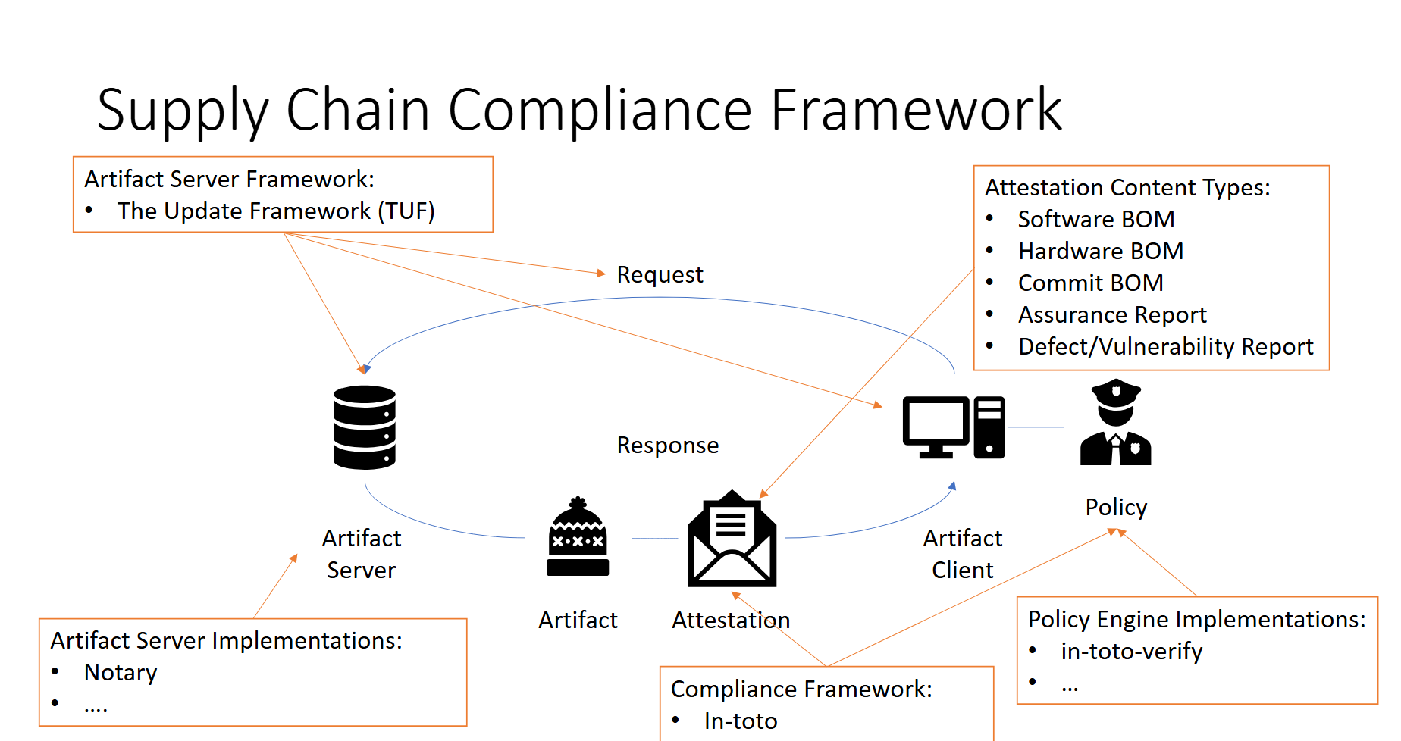
Renewed Urgency: New scenarios and teams
X-Ray
Geneva Actions
Attestation
Defer
Availability Test
To simultaneously reduce burden across Azure service teams and enable consistent experiences through a OnePlane philosophy, it’s critical for us to step up to provide a common policy framework for Microsoft services to leverage for their diverse needs.
Policy Framework
Standardization is critical for security
Just in the last 6 months, many teams with custom solutions
Notes:
So many different policy engines popped up in last 6 months across diverse scenarios
Urgency to have a common engine

Slide 3

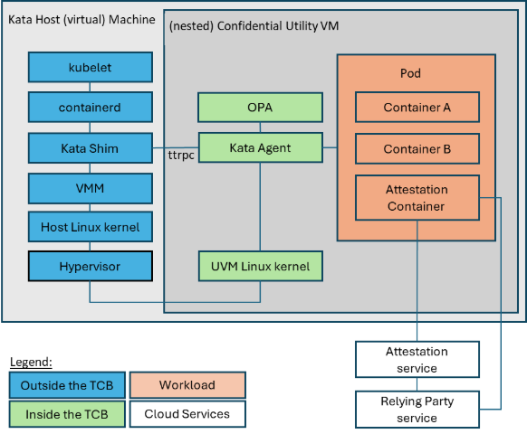
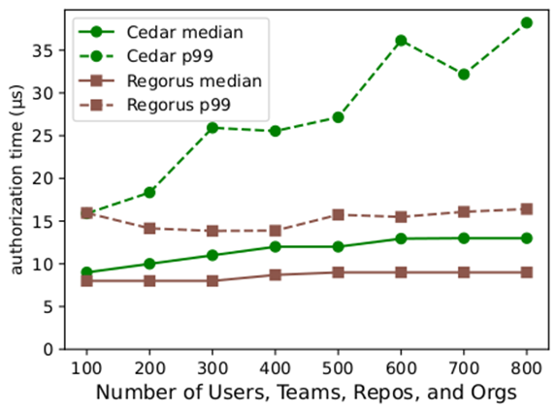
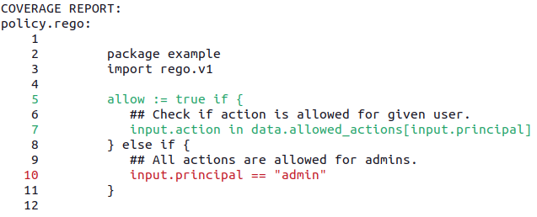
Regorus Engine
Rego-Rus(t) – A fast, lightweight, open-source Rego interpreter written in Rust
Rigorous – Rigorous enforcer of well-defined Rego semantics
Regorus 6.5x faster than Cedar which is 80x faster than OPA
Confidential Containers
Rego shines as a Policy Intermediate Language
Regorus
Policy Coverage
Notes:
Rego is flexible, fast, strong – perfect basis for an IL
Regorus has momentum + confidential compute scenarios
Features: suitability as IL

