Slide 1
The Problem
Azure Policy must support multiple policy languages. Across Microsoft, teams maintain separate engines.
OPA / Rego
Cedar
Azure Policy
AKS Admission
Custom
N engines = N × audits + N × test suites + N × pipelines + N × teams
Multiplicative cost. Inconsistent behavior. Fragmented tooling.
Every new policy language multiplies the problem.

Slide 2
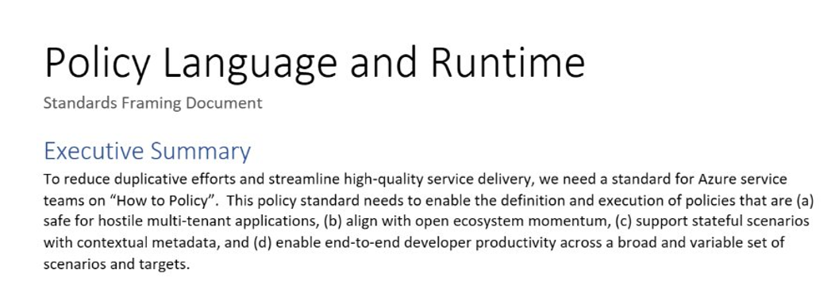
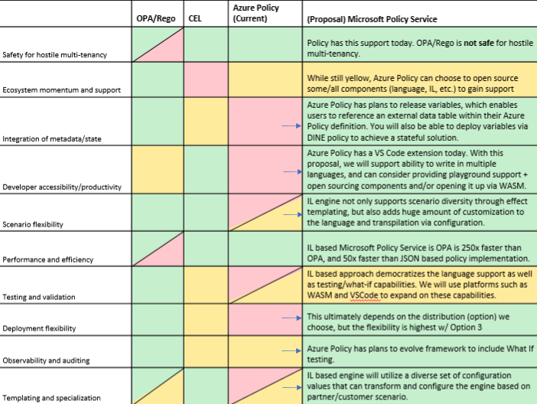
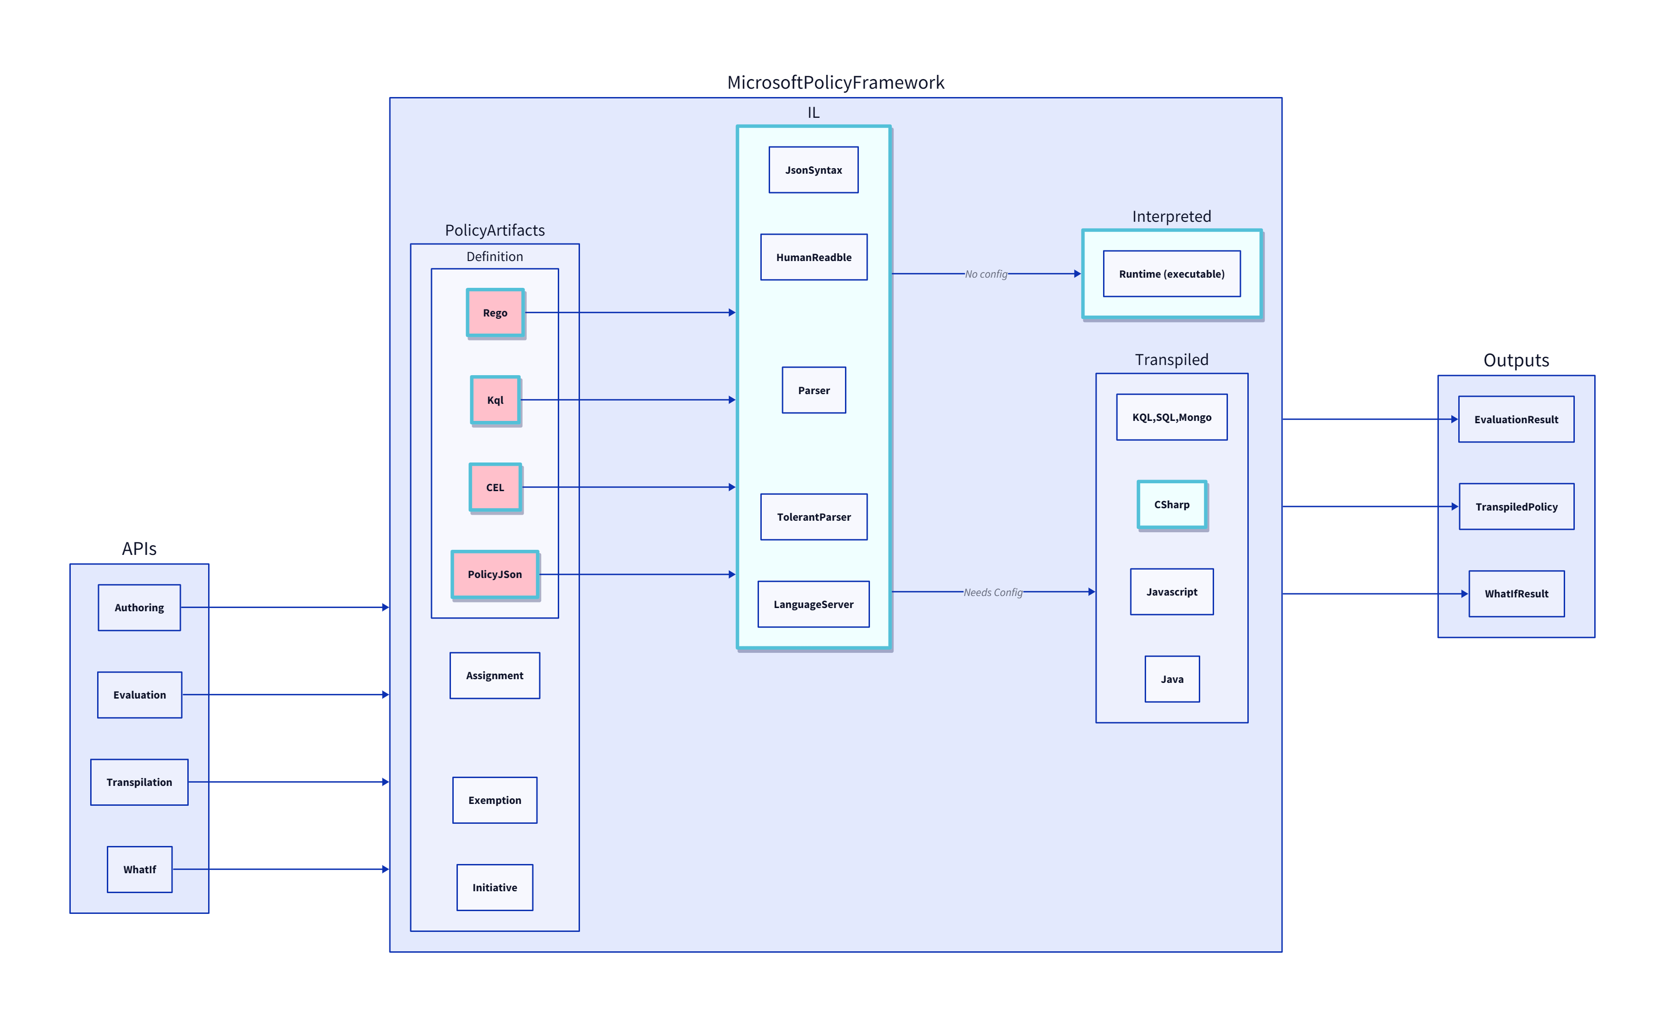
Background: Azure CTO Memo: “How to Policy”/OPA
Investigation
Gaps in OPA
Intermediate Language
Green Light (Mark Russ, Brendan Burns)
Multi Tenancy
Scalability
Lifecycle
Notes:
Go quicker
How we started focusing on this (CTO suggestion to align on a policy engine – OPA)
Issues with OPA
Our solution: standardize on a common policy engine & framework, with flexibility when it comes to the interface language
Green light from Mark Russ, BBurns

Slide 3

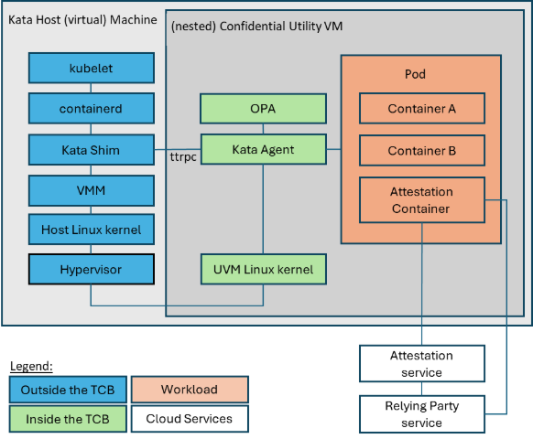
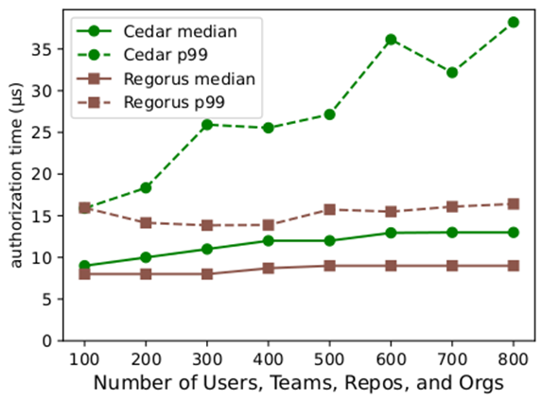
Regorus Engine
Rego-Rus(t) — A fast, lightweight, open-source Rego interpreter written in Rust. Rigorous enforcer of well-defined Rego semantics.
Origin: Confidential Containers
Regorus 6.5× faster than Cedar, 80× faster than OPA
Cedar paper: arxiv.org/abs/2403.04651
Open Source Adoption
Kata Containers
NVIDIA Attestation SDK
Container runtime for confidential containers — uses Regorus for policy evaluation
GPU attestation and verification — Regorus enforces attestation policies
Internal Microsoft Adoption
AKS Confidential Containers
Policy Control Point Service
Azure Graph Service
JIT (Just-In-Time)
Network Config Validator
Open source (MIT) — github.com/microsoft/regorus

Slide 4
What Java Did for Apps, RVM Does for Policy
JVM (Applications)
Java · Kotlin Scala · Groovy
Compilers
Java Bytecode
JVM: Any Platform
→
→
→
RVM (Policy)
Rego · Cedar Azure Policy · more
Compilers
RVM Bytecode
RVM: Any Platform
→
→
→
What this gives you
– One security surface to audit
– One engine to optimize
– One test framework to maintain
– One artifact to deploy
– Any new language gets the entire tooling ecosystem for free

Slide 5
LIVE DEMO
RVM Playground — Cross-language policy in your browser
Rego → Compile to bytecode → Run
Cedar → Same bytecode target → Same engine
Azure Policy → Same bytecode target → Same engine
https://anakrish.github.io/rego-virtual-machine-playground/

Slide 6
A Comparison with Amazon’s Cedar
Cedar and RVM are independent efforts with different architectures and different design goals.
Cedar SDK (Amazon)
Regorus / RVM (Microsoft)
✓ Strong formal foundations — Dafny proofs, 100M DRT/night
✓ Multi-language: Rego + Cedar + Azure Policy + extensible
✓ Purpose-built for authorization (RBAC + ABAC)
✓ Compiled register-based bytecode — high performance
✓ Amazon Verified Permissions — managed cloud service
✓ HostAwait: pause mid-eval for external host data
✓ Open source (Apache 2.0), ~5.7K GitHub stars
✓ Suspendable execution — breakpoints, step-through debugging
– Single language — Cedar only, no Rego or Azure Policy
– AST tree-walking evaluator — no bytecode compilation
✓ 8 language bindings (C, C++, C#, Go, Java, Python, Ruby, JS)
– No mid-evaluation host callbacks
✓ Compile once, run anywhere — WASM, cloud, edge, bare metal
– No suspendable execution, no step-through debugging
✓ Instruction budget + memory limits per evaluation
– Limited expressiveness — no loops, no user-defined functions
✓ Open source (MIT) — github.com/microsoft/regorus
✓ Full Rego expressiveness — loops, functions, partial rules
✓ Z3-powered formal analysis — diff, subsumption, test gen
RVM can also compile Cedar to bytecode — Cedar users get RVM performance, tooling, and formal analysis for free

Slide 7
Policy Intelligence
Bytecode + Z3 unlocks formal analysis across every language RVM supports.
AWS invested ~8 years building formal analysis (Zelkova, IAM Access Analyzer, Cedar proofs) — only for IAM/Cedar. None of the capabilities below exist in their stack.
Policy Diff
Policy Subsumption
Auto Test Generation
Prove two policies are equivalent or find a distinguishing input.
Prove new policy is a superset of old — safe migration guarantee.
Z3-driven — generate inputs that cover every code path.
regorus diff
regorus subsumes
regorus gen-tests
MC/DC Coverage
Dead Rule Detection
Input Synthesis
Modified condition / decision coverage — each condition toggled.
UNSAT path = provably unreachable. No inputs can ever trigger it.
Z3-driven input generation with JSON output. Target any line.
--condition-coverage
UNSAT analysis
--cover-line / --avoid-line
“Novel capabilities include adding to workflows for guardrailing AI-generated policies. The IAM angle is where customers maintain policies over a portal and program policies by hand or their custom automation. When this applies to policies you consume, it makes sense to figure out what to surface.”
— MSR Researcher

Slide 8
LIVE DEMO
Policy Intelligence — Formal Verification with Z3
regorus diff
Are these two policies equivalent? Prove it — or find the difference.
regorus gen-tests
Auto-generate test inputs that cover every path.
--cover-line
Synthesize an input that reaches a specific line.
coverage
MC/DC condition coverage — every condition independently toggled.
Z3-powered · Works across Rego, Cedar, Azure Policy

Slide 9
Copilot + Policy Intelligence
AI writes the policy — math proves it’s correct.
Developer “Only allow reads for interns”
Copilot Generates Rego policy from intent
Policy Intelligence Verifies formal properties: • No privilege escalation • No bypasses possible
VERIFIED Safe to deploy → Production
→
→
→
↑
↓
Feedback Loop Repeat until Z3 proof passes or developer reviews counterexample
←←← Counterexample fed back to Copilot
ISSUE FOUND “Intern with role=manager can still write”
Copilot auto-revises policy using the counterexample and re-submits for verification
Every AI-generated policy gets a mathematical proof before it reaches production. Copilot iterates automatically using counterexamples until the proof passes.
Why this matters
– AI hallucinations caught before deployment — not after an incident
– Counterexamples become regression tests automatically
– Works across Rego, Cedar, and Azure Policy — same verification loop

Slide 10
What’s Next — CI Integration & Compliance
PR Review Bot — Formal Diff in CI
Pull Request Modifies policy.rego
CI Pipeline runs regorus diff v1 vs v2
PR Comment — Formal Diff Report
→
→
Input #1: role=contractor, resource=internal-docs → was ALLOW, now DENY
Input #2: role=vendor, action=read → was DENY, now ALLOW (wider access)
No behavioral change → auto-approve
Changes found → reviewer sees exact divergent inputs
Wider access detected → mandatory security review
Regulatory Impact Analysis — Scan All Policies for Compliance Gaps
Regulation “MFA required for all PII access”
Formalize & Scan ∀ request: accesses_pii(r) → has_mfa(r)
39 services Compliant Mathematical proof for each
3 services — Gap Found billing-api: no MFA on /invoices hr-portal: admin override bypasses PII analytics: logging exposes email
→
→
Each result backed by a mathematical proof — not sampling. Counterexamples pinpoint the exact non-compliant path.
Both capabilities work across Rego, Cedar, and Azure Policy — because they operate on RVM bytecode.

Slide 11
One Engine. Every Policy. Formal Analysis Built In.
Regorus Virtual Machine
Rego + Cedar + Azure Policy — one bytecode target
High performance · Memory safe · Portable · 8 language bindings
Policy diff · Subsumption · Auto test generation · Coverage
Open Source (MIT) · github.com/microsoft/regorus
Try it: https://anakrish.github.io/rego-virtual-machine-playground/
github.com/microsoft/regorus

