Slide 1
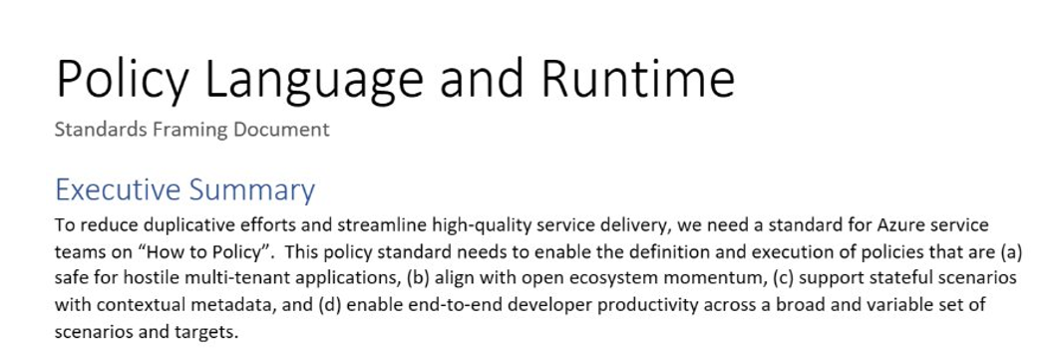
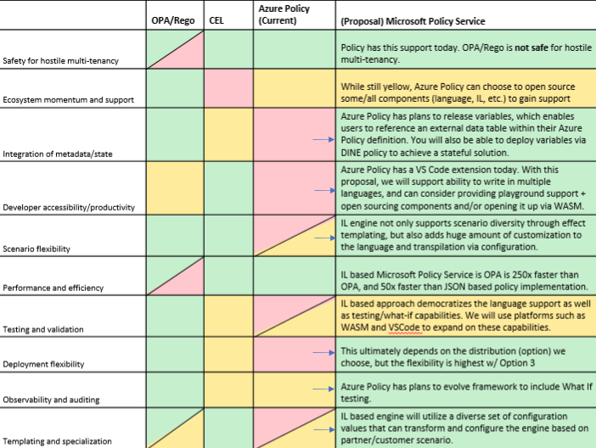
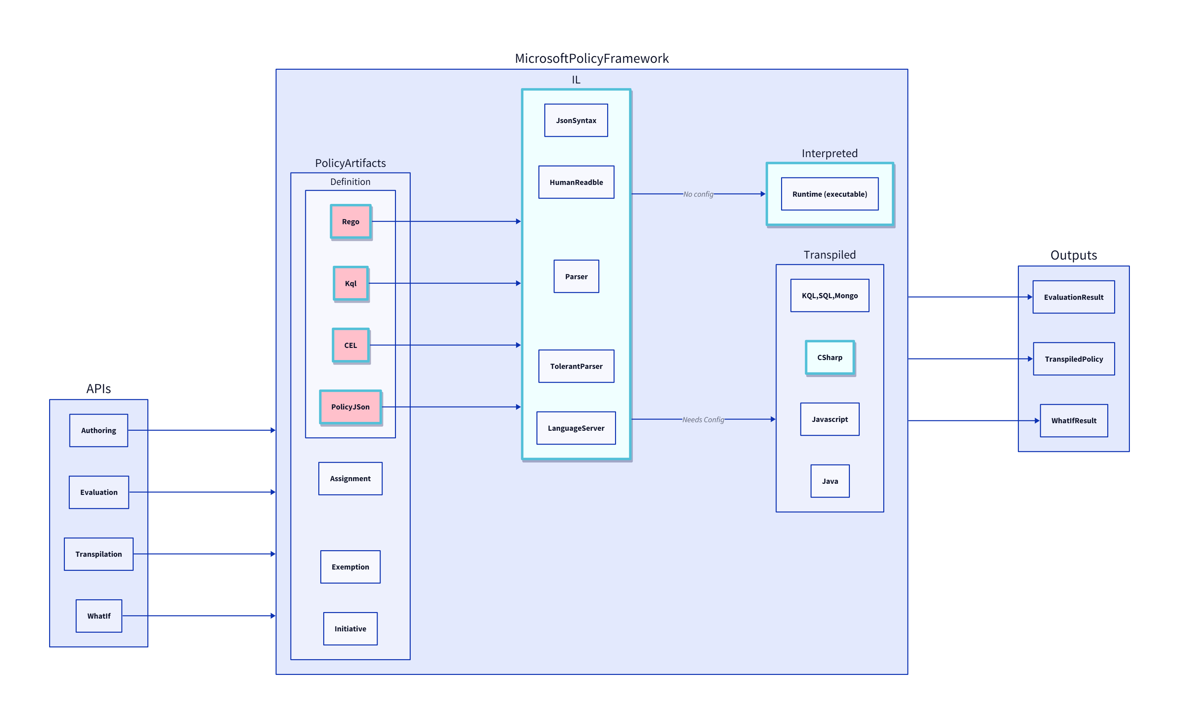
Background: Azure CTO Memo: “How to Policy”/OPA
Investigation
Gaps in OPA
Intermediate Language
Green Light (Mark Russ, Brendan Burns)
Multi Tenancy
Scalability
Lifecycle
Notes:
Go quicker
How we started focusing on this (CTO suggestion to align on a policy engine – OPA)
Issues with OPA
Our solution: standardize on a common policy engine & framework, with flexibility when it comes to the interface language
Green light from Mark Russ, BBurns

Slide 2
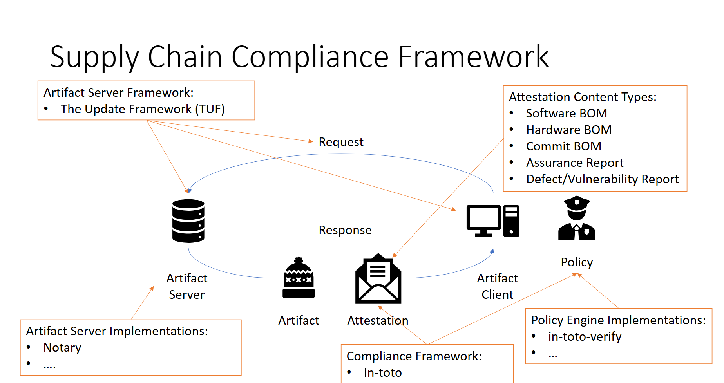
Renewed Urgency: New scenarios and teams
X-Ray
Geneva Actions
Attestation
Defer
Availability Test
To simultaneously reduce burden across Azure service teams and enable consistent experiences through a OnePlane philosophy, it’s critical for us to step up to provide a common policy framework for Microsoft services to leverage for their diverse needs.
Policy Framework
Standardization is critical for security
Just in the last 6 months, many teams with custom solutions
Notes:
So many different policy engines popped up in last 6 months across diverse scenarios
Urgency to have a common engine

Slide 3
The Power of RVM
Regorus Virtual Machine
One Engine · Every Policy Language · Any Platform
microsoft/regorus · Open Source (MIT)

Slide 4
The Problem
The Solution
Azure Policy must support multiple policy languages. Across Microsoft, teams maintain separate engines.
What Java did for applications, RVM does for policy.
OPA / Rego
Cedar
Azure Policy
Rego · Cedar Azure Policy
Compilers
RVM Bytecode
Any Platform
→
→
→
AKS Admission
Custom
– One engine to audit and certify
– Compiled bytecode — high performance
– Rust core — memory safe, no_std
– 8 language bindings — deploy anywhere
– HostAwait — suspend mid-eval for host data
– WASM playground in browser
N audits · N test suites · N pipelines · N teams
Let me show you — live, in your browser.

Slide 5
LIVE DEMO
RVM Playground — Cross-language policy in your browser
https://anakrish.github.io/rego-virtual-machine-playground/

Slide 6
One Engine. Every Policy. Any Platform.
Regorus Virtual Machine
Multi-Language
High Performance
Deploy Anywhere
Safe & Auditable
Rego + Cedar + Azure Policy → one bytecode target
Compiled register VM Short-circuit optimization No GC, no cloning
Cloud · Edge · WASM 8 language bindings no_std compatible
Memory safe (Rust) Instruction + memory limits Open source (MIT)
Try it: https://anakrish.github.io/rego-virtual-machine-playground/
github.com/microsoft/regorus

Slide 7
APPENDIX
Competitive Landscape
OPA (Go)
Regorus / RVM
+ Mature ecosystem, large community
+ Rego language
Multi-language: Rego + Cedar + Azure Policy + more
– Go runtime overhead, GC pauses
– Embeddable via cgo (complex, heavy)
Compiled register-based bytecode with short-circuit optimization
– Single language — no Cedar or Azure Policy
Rust core — memory safe, no_std, no GC, WASM compatible
Cedar SDK (Rust)
8 language bindings: C, C++, C#, Go, Java, Python, Ruby, JS
+ Strong formal foundations
vs
+ Amazon Verified Permissions — managed cloud service
HostAwait: suspendable execution for mid-eval host callbacks
– Single language — no Rego or Azure Policy
Breakpoints, stepping, debug — suspendable by design
– No bytecode — AST tree-walking evaluator
– No mid-evaluation host callbacks
Portable binary artifacts — compile once, run anywhere
Custom Engines
Interactive WASM playground in browser
– One-off implementations per product
Policy intelligence: formal analysis via Z3 (upcoming)
– Per-product maintenance & security burden
– No shared tooling or analysis
Open source (MIT) — transparent and auditable

Slide 8
APPENDIX
Developer Tooling & Policy Intelligence
Tools built once work across every policy language.
Policy Languages
RVM Unified AST/IR Compiler Runtime
Editor Experience
Code Quality
DevOps & CI
Rego
LSP Server
Linter
Test Framework
Cedar
IntelliSense
Formatter
Doc Generator
Azure Policy
→
→
Go-to-Definition
Static Analysis
CI/CD Gates
Future DSLs
Autocomplete
Dead Rule Finder
Coverage
Policy Intelligence — Formal Analysis (separate presentation)
Z3-powered Satisfiability
Conflict & Redundancy Detection
Policy Equivalence Proofs
Coverage & Reachability
Without RVM: N tools × M languages. With RVM: build each tool once.

Slide 9
APPENDIX
Trust Through Safety
Memory Safety
Execution Safety
Auditability
– Written in Rust — no buffer overflows
– no_std compatible — bare metal ready
– No unsafe code in evaluation path
– Configurable memory limits per evaluation
– Instruction budget — bounded CPU time
– Deterministic: same input = same output
– Sandboxed — no file or network I/O
– Full disassembly with source mapping
– Breakpoints & step-through debugging
– Structured audit logs — every decision traceable
– Forward-compatible binary serialization
– Deterministic — enables formal verification
– Open source (MIT) — fully transparent
Compliance Impact
One engine to certify
Reproducible results
Resource & time bounded
Open source (MIT)

Slide 10
APPENDIX
Why Bytecode Matters
Compiling policy to bytecode unlocks capabilities you can’t get from a tree-walking interpreter.
Performance
Portable Artifacts
Tooling Ecosystem
Suspendable Execution
Safety & Governance
– Much faster than tree-walking
– Register-based, minimal dispatch
– No cloning, no boxing
– Compile once, run anywhere
– Ship pre-compiled bundles
– Forward-compatible serialization
– Disassembly + source mapping
– Breakpoints & step-through
– Build once, all languages
– HostAwait: pause mid-eval
– Fetch external data on demand
– Resume where you left off
– Instruction budget for CPU
– Per-evaluation memory limits
– Deterministic, one engine to certify
Without bytecode: interpreter × tooling × deploy per language
With RVM: compile any language → one artifact → tooling for free

