Slide 1
Policy Analysis for Rego, Cedar, and Azure Policy
Formal Verification via Bytecode-Level Z3 Encoding
Anand Krishnamoorthi
Azure Policy Team · Microsoft
MSR Verification Workshop · 2026
github.com/microsoft/regorus
RVM Playground
RVM Policy Analysis Demo

Slide 2
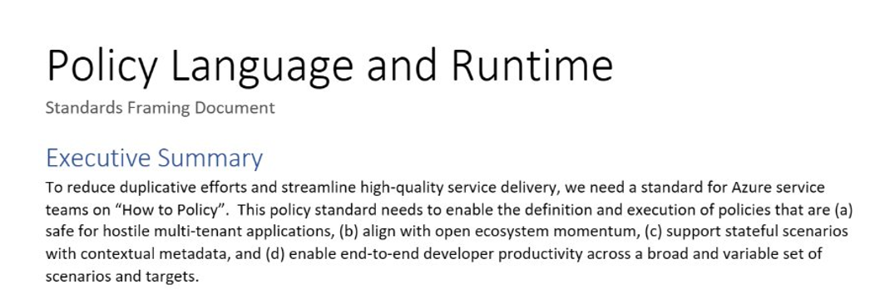
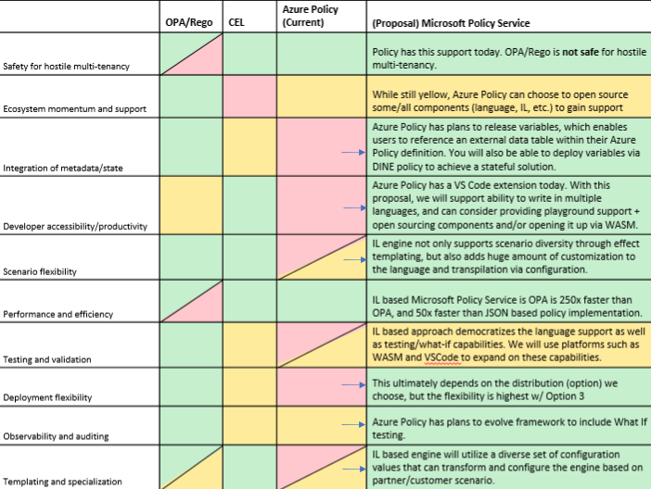
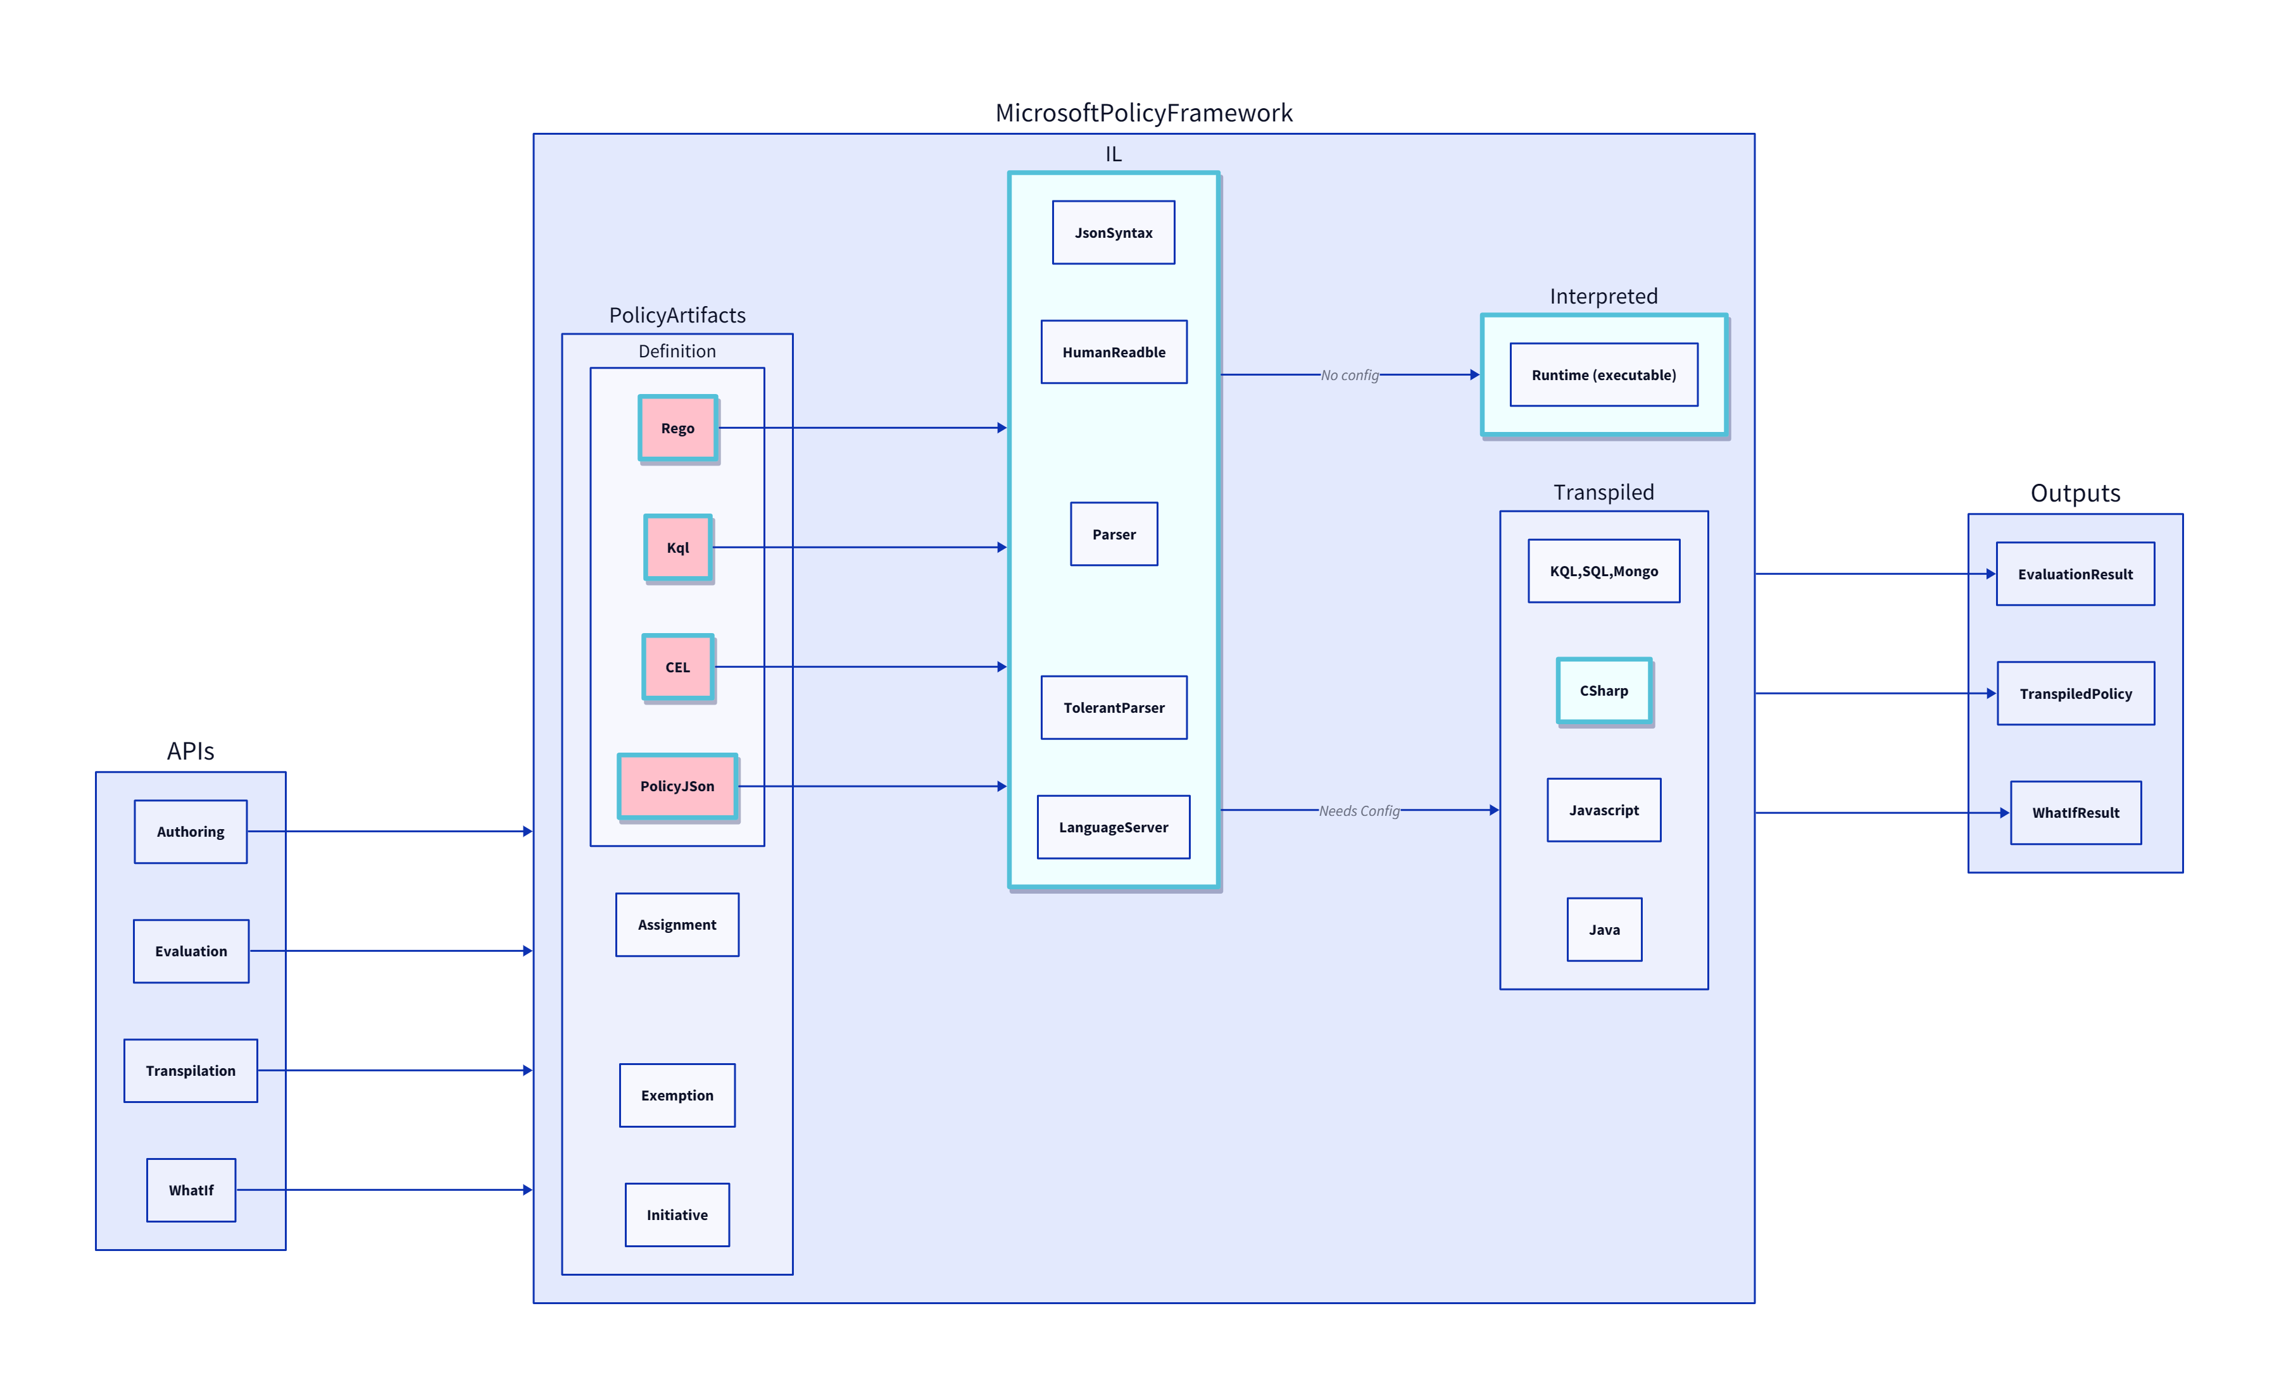
Background: Azure CTO Memo: “How to Policy”/OPA
Investigation
Gaps in OPA
Intermediate Language
Green Light (Mark Russ, Brendan Burns)
Multi Tenancy
Scalability
Lifecycle
Notes:
Go quicker
How we started focusing on this (CTO suggestion to align on a policy engine – OPA)
Issues with OPA
Our solution: standardize on a common policy engine & framework, with flexibility when it comes to the interface language
Green light from Mark Russ, BBurns

Slide 3
The RVM: One Bytecode, Multiple Languages
Rego (OPA)
→
Per-Language Compilers AST → register bytecode
RVM Bytecode Register-based IR Untyped values Structured guards Explicit control flow
Evaluate Fast execution engine (production use)
allow / deny audit / log
→
→
Cedar (Amazon)
→
→
Analyze (Z3) Symbolic execution ∀-input proofs
proofs / tests diffs / coverage
Azure Policy
→
→
→
Compile once, then both run and analyze the same bytecode. Works for Rego, Cedar, and Azure Policy without separate toolchains.
RVM properties that enable analysis
Register-based (not stack)
Named registers map directly to Z3 variables — no stack simulation needed
Structured guards
AllOfGuard / AnyOfGuard → Z3 And/Or with short-circuit semantics
Untyped values
Values carry dynamic type tags — modeled as Z3 algebraic datatypes (String | Number | Bool | Set | Object | Undefined)
Explicit control flow
No exceptions, no hidden branches — complete symbolic execution is tractable

Slide 4
Why Formal Analysis?
The problem
What we do today (and why it’s not enough)
Billions of policy evaluations/day across Azure
1400+ built-in Azure Policy definitions
Rego/OPA is the de facto standard for K8s, service mesh, IAM
Every policy change is a regression risk at cloud scale
LLMs are starting to author policies — faster than humans can review
Manual tests
Hand-written; miss edge cases by definition
Code review
Can’t enumerate all input combinations
Shadow mode
Needs production traffic, takes weeks, only covers inputs that actually happen
Can we get mathematical guarantees — not for a few test inputs, but for all possible inputs?
What we can answer with Z3
Property verification
Equivalence
Subsumption
Test generation
Gap detection
“No input bypasses this deny.”
“Does v2 behave the same as v1?”
“Is the new policy at least as restrictive?”
Minimal inputs covering all paths + MC/DC
Inputs where no rule matches (silent fail-open)

Slide 5
DEMO
① RVM Playground — Multi-Language Support
Quick look: compile Rego, Cedar, and Azure Policy to the same RVM bytecode, step through execution
anakrish.github.io/rego-virtual-machine-playground
② RVM Policy Analysis
Semantic diff, subsumption, test generation (MC/DC), property verification
~10K lines of Rust (RVM bytecode → Z3), entirely written with Copilot (Claude Opus). 3rd time lucky.
▶ anakrish.github.io/rvm-policy-analysis

Slide 6
Road Ahead
AWS has ~8 years of production formal analysis
Zelkova (2017) → IAM Access Analyzer → Cedar + Verified Permissions. ~1B SMT queries/day. Named enterprise customers. "Provable Security" brand.
The hard problem: formal analysis of Rego
Cedar was purpose-built for analysis: no loops, no user-defined functions, no partial rules. Rego has all of those. Encoding Rego’s expressiveness into Z3 (bounded loop unrolling, function inlining, partial rule aggregation) is a genuinely difficult translation problem. Rego/OPA remains the dominant policy language in the Kubernetes ecosystem.
Ideas for next steps
Productize
Prototype (CLI, feature branch) → production service. Performance, reliability, documentation.
CI integration
Formal diff on policy PRs. Equivalent → auto-approve. Wider access → review with counterexample.
AI verification loop
LLM generates policy → Z3 verifies or returns counterexample → LLM revises → iterate. Exploratory.
Scalability
Compositional analysis for large policy sets. Avoiding full enumeration over deep nesting and comprehensions.
Publication
The RVM-to-Z3 translation and the multi-language bytecode design are candidates for a formal methods venue.
Verified engine
Formal verification of the RVM implementation itself using Verus. Two layers of trust: verified policies on a verified engine.
Questions and feedback welcome — github.com/microsoft/regorus

