Slide 1
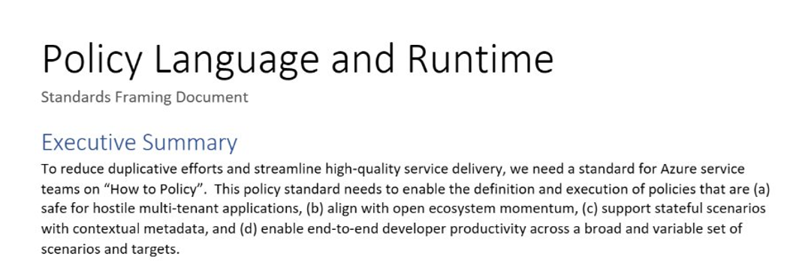
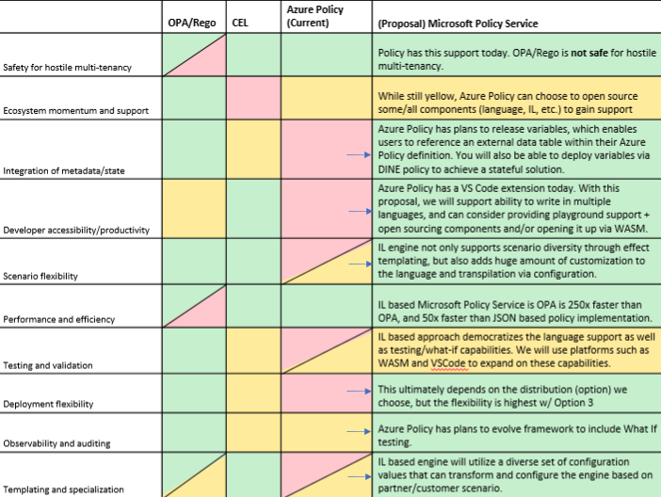
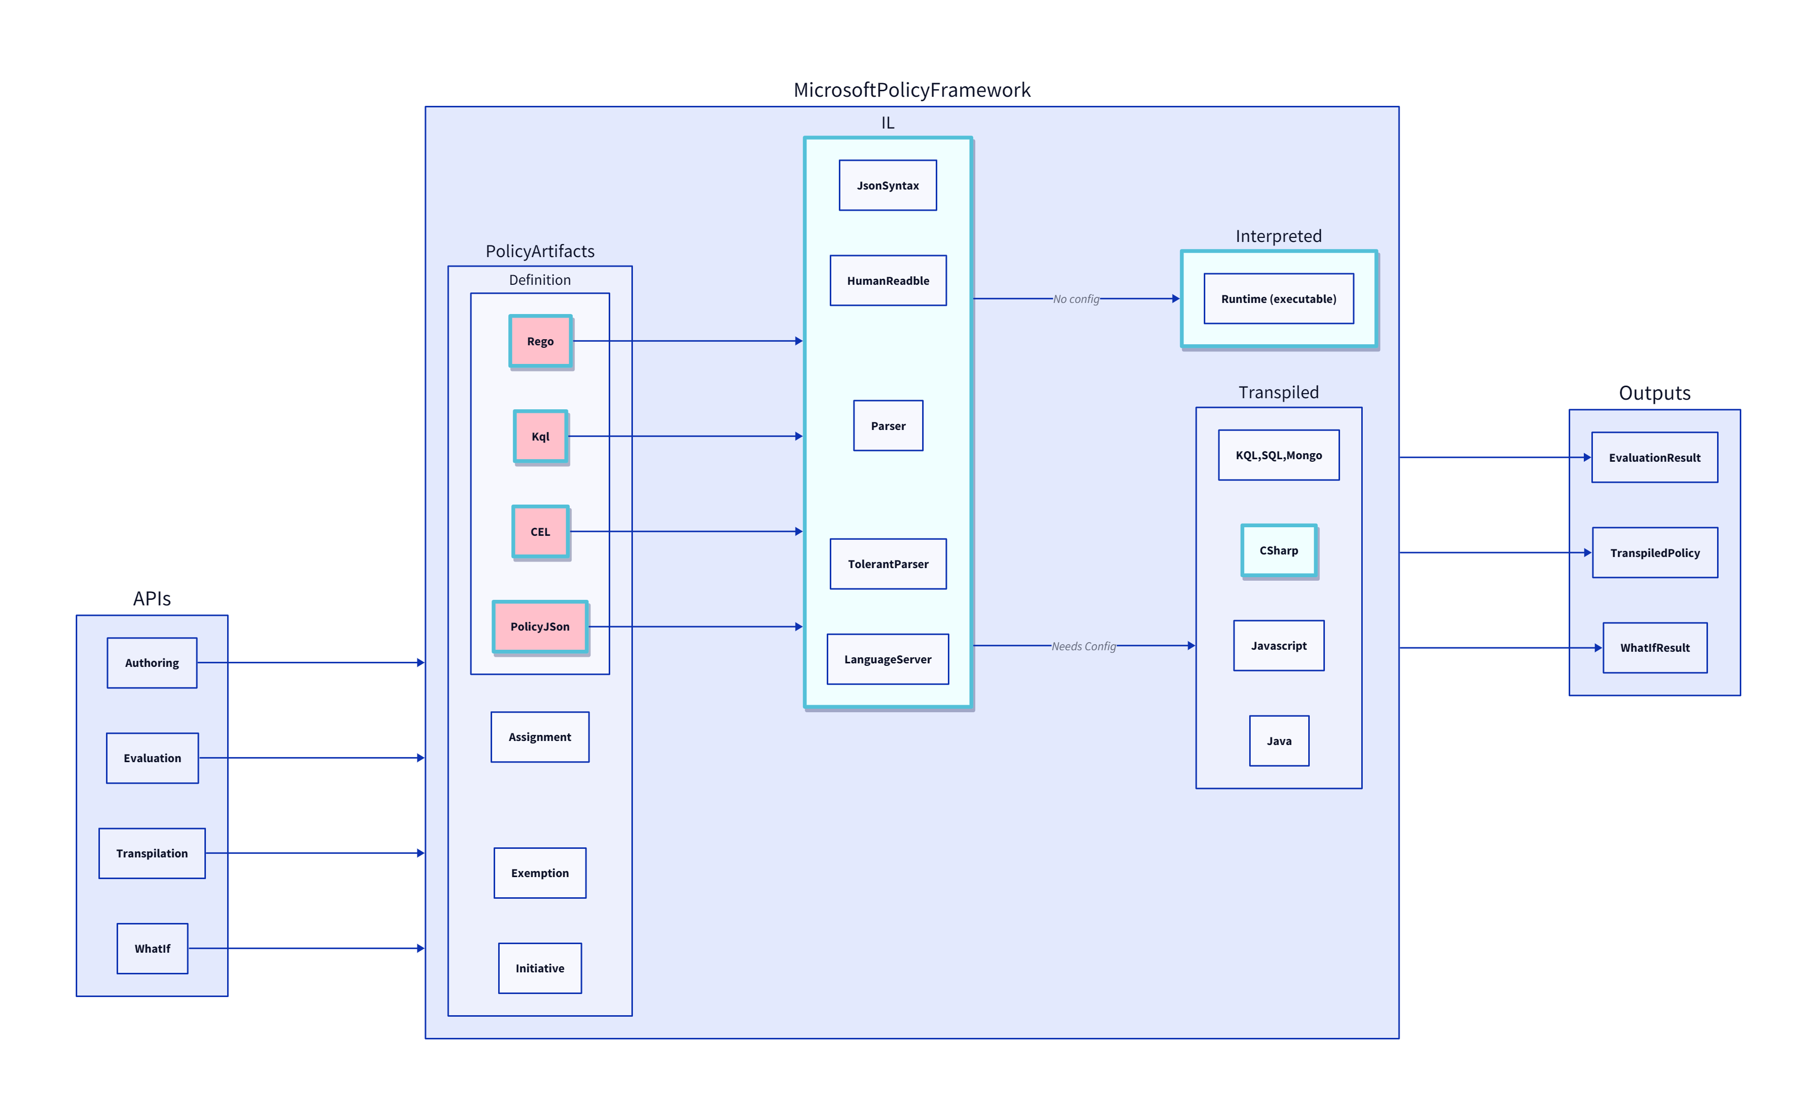
Background: Azure CTO Memo
"How to Policy" — Azure CTO memo on the need for a unified policy framework
Multi Tenancy
Scalability
Lifecycle

Slide 2
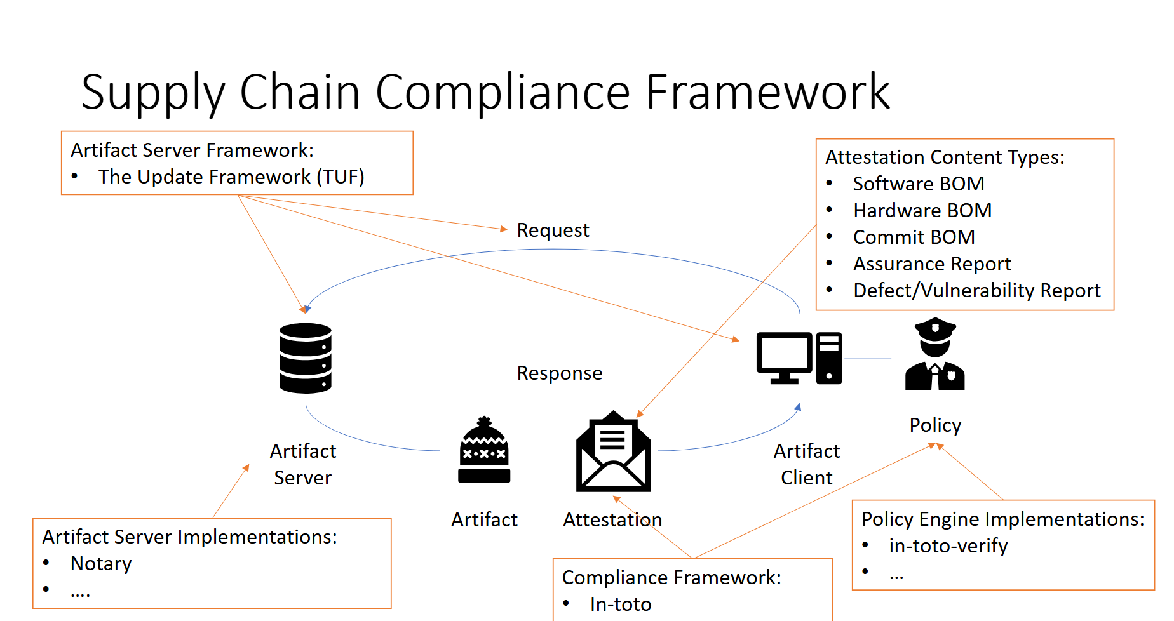
Renewed Urgency: New Scenarios and Teams
To simultaneously reduce burden across Azure service teams and enable consistent experiences through a OnePlane philosophy, it’s critical to provide a common policy framework for Microsoft services.
Standardization is critical for security
Just in the last 6 months, many teams with custom solutions
Multiple teams across Microsoft building separate policy engines — fragmented, duplicated effort.

Slide 3
The Power of RVM
Regorus Virtual Machine
One Engine · Every Policy Language · Any Platform
microsoft/regorus · Open Source (MIT)

Slide 4
Why We Built This
Azure Policy must support multiple policy languages. Across Microsoft, teams maintain separate engines.
OPA / Rego
Cedar
Azure Policy
AKS Admission
Custom
N engines = N audits + N test suites + N pipelines + N teams
The JVM solved this for applications. RVM solves it for policy.
JVM
Java · Kotlin Scala · Groovy
→
Compilers
→
Java Bytecode
→
JVM: Any Platform
RVM
Rego · Cedar Azure Policy · more
→
Compilers
→
RVM Bytecode
→
RVM: Any Platform
One engine to audit, one engine to optimize, one engine to deploy — any new language gets everything for free.

Slide 5
LIVE DEMO
RVM Playground — Cross-language policy in your browser
https://anakrish.github.io/rego-virtual-machine-playground/

Slide 6
What RVM Delivers
Performance
Portability
Safety
Extensibility
– Compiled register-based bytecode
– Short-circuit optimization
– No cloning, no boxing overhead
– Compile once, run anywhere
– WASM, cloud, edge, bare metal
– 8 language bindings
– Rust core — memory safe
– Instruction budget for CPU
– Per-eval memory limits
– Sandboxed — no I/O
– HostAwait: mid-eval callbacks
– Suspendable execution
– Forward-compatible serialization
One engine to certify · Reproducible results · Open source (MIT) · Structured audit logs

Slide 7
Competitive Landscape
OPA (Go)
Regorus / RVM
+ Mature ecosystem, large community
+ Rego language
Multi-language: Rego + Cedar + Azure Policy + more
– Go runtime overhead, GC pauses
– Embeddable via cgo (complex, heavy)
Compiled register-based bytecode with short-circuit optimization
– Single language — no Cedar or Azure Policy
Rust core — memory safe, no_std, no GC, WASM compatible
Cedar SDK (Rust)
8 language bindings: C, C++, C#, Go, Java, Python, Ruby, JS
+ Strong formal foundations
vs
+ Amazon Verified Permissions — managed cloud service
HostAwait: suspendable execution for mid-eval host callbacks
– Single language — no Rego or Azure Policy
Breakpoints, stepping, debug — suspendable by design
– No bytecode — AST tree-walking evaluator
– No mid-evaluation host callbacks
Portable binary artifacts — compile once, run anywhere
Custom Engines
Interactive WASM playground in browser
– One-off implementations per product
Policy intelligence: formal analysis via Z3 (upcoming)
– Per-product maintenance & security burden
– No shared tooling or analysis
Open source (MIT) — transparent and auditable

Slide 8
One Engine. Every Policy. Any Platform.
Regorus Virtual Machine
Rego + Cedar + Azure Policy
High performance · Memory safe · Portable bytecode
8 language bindings · WASM Playground · Open Source (MIT)
Try it: https://anakrish.github.io/rego-virtual-machine-playground/
github.com/microsoft/regorus

