Slide 1
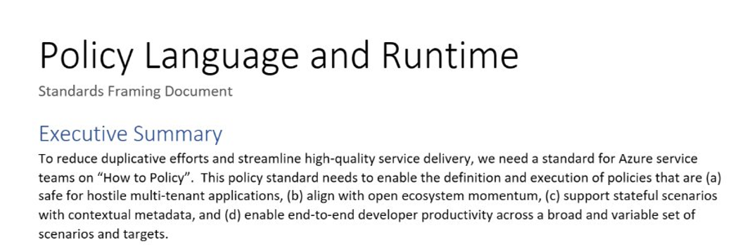
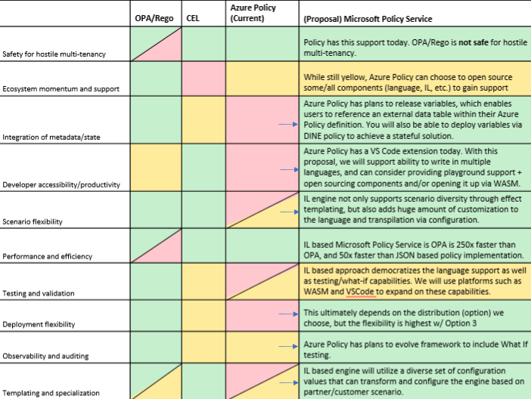
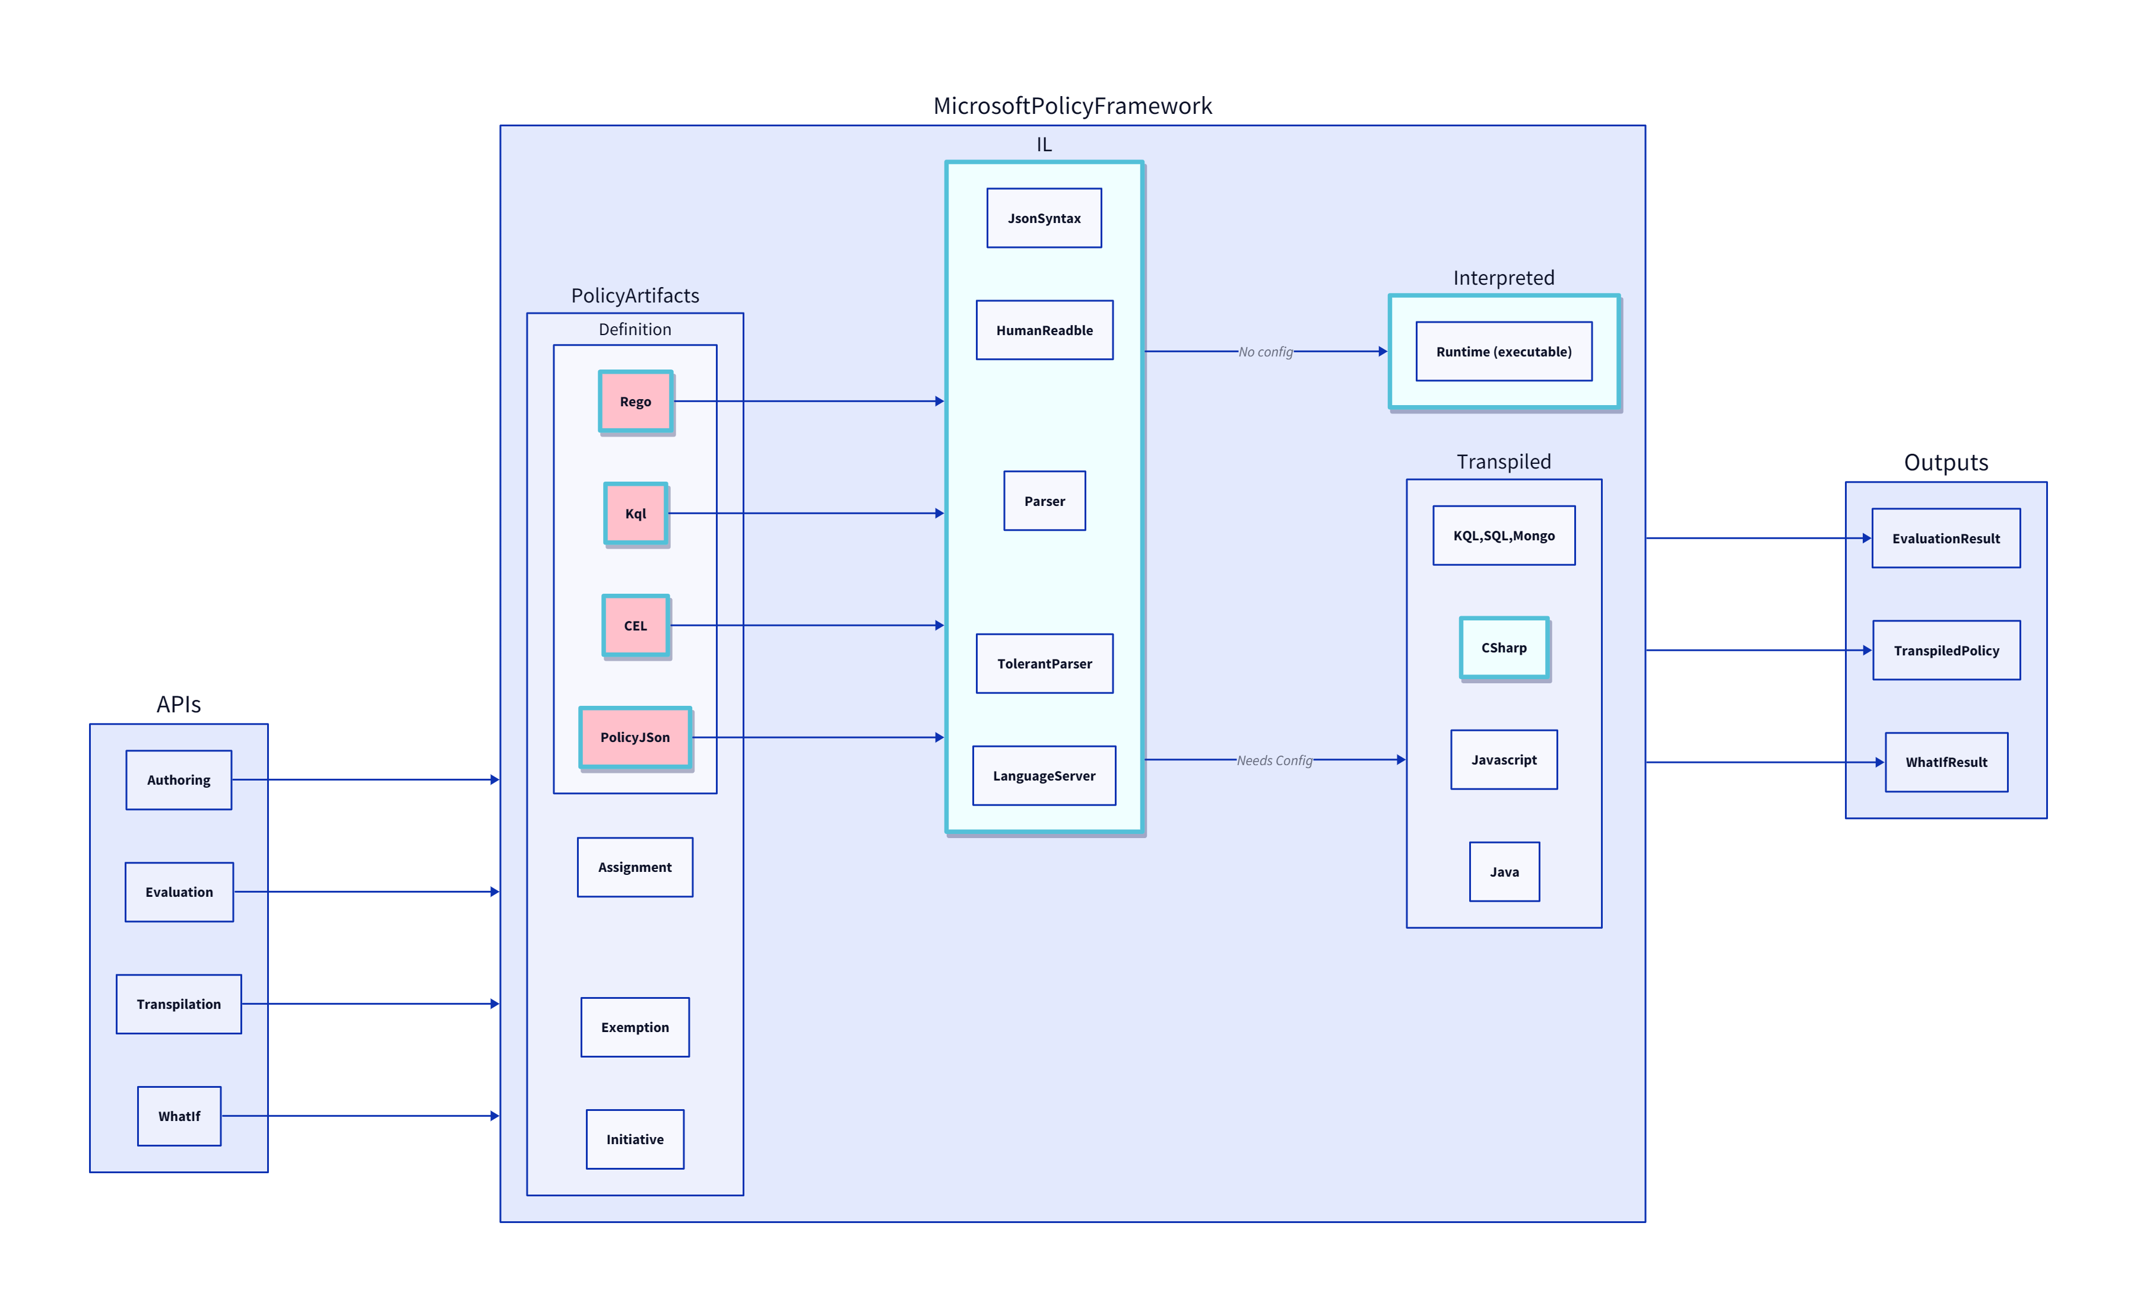
Background: Azure CTO Memo
"How to Policy" — Azure CTO memo on the need for a unified policy framework
Multi Tenancy
Scalability
Lifecycle

Slide 2
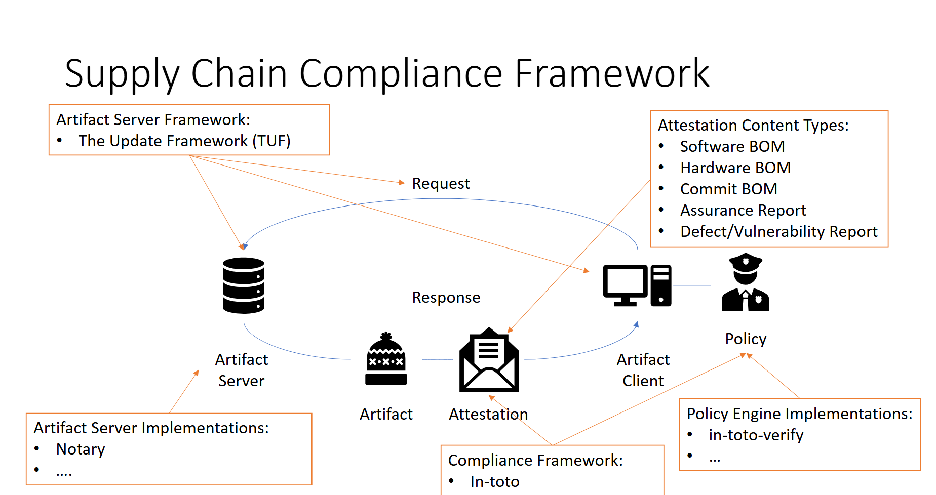
Renewed Urgency: New Scenarios and Teams
To simultaneously reduce burden across Azure service teams and enable consistent experiences through a OnePlane philosophy, it’s critical to provide a common policy framework for Microsoft services.
Standardization is critical for security
Just in the last 6 months, many teams with custom solutions
Multiple teams across Microsoft building separate policy engines — fragmented, duplicated effort.

Slide 3
The Power of RVM
Regorus Virtual Machine
One Engine · Every Policy Language · Any Platform
microsoft/regorus · Open Source (MIT)

Slide 4
The Problem
Azure Policy must support multiple policy languages. Across Microsoft, teams maintain separate engines.
OPA / Rego
Cedar
Azure Policy
AKS Admission
Custom
N engines = N × audits + N × test suites + N × pipelines + N × teams
What if one engine could run them all?
Let me show you.

Slide 5
LIVE DEMO
RVM Playground — Cross-language policy in your browser
https://anakrish.github.io/rego-virtual-machine-playground/

Slide 6
How It Works
What Java did for applications, RVM does for policy.
JVM
Java · Kotlin Scala · Groovy
→
Compilers
→
Java Bytecode
→
JVM: Any Platform
RVM
Rego · Cedar Azure Policy · more
→
Compilers
→
RVM Bytecode
→
RVM: Any Platform
What this means in practice
Security & Compliance
Performance & Portability
Unique Capabilities
– One engine to audit and certify
– Memory safe — Rust, no_std
– Sandboxed — no file or network I/O
– Structured audit logs
– Compiled register-based bytecode
– Compile once, run anywhere
– Cloud, edge, WASM, bare metal
– 8 language bindings
– HostAwait: pause mid-eval for host data
– Instruction budget + memory limits
– Breakpoints & step-through debugging
– Forward-compatible binary artifacts

Slide 7
One Engine. Every Policy. Any Platform.
Regorus Virtual Machine
Rego + Cedar + Azure Policy
High performance · Memory safe · Portable bytecode
8 language bindings · WASM Playground · Open Source (MIT)
Try it: https://anakrish.github.io/rego-virtual-machine-playground/
github.com/microsoft/regorus

