Slide 1
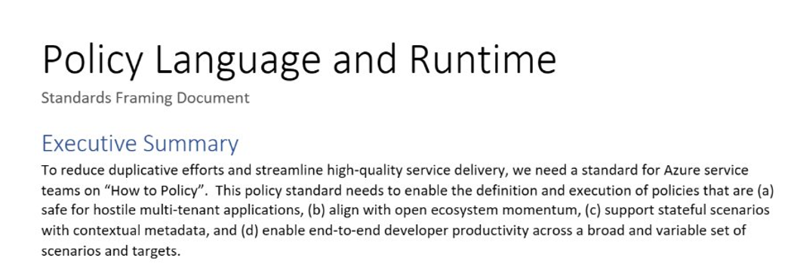
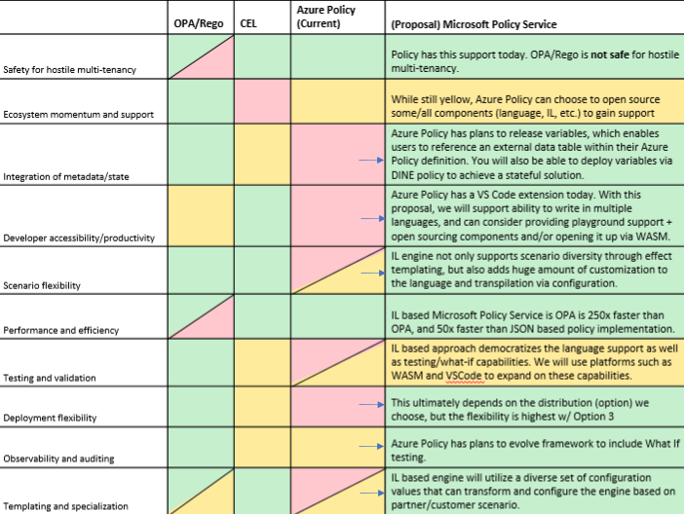
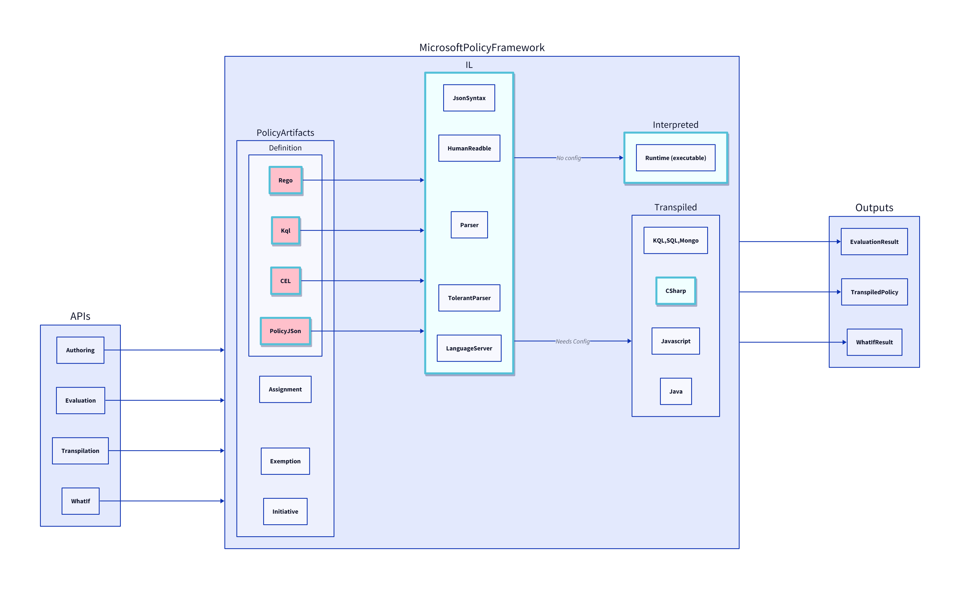
Background: Azure CTO Memo
"How to Policy" — Azure CTO memo on the need for a unified policy framework
Multi Tenancy
Scalability
Lifecycle

Slide 2
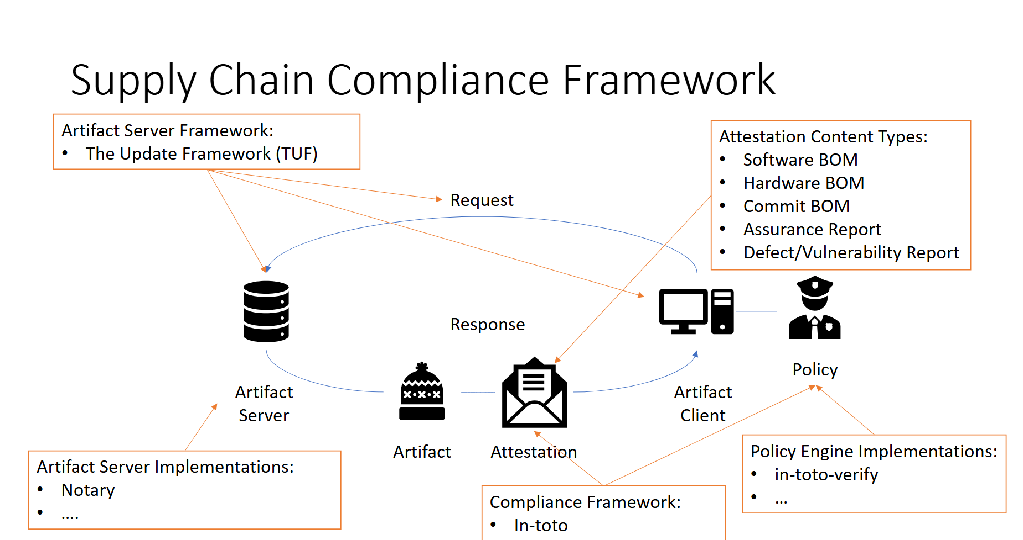
Renewed Urgency: New Scenarios and Teams
To simultaneously reduce burden across Azure service teams and enable consistent experiences through a OnePlane philosophy, it’s critical to provide a common policy framework for Microsoft services.
Standardization is critical for security
Just in the last 6 months, many teams with custom solutions
Multiple teams across Microsoft building separate policy engines — fragmented, duplicated effort.

Slide 3
The Power of RVM
Regorus Virtual Machine
One Engine · Every Policy Language · Any Platform
microsoft/regorus · Open Source (MIT)

Slide 4
The Problem: Policy Engine Proliferation
Azure Policy must support multiple policy languages. Across Microsoft, teams maintain separate engines.
OPA / Rego
Cedar
Azure Policy
AKS Admission
Custom
N separate security audits
N separate testing frameworks
N separate deployment pipelines
N separate teams to maintain
N engines = N × audits + N × test suites + N × pipelines + N × teams
Multiplicative cost, inconsistent behavior, fragmented tooling.

Slide 5
What Java Did for Apps, RVM Does for Policy
JVM (Applications)
Java · Kotlin Scala · Groovy
Compilers
Java Bytecode
JVM: Any Platform
→
→
→
RVM (Policy)
Rego · Cedar Azure Policy · more
Compilers
RVM Bytecode
RVM: Any Platform
→
→
→
What this gives you
One security surface to audit
One engine to optimize
One test framework to maintain
One artifact to deploy
Any new language gets the entire tooling ecosystem for free

Slide 6
LIVE DEMO
RVM Playground — Cross-language policy in your browser
https://anakrish.github.io/rego-virtual-machine-playground/

Slide 7
Under the Hood
What makes the playground possible — and what it means for production.
Performance
Portability
Extensibility
– Register-based bytecode, minimal dispatch
– Short-circuit optimization (PolicyOp)
– No cloning, no boxing
– Compile once, run anywhere
– Cloud, edge, WASM, bare metal
– Forward-compatible binary serialization
– HostAwait: pause mid-eval for host data
– Suspendable execution by design
– Breakpoints and step-through debugging
Trust Through Safety
Memory Safety
Execution Safety
Auditability
– Written in Rust — no buffer overflows
– no_std compatible — bare metal ready
– No unsafe code in evaluation path
– Configurable memory limits per evaluation
– Instruction budget — bounded CPU
– Sandboxed — no file or network I/O
– Structured audit logs — every decision traceable
– Deterministic: same input = same output
– Open source (MIT) — fully transparent
One engine to certify · Reproducible results · Resource & time bounded · Open source (MIT)

Slide 8
Competitive Landscape
OPA (Go)
Regorus / RVM
+ Mature ecosystem, large community
+ Rego language
Multi-language: Rego + Cedar + Azure Policy + more
– Go runtime overhead, GC pauses
– Embeddable via cgo (complex, heavy)
Compiled register-based bytecode with short-circuit optimization
– Single language — no Cedar or Azure Policy
Rust core — memory safe, no_std, no GC, WASM compatible
Cedar SDK (Rust)
8 language bindings: C, C++, C#, Go, Java, Python, Ruby, JS
+ Strong formal foundations
vs
+ Amazon Verified Permissions — managed cloud service
HostAwait: suspendable execution for mid-eval host callbacks
– Single language — no Rego or Azure Policy
Breakpoints, stepping, debug — suspendable by design
– No bytecode — AST tree-walking evaluator
– No mid-evaluation host callbacks
Portable binary artifacts — compile once, run anywhere
Custom Engines
Interactive WASM playground in browser
– One-off implementations per product
Policy intelligence: formal analysis via Z3 (upcoming)
– Per-product maintenance & security burden
– No shared tooling or analysis
Open source (MIT) — transparent and auditable

Slide 9
One Engine. Every Policy. Any Platform.
Regorus Virtual Machine
Rego + Cedar + Azure Policy
High performance · Memory safe · Portable bytecode
8 language bindings · WASM Playground · Open Source (MIT)
Try it: https://anakrish.github.io/rego-virtual-machine-playground/
github.com/microsoft/regorus

