Slide 1
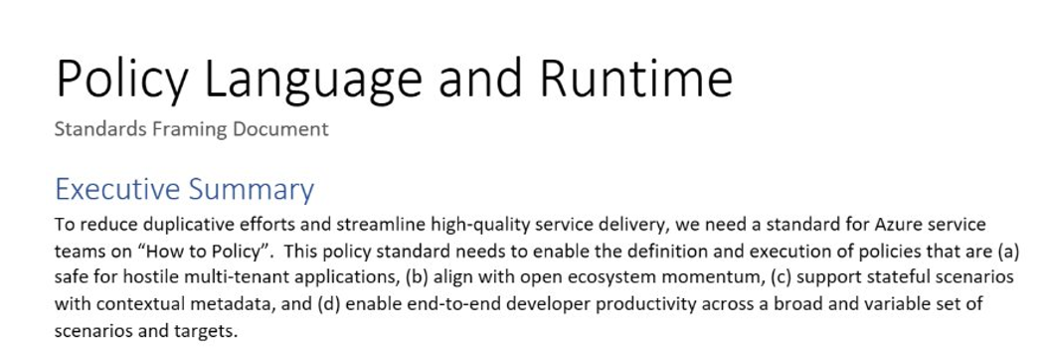
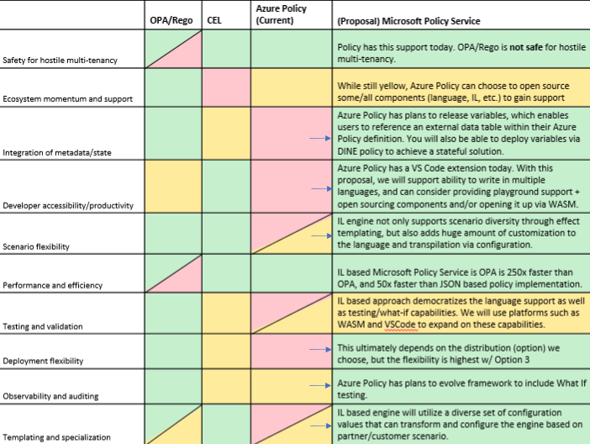
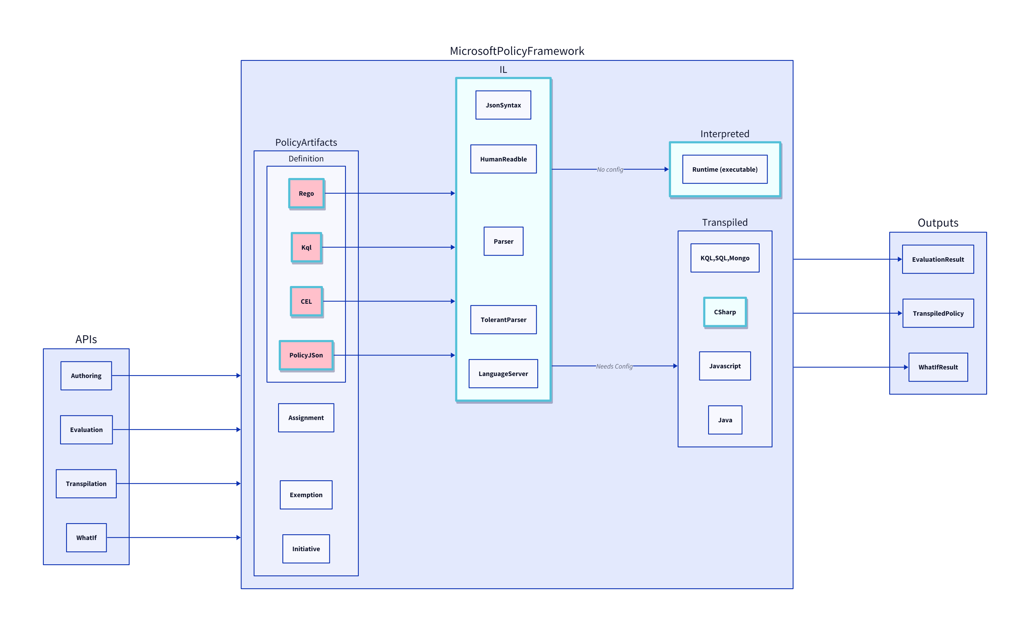
Background: Azure CTO Memo
"How to Policy" — Azure CTO memo on the need for a unified policy framework
Multi Tenancy
Scalability
Lifecycle

Slide 2
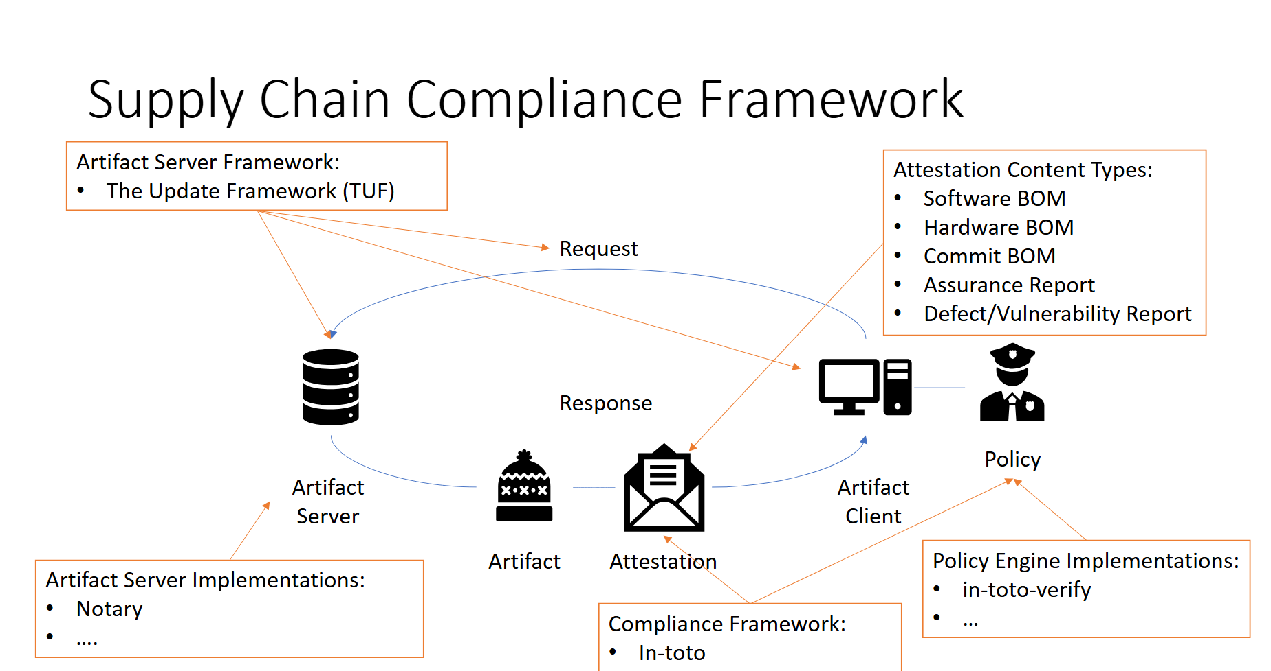
Renewed Urgency: New Scenarios and Teams
To simultaneously reduce burden across Azure service teams and enable consistent experiences through a OnePlane philosophy, it’s critical to provide a common policy framework for Microsoft services.
Standardization is critical for security
Just in the last 6 months, many teams with custom solutions
Multiple teams across Microsoft building separate policy engines — fragmented, duplicated effort.

Slide 3
The Power of RVM
Regorus Virtual Machine
One Engine · Every Policy Language · Any Platform
microsoft/regorus · Open Source (MIT)

Slide 4
Azure Policy must support multiple policy languages.
Across Microsoft, teams maintain separate engines. Every engine means another audit, another test suite, another deployment.
OPA / Rego
Cedar
Azure Policy
AKS Admission
Custom
What if one engine could run them all?

Slide 5
LIVE DEMO
RVM Playground — Cross-language policy in your browser
1. Write
Rego policy in Monaco editor with syntax highlighting
2. Compile
See RVM bytecode and instruction count
3. Run
Set input data, get instant evaluation results
4. Switch
Same policy logic in Cedar — same bytecode target
5. Debug
Step through bytecode, inspect registers
6. Compare
Side-by-side assembly for Rego vs Cedar
https://anakrish.github.io/rego-virtual-machine-playground/

Slide 6
One Engine. Every Policy. Any Platform.
Regorus Virtual Machine
Rego + Cedar + Azure Policy — one bytecode target
High performance · Memory safe · Portable
8 language bindings: C, C++, C#, Go, Java, Python, Ruby, JS
WASM Playground · Debugger · Disassembler
Open Source (MIT) · github.com/microsoft/regorus
Try it: https://anakrish.github.io/rego-virtual-machine-playground/

