Slide 1
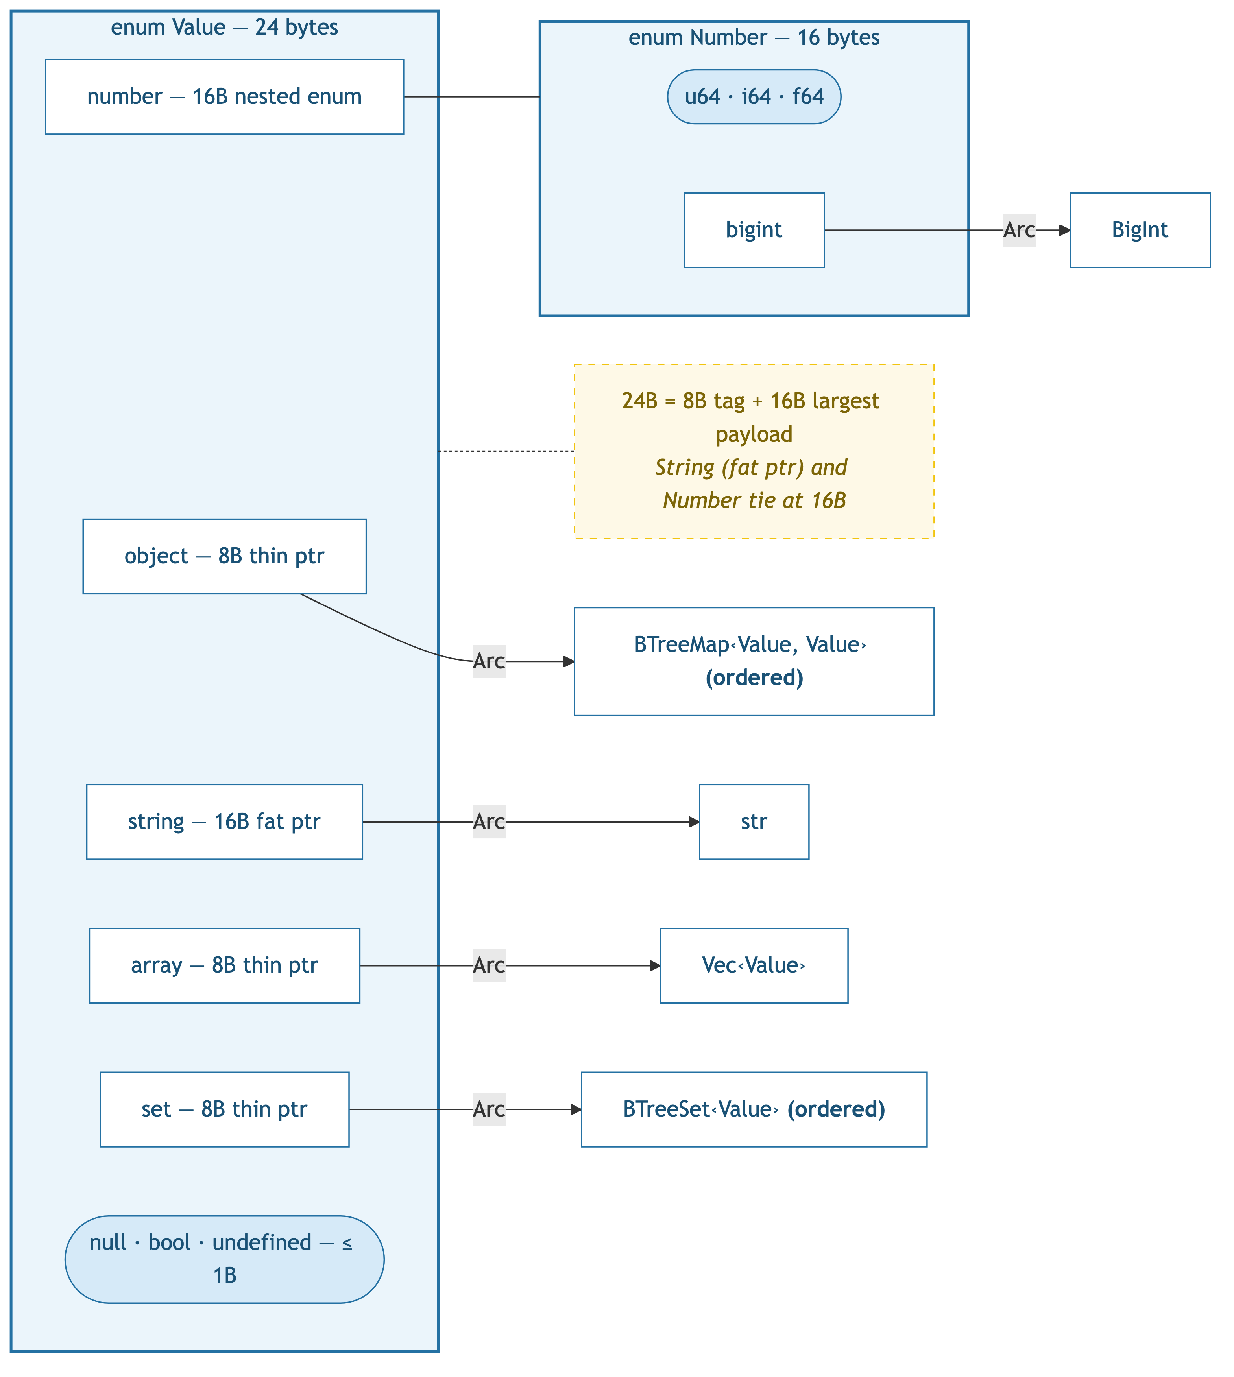
Baseline: Arc + BTreeMap — 24 bytes

Slide 2
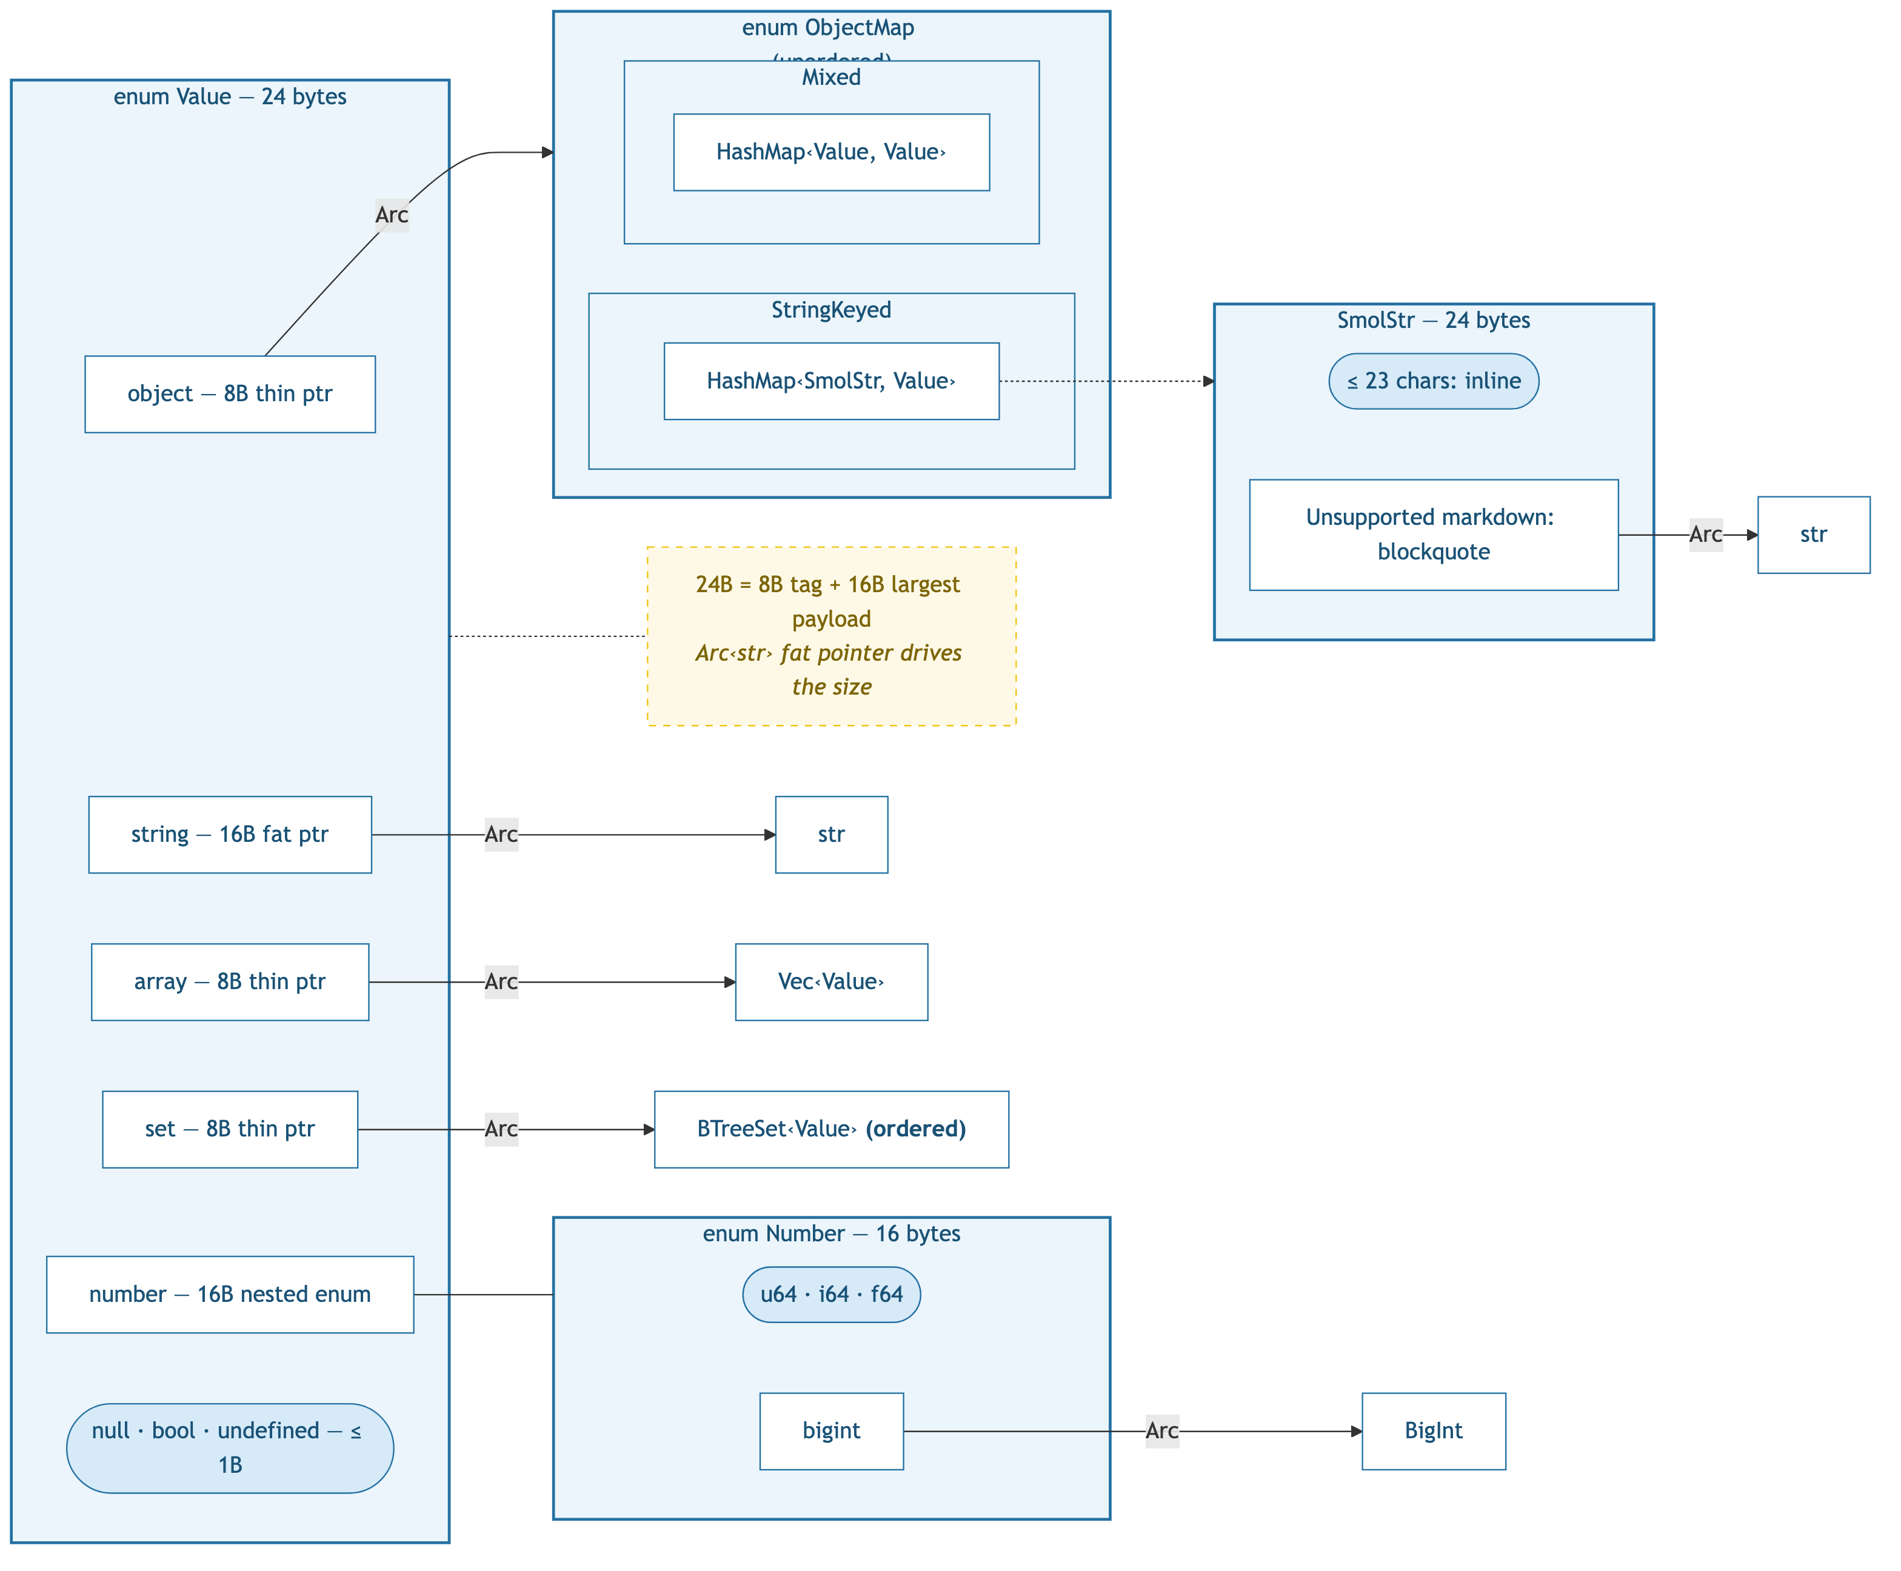
v1: HashMap + SmolStr — 24 bytes

Slide 3
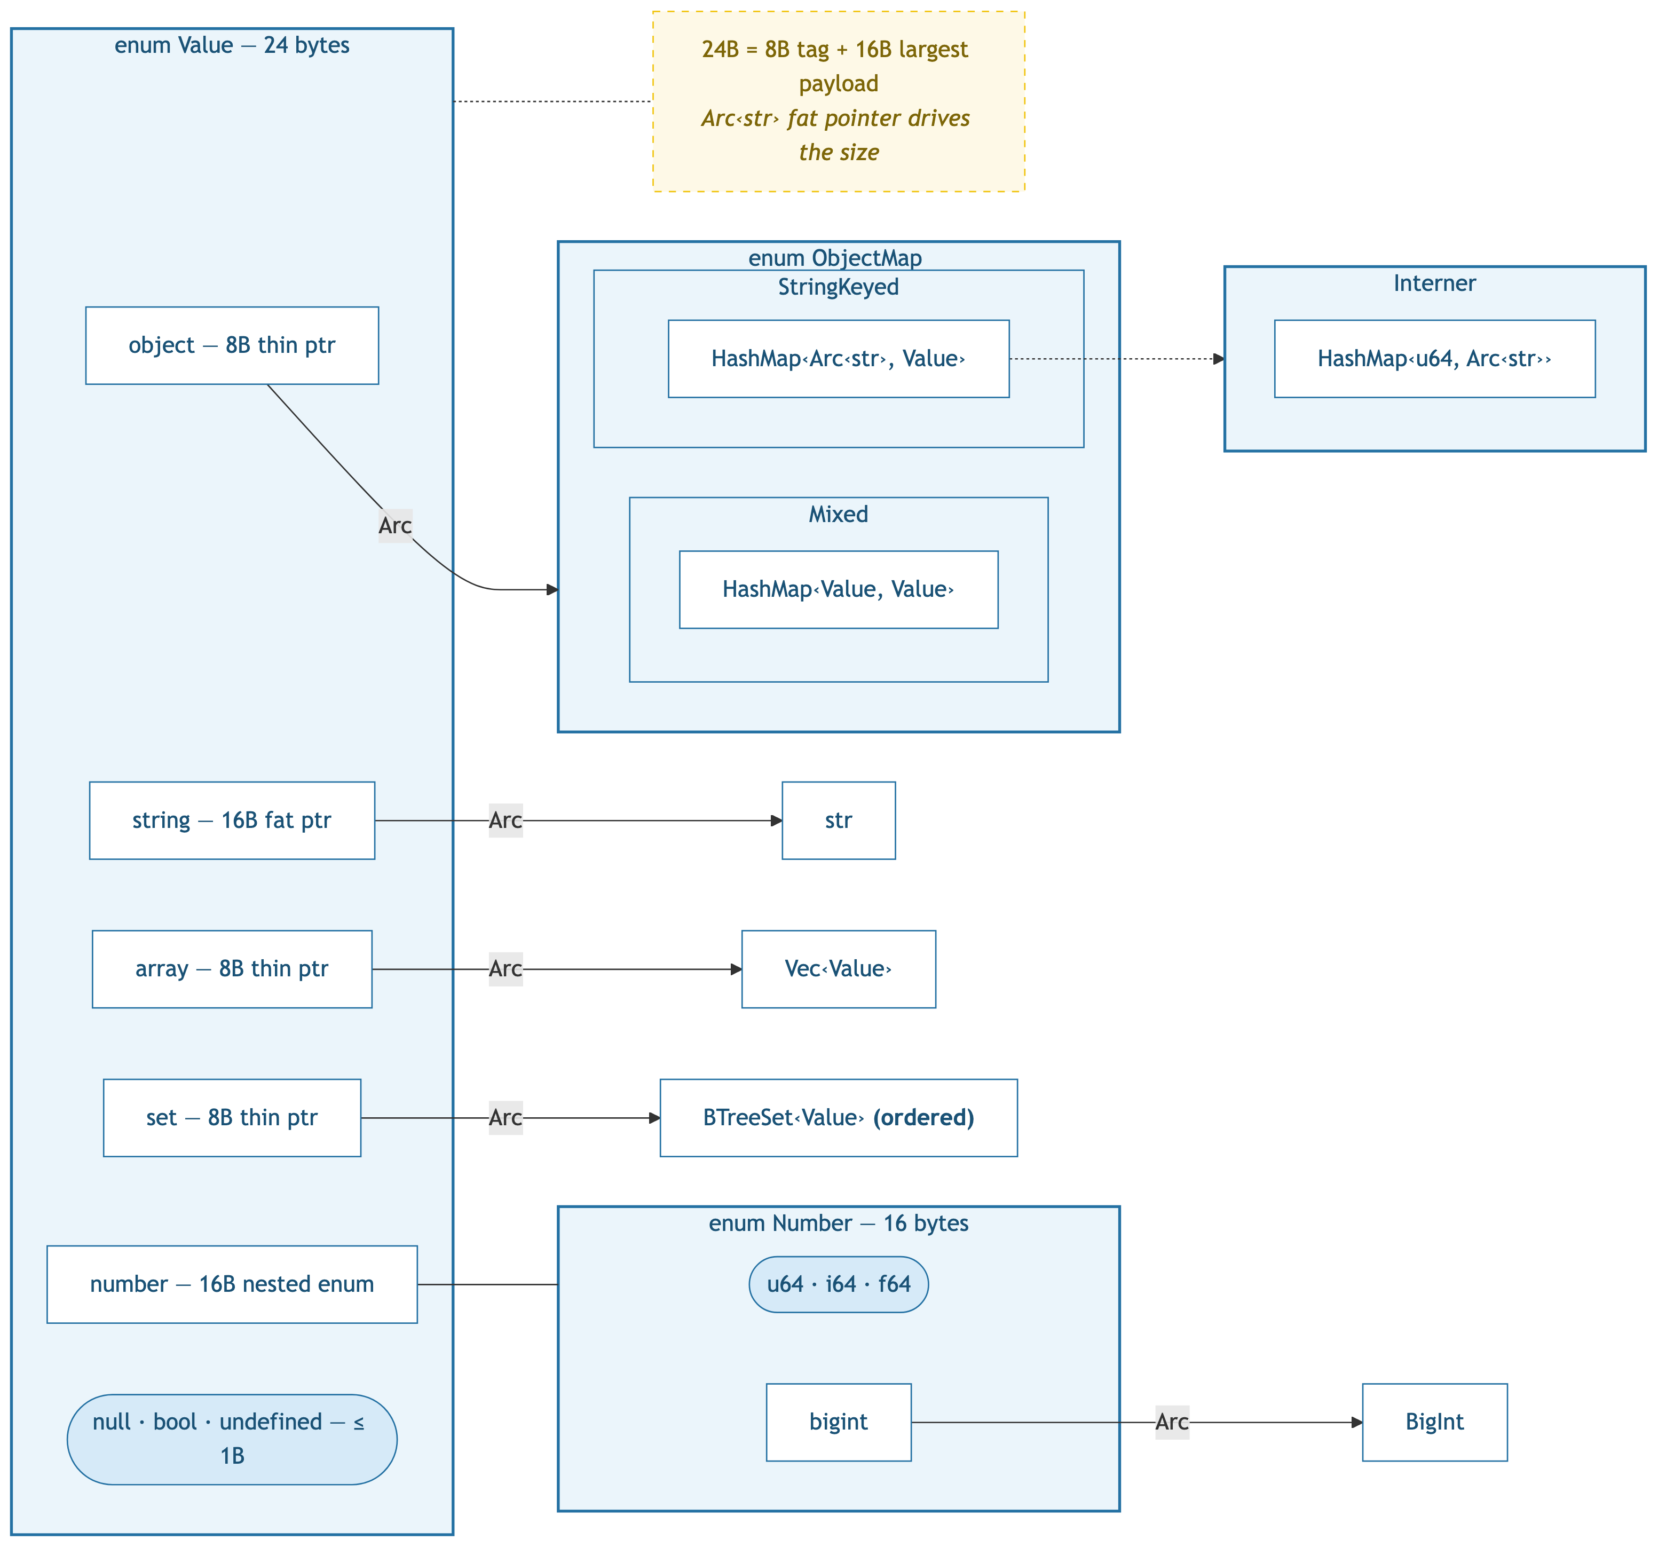
v2: Arc<str> keys — 24 bytes

Slide 4
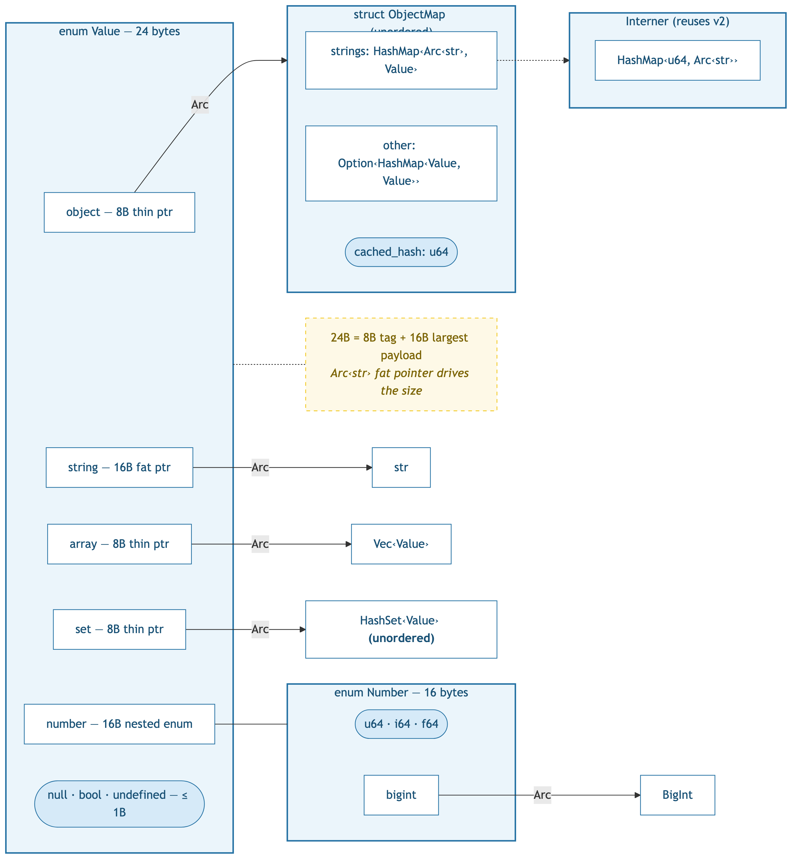
v3: HashSet + cached hash — 24 bytes

Slide 5
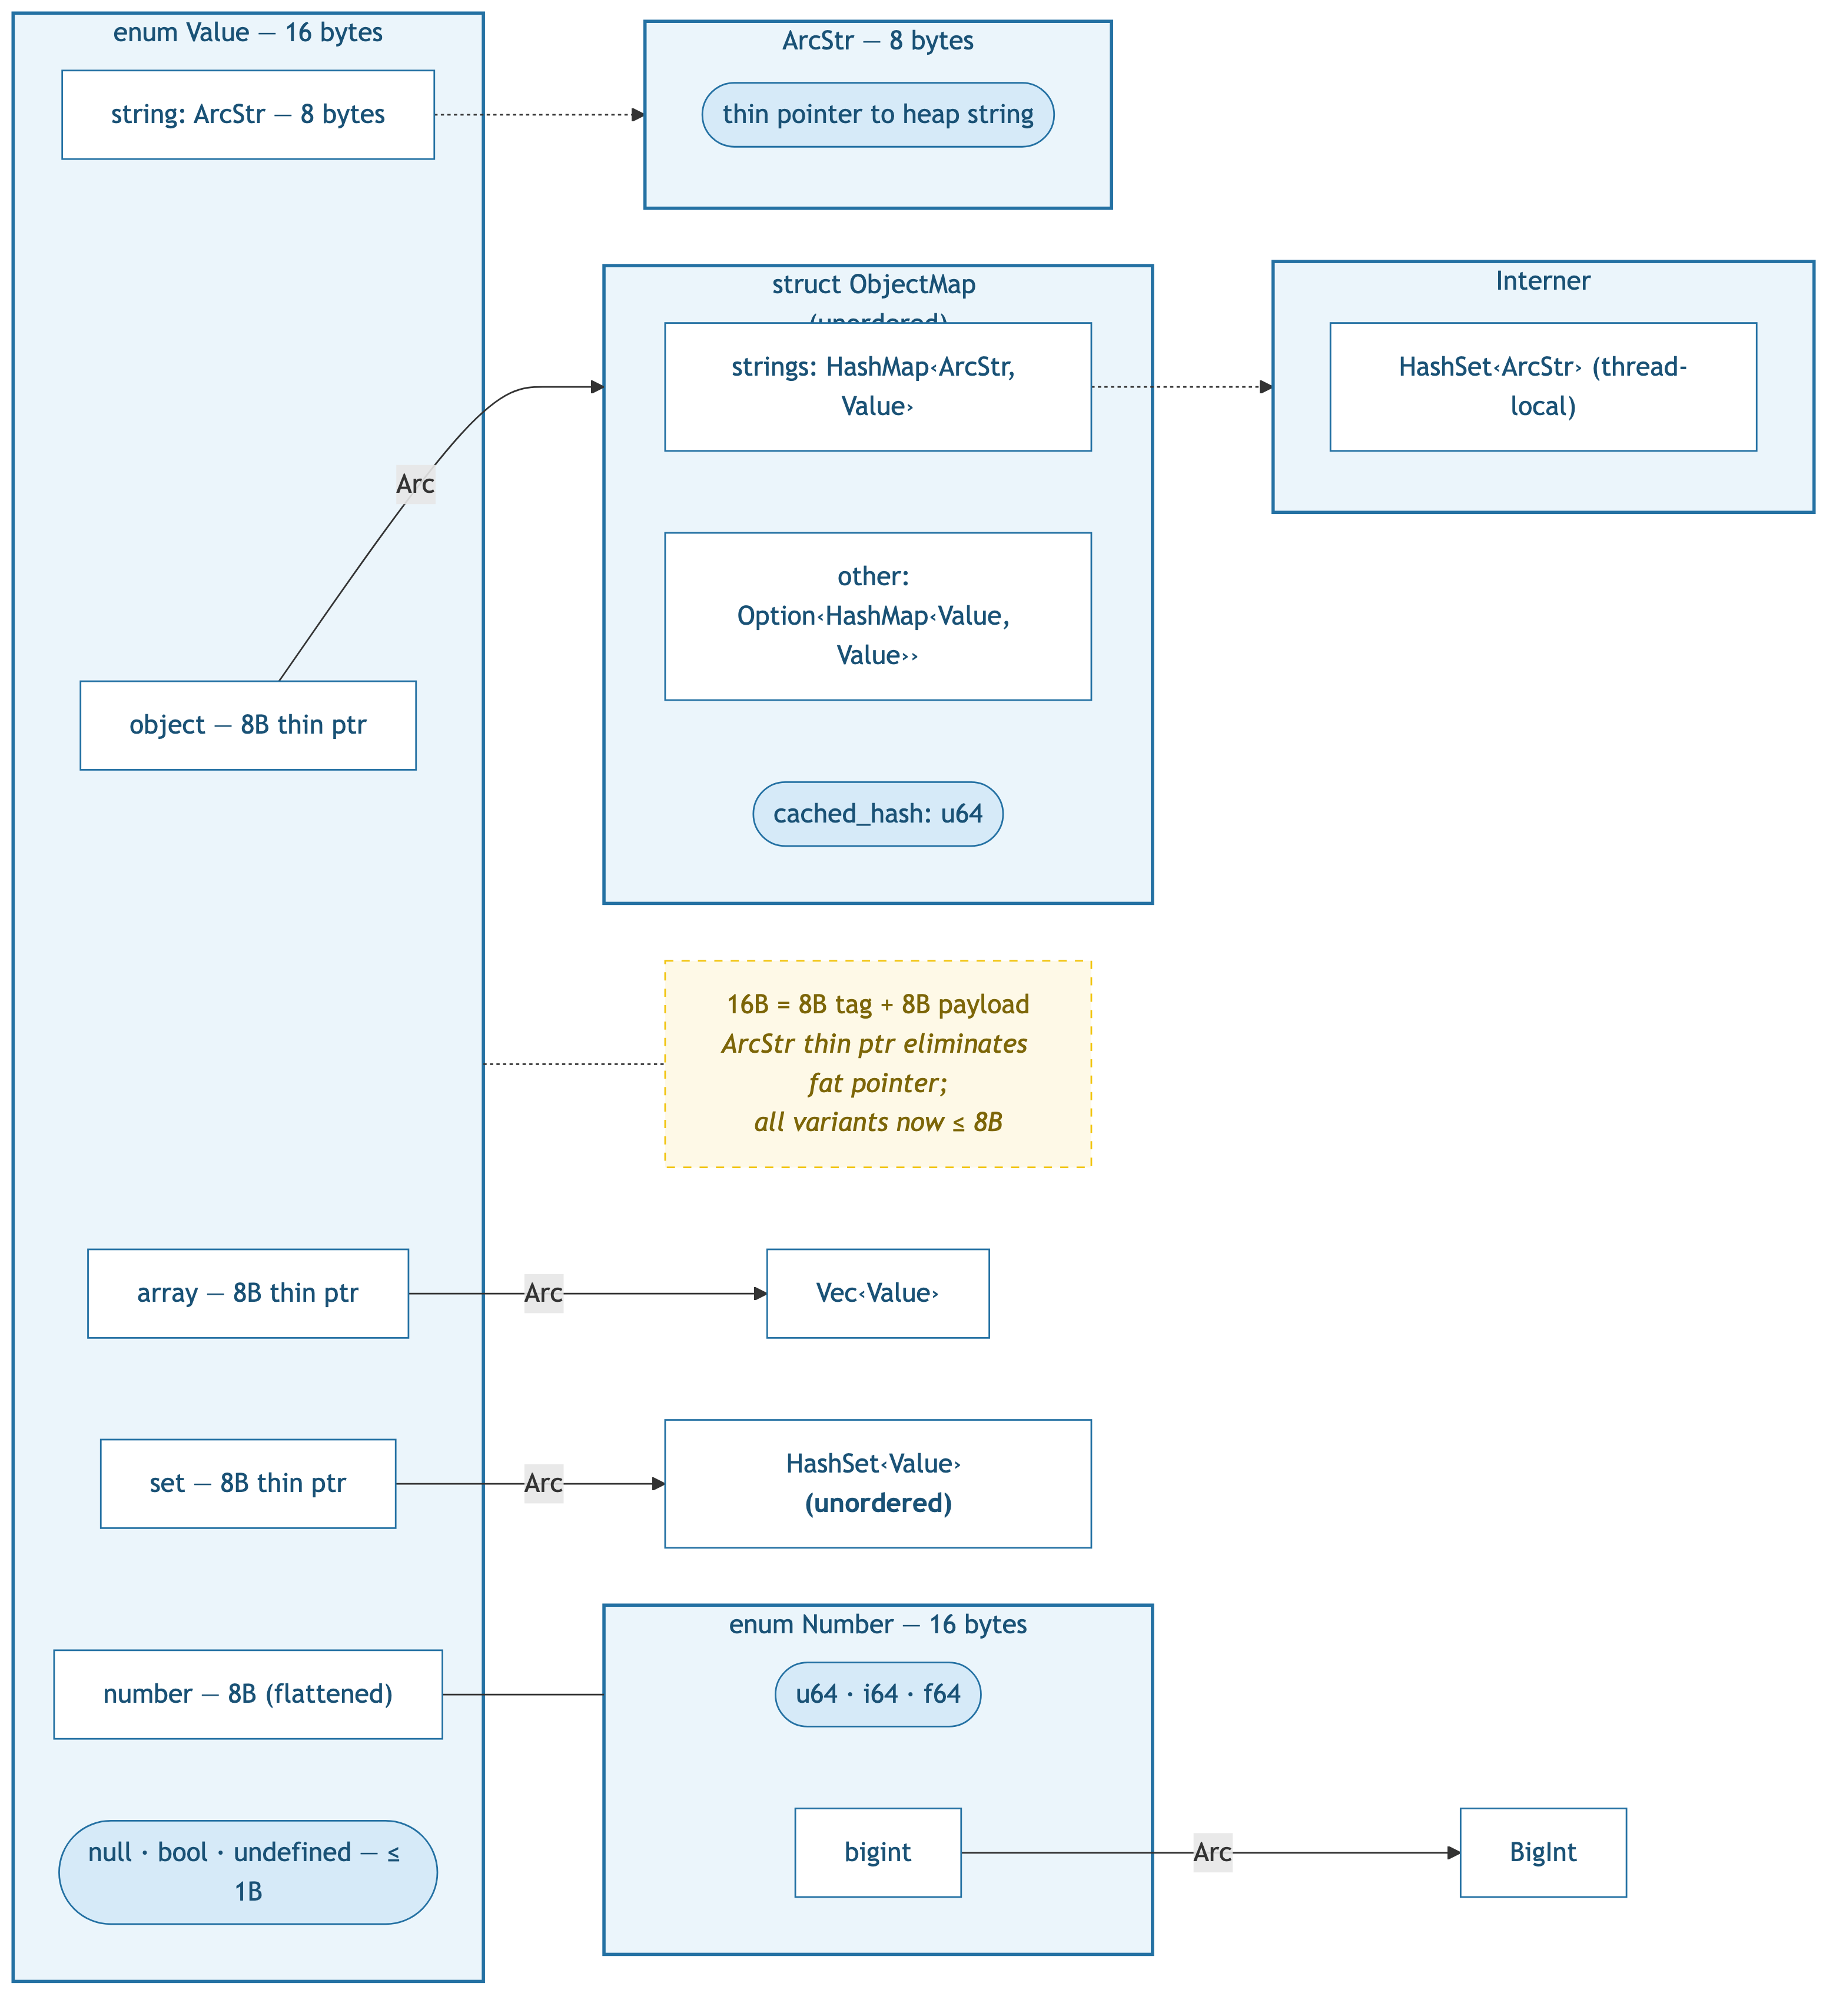
v4: ArcStr thin pointer — 16 bytes

Slide 6
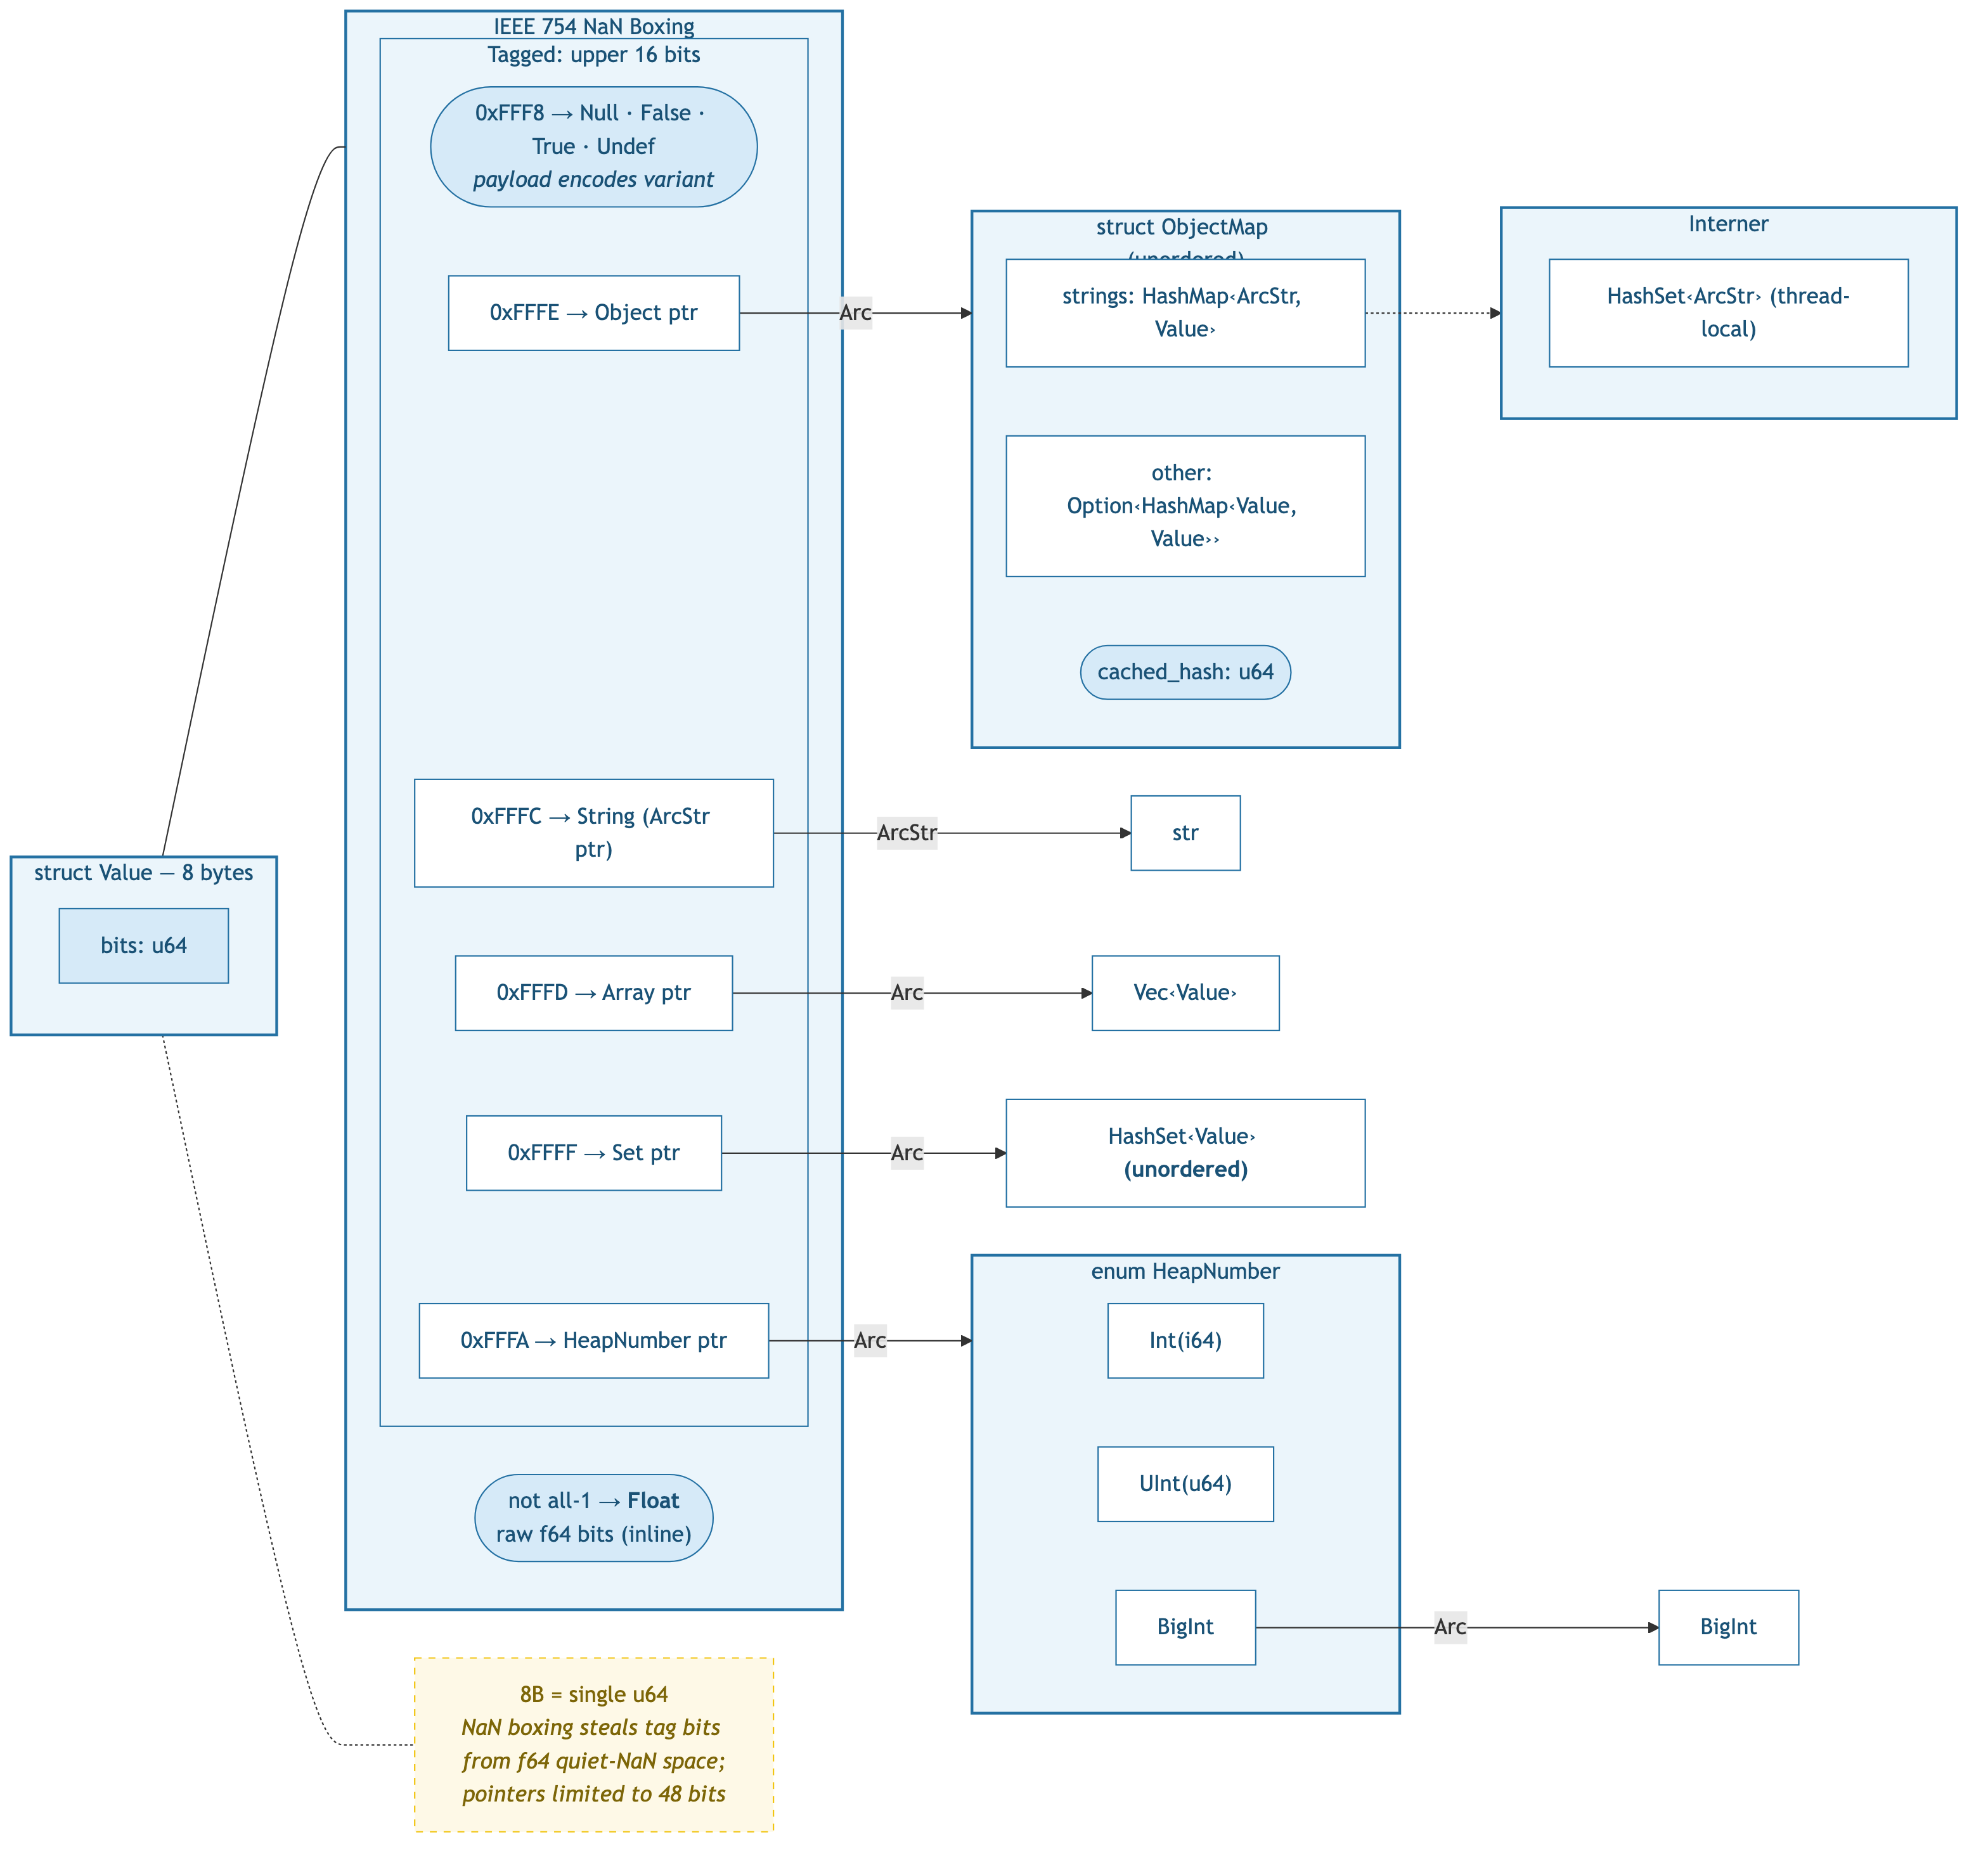
v5: NaN-boxed Value — 8 bytes

Slide 7
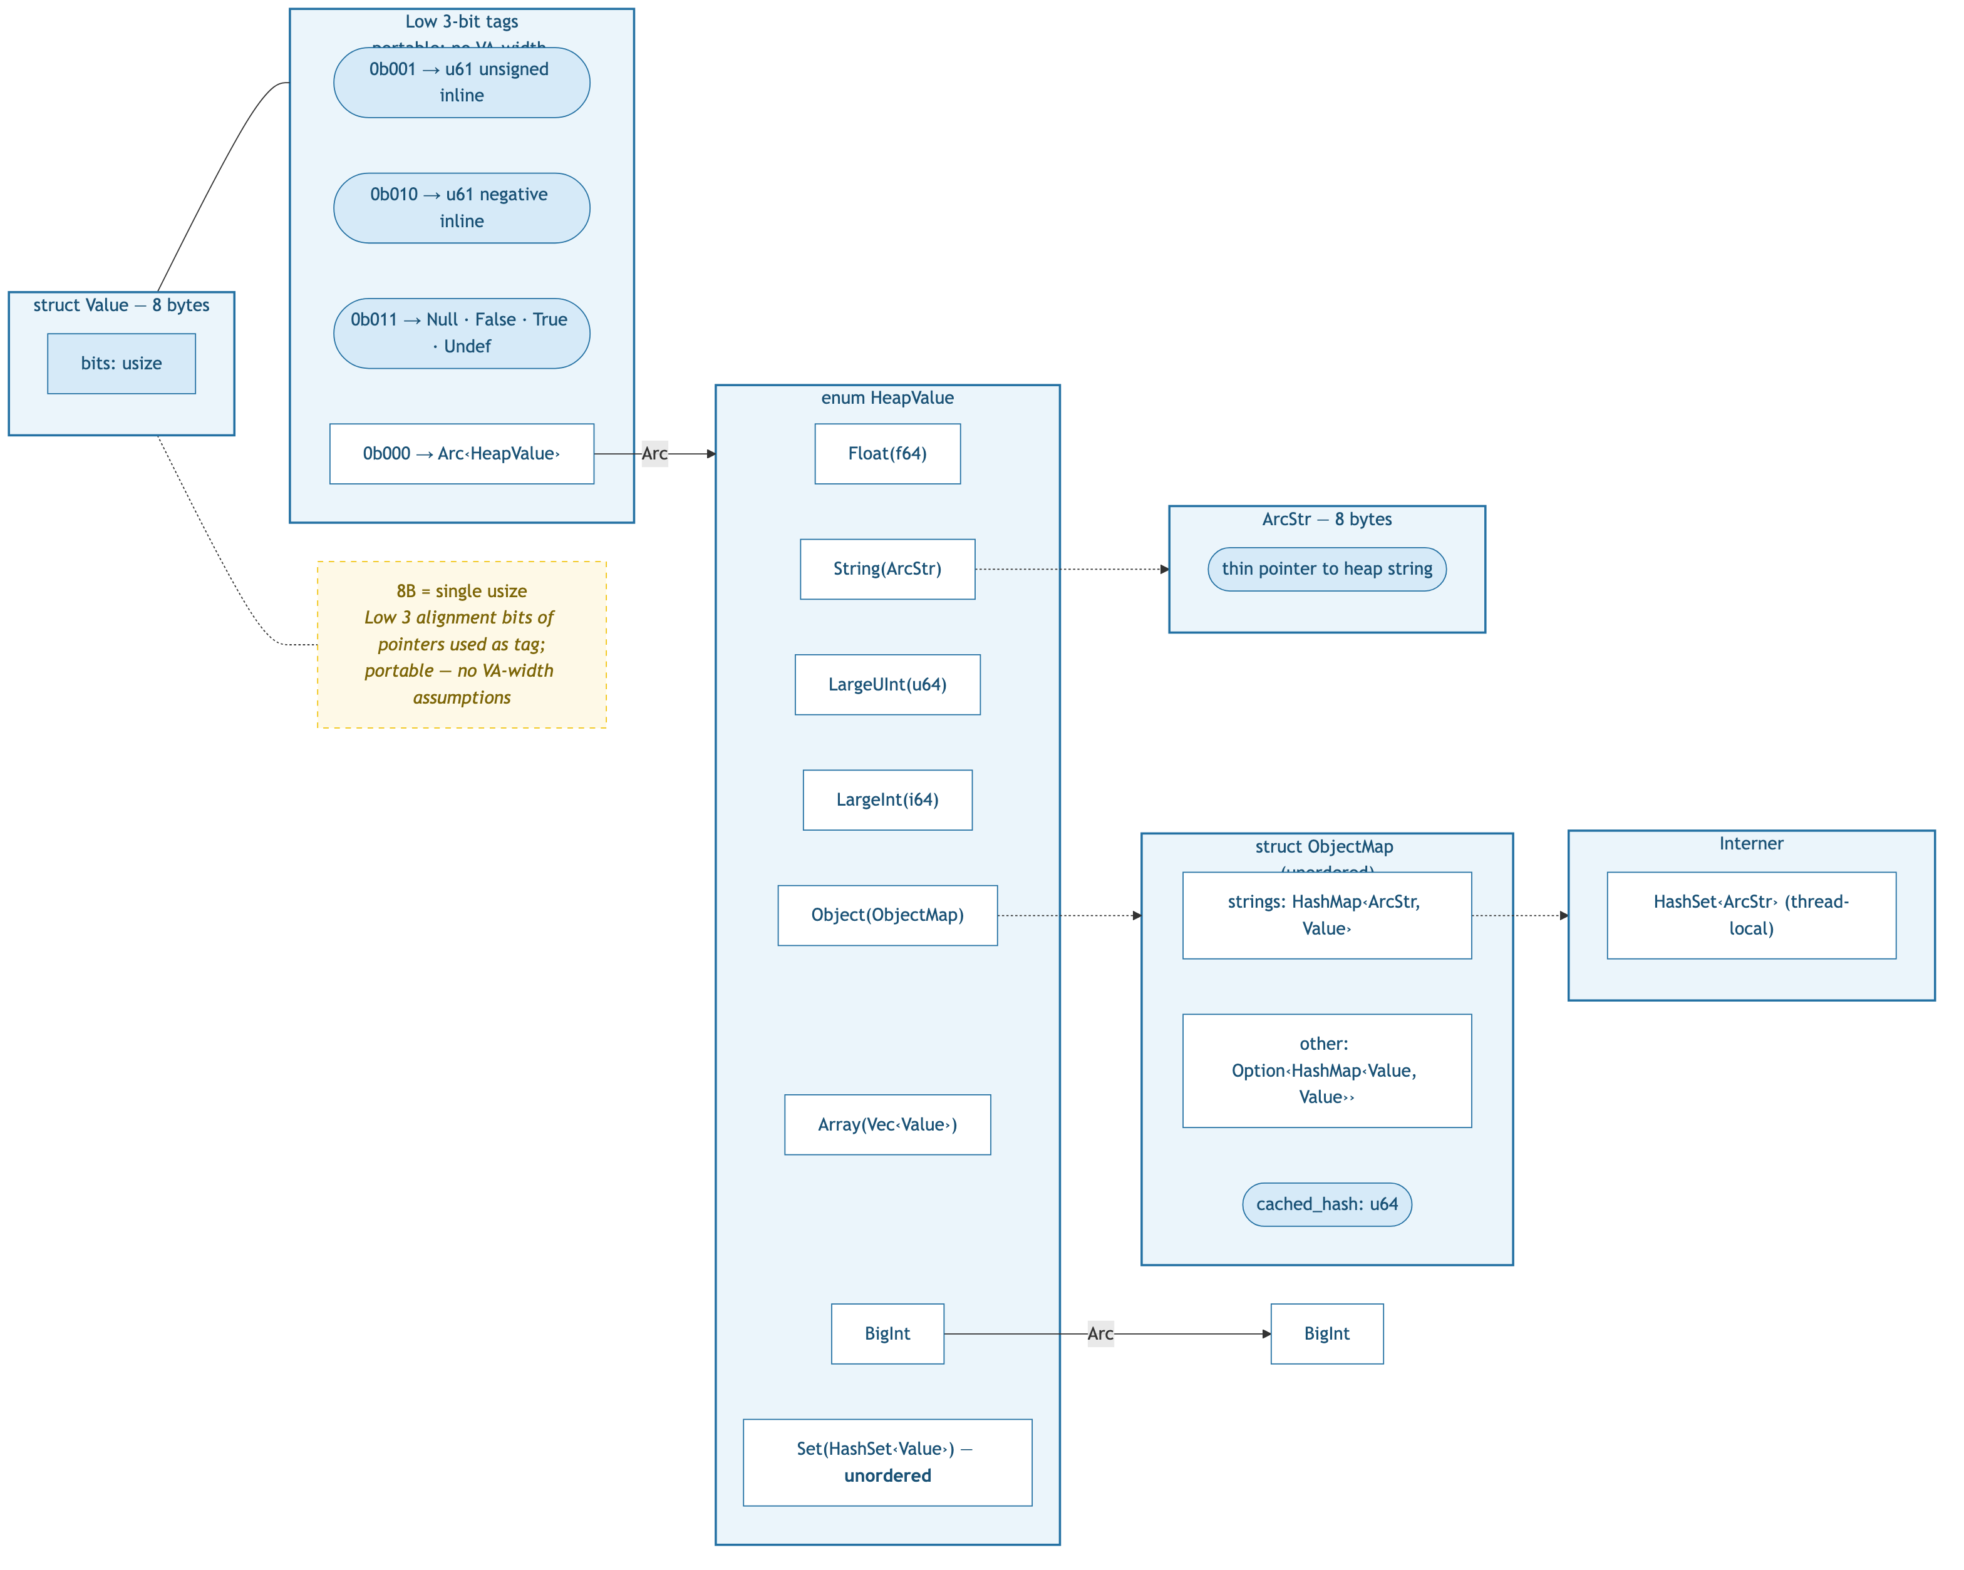
v6: Portable tagged pointer — 8 bytes

Slide 8
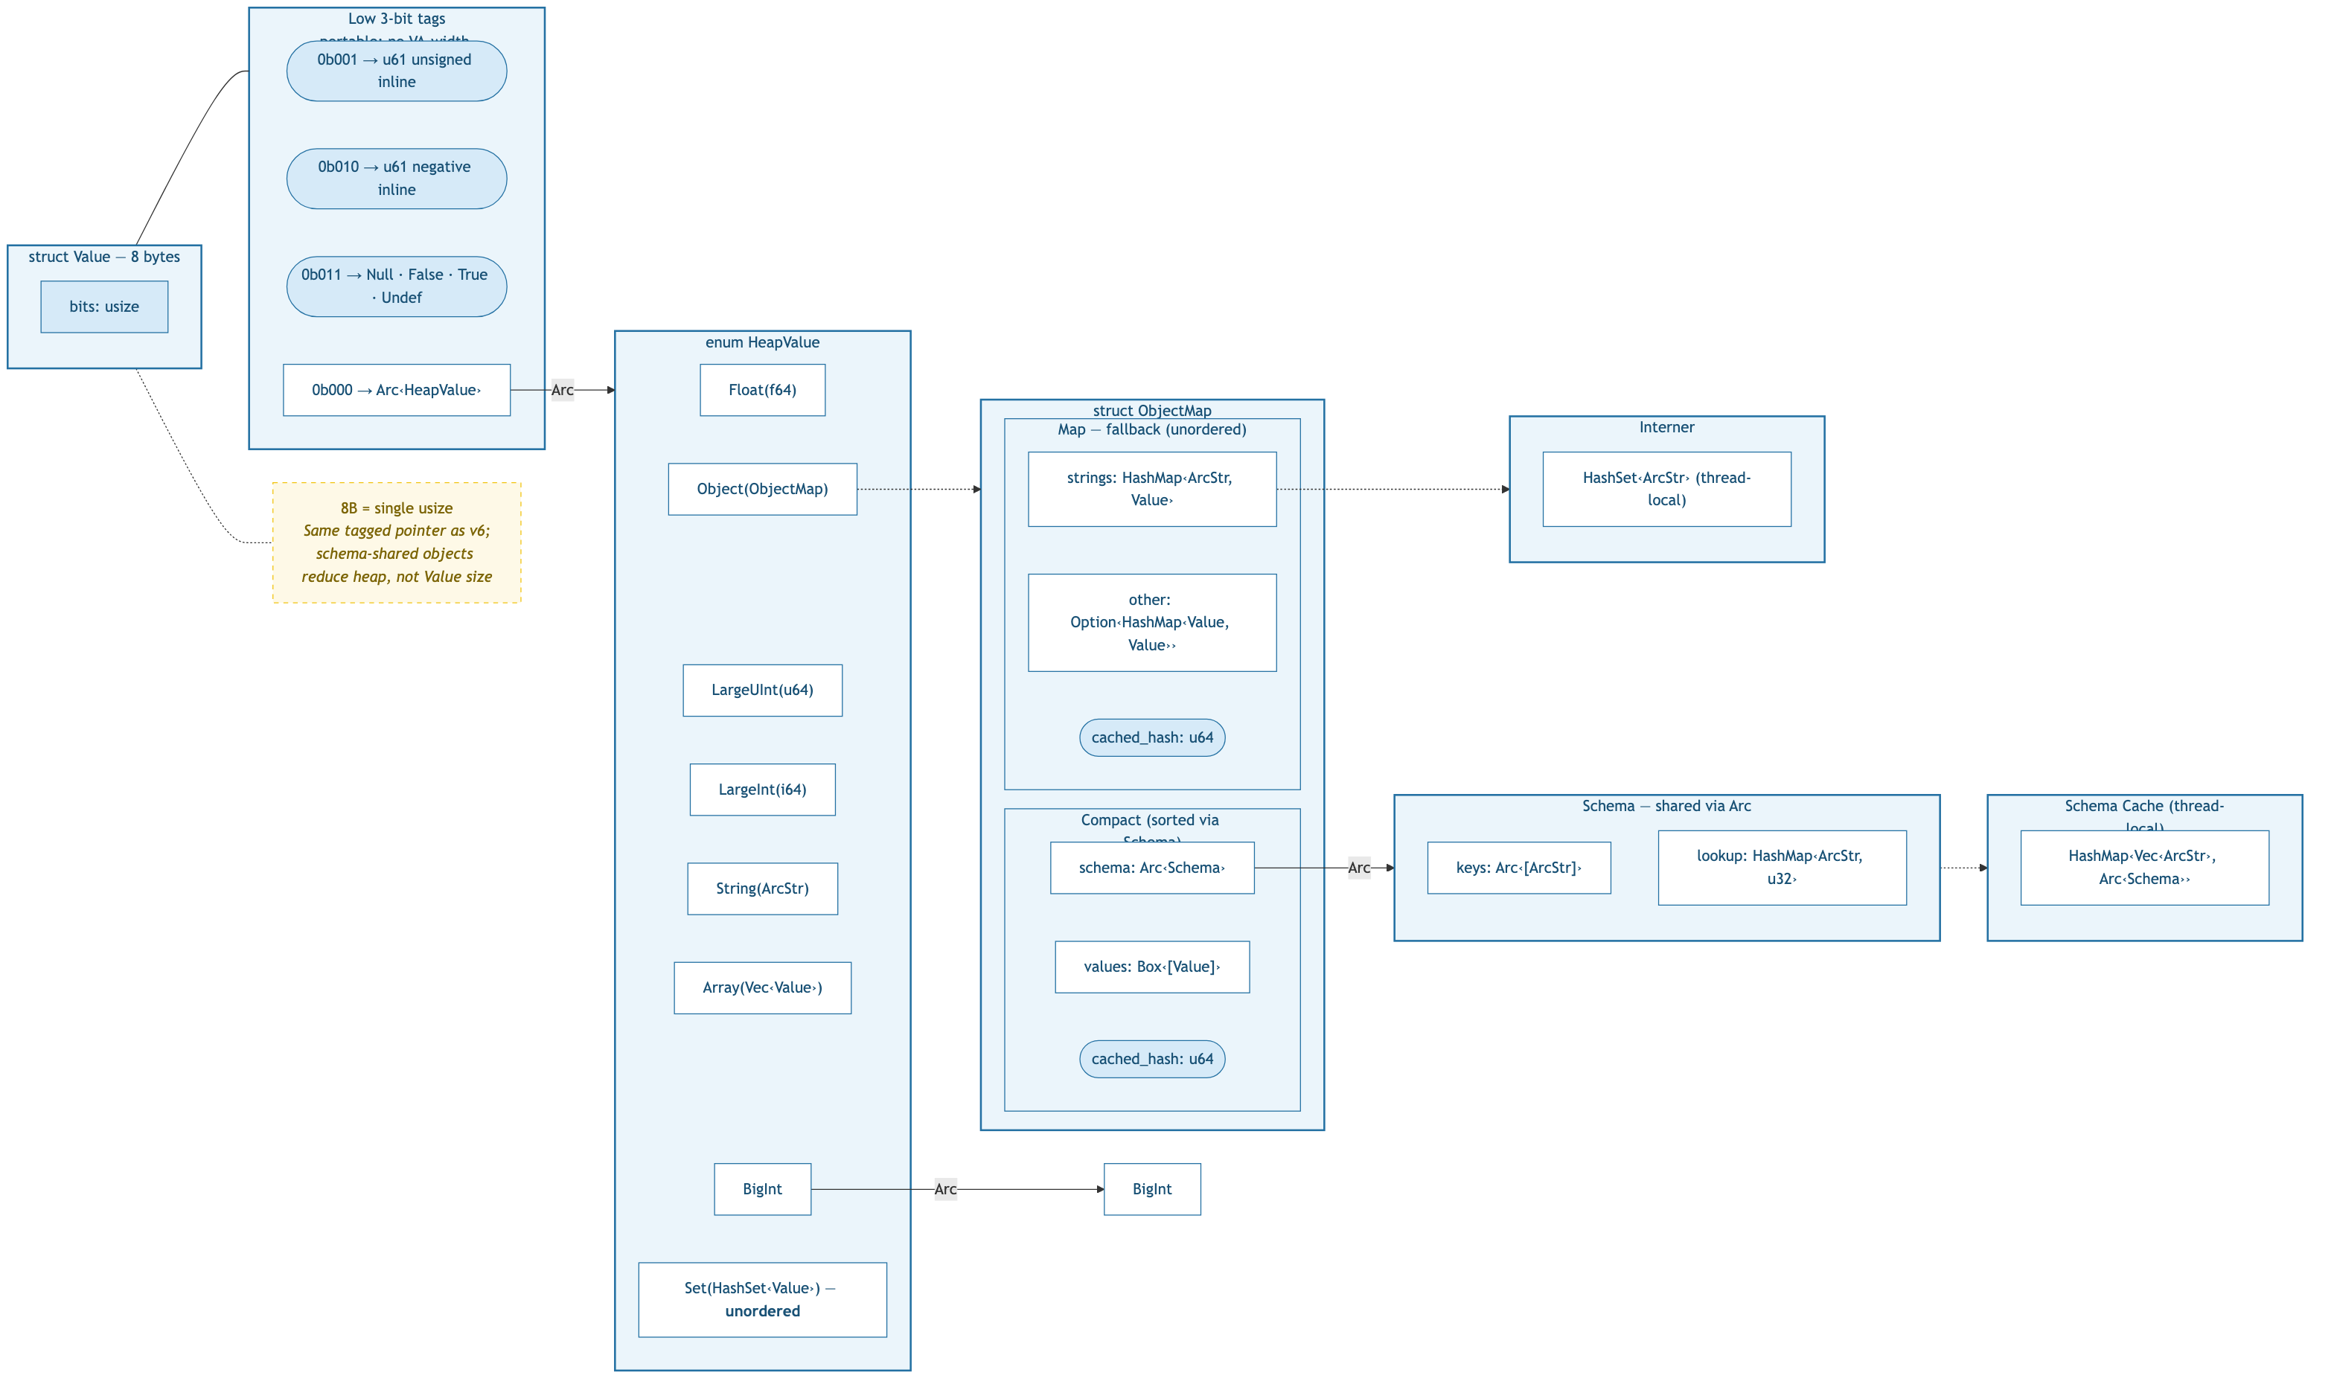
v7: Tagged pointer + schema — 8 bytes

Slide 9
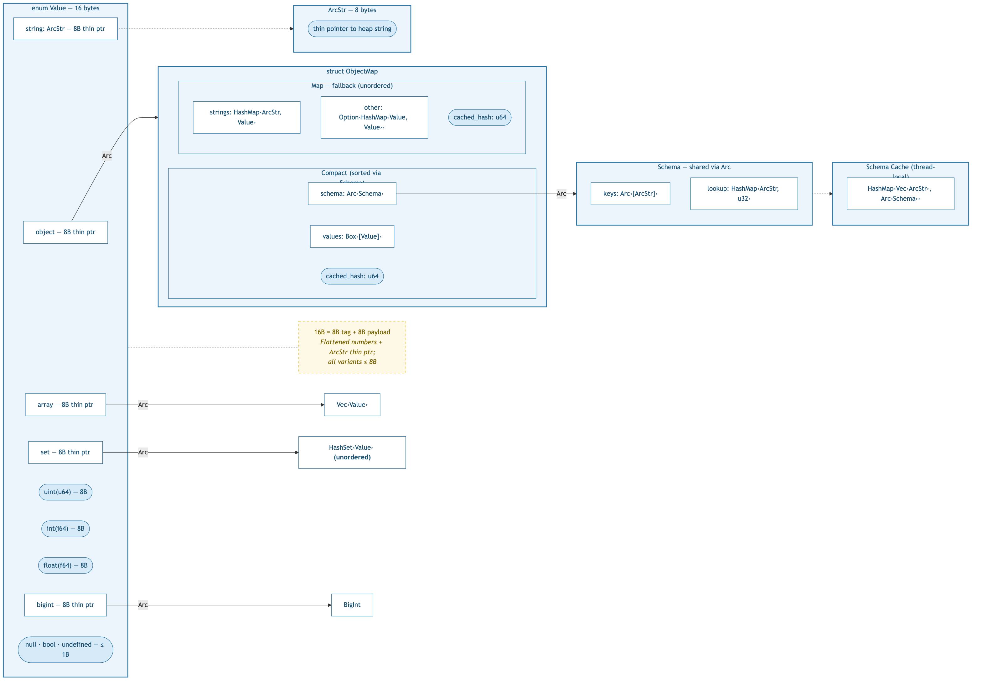
v8: Flattened Number + schema — 16 bytes

Slide 10
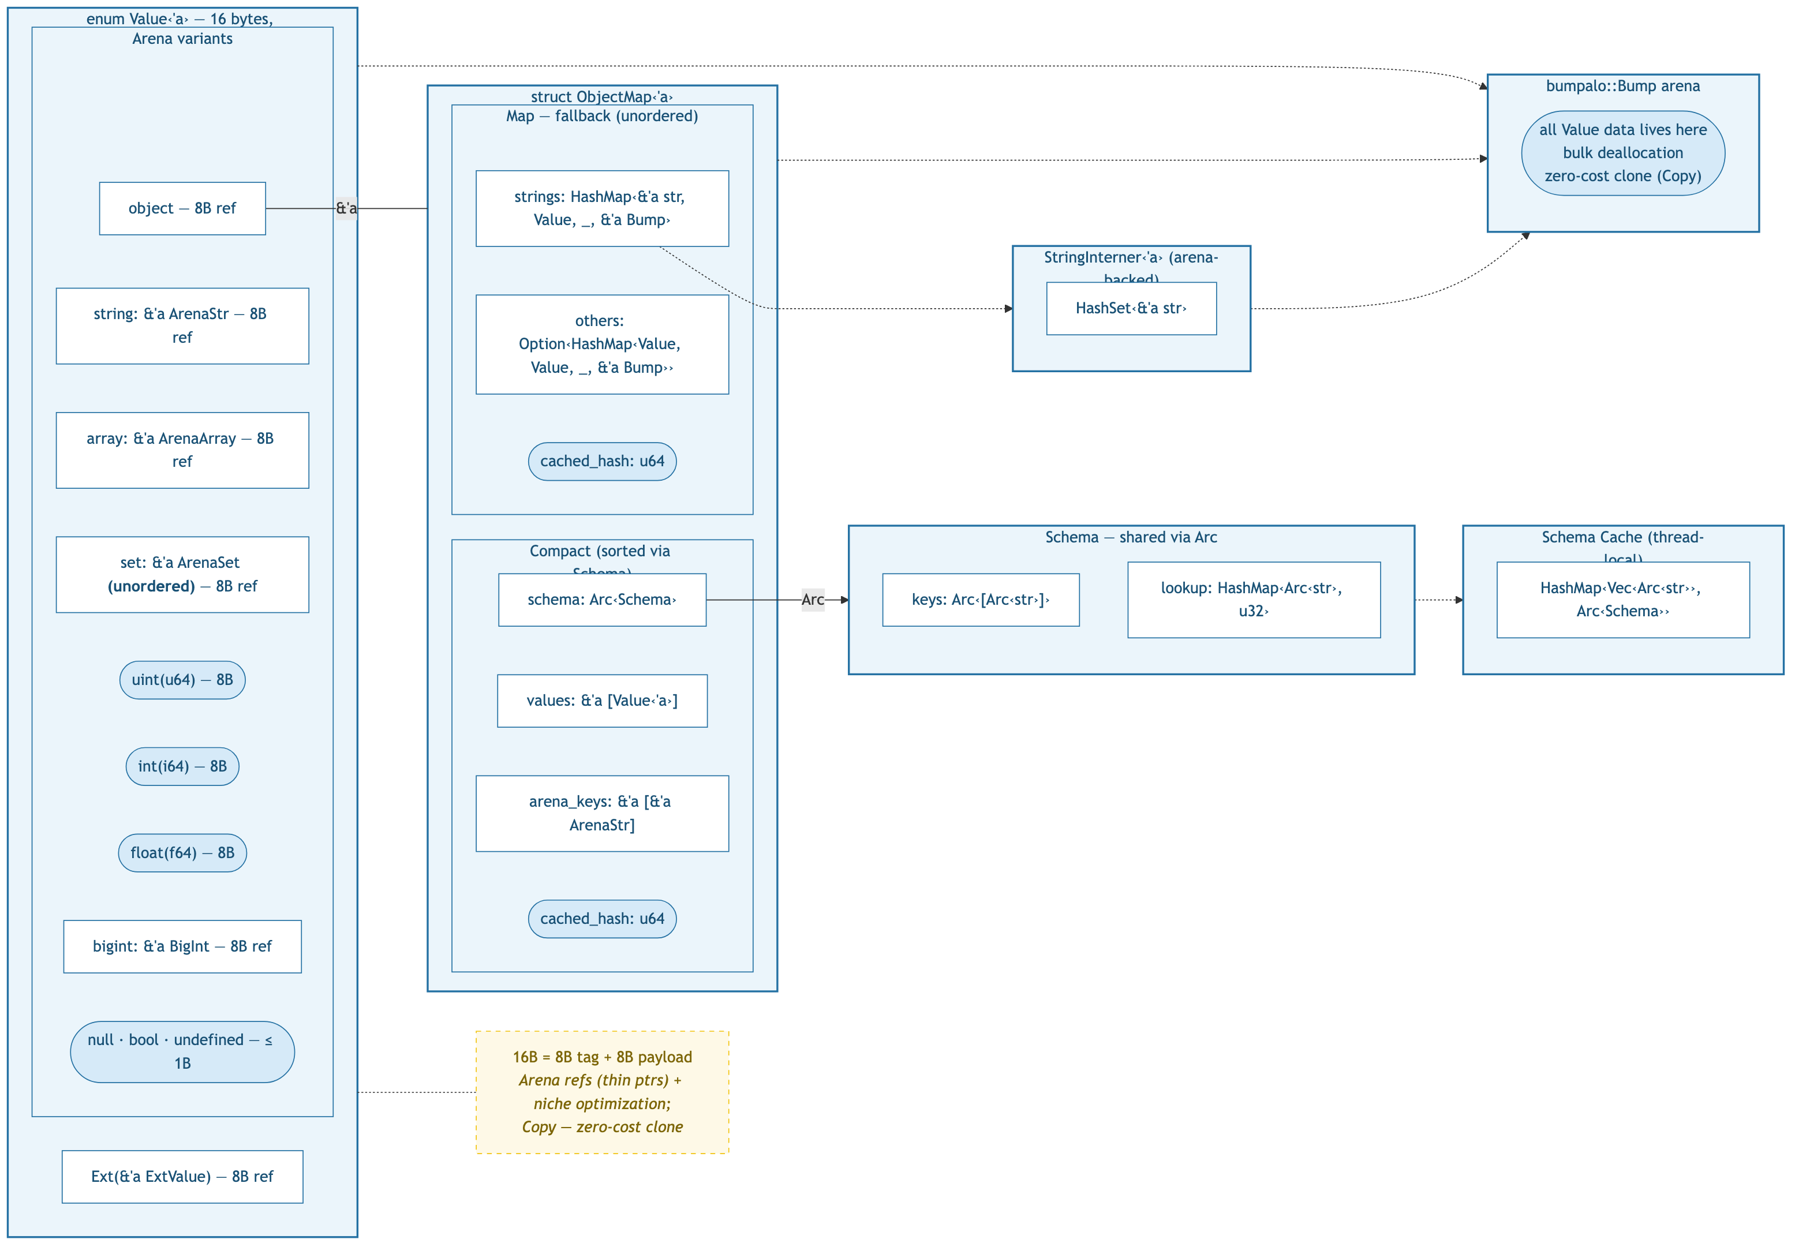
v9: Arena-allocated, Copy — 16 bytes

